Slide 1
Leveling Machine
Mechanical and physical properties of soil
Assistant Professor Khalid Zemam Amer

Slide 2
Soil.
Type of soils.
Basic soil phases

Slide 3
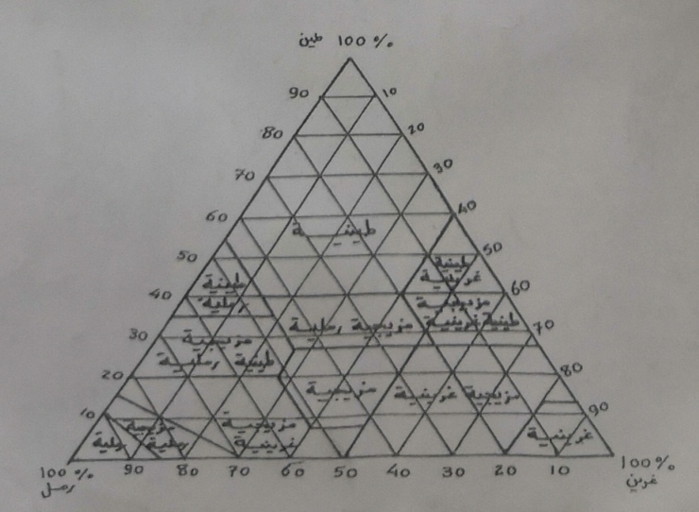
The USA triangulre for percentage soil

Slide 4
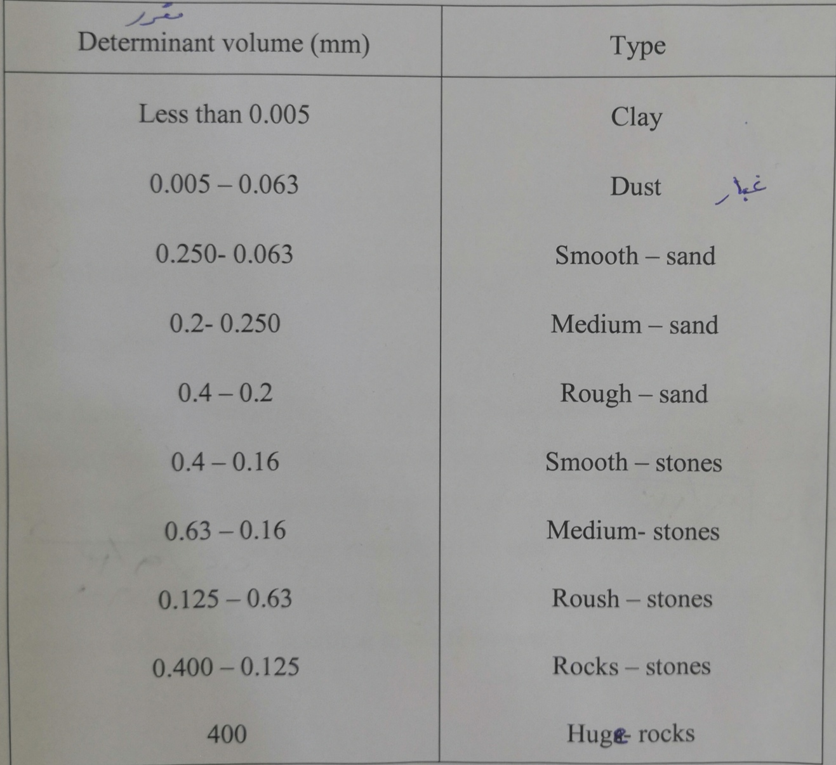
Typs of soils

