Slide 1
Comprehension Class Developing Skills
English Department
Sophomore
2022-2023

Slide 2
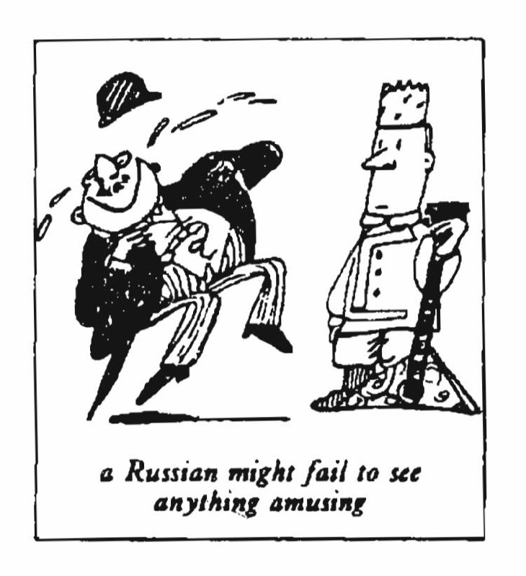
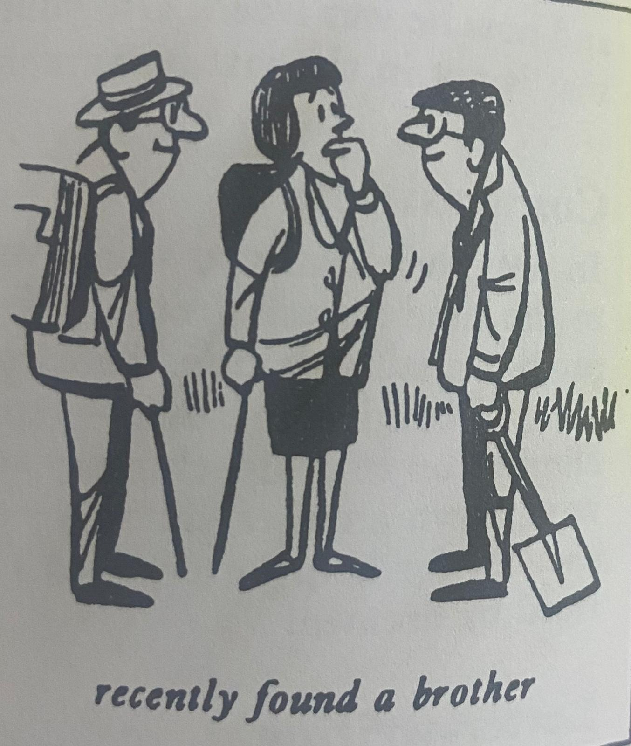
A Chance in a Million!

Slide 3
We are less credulous than we used to be. In the nineteenth century, a novelist would bring his story to a conclusion by presenting his readers with a series of coincidences-most of them wildly improbable. Readers happily accepted the fact that an obscure maid-servant was really the hero's mother. A long-lost brother, who was presumed dead, was really alive all the time and wickedly plotting to bring about the hero’s downfall. And so on. Modern readers would find such naive solutions totally unacceptable. Yet, in real life, circumstances do sometimes conspire to bring about coincidences that anyone, but a nineteenth-century novelist would find incredible. A German taxi driver, Franz Bussman, recently found a brother who was thought to have been killed twenty years before. While on a walking tour with his wife, he stopped to talk to a workman. After they had gone on, Mrs. Bussman commented on the workman's close resemblance to her husband and even suggested that he might be his brother.

Slide 4
Franz poured scorn on the idea, pointing out that his brother had been killed in action during the war. Though Mrs. Bussman was fully acquainted with this story, she thought that there was a chance in a million that she might be right. A few days later, she sent a boy to the workman to ask him if his name was Hans Bussman. Needless to say, the man's name was Hans Bussman and he really was Franz's long-lost brother.
When the brothers were re-united, Hans explained how it was that he was still alive After having been wounded towards the end of the war, he had been sent to hospital and was separated from his unit. The hospital had been bombed and Hans had made his way back into Western Germany on foot. Meanwhile, his unit was lost and all records of him had been destroyed. Hans returned to his family home, but the house had been bombed and no one in the neighborhood knew what had become of the inhabitants. Assuming that his family had been killed during an air raid, Hans settled down in a village fifty miles away where he had remained ever since.

Slide 6
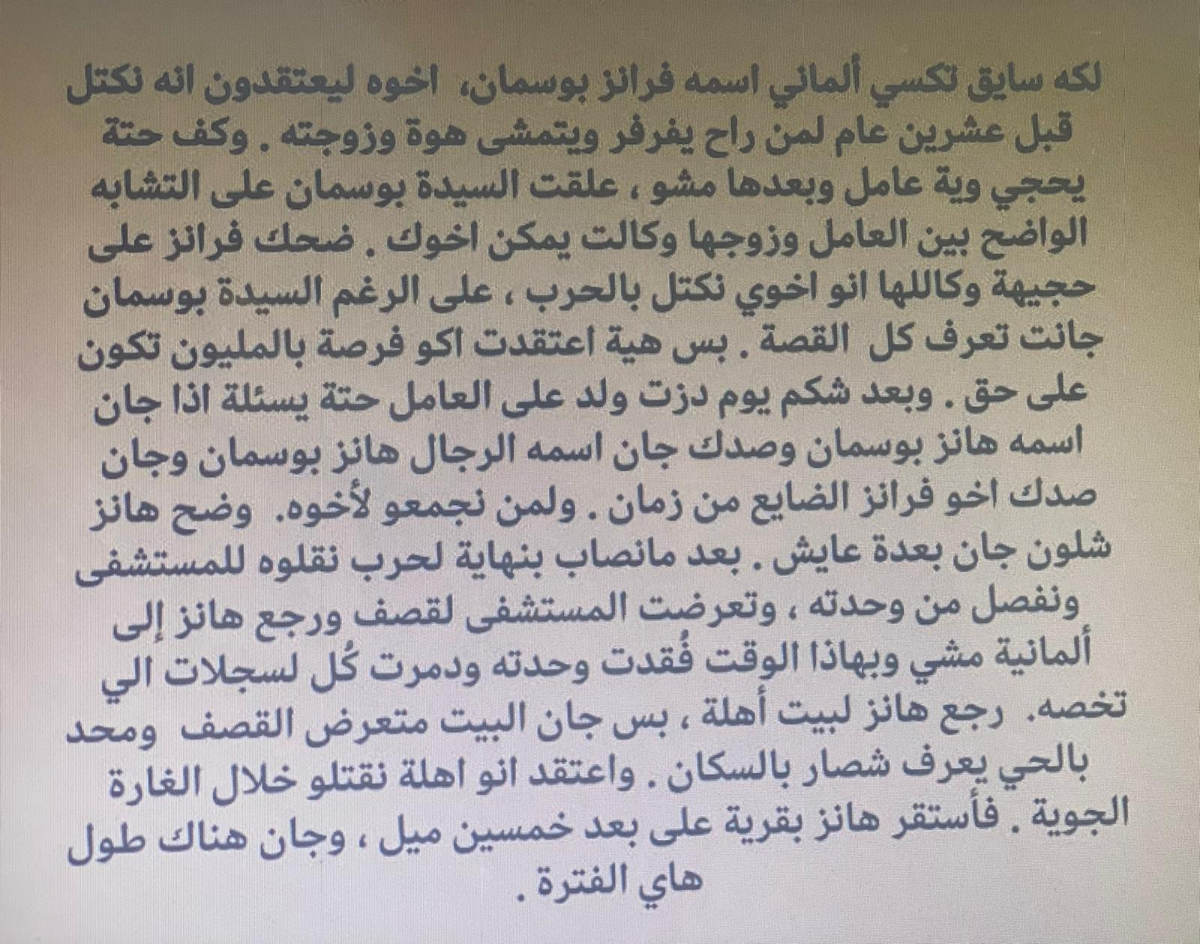

Slide 7
Precis:
The passage discusses how readers’ acceptance of coincidences in stories has changed over time. In the past, readers were willing to accept improbable coincidences as part of the plot, but modern readers are more skeptical. However, in real life, coincidences can still occur. The text gives an example of a German taxi driver who found his long–lost brother by chance after his wife noticed a workman who resembled her husband. The brother had been presumed dead after being separated from his unit during the war and was assumed to have been killed.

Slide 8
Comprehension Questions:
Q1/ Answer the following using what you have learned from the paragraph:
1- How did the novelist end his story?
A novelist would bring his story to a conclusion by presenting his readers with a series of coincidences most of them wildly improbable.
2-Where did the driver Franz find his brother?
He found it while he was on a walking tour with his wife when he stopped to talk to the worker.
3- What did Hans do after the bomb?
After the hospital was bombed, Hans returned to West Germany on foot.
4- Where was Hans settled?
Hans settled in a village fifty miles away where he has stayed.
5-Why is Mrs. Bussman surprised form of the workman?
Because he is like her husband.

Slide 9
Q2/ Fill in the blanks with the proper answers:
1-Moden readers would find some ………… (naive) solutions totally unacceptable.
2 – In real life, circumstances do something conspire to bring about ……………… (coincidences).
3 – Readers happily accepted the fact that an ……………….. (obscure ending) was interesting.
4 – In ………………… (nineteenth century), a novelist would bring a story to an ending by presenting the readers with a series of coincidences.

Slide 10
vocabulary
1-credulous: naive ساذج(Adj.)
2-coincidences: chance صدفة(N.)
3-acquainted: informed مطلع(Adj.)
4-obscure: unknown غامض (Adj.)
5-scorn: sarcasm سخرية (N.)
6-presumed: supposed يفترض (V.)
7-wounded: injuredمجروح (Adj.)
8-resemblance: likenessتشابه (N.)
9-incredible: unbelievableلا يصدق (Adj.)
10-conspire: plot تأمر (V.)

Slide 11
Grammar
1- used to and would:
S+ used to + inf (active & stative verbs).
S+ would + inf (active verbs)
When I was young, I used to have a lot of free time than I do now. I would live near my work and would always get home early. Sometimes I would do a bit of gardening or go for a long walk.
2-difference between accept and agree :
use accept to mean that you take something that someone gives to you
Ex. I accepted my friend’s present.
use agree to mean you are willing to do something.
EX. I agree with your opinion.

Slide 12
Grammar
3. Possessive ’S:
* George’s umbrella
* the woman’s handbag
* Keat’s poetry
* the children’s clothes
* the soldier’s uniforms
* in six hour’s time
* a hundred pound’s worth

Slide 13
Grammar
Having been + past participle
Note that this passive structure can also be used in participle clauses as an alternative to a since-clause:
Having been unemployed for over two years, I found it difficult to get work.
4. Past perfect passive voice (had+been+p.p.)
The school had been built.
The market had been cleaned.
The movie had been watched in a cinema.

Slide 14
