Slide 1
Inst. Abdulridha Sholi

Slide 2
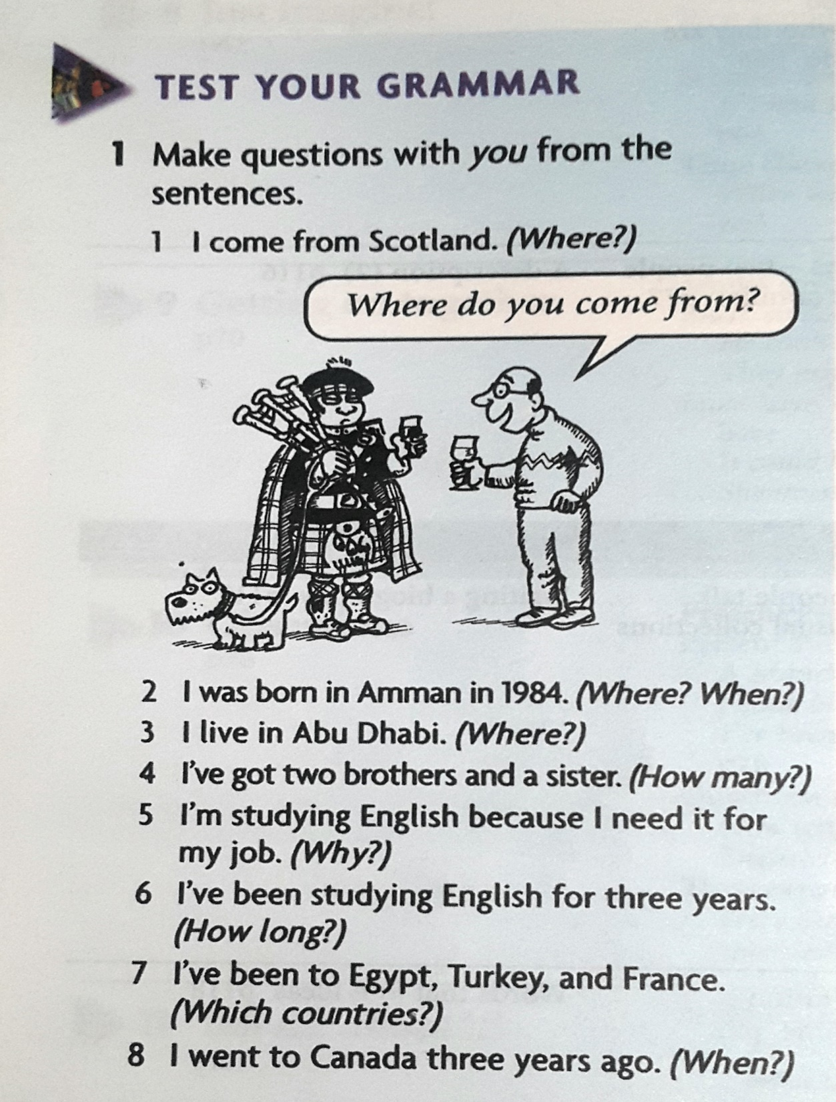
Inst. Abdulridha Sholi

Slide 3
1. Where do you come from? 2. Where were you born? When were you born? 3. Where do you live? 4. How many brothers and sisters have you got? 5. Why are you studying English? 6. How long have you been studying English? 7. Which countries have you been to? 8. When did you go to Canada?
Inst. Abdulridha Sholi

