Slide 1
The Downward Spiral of Measuring People’s Performance
Can you prove that measuring and monitoring people’s performance actually does improve the performance of the organization?

Slide 2
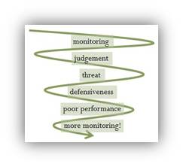

Slide 3
There are problems in measuring people to manage their performance.
And these problems stem from the beliefs and attitudes people have about being measured that reinforce a downward spiral in overall organizational performance.

Slide 4
It starts with monitoring…
Managers want people to perform better so they monitor people to assess their performance.

Slide 5
Monitoring leads to judgment…
When people know they are being monitored, they feel judged. No-one likes to feel judged. Do you like to feel judged?

Slide 6
Judgment leads to threat…
People will then take the judgement personally and that makes them feel threatened.

Slide 7
Threat leads to defensiveness…
When people feel threatened, they get defensive in an attempt to protect ourselves in any way they know how.
The most common method to protect themselves from the threat of performance measures is to hide performance problems so the measures look good. Or they will manipulate the measures to make the results look good. Or they will set targets for measures they know they can achieve.

Slide 8
Defensiveness makes performance worse…
When the important performance problems are hidden, performance gets worse. Why wouldn’t it get worse if it’s being ignored?

Slide 9
Worsening performance leads to more monitoring…
Managers will pick up that performance is worsening, probably by the upstream impacts on higher level performance measures. And so their instinct is that more monitoring is needed.
More monitoring means that people are feeling the scrutiny of more judgement. And the spiral continues to go down.

