Slide 1
Increased Intracranial pressure ,
Cerebral , Edema And Brain herniation
Dr.Khudur Shukur

Slide 2
Rigid

Slide 3
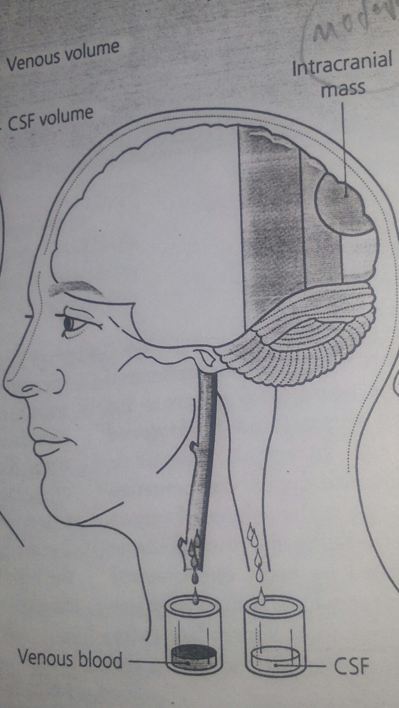

Slide 4
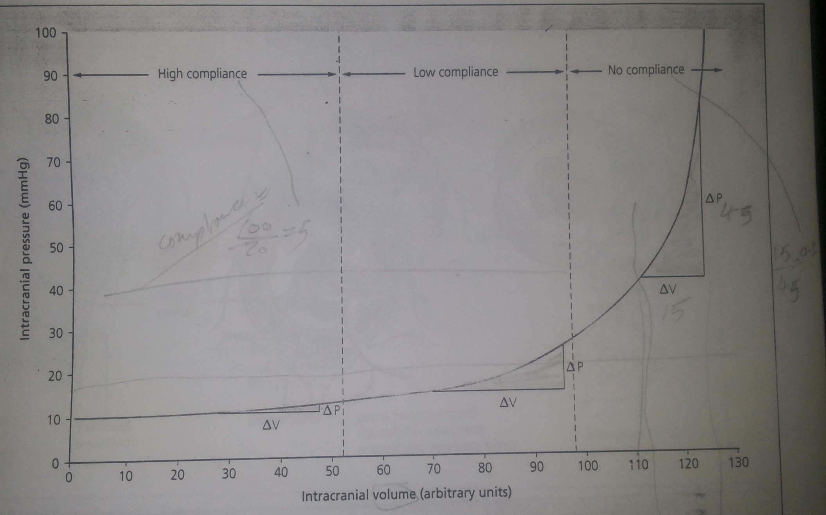

Slide 5
1- Intracranial contents and their Respective Volume
a- Brain/ 1400 ml /80%
b- Blood / 150 ml
c- Cerebrospinal fluid / 150ml
2- The Blood Brain Barrier BBB
a- tight junctions :vasogenic edema
b- lipid soluble substances: passive
c- carriers for sugar and amino acids
3- Cerebral Edema : water : volume
a- vasogenic: extracellular/opened tight junctions /tumor/trauma/abscess/
b- cytotoxic/ intracellular swelling /early stage of infarction /hypoxia
c- interstitial/CSF : Trans ependymal/ Hydrocephalus/.

Slide 6
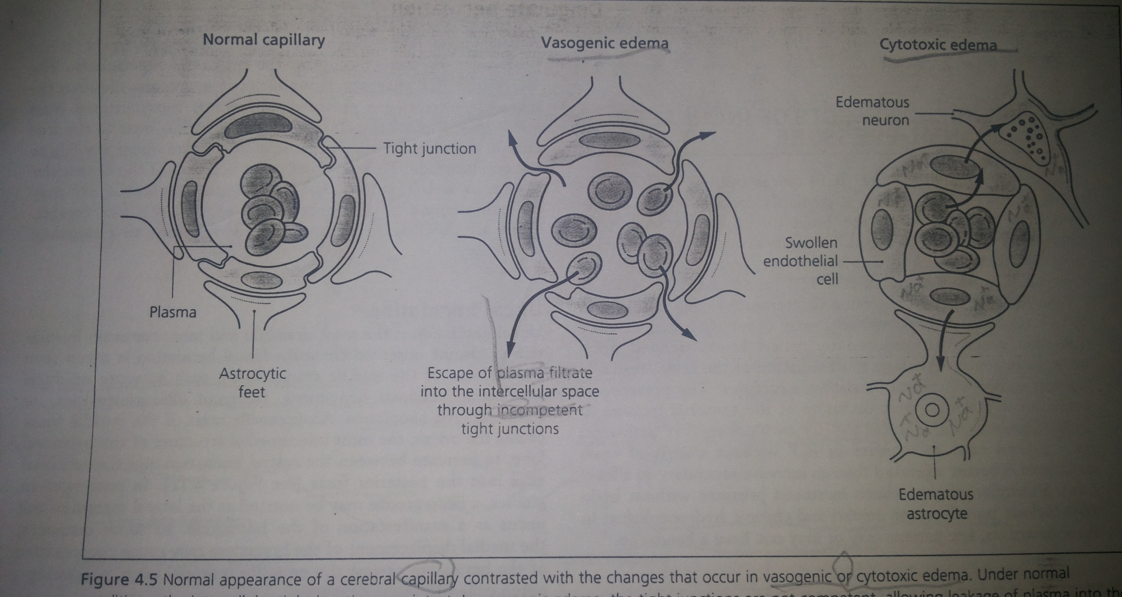

Slide 7
4- Cerebral Blood Flow (CBF)
50ml / 100 g / minute
a- cerebral perfusion pressure(cpp):effective gradient
mean arterial pressure / intracranial pressure
b- CO2
c- O2
Autoregulation:

Slide 8
Blood supply to the brain
The brain gets 15% of the cardiac output and 20% of the oxygen consumption
The brain tissue gets in average 50ml of blood per 100gr of tissue per minute. The gray matter receives about 3 to 4 times more than the white matter
Total blood supply to the brain is about 500-600ml per minute

Slide 9
Autoregulation
Maintains a regular blood supply to the brain in changing blood pressures
The range is 50-160 mm mercury
Possible mechanisms are the myogenic control, neurogenic and biochemichal control

Slide 10
Factors Affecting the blood supply
Autoregulation
Biochemical changes – O₂ and CO₂
Blood brain barrier - BBB

Slide 12
