Slide 1
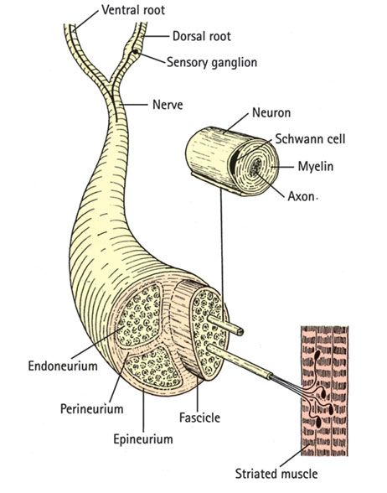
Peripheral nerve injuries

Slide 2
NERVE STRUCTURE AND FUNCTION
Peripheral nerves are bundles of axons conducting
efferent (motor) impulses from cells in the anterior
horn of the spinal cord to the muscles, and afferent
(sensory) impulses from peripheral receptors via cells
in the posterior root ganglia to the cord. They also
convey sudomotor and vasomotor fibres from ganglion
cells in the sympathetic chain. Some nerves are
predominantly motor, some predominantly sensory;
the larger trunks are mixed, with motor and sensory
axons running in separate bundles.

Slide 3
Pathological classification
Nerves can be injured by ischaemia, compression,traction, laceration or burning. Damage varies in severity from transient and quickly recoverable loss of function to complete interruption and degeneration.
SEDDON CLASSIFICATION OF NERVE INJURIES:
1-Transient ischaemia:
Acute nerve compression causes numbness and tingling within 15 minutes, loss of pain sensibility after30 minutes and muscle weakness after 45 minutes.
Relief of compression is followed by intense paraesthesiae
lasting up to 5 minutes (the familiar ‘pins and needles’ after a limb ‘goes to sleep’); feeling is restored within 30 seconds and full muscle power after about 10 minutes.
These changes are due to transient endoneurial anoxia and they leave no trace of nerve damage.

Slide 4
2-Neurapraxia
Seddon (1942) coined the term ‘neurapraxia’ to
describe a reversible physiological nerve conduction block in which there is loss of some types of sensation and muscle power followed by spontaneous recovery after a few days or weeks. It is due to mechanical pressure causing segmental demyelination and is seen typically in ‘crutch palsy’, pressure paralysis in states of drunkenness (‘Saturday night palsy’) and the milder types of tourniquet palsy.

Slide 5
3-AXONOTEMESIS
This is a more severe form of nerve injury, seen typically after closed fractures and dislocations. The term means, literally, axonal interruption. There is loss of conduction but the nerve is in continuity and the neural tubes are intact. Distal to the lesion, and for a few millimetres retrograde, axons disintegrate and are resorbed by phagocytes.
This wallerian degeneration (named after the physiologist, Augustus Waller, who described the process in 1851) takes only a few days and is accompanied by marked proliferation of Schwann cells and fibroblasts lining the endoneurial tubes.
The denervated target organs (motor end-plates and sensoryreceptors) gradually atrophy, and if they are not reinnervated within 2 years they will never recover.
Axonal regeneration starts within hours of nerve damage, probably encouraged by neurotropic factors produced by Schwann cells distal to the injury. From the proximal stumps grow numerous fine unmyelinated tendrils, many of which find their way into the cell-clogged endoneurial tubes. These axonal processes grow at a speed of 1–2 mm per day, the larger fibres slowly acquiring a new myelin coat. Eventually they join to end-organs, which enlarge and start functioning again.

Slide 6
Wallerian degeneration

Slide 7
4-Neurotmesis
In Seddon’s original classification, neurotmesis mean division of the nerve trunk, such as may occur in an open wound. It is now recognized that severe degrees of damage may be inflicted without actually dividing the nerve. If the injury is more severe, whether the nerve is in continuity or not, recovery will not occur.
As in axonotmesis, there is rapid wallerian degeneration, but here the endoneurial tubes are destroyed over a variable segment and scarring thwarts any hope of regenerating axons entering the distal segment and regaining their target organs. Instead, regenerating fibres mingle with proliferating Schwann cells and fibroblasts in a jumbled knot, or ‘neuroma’, at the site of injury. Even after surgical repair, many new axons fail to reach the distal segment, and those that do may not find suitable Schwann tubes, or may not reach the correct end-organs in time, or may remain incompletely myelinated. Function may be adequate but is never normal.

Slide 8
The ‘double crush’ phenomenon
There is convincing evidence that proximal compression of a peripheral nerve renders it more susceptible to the effects of a second, more peripheral injury. This may explain why peripheral entrapment syndromes are often associated with cervical or lumbar spondylosis.
A similar type of ‘sensitization’ is seen in patients with peripheral neuropathy due to diabetes or alcoholism

Slide 9
Clinical features
Acute nerve injuries are easily missed, especially ifassociated with fractures or dislocations, the symptoms of which may overshadow those of the nervelesion.
Always test for nerve injuries following any significanttrauma. If a nerve injury is present, it is crucial
also to look for an accompanying vascular injury. Ask the patient if there is numbness, paraesthesia ormuscle weakness in the related area.
Then examine the injured limb systematically for signs of abnormal posture (e.g. a wrist drop in radial nerve palsy), weakness
in specific muscle groups and changes in sensibility.Areas of altered sensation should be accuratelymapped. Each spinal nerve root serves a specific dermatome
the skin feels dry due to lack of sweating. If this is not obvious, the‘plastic pen test’ may help. The smooth barrel of the pen is brushed across the palmar skin: normally there is a sense of slight stickiness, due to the thin layer ofsurface sweat, but in denervated skin the pen slips along smoothly with no sense of stickiness in the affected area.
The neurological examination must be repeated at intervals so as not to miss signs which appear hours after the original injury, or following manipulation or operation.
In chronic nerve injuries there are other characteristic signs. The anaesthetic skin may be smooth and shiny, with evidence of diminished sensibility such as cigarette burns of the thumb in median nerve palsy or foot ulcers with sciatic nerve palsy. Muscle groups will be wasted and postural deformities may become fixed.

Slide 10
Assessment of nerve recovery
The presence or absence of distal nerve function can be revealed by simple clinical tests of muscle power and sensitivity to light touch and pin-prick. Remember that after nerve injury motor recovery is slower than sensory recovery.
More specific assessment is required to answer two questions: How severe was the lesion? How well is the nerve functioning now?
THE DEGREE OF INJURY
The history is most helpful. A low energy injury is likely to have caused a neurapraxia; the patient should be observed and recovery anticipated. A high energy injury is more likely to have caused axonal and endoneurial disruption and so recovery is less predictable. An open injury, or a very high energy closed injury, will probably have divided the nerve and early exploration is called for.
Tinel’s sign – peripheral tingling or dysaesthesia provoked by percussing the nerve – is important. In neurapraxia, Tinel’s sign is negative. In axonotmesis, it is positive at the site of injury because of sensitivity of the regenerating axon sprouts. After a delay of a few days or weeks, the Tinel sign will then advance at a rate of about 1 mm each day as the regenerating axons progress along the Schwann-cell tube. Motor activity also should progress down the limb. Failure of
If the Tinel sign proceeds very slowly, or if muscle groups do not sequentially recover as expected, then a good recovery is unlikely and here again exploration must be considered.

Slide 11
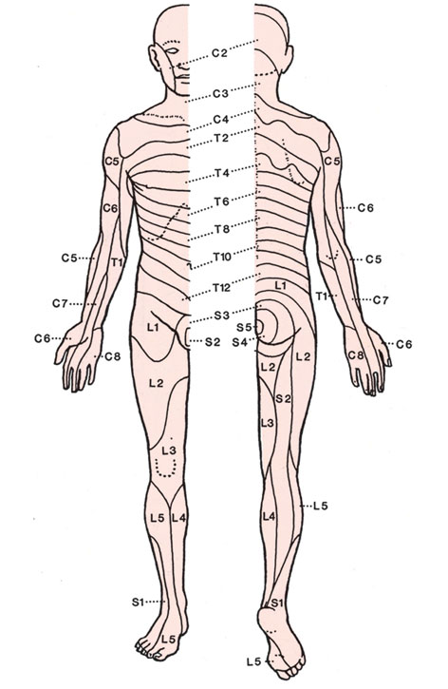

Slide 12
Nerve conduction study and Electromyography (EMG) studies can be helpful. If a muscle loses its nerve supply, the EMG will show denervation potentials by the third week excludes neurapraxia but of course it does not distinguish between axonotmesis and neurotmesis; this remains a clinical distinction, but if one waits too long to decide then the target muscle may have failed irrecoverably and the answer hardly matters

Slide 13
PRINCIPLES OF TREATMENT
1-Nerve exploration :Closed low energy injuries usually recover spontaneously and it is worth waiting until the most proximally supplied muscle should have regained function. Exploration is indicated:
(1) if the nerve was seen to be divided and needs to be repaired; (2) if the type of injury (e.g. a knife wound or a high energy injury) suggests that the nerve has been divided or severely damaged; (3) if recovery is inappropriately delayed and the diagnosis is in doubt.
Vascular injuries, unstable fractures, contaminated soft tissues and tendon divisions should be dealt with before the nerve lesion.
The incision will be long, as the nerve must be widely exposed above and below the lesion before the lesion itself is repaired. Thenerve must be handled gently with suitable instruments.
Bipolar diathermy and magnification are essential. An operating microscope is ideal but magnifying loupes are better than nothing. A nerve stimulator is essential if scarring makes recognition uncertain. If microsurgical equipment and expertise are not available, the nerve lesion should be identified and the wound closed pending transferral to an appropriate facility.

Slide 14
2-Primary repair
A divided nerve is best repaired as soon as this can be done safely. Primary suture at the time of wound
toilet has considerable advantages: the nerve ends have not retracted much; their relative rotation is usually undisturbed; and there is no fibrosis.
A clean cut nerve is sutured without further preparation; a ragged cut may need paring of the stumps with a sharp blade, but this must be kept to a minimum. The stumps are anatomically orientated and fine (10/0) sutures are inserted in the epineurium. There should be no tension on the suture line. Opinions are divided on the value of fascicular repair with perineurial sutures.
Sufficient relaxation of the tissues to permit tension- free repair can usually be obtained by positioning the nearby joints or by mobilizing and re-routing the nerve. If this does not solve the problem then a primary nerve graft must be considered. A traction lesion especially of the brachial plexus – may leave a gap too wide to close. These injuries are best dealt with in
specialized centres, where primary grafting or nerve transfer can be carried out.
If a tourniquet is used it should be a pneumatic one; it must be released and bleeding stopped before the wound is closed. The limb is splinted in a position to ensure minimal tension on the nerve; if flexion needs to be excessive, a graft is required. The splint is retained for 3 weeks and thereafter physiotherapy is encouraged.

Slide 15
3-Delayed repair
Late repair, i.e. weeks or months after the injury, may be indicated because: (1) a closed injury was left alone but shows no sign of recovery at the expected time; (2) the diagnosis was missed and the patient present late; or (3) primary repair has failed. The options must be carefully weighed: if the patient has adapted to the functional loss, if it is a high lesion and re-innervation . is unlikely within the critical 2-year period, or if there is a pure motor loss which can be treated by tendon transfers, it may be best to leave well alone. Excessive scarring and intractable joint stiffness may, likewise, make nerve repair questionable; yet in the hand it is still worthwhile simply to regain protective sensation.
The lesion is exposed, working from normal tissue above and below towards the scarred area. When the nerve is in continuity it is difficult to know whether resection is necessary or not. If the nerve is only slightly thickened and feels soft, or if there is conduction across the lesion, resection is not advised; if the ‘neuroma’ is hard and there is no conduction on nerve stimulation, it should be resected, paring back the stumps until healthy fascicles are exposed.
How to deal with the gap? The nerve must be sutured without tension. The stumps may be brought together by gently mobilizing the proximal and distal segments, by flexing nearby joints to relax the soft tissues, or (in the case of the ulnar nerve) by transposing the nerve trunk to the flexor aspect of the elbow.
In this way, gaps of 2 cm in the median nerve, 4–5 cm in the ulnar nerve and 6–8 cm in the sciatic nerve can usually be closed, the limb being splinted in the ‘relaxing’ position for 4–6 weeks after the operation. Elsewhere, gaps
of more than 1–2 cm usually require grafting.

Slide 16
4-Nerve grafting
Free autogenous nerve grafts can be used to bridge gaps too large for direct suture. The sural nerve ismost commonly used; up to 40 cm can be obtained
from each leg. Because the nerve diameter is small, several strips may be used (cable graft).
The graft should be long enough to lie without any tension, and it should be routed through a well-vascularized bed. The graft is attached at each end either by fine sutures
or with fibrin glue. It is crucial that the motor and sensory fascicles are appropriately connected by the graft.
There are various techniques which can help. If the ulnar and median nerves are both damaged (e.g. in Volkmann’s ischaemia) a pedicle graft from the ulnar nerve may be used to bridge the gap in the median. It is also possible to use free vascularized grafts for certain brachial plexus lesions.

Slide 17
5-PRINCIPLES OF TENDON TRANSFER
Assess the problem
Which muscles are missing?
Which muscles are available?
The donor muscle should be:expendablepowerful enough an agonist or synergist ,The recipient site should:be stable
have mobile joints and supple tissues
The transferred tendon should be:
routed subcutaneouslyplaced in a straight line of pull ,capable of firm fixation
The patient should be:
motivated able to comprehend and attend hand therapy intercostal nerves or the spinal accessory nerve to the stump of the original nerve supplying that muscle.
Care of paralysed parts
While recovery is awaited the skin must be protected from friction damage and burns. The joints should be moved through their full range twice daily to prevent stiffness and minimize the work required of muscles
when they recover. ‘Dynamic’ splints may be helpful. Tendon transfers
Motor recovery may not occur if the axons, regenerating at about 1 mm per day, do not reach the muscle within 18–24 months of injury.
This is most likelywhen there is a proximal injury in a nerve supplying distal muscles. In such circumstances, tendon transfers should be considered. The principles can be summarized in the Box on the previous page.

Slide 18
PROGNOSIS
1-Type of lesion Neurapraxia always recovers fully; axonotmesis may or may not; neurotmesis will not
unless the nerve is repaired.
2- Level of lesion The higher the lesion, the worse theprognosis.
3- Type of nerve Purely motor or purely sensory nerves recover better than mixed nerves, because there is less likelihood of axonal confusion.
4- Size of gap Above the critical resection length, suture is not successful.
5- Age Children do better than adults. Old people do poorly.
6- Delay in suture This is a most important adverse factor. The best results are obtained with early nerve repair. After a few months, recovery following suture
becomes progressively less likely.
7- Associated lesions Damage to vessels, tendons and other structures makes it more difficult to obtain recovery of a useful limb even if the nerve itself recovers.
8-surgical techniques Skill, experience and suitable facilities are needed to treat nerve injuries. If these arelacking, it is wiser to perform the essential wound toiletand then transfer the patient to a specialized centre.

