Slide 1
MEDICAL GENETICS

Slide 2
WHAT IS MEDICAL GENETICS?
Medical genetics involves any application of genetics to medical practice. It thus includes:
studies of the inheritance of diseases in families
the mapping of disease genes to specific locations on chromosomes,
analyses of the molecular mechanisms through which genes cause disease,
the diagnosis and treatment of genetic disease. As a result of rapid progress in molecular genetics, gene therapy—the insertion of normal genes into pa­tients in order to correct genetic diseases—has recently been initiated.
Genetic counseling, which involves the communication of in­formation regarding risks, prognoses, and treatment to patients and their families.

Slide 3
TYPES OF GENETIC DISEASES
Each human is estimated to have approximately 50,000 to 100,000 different genes. Alterations in these genes or in combinations of them, can produce genetic disorders. These disorders are classified into several major groups:
1. Chromosome disorders, in which entire chromosomes, or large segments of them, are missing, duplicated, or otherwise altered. These disorders in­clude diseases such as Down syndrome and Turner syndrome.
2. Disorders in which single genes are altered (often termed "mendelian" conditions, or single-gene dis­orders). Well-known examples include cystic fibrosis, sickle cell disease, and hemophilia.

Slide 4
TYPES OF GENETIC DISEASES
3. Multifactorial disorders, which are due to a combi­nation of multiple genetic as well as environmental causes. Many birth defects, such as deft lip and/or deft palate, as well as many adult disorders, including heart disease and diabetes, belong in this category.
4. Others e.g. Mitochondrial disorders, a relatively small number of diseases caused by alterations in the small cytoplasmic mitochondrial chromosome.

Slide 5
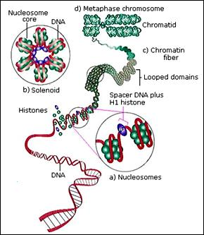

Slide 6
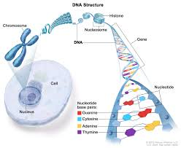

Slide 7
Anatomy of human genome
Somatic cells have diploid number of chromosomes( having 23 pairs chromosomes -22 pairs of autosomes and one of sex chromosomes-).
Gametes have haploid number of chromosomes (have a total of 23 chromosomes).
Genes, the basic unit of inheritance, are contained in chromosomes and consist of DNA It is a tightly coiled structure. This coiling occurs at several levels: the nucleosome, the solenoid, and 100-kb loops.

Slide 8
The basic structure of DNA is: sugar + phosphate + nitrogenous base (neucleotide)
The most important constituent of DNA is the four nucleotide bases: adenine, guanine (purines) thymine, and cytosine (pyrimidines). DNA has a double helix structure
Sequence of each 3 nucleotides------Codone
Sequence of codones -------Gene ( functional entity of information)
Sequence of genes --------- Genome (human genetic program)

Slide 9
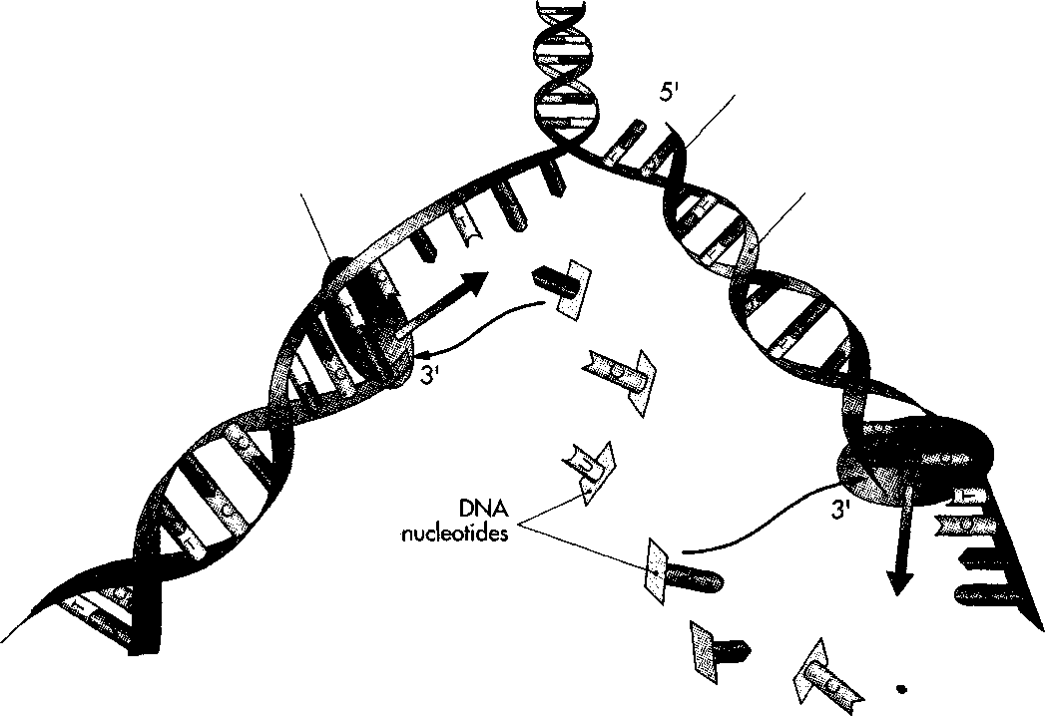

Slide 10
Several different enzymes are involved in DNA repli­cation. One enzyme unwinds the double helix, one holds the strands apart, and others perform other dis­tinct functions.
DNA polymerase is one of the key replication enzymes. It travels along the single DNA strand, adding free nucleotides to the 3' end of the new strand.( 3' and 5' referred to no. of the carbon atom in the pentose sugar to which the base is attached).
Nucleotides can be added only to this end of the strand, so replication always proceeds from the 5' to the 3' end. When referring to the orientation of sequences along a gene, the 5' direction is termed "upstream," while the 3' direction is termed "downstream."

Slide 11
DNA sequences encode proteins through the processes of transcription and translation. These both involve ribonucleic acid, a single-stranded molecule similar to DNA except that it has a ribose sugar and a uracil base rather than thymine.
In the process of transcription, RNA polymerase II binds to a promoter site near the 5' end of a gene on the non-template strand and, through complementary base pairing, helps to produce an mRNA strand from the template DNA strand

Slide 13
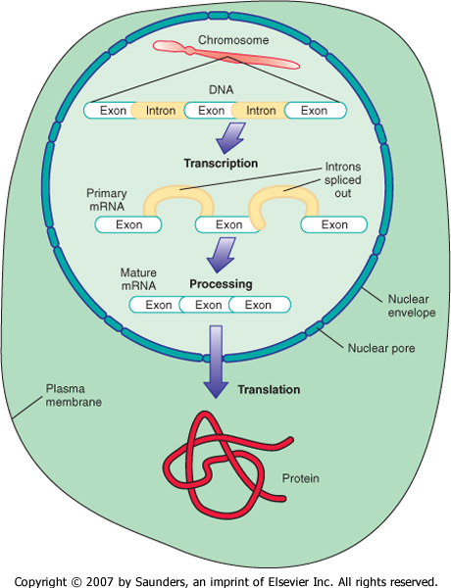

Slide 14
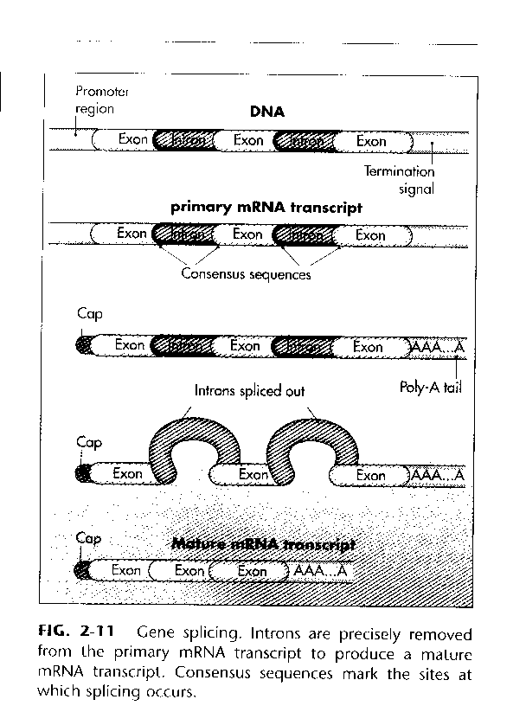

Slide 15
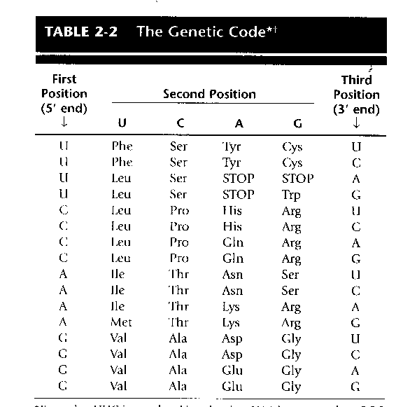

Slide 16
The Genetic Code
Of the 64 possible codons, 3 signal the end of a gene and are known as stop codons. These are UAA, UGA, and UAG. The remaining 61 all specify amino acids. This means that most amino acids can be specified by more than one codon.
While a given amino acid may be specified by more than one codon, each codon can designate only one amino acid.

Slide 17
The Genetic Code
Human genetic program amount to 6 billion base-pair (bp) of DNA (two copies) it encode 50 000 genes.
Each gene e.g. a 1400 bp is likely to produce 30 000 deferent proteins by changing sites of splicing, site if starting transcription and site of termination.

Slide 18
The Genetic Code
Mutations ------ are an alteration in DNA sequence they are the ultimate source of genetic variation.
Some mutations ----- result in genetic disease
Others----------- have no physical effects. depending on the site of the mutation on the genome

Slide 19
Types of mutations
1. Point mutation : which is substation of one nucleotide for another within a gene these include:
Missense ----
Non­sense------
Splice site mutation-----

Slide 20
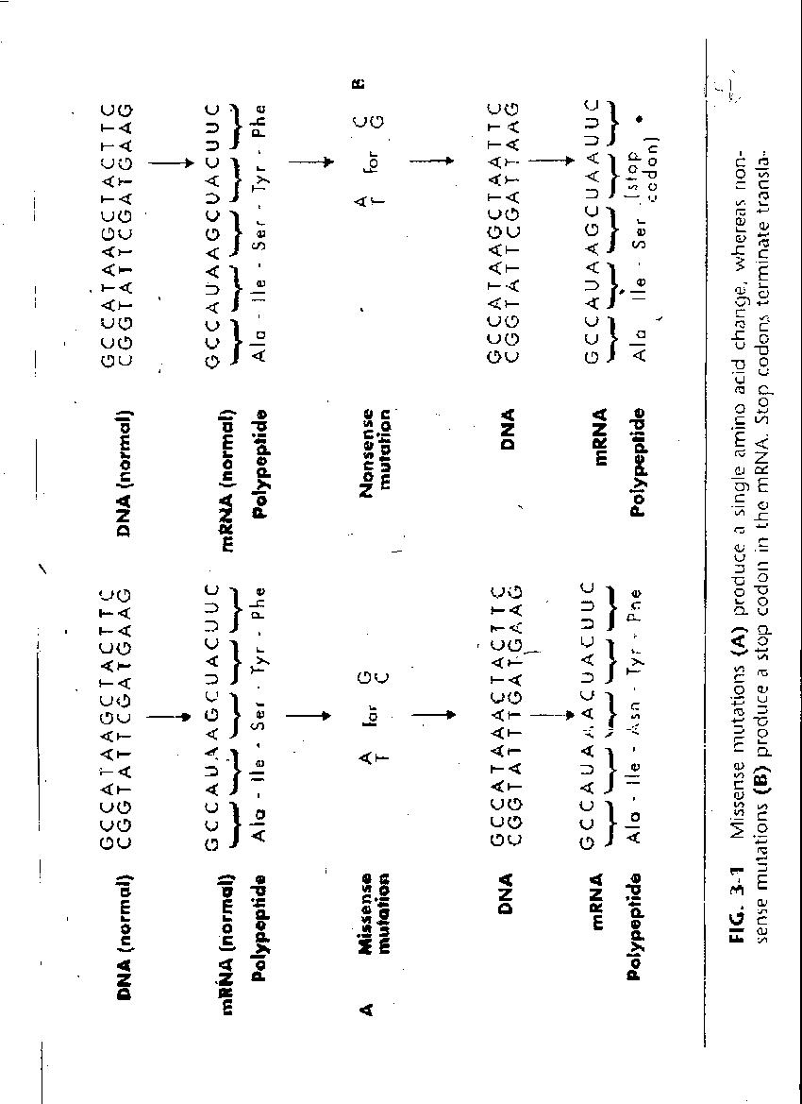

Slide 21
Types of mutations
2. Deletion/ insertion : a loss / gain of DNA sequence that range from single Bp to large part of chromosome. If no. of Bp affected is no multiple of 3 ------ Frame shift mutation i.e. it can alter all the downstream codons.
3. Duplication / Deletion of whole gene : may result in more than 2 copies of the same whole gene then result in increase production of certain protein

Slide 22
Types of mutations
4. Trinucleotide repeat expansion: The repeat units are three bases long, so a typical example would be CAGCAGCAG. A normal individual will have a rela­tively small number of these tandem repeats (e.g., 20 to 30) at a specific chromosome location. For reasons that are not yet understood, the number of repeats can increase dramatically during meiosis or possibly during early fetal development, so that a newborn may have hundreds or even thousands of repeats. When this occurs in certain regions of the genome, it causes genetic disease. E.g. fragile X chromosome ( CGG tandemly repeated within a gene)

Slide 23
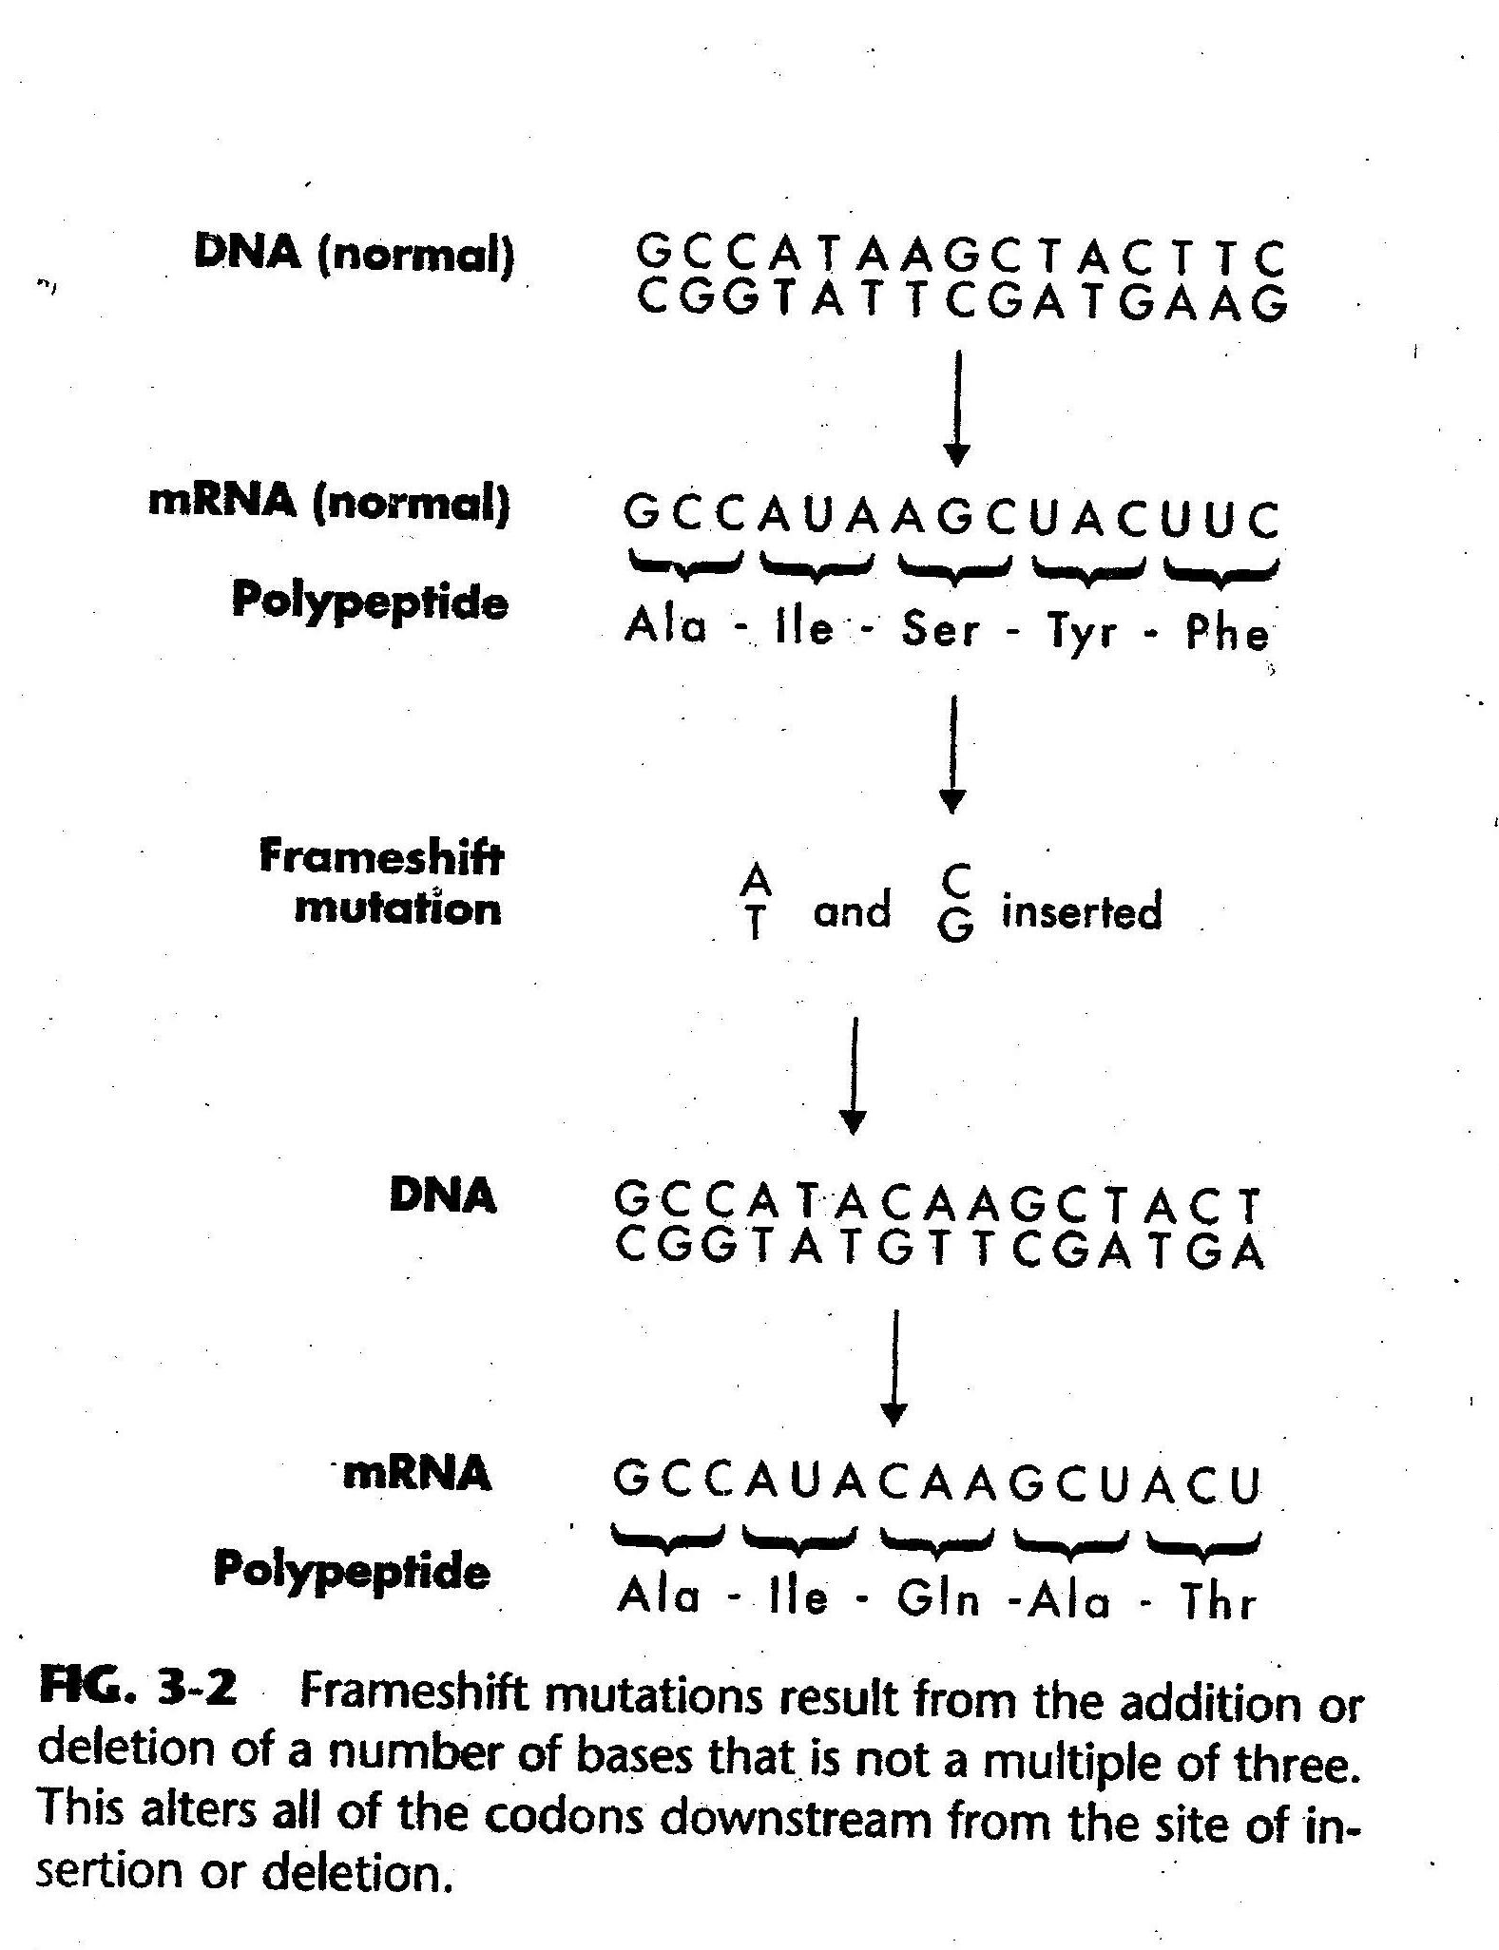

Slide 24
Mutation can result in :
Gain of function :
are sometimes seen in domi­nant diseases.
loss of function of the protein product:
(1) recessive diseases;
(2) diseases involving haplo-insufficiency, in which 50% of the gene product is insufficient for normal function;
(3) dominant negative mutations, in which the abnormal protein product interferes with the normal protein product.

Slide 25
Causes of Mutation
Many substances in our environment are known to be mutagenic. These include
ionizing and non-ionizing radiation,
chemicals.
These mutagens are capable of causing base substitutions, deletions, and frameshifts.
Ionizing radiation can induce double-stranded DNA breaks.
Mutagens occur either naturally,
or generated by humans

Slide 26
Loci ---------- the position of gene on a chromosome.
Alleles-------- the differing of the DNA sequences among individuals as a result of mutation.
Genotype of individual -------- refers to their genetic make up i.e. sequences of their genes.
Phenotype of individual -------- describe any aspect of structure, development of pathophysiology in an individual.

Slide 27
Penetrance ----- the proportion of individuals in a population pocessing the diseased gene (genotype) who express the disease phenotype. The mutation is said to be fully penetrance if all individuals who inherit it, develops the associated disease phenotype e.g. neurofibromatosis
Exptession -------describe the degree to which the severity of the disease phenotype may vary. e.g. for variable expressive disease is Tuberous sclerosis.

