Slide 1
Immune thrombocytopenia purpura(ITP)

Slide 2
Immune thrombocytopenia purpura(ITP)
1- Chronic ITP: This is relatively common disorder ,with highest incidence in women 15-50 y ,it is commonest cause of thrombocytopenia without anemia or neutropenia ,it is usually idiopathic but may be seen in association with other disorders e.g. SLE ,HIV infection, CLL, Hodgkin's disease or autoimmune hemolytic anemia.

Slide 3
Pathogenesis:
Platelets sensitization with autoantibody usually IgG result in their premature removal from circulation by cells of RE system. The normal life span of platelets is 7-10 days but in ITP is reduced to few hours.
Lightly sensitized platelets mainly destroyed by macrophages in spleen but heavily sensitized platelets or platelets coated with complement as well as IgG mainly destroyed throughout RE system mainly in liver.

Slide 4
Diagnosis:
1- Platelets count 10-50×10⁹/L, Hb & WBC are
normal.
2- Blood film shows reduced platelets number & often large.
3-BM shows normal or increased number of
megakaryocytes.
4- Sensitive tests to demonstrate anti platelets IgG either alone or with complement or IgM on platelets surface or in serum
5-Antinuclear factor is present in serum of patient with SLE
6-Direct antiglobulin test is positive in case with associated autoimmune hemolytic anemia.

Slide 5
2- Acute ITP:
Is most common in children , the mechanism is not well established .
In 75% of patients ,the thrombocytopenia & bleeding follow vaccination or/& infection e.g. measles, chicken pox or infectious mononucleosis ,and allergic reaction with immune complex formation & complement deposition on
platelet is suspected.
Spontaneous remission is usual, but in 5-10% of cases the disease becomes chronic.

Slide 6
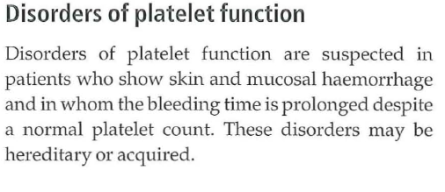

Slide 7
Hereditary disorders
Thrombasthenia (Glanzmann's disease)
This autosomal recessive disorder leads to failure of primary platelet aggregation because of a deficiency of membrane GPIIb
Bernard-Soulier syndrome
In this disease the platelets are larger than normal and there is a deficiency of GPIb.
There is defective binding to VWF, defective adherence to exposed subendothelial connective tissues

Slide 8
Storage pool diseases
In the rare grey platelet syndrome, the platelets are larger than normal and there is a virtual absence of alpha granules with deficiency of their proteins.
In the more common beta storage pool disease there is a deficiency of dense granules.

Slide 9
Acquired disorders
Antiplatelet drugs Aspirin therapy is the most common cause of defective platelet function. It produces an abnormal bleeding time
Hyperglobulinaemia associated with multiple
myeloma or Waldenstrom's disease may cause interference with platelet adherence, release and aggregation.
Myeloproliferative and myelodysplastic
Disorders Intrinsic abnormalities of platelet function occur

Slide 10
UraemiaThis is associated with various abnormalities of platelet function.
Heparin, dextrans, alcohol and
radiographic contrast agents may also cause defective function

Slide 11
DIC (disseminated intravascular coagulation).
Wide spread intravascular deposition of fibrin with consumption of coagulation factors & platelets occur as consequence of many disorders which release procoagulant material into the circulation or cause wide spread endothelial damage or platelets aggregation.
It may be associated with fulminant hemorrhagic syndrome or run less severe & more chronic course.

Slide 12
Causes of DIC:
1-Infections: gram negative & meningococcal septicaemia, septic abortion &clostridium welchii septiacemia, severe falciparum malaria, & viral infection.
2-Malignancy: widespread mucin-secreating adenocarcinoma& promylocytic leukaemia.
3- Obstetric complication: amniotic fluid embolism, premature separation of placenta, eclampcia& retained placenta
4-Hypersensetivity reactions: Anaphylaxis & incompatible blood transfusion
5- Widespread tissue damage: following surgery or trauma.
6-other: liver failure, snake venoms severe burns, hypothermia, heat stroke, acute hypoxia &vascular malformation.

Slide 13
Pathogenesis:
1-DIC may be triggered by entry of procoagulant material into circulation
2-DIC may be initiated by widespread endothelial damage & collagen exposure.
3-Widespread intravascular platelets aggregation may also precipitate DIC.
4-intravascular thrombin formation produce large amount of circulating fibrin monomers which form complex with available fibrinogen.
5- Intense fibrinolysis is stimulated by thrombi on vascular walls & release of split products interferes with fibrin polymerization
6- The combined action of thrombin & plastin normally causes depletion of fibrinogen, prothrombin, factor V & VIII.
7- Intravascular thrombin also causes widespread platelets aggregation, release & deposition leading to consumption of platelets.

Slide 14
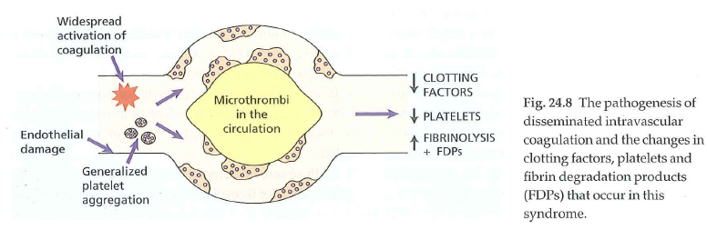

Slide 15
Lab. Findings:
Tests of haemostasis:
1-The platelets count is low
2-Fibrinogen screening tests or assay indicate deficiency.
3- The thrombin time is prolonged
4-high levels of fibrinogen & fibrin degradation products are seen in serum & urine.
5- Test for the fibrin-monomer complex is positive
6- The prothrombin time & APTT are prolonged.
7-Factor V &VIII activities are reduced

Slide 16
Blood film:
There is hemolytic anemia with red cells fragmentation due to their passage through fibrin strands in small vessels.

