Slide 1
water-soluble vitamin B₉. Folic acid is itself not biologically active, but its biological importance is due to tetrahydrofolate and other derivatives after its conversion to dihydrofolic acid in the liver.
Vitamin B₉ is essential to numerous bodily functions. The human body needs folate to synthesize DNA, repair DNA, and methylate DNA as well as to act as a cofactor in biological reactions involving folate. It is especially important in aiding rapid cell division and growth, such as in infancy and pregnancy. Children and adults both require folic acid to produce healthy red blood cells and prevent anemia.

Slide 2
Chemistry
Folic acid is applied to a number of compounds which contain the following groups:
Pteridine nucleus (Pyrimidine and Pyrazine rings).-
Para-aminobenzoic acid (PABA) and-
Glutamic acid. -
Chemically called Pteroyl Glutamic Acid(PGA).
There are at least three chemically related compounds of nutritional importance which occur in natural products,all may be termed (Pteroyl Glutamates).

Slide 4
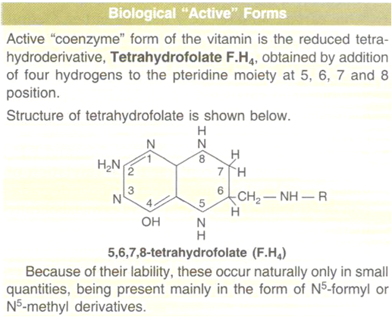
Biological Active Forms

Slide 5
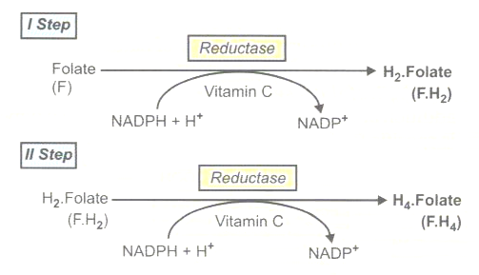
Formation of F.H4
Folic acid, before functioning as a coenzyme, must be reduced first to 7,8-dihydrofolic acid(F.H2) and then to 5,6,7,8 Tetrahydrofolate (F,H4) .

Slide 6
Absorption
Polyglutamates ingested in diet are converted to monoglutamates and dihydrofolates are reduced to tetrahydrofolates by Folate reductase.then converted to methyltetrahydrofolates ,which enter the portal blood and then carried to liver.
Excretion
Urine: 2 to 5 µg ̸ day.This is much increased after an oral dose of folate if the tissues are saturated.
Feces: 20% of the ingested folates that remains unabsorbed + 60 to 90 µg in the bile that is not reabsorbed + some unabsorbed synthesis of folate by bacterial flora of intestine.

Slide 7
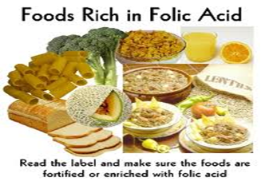
Sources
Leafy vegetables such as spinach, asparagus.
Legumes such as dried or fresh beans, peas and lentils.Egg yolks. Baker's yeast.Fortified grain products (pasta, cereal, bread).
Sunflower seeds. Liver and liver products contain high amounts of folate and Kidney.

Slide 8
Function
1-The only function of vitamin B9 (folate) coenzymes in the body appears to be acting as acceptors and donors of one-carbon units (in a variety of reactions critical to the metabolism of nucleic acids and amino acids .
2-Vitamin B9 coenzyme play a vital role in DNA metabolism through the synthesis of DNA from its precursors (‘thymidine’ and ‘purines’.
3-Folate coenzymes are required for the metabolism of several important amino acids, such as the synthesis of methionine from homocysteine. .
4-Prevents serious birth defects in the fetus and new-born such as neural tube.
5- Vitamin B9 helps in producing healthy red blood cells and shields the fetus and pregnant woman from anemia; especially Megaloblastic Anemia.
6- Folic acid helps in digestion and strengthening the nervous system, thus improving mental and emotional health.
7-Vitamin B9 is also important because it is a natural provider of strong immune power and enhances the body’s energy reservoir.

Slide 9
Deficiency
Folate deficiency is most often caused by a dietary insufficiency; however, folate deficiency can occur in a number of other situations. For example, alcoholism is associated with low dietary intake and diminished absorption of folate, which can lead to folate deficiency. Additionally, certain conditions such as pregnancy or cancer result in increased rates of cell division and metabolism, causing an increase in the body's demand for folate .Several medications may also contribute to this deficiency. .

Slide 10
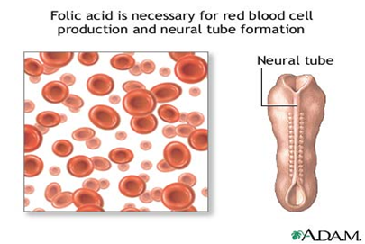
Folic acid for a healthy pregnancy and baby
Folic acid is a B vitamin that helps a baby’s neural tube to grow healthy during pregnancy. The neural tube will become a baby’s brain and spinal cord. But if the neural tube doesn’t close the way it should, it can cause a very serious birth defect
called a neural tube defect (NTD).

Slide 12
Results of deficiency: 1-Megaloblastic anemia. 2-Low birth weight and neural tube defects. 3-Smooth tongue,frequent infections. 4-Elevated homocysteine level( increased risk of heart disease).

