Slide 1
Cell signaling is part of a complex system of communication that governs basic cellular activities and coordinates cell actions. The ability of cells to perceive and correctly respond to their microenvironment is the basis of development, tissue repair, and immunity as well as normal tissue homeostasis.
Errors in cellular information processing are responsible for diseases such as cancer, autoimmunity, and diabetes.

Slide 2
Cell signaling can be classified to be mechanical and biochemical based on the type of the signal.
Mechanical signals are the forces exerted on the cell and the forces produced by the cell. These forces can both be sensed and responded by the cells.
Biochemical signals are the biochemical molecules such as proteins, lipids, ions and gases. These signals can be categorized based on the distance between signaling and responder cells.

Slide 3
Signaling molecules may trigger:
An immediate change in the metabolism of the cell (e.g., increased glycogenolysis when a liver cell detects adrenaline);
An immediate change in the electrical charge across the plasma membrane (e.g., the source of action potentials);
A change in the gene expression — transcription — within the nucleus. (These responses take more time.)

Slide 4
Signaling within, between, and amongst cells is subdivided into the following classifications:
Intracrine signals are produced by the target cell that stay within the target cell.
Autocrine signals are produced by the target cell, are secreted, and affect the target cell itself via receptors.
Juxtacrine signals target adjacent (touching) cells.
Paracrine signals target cells in the vicinity of the emitting cell. Neurotransmitters represent an example.
Endocrine signals target distant cells. Endocrine cells produce hormones that travel through the blood to reach all parts of the body.

Slide 7
Signal Transduction | Metabolism
Provides information transfer | Provides mass transfer
Quantities: 10 to 10⁴ molecules per cell | Quantity of converted material: μM or Mm
A signal pathway may assemble dynamically | A metabolic network is determined by the present set of enzymes
Amount of catalyst and substrate in the same order of magnitude | The catalyst to substrate ratio is low (Michaelis-Menten kinetics)

Slide 8
Signal transduction occurs when an extracellular signaling molecule activates a cell surface receptor. In turn, this receptor alters intracellular molecules creating a response.
There are two stages in this process:
1-A signaling molecule activates a specific receptor protein on the cell membrane.
2-A second messenger transmits the signal into the cell, eliciting a physiological response.
In either step, the signal can be amplified. These molecular circuits detect, amplify, and integrate diverse external signals to generate responses such as changes in enzyme activity, gene expression, or ion-channel activity.

Slide 10
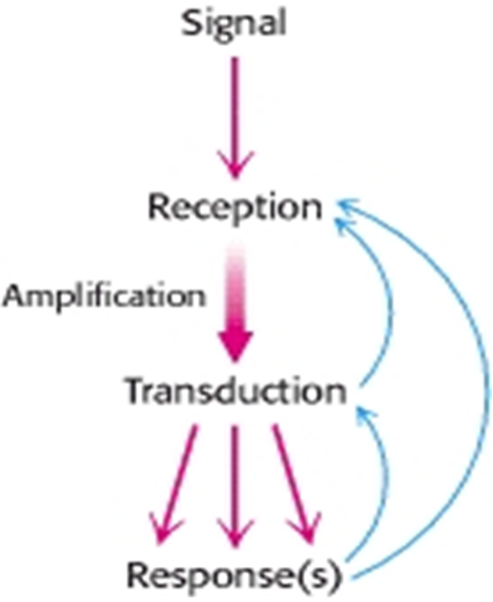
Signal transduction occurs when an extracellular signaling molecule activates a cell surface receptor. In turn, this receptor alters intracellular molecules creating a response. There are two stages in this process:
1-A signaling molecule activates
a specific receptor protein on
the cell membrane. 2-A second messenger transmits
the signal into the cell,
eliciting a physiological response

Slide 11
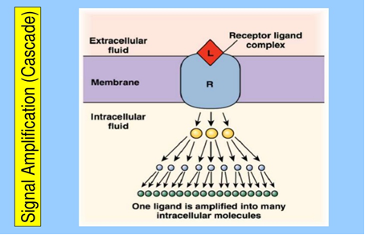
A signal transduction functions much like a switch.

Slide 12
The information flows from the gene to the primary transcript to mRNA to protein. However, can affect any of steps involved and can affect the rates of processing, degradation, or modification of the various products.
By selectively affecting gene transcription and the consequent production of appropriate target mRNA, the amount of specific proteins are changed and metabolic processes are influenced.

Slide 14
Regulation of gene expression:-
Control of transcription results from changes in the interaction of specific binding regulatory protein with various regions of DNA in the controlled gene. This can have a positive or negative effect on transcription.
Transcription control can result in tissue-specific gene expression and gene regulation is influenced by hormones, heavy metals, and chemicals.
Gene expression can also be modulated by gene amplification, and RNA stabilization.

Slide 15
General Features of Signal Transduction Signal transductions are remarkably specific and exquisitely sensitive.

Slide 16
Types of responses:-
The biologic system exhibit three types of temporal responses to a regulatory signal:-
1-Type A response:-
It is characterized by an increased extent of gene expression that is dependent upon the continued presence of inducing signal.
2-Type B response:-
Exhibite an increased amount of gene expression that is transient even in the continued presence of the regulatory signal.
3-Type C response:-
Exhibites, in response to the regulatory signal, an increased extent of gene expression that persists indefinitely even after termination of the signal.

Slide 18
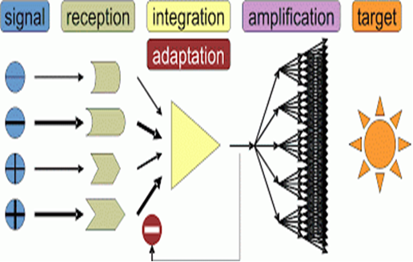
Principles of Signal Transduction
The information that the signal has arrived is then converted into other chemical forms, or transduced. The signal is often amplified before evoking a response. Feedback pathways regulate the entire signaling process.

Slide 19
Types of Receptor:-
Receptors can be divided into:-
Intracellular receptors.
Cell-surface receptors.
Ligand – gated ion channel receptors are a class of receptor that may occur both at the cell-surface or intracellular.
Cell-surface receptors:-
There are many different class of transmembrane receptor that recognizes different exctracellular signaling molecules:-
G- protein – coupled receptors. e.g., chemokine receptors.
Receptor tyrosine Kinases. e.g., growth factor receptors.
Integrins.
Toll-like receptors.

Slide 20
The use of second messengers has several consequences.
First, second messengers are often free to diffuse to other compartments of the cell, such as the nucleus, where they can influence gene expression and other processes.
Second, the signal may be amplified significantly in the generation of second messengers.
Third, the use of common second messengers in multiple signaling pathways creates both opportunities and potential problems.
Second messengers relay information from the receptor-ligand complex. Changes in the concentration of small molecules (second messengers), constitute the next step in the molecular information circuit. Particularly important second messengers include cyclic AMP and cyclic GMP, calcium ion, inositol 1,4,5-trisphosphate, (IP₃), and diacylglycerol

Slide 21
1- G-Protein – coupled Receptors.
G-protein – Coupled receptors (GPCR) are a family of integral membrane proteins that posses seven membrane-spanning domains, and are linked to a guanine nucleotide- binding protein (or heterotrimeric G protein).
The total strength of signal amplification by a G-protein – coupled receptor (GPCR) is determined by:-
The lifetime of the ligand – receptor-complex ..
The amount and lifetime of the receptor-effector protein – complex.
3- Deactivation of the activated receptor.
4- Deactivation of effectors through intrinsic enzymatic activity.

Slide 22
Protein phosphorylation is a common means of information transfer. Many second messengers elicit responses by activating protein kinases. These enzymes transfer phosphoryl groups from ATP to specific serine, threonine, and tyrosine residues in proteins.
This protein kinase and others are the link that transduces changes in the concentrations of free second messengers into changes in the covalent structures of proteins. Although these changes are less transient than the changes in secondary-messenger concentrations, protein phosphorylation is not irreversible. Indeed, protein phosphatases are enzymes that hydrolytically remove specific phosphoryl groups from modified proteins.

Slide 23
2- Receptor Tyrosine Kinases (RTKs) :-
Are transmembrane proteins ,they are enzymes that transfer phosphate groups from ATP to the amino acid Tyrosine on a protein.
They are effective when cell needs to regulate and coordinate a variety of activities and trigger several signal pathways at once, so they regulate cell proliferation, differentiation, cell survival and cellular metabolism.

Slide 24
The signaling molecules that activate RTK are soluble or membrane bound peptide or protein hormones. Examples:
1-Nerve growth factor (NGF)
2- Platelets-derived factor(PDGF)
3- Fibroblast growth factor(FGF)
4- Epidermal growth factor(EGF)
(RTK) proteins are classified depending on the:-
1- Structural properties.
2- Ligand specificity.

Slide 25
3- Integrins:-
Are produced by a wide variety of cell types, and play a role in the attachment of a cell to the extracllular matrix (ECM) and to other cells, and in the signal transduction of signals received from extracellular matrix components such as fibronectin, collagen.
Important differences between integrin – signaling in circulating blood cells and that in non-circulating cells.
Integrins at the cell-surface of circulating cells are inactive under normal physiological conditions.
Epithelial cells , in contrast , have active integrins at their cell surface under normal condition , which help to maintain their stable adhesion to underlying stromal cells, which provide appropriate signal in order to maintain their survival and differentiation.

Slide 26
4- Toll like receptors (TLRs):-
They are a type of pattern recognition receptor and recognize molecules that are shared by pathogens but distinguishable from host molecules , once they have breached physical barriers such as the skin or intestinal tract mucose and activate immune cell responses , they are play a key role in the innate immune system.
Following activation by ligands of microbial origin, several reactions are possible. Immune cells can produce signaling factors called cytokines with trigger inflammation. In the case of bacterial factor, the pathogen might be phagocytosed and digested, and its antigens presented to CD4. T cells. In the case of a viral factor, the infected cell may shut off its protein synthesis and may undergo programmed cell death (apoptosis). Immune cells that have detected a virus may also release anti-viral factors such as interferones.

Slide 27
The signal is terminated
Protein phosphatases are one mechanism for the termination of a signaling process. After a signaling process has been initiated and the information has been transduced to affect other cellular processes, the signaling processes must be terminated.
Without such termination, cells lose their responsiveness to new signals. Moreover, signaling processes that fail to be terminated properly may lead to uncontrolled cell growth and the possibility of cancer.

Slide 29
Calcium is Mediator of Hormone Action:-
Certain hormone- receptor interactions result in the activation of phospholipase C. This appears to involve a specific G protein, which also may activate a calcium channel.
Phospholipase C results in generation of inositol triphosphate (IP3), which liberates stored intracellular Ca⁺², and diacylglycerol (DAG), a potent activator of protein kinase C (CPK).
In the scheme below , the activated (PKC) phosphorylates specific substrates , which then alter physiologic processes , the Ca⁺² calmodulin complex can activate specific kinases these actions result in phosphorylation of substrates , and this leads to altered physiologic responses .

Slide 31
Nitric Oxide (No) as a second Messenger:-
The gas nitric oxide (No) is free radicals that diffuse through the plasma membrane and effects nerby cells. In high Conc., (No) is toxic, and is responsible for some damage after a strocke.
NO diffuses freely across cell membranes.
There are so many other molecules with which it can interact, that it is quickly consumed close to where it is synthesized.
Thus NO acts in a paracrine or even autocrine fashion — affecting only cells near its point of synthesis.
(No) serves multiple functions, some of them are:-
1-Relaxation of blood vessels.
2-Regulation of exocytosis of neurotransmitters.
3-Cellular immune response.
4-Activation of apoptosis.

