Slide 1
College of medicine Almustansiriyah University
Department of Surgery
ENT Unit
ENT – Demonstration Videos
Dr Haider Alsarhan

Slide 2
ENT – Videos

Slide 3
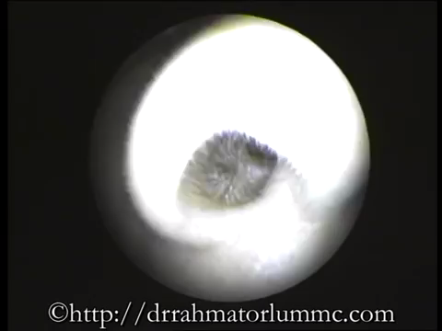
ENT – Videos

Slide 4
ENT – Videos

