Slide 1
Skin tumors

Slide 2
Benign epidermal tumors
Premalignant epidermal tumours
Malignant epidermal tumours
Tumours of the dermis

Slide 3
Benign epidermal tumors
Seborrhoeic keratosis
un-related to sebaceous glands.after age of 50 .
multiple but may be single.on the face and trunk.
distinctive ‘stuck-on’ appearance. flat, raised, filiform or pedunculated.
Surface smooth or verrucous. yellow–white to dark brown–black.
ugly or easily traumatized ones can be removed with a curette, or by cryotherapy.

Slide 4
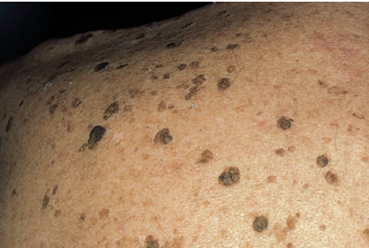

Slide 5
Skin tags (acrochordon)
common benign outgrowths of skin
Skin tags are most common in obese women
around the neck and within the major flexures.
look unsightly, catch on clothing and jewellery.
soft skin-coloured or pigmented pedunculated papules.
Small lesions can be snipped off with fine scissors, frozen with liquid nitrogen or destroyed with electrodessication.

Slide 6
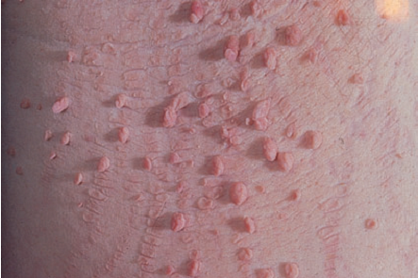

Slide 7
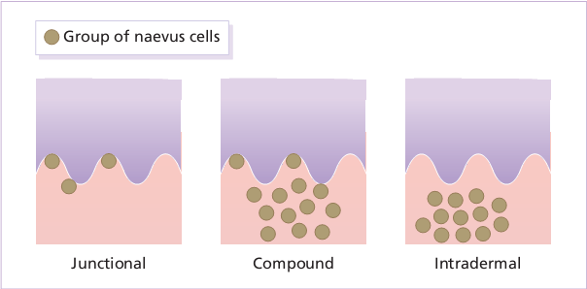
Melanocytic naevi localized benign tumours of melanocytes.
The ‘junctional’ type (proliferating melanocytes in clumps at the dermo-epidermal junction).
A ‘compound’ naevus has both dermal and junctional components.
the melanocytes in an‘intradermal’ naevus are all in the dermis.

Slide 8
Malignant change should be considered in a melanocytic naevus if : Enlargement, increased or decreased pigmentation, altered shape, altered contour, inflammation, ulceration, itch, or bleeding.
Excision is needed when:
naevus is unsightly;
malignancy is suspected
risk as large congenital melanocytic naevus
naevus repeatedly inflamed or traumatized.

Slide 9
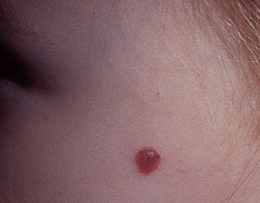
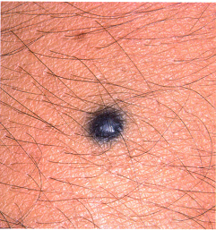
Spitz naevi develop over a month or two as solitary pink or red nodules up to 1 cm in diameter, common on the face and legs. Benign, excision is best.
Blue naevi striking grey–blue color, appear on the limbs, buttocks and lower back. usually solitary.

Slide 10
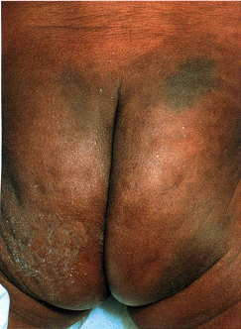
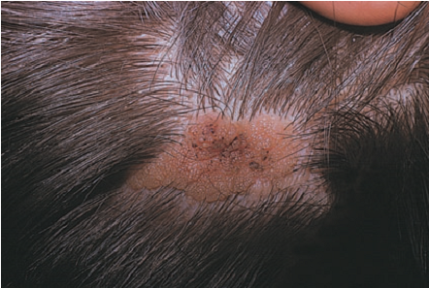
Mongolian spots Pigment in dermal melanocytes , bruise-like greyish areas seen on the lumbosacral area of most Down’s syndrome and many Asian and black babies. They usually fade during childhood.
Sebaceous naevus A flat hairless area at birth, usually in the scalp, become more yellow and more raised at puberty. Risk of basal cell carcinomas in adult life.

Slide 11
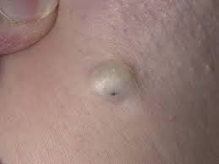
Epidermoid and pilar cysts Common and occur on the scalp, face, behind ears, trunk. often have a central punctum.
The lining of a cyst resembles normal epidermis (an epidermoid cyst) or the outer root sheath of the hair follicle (a pilar cyst).
excision
incision followed by expression of contents + removal of the cyst wall.

Slide 12
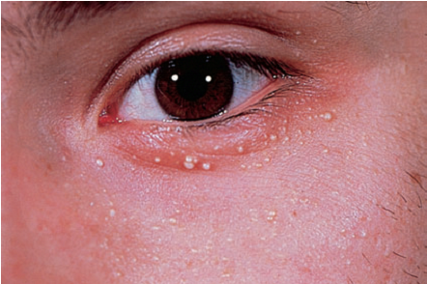
Milia
small subepidermal keratin cysts. common on face in all age groups. appear as tiny white papules of 0.5 –2 mm. contents of milia can be picked out with a sterile needle.

Slide 13
Premalignant epidermal tumours
Actinic keratoses
discrete rough-surfaced pink or grey scaling macules or papules usually less than 1 cm
on sun-damaged skin, middle-aged+elderly.
The effects of sun exposure are cumulative.
Their rough surface better felt than seen.
Transition to squamous cell carcinoma, if: enlarges, nodular, ulcerates, bleeds.

Slide 14
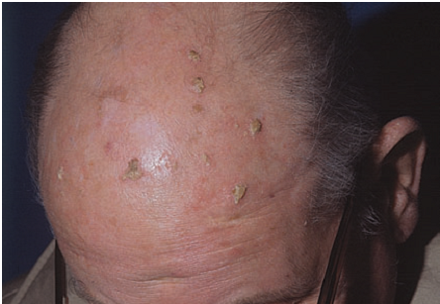
Freezing with liquid nitrogen effective. Shave removal or curettage for large lesions
Multiple lesions treated with 5-fluorouracil, Imiquimod, 3% Sodium diclofenac gel.

Slide 15
Malignant epidermal tumours
Basal cell carcinoma appear on faces of elderly. Prolonged sun exposure. destroys tissue locally.
Nodulo-ulcerative small glistening translucent, skin-coloured papule. Central necrosis leaves an ulcer with an adherent crust and a rolled pearly edge. Coarse telangiectatic vessels .
Excision with 0.5 cm of surrounding normal skin.
Radiotherapy.
Cryotherapy, curettage, cautery . photodynamic

Slide 16
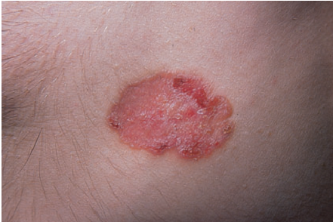
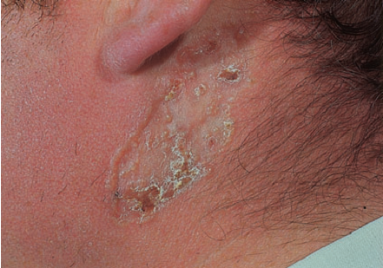
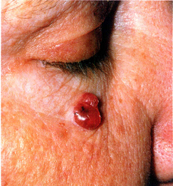
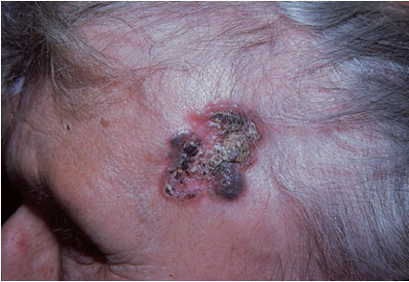
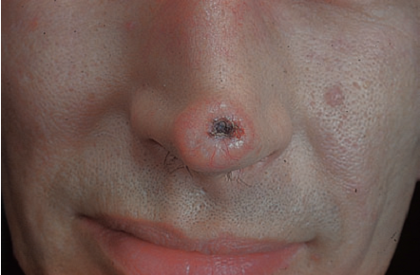

Slide 17
Squamous cell carcinoma
ultraviolet radiation, X-rays and chronic inflammation.
DNA of human papilloma virus
may arise as thickenings in an actinic keratosis or, de novo, as small scaling nodules; rapidly growing lesions
may start as ulcers with a granulating base and an indurated edge.
common on the lower lip, in the mouth.

Slide 18
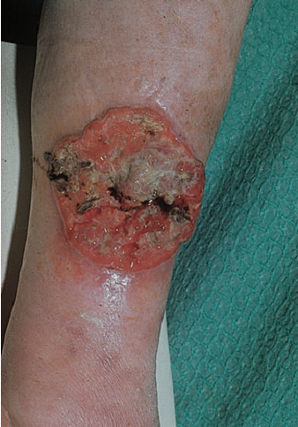
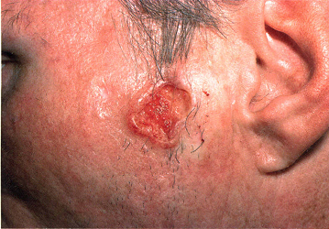
low-risk tumours should be excised with a 0.5-cm border of normal skin. Wider excision (6 mm or more) is recommended for high-risk tumours. Palpation of regional nodes is important in work-up . Radiotherapy is effective.

Slide 19
Malignant melanoma
Genetic Susceptibility
Sunlight
Pre-existing melanocytic naevi
Eighty percent of invasive melanomas are preceded by a superficial and radial growth phase, shown clinically as the expansion of an irregularly pigmented macule or plaque. Most are multicoloured mixtures of black, brown, blue, tan and pink. reniform projections and notches.

Slide 20
Lentigo maligna melanoma on exposed skin of elderly. An irregularly shaped pigmented macule (a lentigo maligna)
Superficial spreading melanoma in Caucasoids.
Acral lentiginous melanoma on palms and soles
Nodular melanoma appears as a pigmented nodule with no preceding n situ phase. rapidly growing and aggressive type.
Subungual melanomas painless areas of pigmentation expanding under nail,onto the nail fold (Hutchinson’s sign).

Slide 21
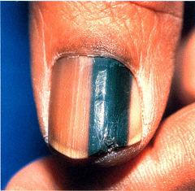
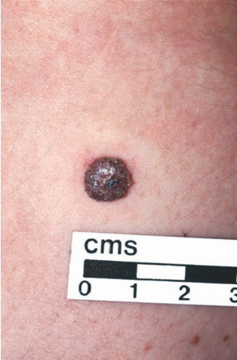
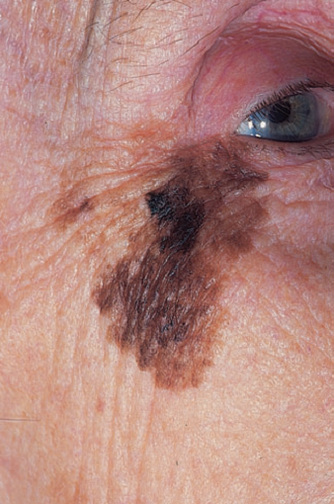
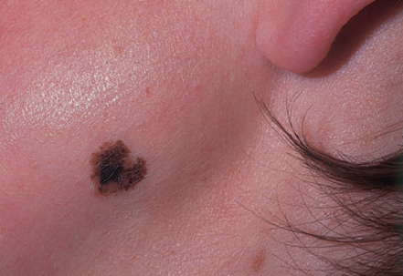

Slide 22
An excision biopsy, with a 2–5 mm margin of clearance laterally and down to the subcutaneous fat.
If histology confirms the diagnosis then wider excision.
0.5 cm clearance for melanomas in situ and 1 cm clearance is required for all invasive melanomas.
If lymph node involvement, fine needle aspiration done. If involvement is confirmed then block dissection of involved group of nodes.
Chemotherapy may be palliative

Slide 23
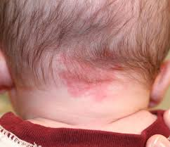
Tumours of the dermis Benign dermal tumours
Malformations
1.Salmon patches (‘stork bites’) present in 50% of all babies, caused by dilatated capillaries in superficial dermis. dull red, often telangiectatic macules,on the nape of the neck, the forehead and the upper eyelids.
Nuchal lesions may remain
unchanged, patches in other
areas usually disappear in a year.

Slide 24
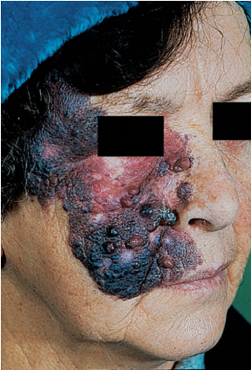
2. Port-wine stains present at birth, caused by dilatated dermal capillaries. pale, pink–purple macules on face or trunk. They persist, in middle age may darken and become studded with angiomatous nodules. flash lamp-pumped pulsed dye laser, sessions can begin in babies.

Slide 25
3.Haemangiomas
appear within a few weeks of birth and grow for a few months, forming a raised compressible swelling with a bright red surface.
Spontaneous regression then follows
Bleeding follow trauma, ulceration in napkin .
Observation and encouragement.. If lesions ulcerate, bleed repeatedly, interfere with feeding or with vision, high doses of systemic steroids successful in proliferative phase.
pulsed dye lasers for large lesions in infancy.

Slide 26
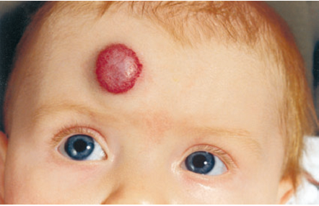

Slide 27
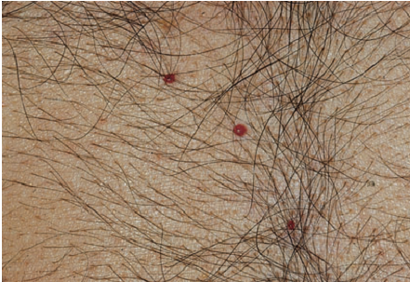
cherry angiomas common on the trunks of the middle-aged and elderly. They are small bright red papules and of no consequence.

Slide 28
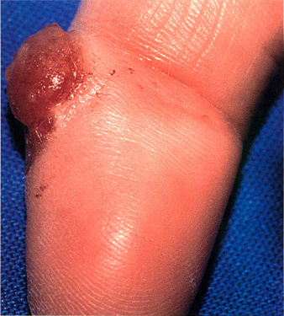
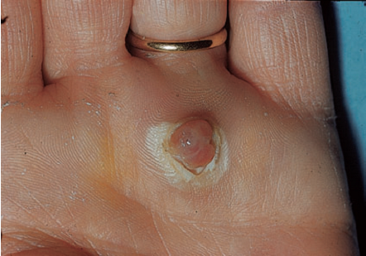
Pyogenic granulomas common benign acquired haemangiomas. develop at sites of trauma, over course of a few weeks, as bright red raised, raspberry-like lesions which bleed easily. removed by curettage under local anaesthetic with cautery to the base.

Slide 29
Dermatofibromas
benign tumours are firm, discrete, usually solitary dermal nodules, on extremities of young adults.
Iceberg effect in that they feel larger than they look.
The overlying epidermis is often lightly pigmented and dimples when the nodule is squeezed.
may follow minor trauma or an insect bite.
It should be excised.

Slide 30
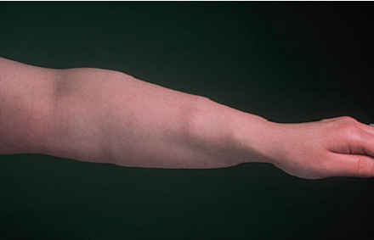
Lipomas common benign tumours of mature fat cells in subcutaneous tissue. single or many.
common on proximal limbs,can occur at any site. irregular lobular shape,soft rubbery consistency,rarely painful.
removed only doubt about diagnosis, painful, unsightly or interfere with activities

