Slide 1
المحاضرة الثانية انزيمات 21-4-2019

Slide 2
Enzyme classes :
Your body contains around 3,000 unique enzymes, and are classified into six categories: Oxidoreductases, transferases, hydrolases, Lyases, ligases, and Isomerases. As in table (3).
Table (3): Enzyme classes.
Factors Affecting The Enzyme Activity
1-Enzyme concentration
2- substrate concentration
3- Product concentration
4-Tempreture
5- pH
6- UV light & Radiation
7- Activators
8-Inhibitors
9- Anti enzymes
10- Time
Class | Enzyme Function
Oxidoredo-reductases | Catalyze oxidation-reduction reactions Glucose Dehydrogenase, oxidizes Glucose to ATP in animals.
Transferases | Catalyze the transfer of functional groups among molecules, Transaminase Kinases.
Hydrolases | Add water across a bond, Lipases.
Lyases | Catalyze a formation of double bonds (or a ring structure), Decarboxylases.
Ligases | Catalyze bond formation, Citric acid synthetase.
Isomerases | Catalyze isomerization (changing of a molecule into its isomer), Phospho hexo isomerase: glucose-6-phosphate ↔ fructose-6-phosphate.

Slide 3
Factors Affecting The Enzyme Activity:
1-Enzyme concentration:
If the concentration of the enzyme is increased, the velocity of the reaction proportionately increases, in clinical application determination of enzyme concentration & for diagnosis of inborn error in metabolism.
as bellow. Figure(6).
2- The substrate concentration:
the rate of enzymatic reaction increases as the substrate concentration increases until a limiting rate is reached, after which further increase in the substrate concentration produces no significant change in the reaction rate. At this point, all of the enzyme active sites have saturated with substrate, Figure(7).
3- Product concentration:
With increase in product concentration the velocity rate decrease causing feed-back inhibition of enzyme.
enzyme concentration X2
Product concentration
enzyme concentration X1
No enzyme
Time
Figure(6): The effect of increasing the enzyme concentration upon the reaction. X1,X2 are increasing concentration.
The reaction rate.
The reaction rate.
Substrate concentration.
The enzyme concentration.
Figure(7): The effect of substrate concentration on Enzyme action.

Slide 4
4-The effect of Temperature on Enzyme activity: Each enzyme has a temperature that it works optimally in, which in humans is around 37⁰ the normal body temperature for humans. Temperature is speed up all reactions. Figure(8) indicate enzyme activity stops completely at 0C°, but if the temperature rises again, then the enzyme gets reactivated once more, besides If the temperature gets too hot, the enzyme denatures.
Figure(8): The effect of Temperature on
Enzyme action.
5-The effect of pH (H⁺ concentration) on Enzyme action:
substances that contain acidic carboxylic groups (COOH–) and basic amino groups (NH₂). So, the enzymes are affected by changing the pH value. Each enzyme has a pH value that it works at with maximum efficiency called the optimal pH. If the pH is lower or higher than the optimal pH, the enzyme activity decreases until it stops working. Pepsin works at a low pH, it is highly acidic, while trypsin works at a high pH, it is basic. Most enzymes work at neutral pH 7.4, Fig(9).
6-UV light & Radiation:
Radiation of high energy rays [X-ray] activate peroxides to react with enzyme producing oxidized enzyme but losing of enzyme activity.
In turn this cause loss of gene expression.
Enzyme activity
Trypsin
Enzyme activity
Pepsin
Enzyme pH (H⁺ concentration)
Fig(9): The effect of pH (H⁺ concentration) on Enzyme action.

Slide 5
7-The Effect Of Activators and Inhibitors on Enzyme activity
Effects of Activators on Enzyme Activity:
Enzyme activators are molecules that bind to enzymes and increase their activity.
A cofactor: is a non-protein chemical compound or metallic ion (Ca⁺², Fe⁺², Mg ⁺²,Mn ⁺², Zn ⁺², and K⁺), that must bind to particular enzymes before a reaction occurs, Cofactors can be sub classified as either inorganic ions binding cofactors, or complex organic molecules(prosthetic group) binding cofactors called coenzymes. Cofactors can be considered "helper molecules" that assist in biochemical transformations.
Effects of Inhibitors on Enzyme Activity:
An enzyme inhibitor is a molecule, which bind to enzyme, & decreases their activity during biochemical reaction. Drug products are most manufactured with enzyme inhibitors by blocking an enzyme’s activity known as pathogen or correct a metabolic imbalance. Enzyme Inhibitors may act combining directly with the enzyme and so effectively remove it from the substrate (like Drugs), the optimum temperature for most human enzymes start between 35⁰C and 40⁰C. Human enzymes start to denature above 40⁰C and stop its catalytic activity.
Enzyme inhibition can be categorized in three types:
1-Competative Inhibitor.
2-Un Competative(Reversbile) Inhibitor.
3-No Competative (Irreversbile) Inhibitor.
Some enzymes containing or requiring metal ions as
Fe⁺² or Fe⁺ᵌ : Peroxidase
Zn⁺² : Alcohol dehydrogenase.
Table 4:-metal ions as cofactors.

Slide 6
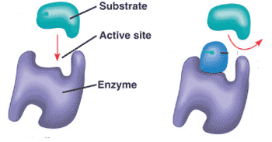
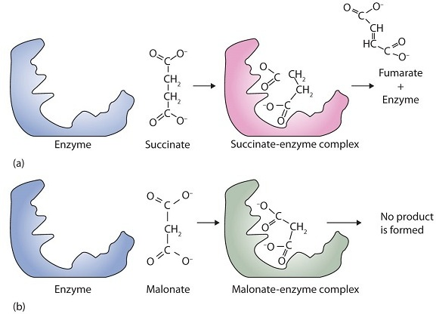
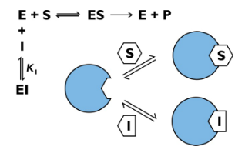
The Effect Of Activators and Inhibitors on Enzyme activity
Effects of Inhibitors on Enzyme Activity:
An enzyme inhibitor is a molecule which bind to enzyme, & decreases their activity during biochemical reaction as in fig-11 below:-
Enzyme inhibition can be categorized in three types:
1-Competative Inhibitor:
Substances [I] that compete with the substrate [S] for the same active site of enzyme molecule and form new enzyme- substrate complex [ES]. Malonate and succinate are the anions of dicarboxylic acids and contain three and four carbon atoms, respectively. The malonate molecule binds to the active site because the spacing of its carboxyl groups is not greatly different from that of succinate. However, no catalytic reaction occurs because malonate does not have a CH₂CH₂ group to convert to CH=CH. This reaction will also be discussed in connection with the Krebs cycle, and energy production.
inhibitor
fig-11
Fig. (12)Competitive Inhibition. (a) Succinate binds to the enzyme succinate dehydrogenase.
A dehydrogenation reaction occurs, and the product— fumarate —is released from the enzyme. (b) Malonate also binds to the active site of succinate dehydrogenase. In this case, however, no subsequent reaction occurs while malonate remains bound to the enzyme.
Competitive inhibition

Slide 7
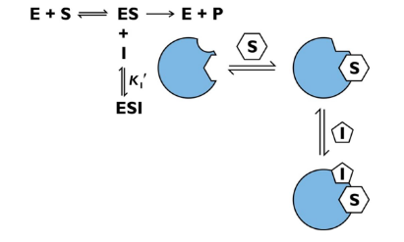
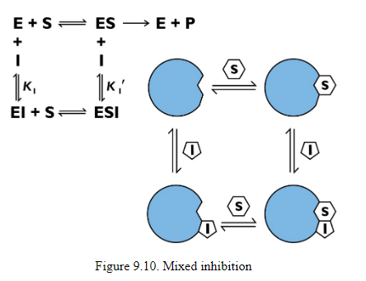
2-Uncompetitive inhibition:
Decrease enzyme activity and full activity return when inhibitor [I] is removed.
3-No - competitive Irreversible Inhibitor:
An irreversible inhibitor inactivates an enzyme by bonding covalently to a particular group at the active site. The inhibitor-enzyme bond is so strong that the inhibition cannot be reversed, by the addition of excess substrate. The nerve gases, especially Diisopropyl Fluorophosphate (DIFP), irreversibly inhibit biological systems by forming an enzyme-inhibitor complex with a specific OH group of serine situated at the active sites of certain enzymes. The peptidase enzymes trypsin, and chymotrypsin contain serine groups at the active site, and are inhibited by DIFP (Glaucoma Drug).
Uncompetitive inhibition
serine DIFP serine-DIFP complex nerve gas
No - competitive inhibition

Slide 8
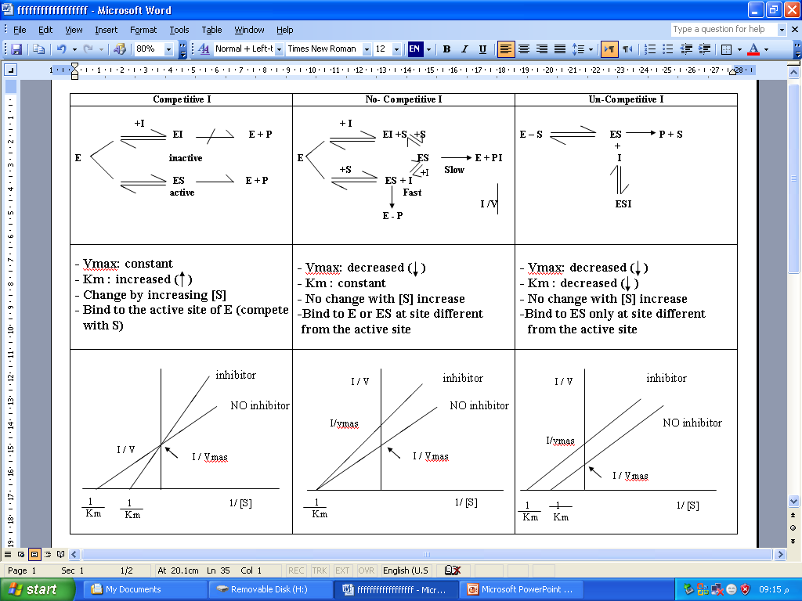
Table (4): Enzyme Inhibitors.

