Slide 2
Post-term pregnancy
Dr ban hadi
F.I.C.O.G.2019

Slide 3
Definitions
Term
Post-date

Slide 4
Definition:
The standard international definition of prolonged pregnancy by WHO is 42 completed weeks or more (294 days or more) from first day of last menstrual period, the gestational age having been established by ultrasound prior to 16 weeks.

Slide 5
Incidence:
Incidence of post term pregnancy is 10-15%
Dating by last menstrual period alone has 70% tendency to over estimate the gestational age (delayed ovulation).
Routine use of early ultra sound to calculate gestational age reduce incidence from 15 % to 1.5%.

Slide 6
Aetiology and pathology:-
The most common cause is inaccurate dating.
The cause of prolonged pregnancy is not clear may represent simple biological variation.
Prolonged pregnancy more common in:
1. Primigravida.
2. Previous Prolonged pregnancy 30%.
3.Anencephaly
4.Placental sulphatase deficiency
5.Male fetus
5.Adrenal hypoplasia
6.Nulliparity
7.Obesity.

Slide 7
Physiological changes associated with prolonged gestation
1)Amniotic fluid changes
Reduced in amount, cloudy with vernix caseosa and meconium
2) Fetal changes
Macrosomia
IUGR
3) Placental changes
Hemorrhagic infarcts, cotyledons and white fossi

Slide 8
Complications A.Fetal and neonatal risks
1.Increased perinatal morbidity and mortality

Slide 9
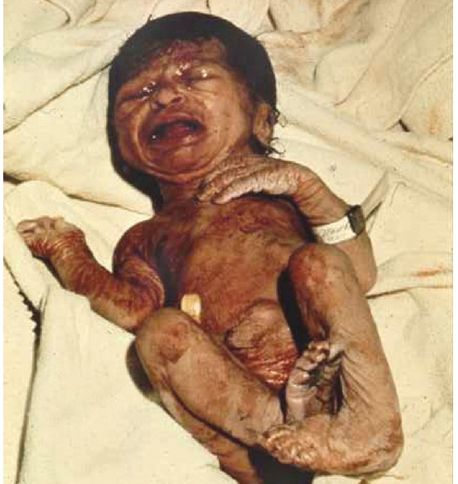
2.Post maturity syndrome
Thick, viscous meconium coated desquamating skin. Old appearance and wrinkling of the hands:

Slide 10
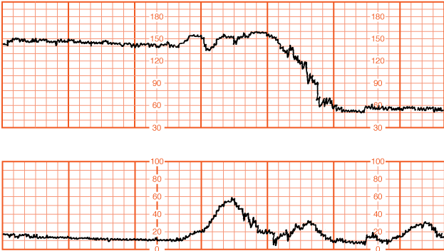
3.Intrapartum fetal distress
Prolonged fetal heart rate deceleration

Slide 11
Complications A.Fetal and neonatal risks
4.Meconium aspiration syndrome
5.Fetal trauma & traumatic deliveries
6.Sudden infant death syndrome

Slide 12
Complications B. Maternal risks
Increased risk of dystocia, PPH
perineal trauma, operative delivery
psychological morbidity

Slide 13
Management: History
Reliability of gestational age estimation
Any risk factor

Slide 14
Management: examination
General exam. BP
Abdominal exam. To evaluate fetal presentation, size and engagement.
Pelvic examination: Ripeness of the cervix is important in the management of prolonged pregnancy using Bishop score, 6 or less indicates poor inducibility
Pelvimetry

Slide 15
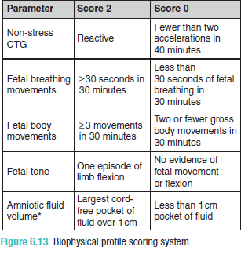
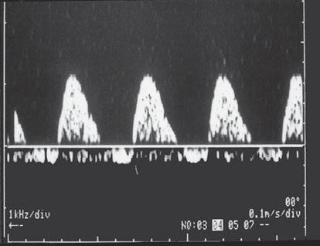
ultrasoud
Amount of liquore, fetal size, fetal wellbeing

Slide 16
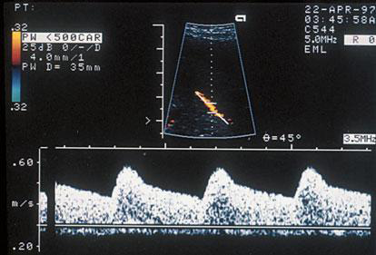
ultrasoud
Doppler study

Slide 17
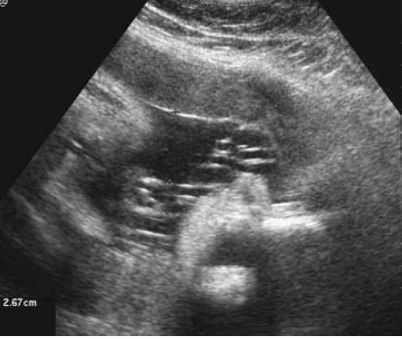
ultrasoud
Amount of liquore, DVP

Slide 18
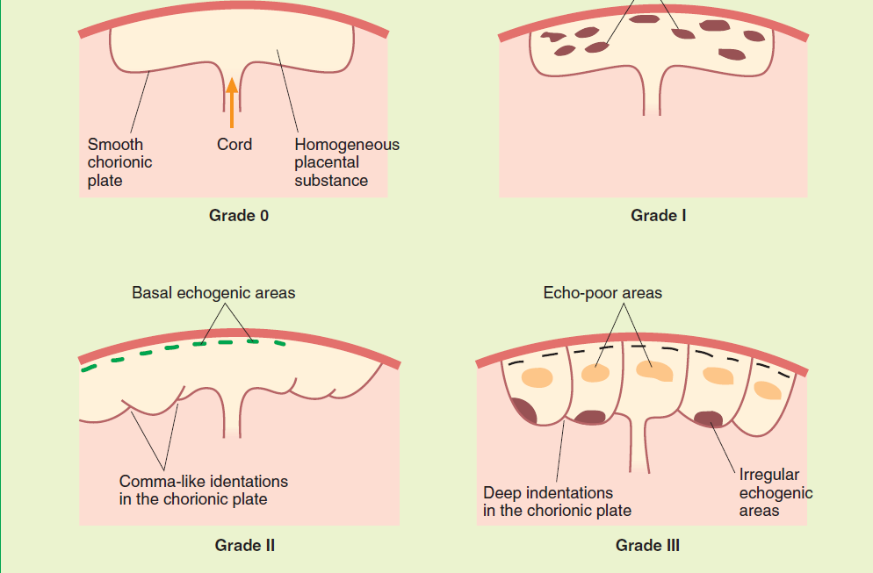
ultrasoud

Slide 19
D. Fetal monitoring in post term pregnancy
-At least twice weekly NST and DVP.
-Fetal movements or kick count
-The biophysical profile (BPP) holds no advantage over NST and liquore assessment.
-Umbilical artery Doppler to detect IUGR
-CST If positive indicates delivery by caesarean section.

Slide 20
E. Sweeping the membranes
at or beyond 40 weeks appears to reduce the incidence of post term pregnancy and the frequency of using other methods of induction

Slide 21
F. Induction of labour
at 41 completed weeks and beyond reduces the perinatal mortality, meconium staining of amniotic fluid and caesarean section compared to conservative management which involves monitoring the fetal condition until spontaneous onset of labour.

Slide 22
A-if the date is confirmed and the cervix is favourable,
labour should be induced with artificial rupture of membranes and intra venous (IV) oxytocin
with continous intra partum fetal monitoring for deceleration

Slide 23
B-if the date is confirmed and the cervix is unfavourable there are two options
Induce labour:- by using of PGE2 gel or vaginal suppositories or the use of Foley's catheter & extra-amniotic infusion of NS
Observation:-both NST & AFI should be performed twice weekly.
Delivery should take place if the NST becomes non reactive or If the AFI is <5 cm or DVP <2 cm.

Slide 24
C- if the date is uncertain:-
Both the NST & AFI can be performed twice weekly while waiting for spontaneous labour to occur.
Delivery should take place if the NST becomes non reactive or if the AFI <5 cm

Slide 25
Notes:
Those with decreased amniotic fluid volume: amnio-infusion with 1000 ml of warm normal saline solution can be performed; it will prevent cord compression & signs of fetal distress

Slide 26
Those with baby weight > 5 kgm → CS
Those with baby weight > 4500 gm → CS if they are IDDM
Patient at 42 weeks should be delivered irrespective to the state of the cervix

Slide 27
Thank you

