Slide 2
Lecture Four:عضوية
Alcohols
Alcohols are some of the most important molecules in organic chemistry. They contain the hydroxyl functional group (-OH), bonded to a carbon atom of an alkyl, or substituted alkyl group(R), Table (1).
Alcohols Uses :
Ethanol:
-Ethanol CH₃CH₂OH is an effective in killing organisms like bacteria, fungi, and viruses, so it is commonly used as hand sanitizer gels & medical wipes at clinics and hospitals.
- Ethanol spirits consist of a mixture of Ethanol with a small quantity of methanol, and possibly some color added. Because methanol is poisonous, industrial Ethanol spirits are unfit to drink.
Ethanol use as a fuel: Ethanol burns to produce carbon dioxide and water, as shown in the equation below, so can be used as a fuel.
CH₃CH₂OH + 3 O₂ → 2 CO₂+ 3 H₂O.
Table (1): Alcohol Classification.
Types of Alcohol
 | Primary Alcohol
 | Secondary Alcohol
 | Tertiary Alcohol

Slide 3
Alcohols Uses :
-Ethanol is a solvent: it’s a widely safe solvent, so used to dissolve many organic compounds that are insoluble in water especially for medicine, to extract active constituents from inert parts of crude drugs.
Type of Cell Reactions
1- Aerobic respiration : is done in presence of oxygen beside the formation of Adenosine Tri Phosphate ATP as energy from cell:
1- Glycolysis in cytoplasm. Figure(1): Mitochondria.
2- Citric acid cycle, & Crips cycle in mitochondria.
Regarding that mitochondria Figure(1), as the cells energy factory, where electrons produced and used for pumping the protons H⁺¹ to the inner membrane space of mitochondria, by the specific enzyme named ATP synthase. The electrons flow to oxygen in presence of proton H⁺¹ and ATP synthase , then forming H₂O, and forming ATP , also decreasing the effect of acidity.
2- Anaerobic respiration:
This type of reactions are done in most prokaryotes that live under environmental conditions in absence of oxygen (not happen in mitochondria).The environmental conditions which lack oxygen uses anaerobic respiration, by use the electron transport chain without the presence of oxygen as electron acceptor to form Adenosine Tri Phosphate (ATP). But less oxidizing molecules such as sulfate (SO4 -), nitrate (NO₃-), or sulfur (S) are used as electron acceptors instead of highly oxidizing of oxygen. Consequently, less energy is formed per molecule of glucose during anaerobic respiration.

Slide 4
Alcoholic fermentation : It’s a type of reactions similar to anaerobic respiration. This method uses the electron transport chain in absence of oxygen as the electron acceptor. This is very common in yeast (unicellular fungus). Yeast cells release zymase enzymes for hydrolysis of complex carbohydrates into Glucose then Ethanol the main end product to achieve the fermentation. there are a slight smell of alcohol (from ethanol) and gas coming off the mixture (from CO₂), Figure (2).
Alcoholic fermentation Reaction:
Zymase Enzyme
C₆H₁₂O₆ + CH₃CH₂OH + CO₂.
Glucose Yeast Cell Ethanol
Figure (2): The Fermentation of Alcohol process to form ATP,
in absence of oxygen.
The absence of oxygen during respiration process, organisms have evolved with mechanisms to recycle Nicotin amide Adenine Dinucleotide (NAD⁺) for glycolysis to continue in order to synthesize Adenosine Triphosphate (ATP) molecules, known as "energy currency" of cells. This process evolves into two different mechanisms, although both share the name of "fermentation":
Ethanol Fermentation occurs in bacteria, yeast,...
Lactic Acid (or Lactate) Fermentation occurs in animals (humans).
Yeast

Slide 5
In mammalian red blood cells (without mitochondria) and in skeletal muscle ( Absence of oxygen or has an insufficient oxygen supply to allow aerobic respiration). In muscles, lactic acid accumulation must be removed by the blood circulation and the lactate brought to the liver for further metabolism. The chemical reactions of lactic acid fermentation are the following:
LDH
Pyruvic acid + NADH ⟷ Lactic acid + NAD​⁺​​
The enzyme used in this reaction is lactate dehydrogenase (LDH). The reaction can proceed in either direction, but the reaction from left to right is inhibited by acidic conditions. Such lactic acid accumulation was once believed to cause muscle stiffness, fatigue, and soreness. Once the lactic acid has been removed from the muscle and circulated to the liver, it can be reconverted into pyruvic acid and further catabolized for energy.
The Effect of Alcohol on Antibiotics:
Consuming of Alcohol while taking Antibiotics can cause dangerous
reaction. Alcohol Consumption cause:
1- An upset of stomach and stomach pain.
2- diarrhea.
3- Ulcers.
4- Digestive problems.
But the signs of Alcohol with Antibiotics reaction cause following side effects:
1-Racing heart rate.
2-Sever headache.
3-Reddening and warming of skin (Flushing).

Slide 6
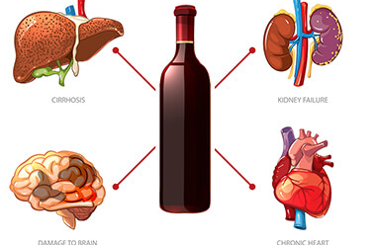
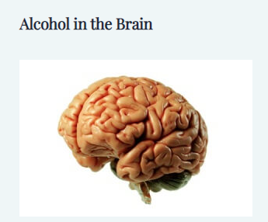
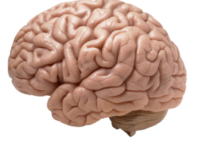
Alcohol's Effects on the Body:
Figure(2): Alcohol's Effects on the Body.
Alcohol swallowed by mouth to the stomach then a small amount pass by stomach wall to the blood stream. About 20 percent of the alcohol from a single drink moves directly to the blood vessels, while most alcohol through intestine and to blood circulation (to reach all over the body). Figure(2).
Blood alcohol concentration (BAC) refers to the amount of alcohol in your blood in relation to the amount of water in your blood. For example, if two people each have blood alcohol levels of 20 mg/dL, the alcohol will metabolize in about an hour in each person, but their BACs can be very different.
Numerous factors can affect Blood alcohol concentration BAC and how you react to alcohol, including:
Age Normal Brain
weight
drinking alcohol on an empty stomach
medications
liver disease
drinking many drinks in a short period of time.
Figure(3): Brain function.
1-The Effect Of Alcohol On Brain :
Alcohol reach the brain in a short time. interferes with the brain’s communication pathways, and can affect brain function, and who looks resulting in change mood and behavior, also reduce the brains ability for controlling body activates (speech, vision and harder to think clearly). Figure(3).

Slide 7
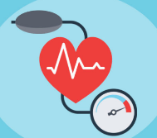
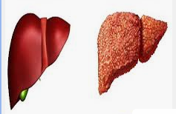
Alcohol's Effects on the Body:
2-The Effect Of Alcohol On Nervous system (CNS) :
Alcohol can disrupt the sympathetic nervous system which controls the constriction and dilation of blood vessels heavy drinking cause rising of blood pressure & damage nervous cells. High blood pressure can lead to many other health problems, including kidney & heart disease.
3-The Effect Of Alcohol On Heart :
Alcohol elevate the heart rate, and expanding of blood vessels. Heavy drinking, makes platelets more likely to clump together into blood clots, which lead to heart attack & doubled the risk of death.
4-The Effect Of Alcohol On Liver:
Normal liver function lead to cleans the blood, and helps digest food. It is a bodily superhero, it has the power to regenerate when it has been damaged, replacing old tissue with new cells. “Anything that keeps your liver from doing its job or from growing back after injury may put your life in danger”. Alcohol interferes with the liver‘s function, so the liver unable to break down fats creating fatty acids. Damaged liver result in Cirrhosis. Cirrhosis is a condition in which liver tissue is destroyed and then replaced with scarred tissue. (scarred that it is unable to function, no blood flow in scared area.) Most peoples die due to Cirrhosis are heavy drinkers. Figure(4).
Normal liver. Liver Cirrhosis
Figure(4): Liver conditions.

Slide 8
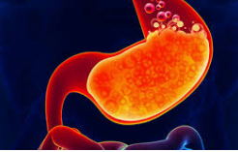
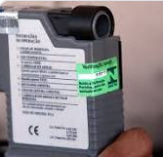
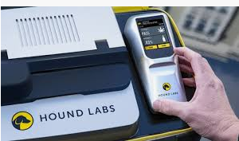
Symptoms of Cirrhosis :
-High blood pressure, and abdominal swelling.
-Jaundice yellowing skins and eyes.
-Destruction of the liver.
-IRREVERSIBLE.
5-The Effect Of Alcohol On Gastro intestinal tract(GIT) :
The gastrointestinal system is damaged by alcohol. Thus it is less able to absorb nutrients, which can lead to malnutrition. Because alcohol supplies calories, alcoholic drinks can be very fattening. Alcohol is absorbed so quickly that its energy is available almost immediately. This energy is burned first, so the body fuel that would normally be used for energy is stored as fat, Figure below
5-The Effect Of Alcohol On Immune System: Drinking too much can weaken your immune system, making your body a much easier target for disease.
Blood Alcohol Concentration(ABC):
Is the amount of alcohol in a person’s body is measured by the weight of the alcohol in a certain volume of blood. 8% is the legal driving limit.
The breathalyzer :
To test the amount of alcohol consumed, a sample of the patient’s breath releases it into an optical cavity figure(2) Breathalyzer. A near-infrared laser is used to calculate the concentration of alcohol. Figure(5).
The breathalyzer
Figure(5):The breathalyzer

Slide 9
References:
1- www.virtualsciencefair.org › public_html › process process - Virtual Science Fair.
2- Human Anatomy & Physiology: Help and Review / Science Courses Next Lesson What is Ethanol? - Formula, Structure & Uses
Chapter 2 / Lesson 8 Transcript | Additional Activities
3- Medically reviewed by Alan center, PharmD onMay9,2019 Written by James Ronald .
4- Medically reviewed by Timothy J. Legg, PhD, CRNP on May 23, 2017 — Written by Kristeen Cherney

