Slide 1
Protozoa

Slide 2
Lab.
Kinetoplastida 1. Leishmania donovani

Slide 3
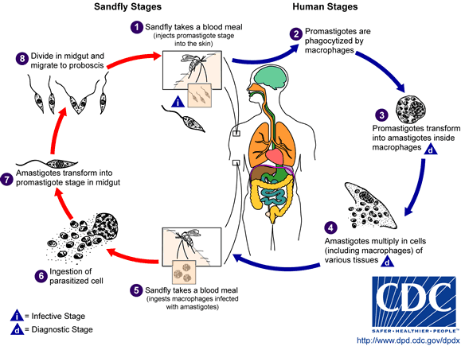
Leishmania as a group

Slide 4
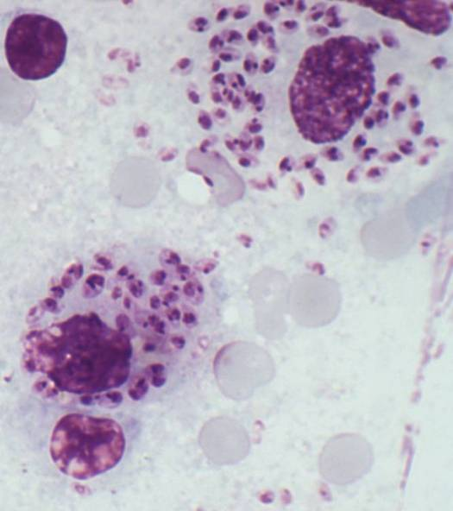
Kinetoplastida 1. Leishmania donovani A. Amastigote: parasite interacellular in macrophage (Mø); shape round-oval, size 3-4 µm; in burst Møs parasite usually ovoid, 4-6 µm long; nucleus red, kinetoplast red.
Amastigotes

Slide 5
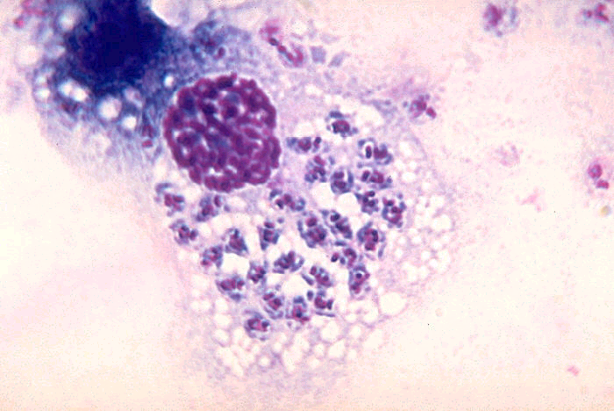
Kinetoplastida 1. Leishmania donovani A. Amastigote: parasite interacellular in macrophage (Mø); shape round-oval, size 3-4 µm; in burst Møs parasite usually ovoid, 4-6 µm long; nucleus red, kinetoplast red.

Slide 6
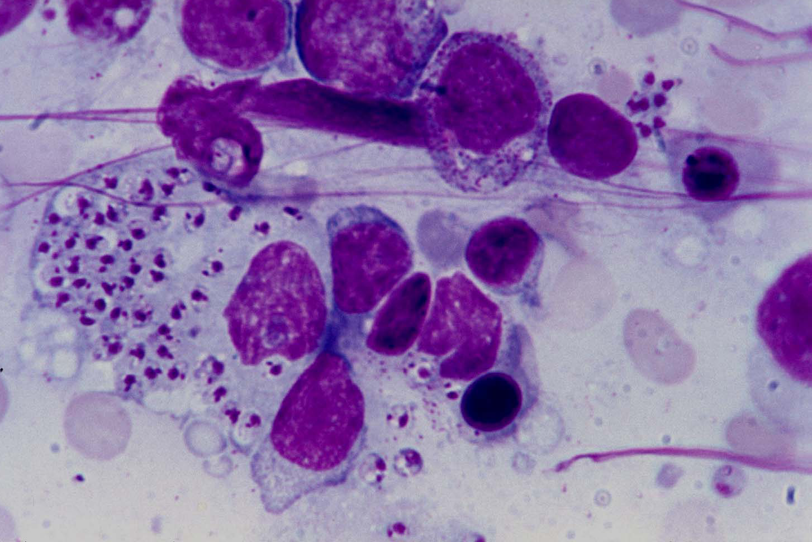

Slide 7
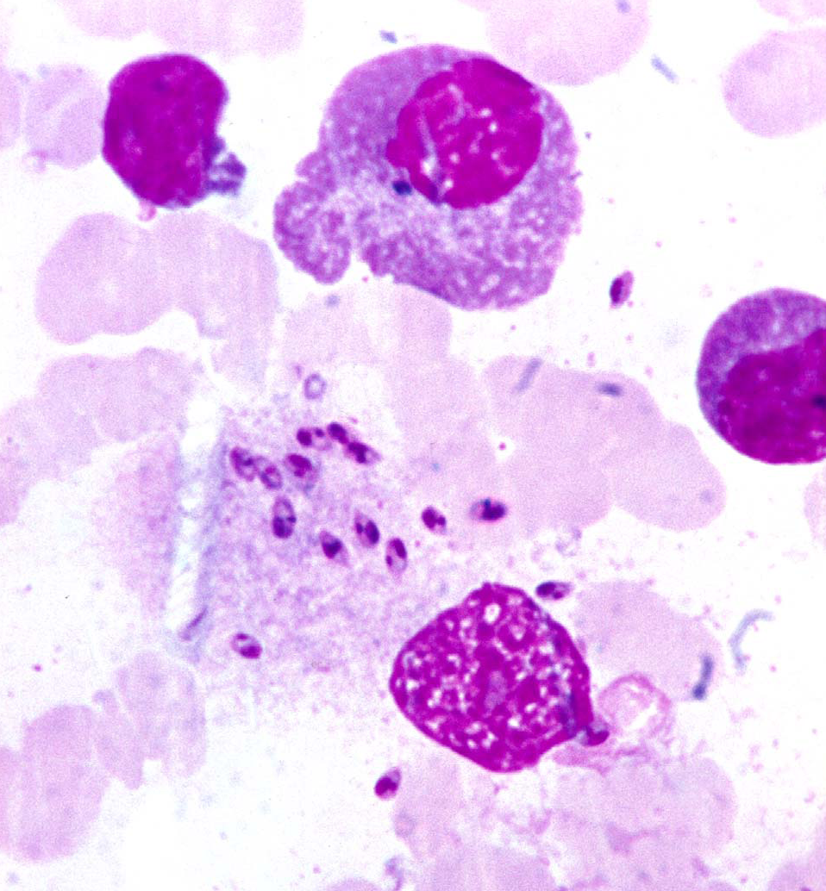

Slide 8
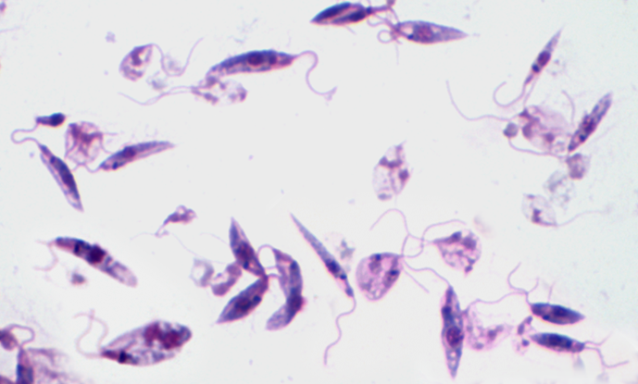
Leishmania donovani B. Promastigote: parasite extra-cell shape Spindale- like; nucleus red, central; kinetoplast red, anterior; flagellum anterior.
nucleus
Kinetoplast
Flagellum

Slide 9
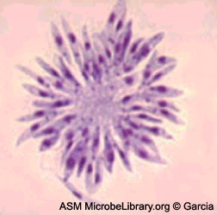
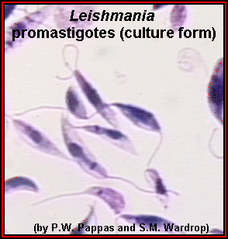

Slide 10
Kinetoplastida
2. Trypanosomes spp.

Slide 11
KINETOPLASTES
African trypanosomes
Trypanosoma gambiense
American trypanosome
Trypanosoma cruzi

Slide 12
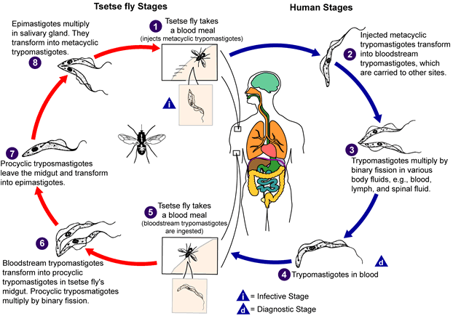

Slide 13
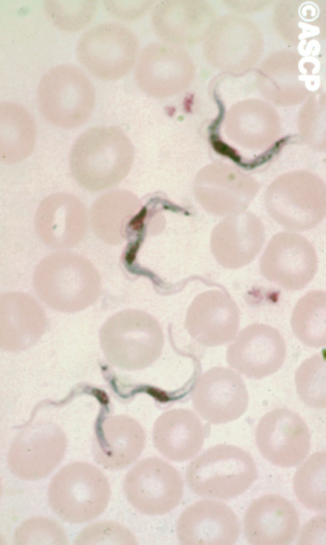
2. Trypanosoma gambiense A. Trypamastigote: parasite extra-cellular in blood stream; shape spindale-like, S-shaped; nucleus central; kinetoplast posterior; flagellum arising from posterior end, extending anteriorly along an undulating membrane.

Slide 14
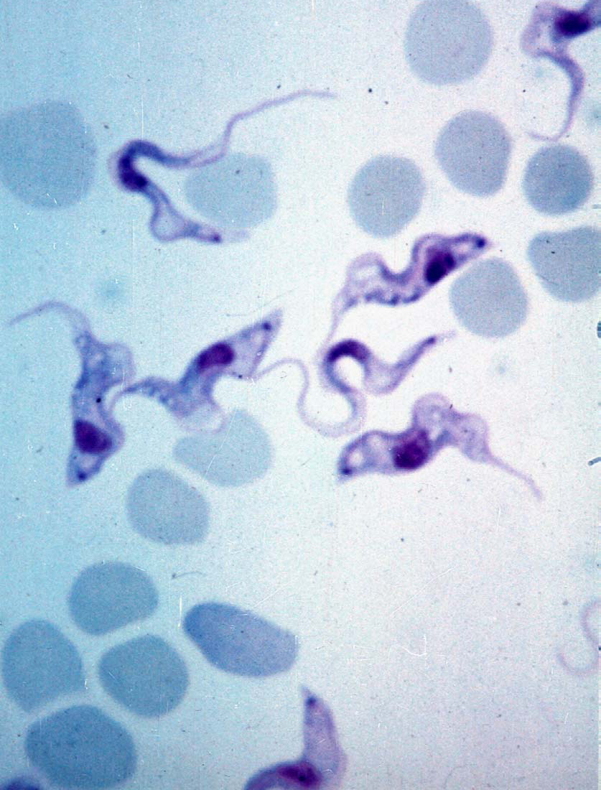

Slide 15
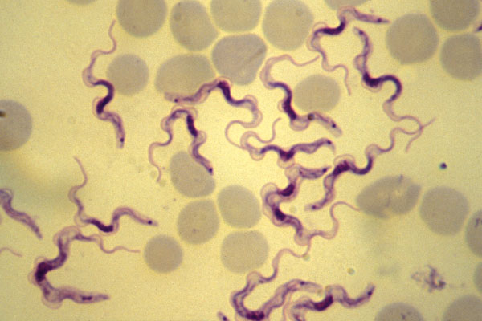

Slide 16
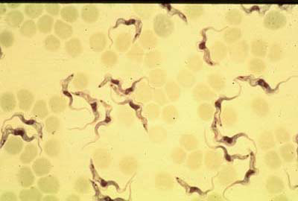

Slide 17
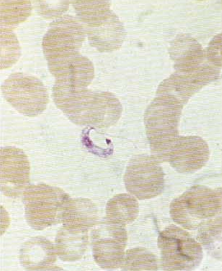
3. Trypanosoma cruzi a. trypamastigot: parasite extra-cellular in blood stream; shape spindale-like, C-shaped; nucleus central; kinetoplast posterior; large, dot-like; flagellum arising from posterior end, extending anteriorly along an undulating membrane.

Slide 18
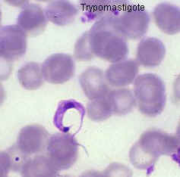

Slide 19
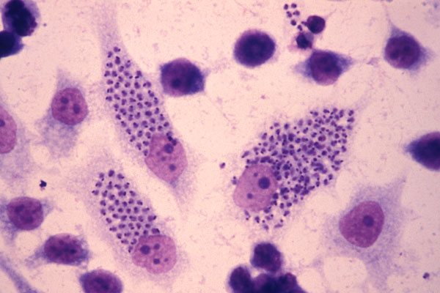
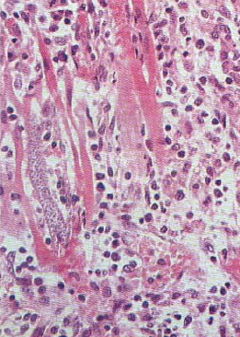
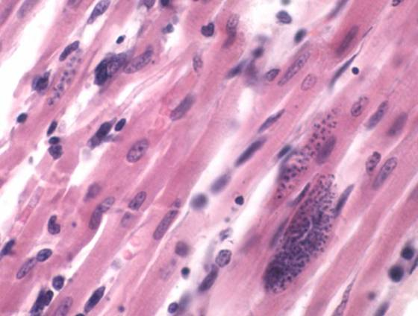
3. Trypanosoma cruzi b. amastigote: parasite intra-celllular; shape round –ovoid; nucleus central; kinetoplast marginal.

