Slide 1
Hair Diseases

Slide 2
Anatomy
The hair shaft is a dead protein.
It is composed of keratinized cells formed by the living hair matrix cells in the hair bulb.
There are 3 types of hair.
Terminal hairs: is thick and pigmented present on the top of the head, beard, axillary and pubic area. This type of hair is influenced by androgens.
Vellus hairs: is short, fine, relatively non-pigmented and covers much of the body. This type of hair is independent of androgens.
Lanugo hairs: is similar to vellus hair found on the fetus.

Slide 3
The Hair Growth Cycle
The anagen (growth): is the active growth phase of the hair. It lasts 2-6 years. About 90-95% of scalp hairs are in this phase.
The catagen (involution): is the phase of acute follicular regression that signals the end of anagen. Less than 1% of scalp hairs are in this 2-3 week period.
The telogen (rest): all activity ceases and the structure rests during this phase. About 5-10% of the scalp hairs are in this 2-3 month period.

Slide 4
The Hair Growth Cycle
Catagen
2-3 weeks
Telogen
2-3 months
Anagen
2-6 years

Slide 5
Alopecia
(Hair loss)
Non-scarring
Generalized
Telogen effluvium
Anagen effluvium
Moth-eaten alopecia
of secondary syphilis
Localized
Androgenic
alopecia in men
Alopecia areata
Trichotillomania
Traction alopecia
Scarring
Primary inflammatory
Infections
Traumatic
Neoplastic
Adrenal androgenic
female-pattern alopecia

Slide 6
Generalized hair loss (Diffuse hair loss)
Usually hair loss occurs without inflammation or scarring. The loss affects hairs throughout the scalp in a more or less uniform pattern.

Slide 7
Telogen effluvium
Is the premature termination of anagen phase and entrance into telogen phase. The causes are:
Acute blood loss.
Childbirth (Postpartum hair loss).
Drugs.
Heparin.
Propanolol.
Vitamin A.
Captopril.
High fever.
Hypothyroidism and hyperthyroidism.
Physical stress (e.g. surgery).
Physiologic (e.g. neonate).
Psychological stress.
Severe illnesses (e.g. SLE).

Slide 8
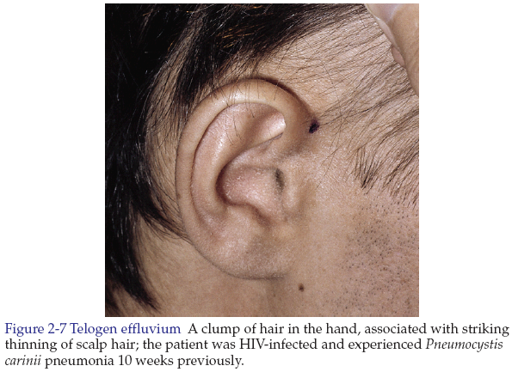

Slide 9
Anagen effluvium
It is the abrupt loss of hair from follicles that are in their growing phase.
The rapidly dividing cells of the matrix and cortex are affected by an insult.
The causes:
Cancer chemotherapeutic agents.
Poisoning by Thallium (rat poison), Arsenic.
Radiation therapy.

Slide 10
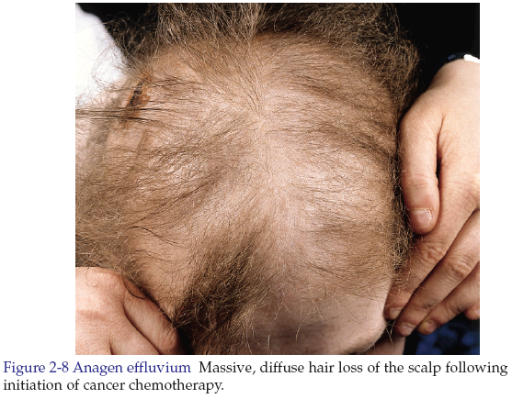

Slide 11
Features differentiating Telogen Effluvium and Anagen Effluvium
Clinical presentation | Telogen | Anagen
Onset of shedding after insult | 2-4 months | 1-4 weeks
Percent hair loss | 20-50 | 80-90
Type of hair lost | Normal club (white bulb) | Anagen hair (pigmented bulb)
Hair shaft | Normal | Narrowed or fractured

Slide 12
Localized hair loss

Slide 13
Androgenic Alopecia in Men (Male-pattern Baldness)
It is a physiologic reaction induced by androgens in genetically predisposed men (and some women).
The inheritance is polygenic.
Thinning of the hair begins between the ages of 12-40.
The baldness may affect the scalp in various patterns.
The terminal hairs are converted into vellus hairs in the androgen sensitive follicles.
The androgen independent follicles on the lateral and posterior scalp is not affected.

Slide 14
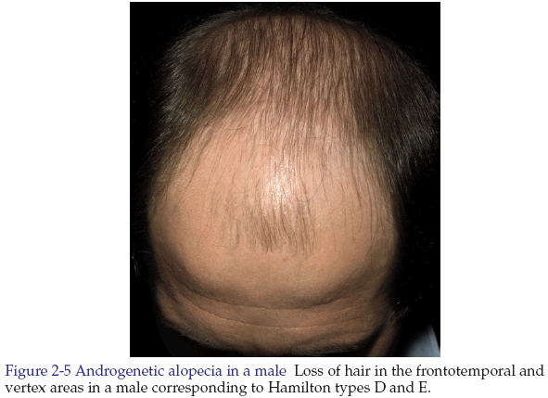

Slide 15
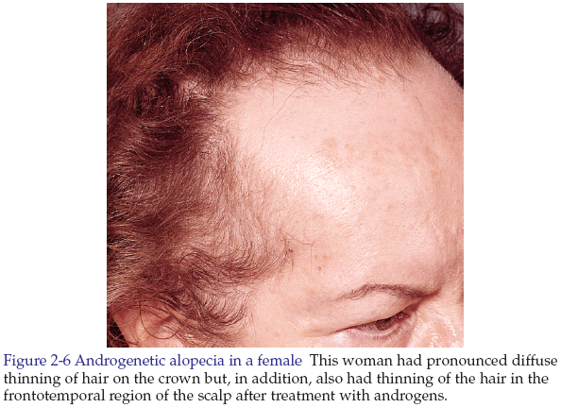

Slide 16
Treatment of male pattern baldness
Notes:
Benefits are seen 6-12 months.
Treatment must be continued indefinitely.
Treatment has no benefit for men who are bald without vellus hair.

Slide 17
Treatment options
Topical Minoxidil 2% or 5%. One milliliter is applied twice daily. Side effects are local irritation, itching, dryness, and erythema may occur due to vehicle of alcohol and propylene glycol.
Oral Finasteride (Propecia 1mg) taken daily. Side effect is transient sexual dysfunction. Contraindication is pregnancy.
Hair transplant: androgen independent hairs from the sides and back of the scalp is taken into the bald area.

Slide 18
Adrenal Androgenic Female-pattern Alopecia
There is gradual loss of hair on the central scalp, with retention of the normal hairline without fronto-temporal recession.
Some of these women have increased level of the serum adrenal androgen: dehydroepiandrosterone sulfate (DHEA-S).
Treatment: Topical Minoxidil 2% or 5%.

Slide 19
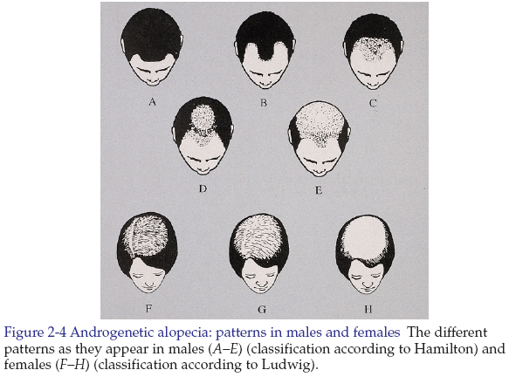

Slide 20
Alopecia areata
It is a common asymptomatic disease.
Characterized by rapid onset of total hair loss in a sharply defined, usually round area.
Any hair bearing surface may be affected.
The cause is unknown. May be an autoimmune disease mediated by T lymphocytes directed to hair follicles.

Slide 21
Alopecia areata is a partial loss of scalp hair, alopecia totalis is 100% loss of scalp hair, and alopecia universalis is 100% loss of the scalp and body hair (very rare).
The skin is smooth and white or may have short stubs (remains) of hair.
The involved hair that are often found retained at the periphery of a lesion have normal upper shaft and a narrowed base described as exclamation point hair.
Nail changes include nail dystrophy in 10-60% and nail pitting.

Slide 22
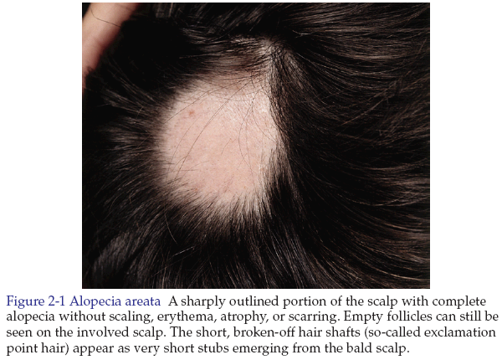

Slide 23
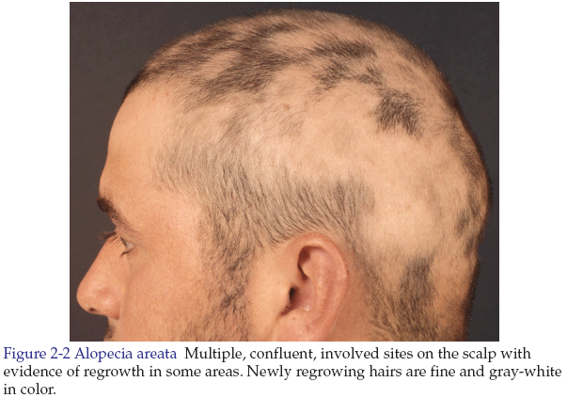

Slide 24
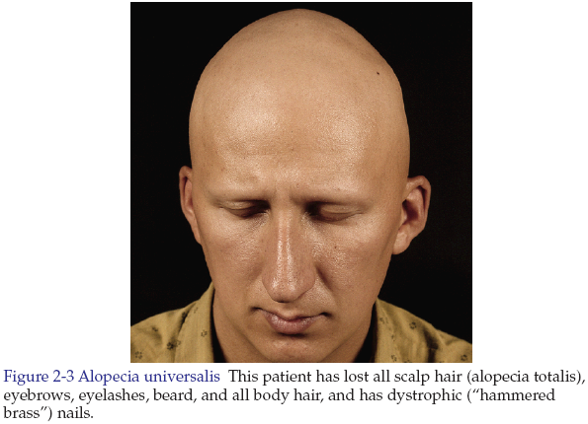

Slide 25
Prognosis
The prognosis is generally excellent; full remission is achieved spontaneously in 80%.
The bad prognostic points are:
Family history of alopecia areata.
Young age of onset.
Presence of immune diseases.
Nail dystrophy.
Atopy.
Extensive hair loss.

Slide 26
Differential diagnoses
Trichotillomania.
Telogen effluvium.
The moth-eaten alopecia of secondary syphilis.

Slide 27
Treatment
Reassurance.
Option 1: intralesional steroids (first choice for patient with less than 50% of scalp involvement).
The preferred compound is triamcinolone acetonide (10 mg/ml).
2.5 mg/ml is used for the beard and eyebrows.
Inject 0.1 ml or less into the mid-dermis at multiple sites 1 cm apart.
Do not raise wheal or inject into subcutaneous tissue.
Repeat every 4 to 6 weeks.
If atrophy of the skin occur, do not reinject affected site until atrophy resolves.
Topical anesthesia (lidocaine cream) may be used.

Slide 28
Option 2: topical minoxidil 5% solution.
Must be applied twice daily.
The maximal dose is 1 ml per application.
Spread solution with fingers.
Topical betamethasone enhances the efficacy of minoxidil solution. Applied 30 minutes after each use of minoxidil.

Slide 29
Trichotillomania
It is recurrent pulling out of hair, resulting in noticeable hair loss, in order to get pleasure, gratification, or relief.
The favorite site is the easily reached frontoparietal region of the scalp, but any scalp area may be involved, eyebrows or eyelashes.
Treatment: consider psychiatric support.

Slide 30
Traction (Cosmetic) alopecia
Prolonged tension created by certain hairstyles, hair rollers, and hot hair straightening combs may result in temporary or, rarely, permanent hair loss (if scarring occurs) in an area corresponding exactly to the stressed hair.

Slide 31
Scarring (Cicatricial) alopecia
Is permanent area of hair loss occur as a result of destruction of the hair follicles by any inflammatory process.
Causes:
Primary inflammatory:
Chronic cutaneous lupus erythematosus.
Lichen planopilaris.
Morphea.
Infections:
Bacterial: e.g. carbuncle/furuncle, tertiary syphilis.

Slide 32
Fungal: e.g. kerion, favus.
Viral: e.g. herpes zoster, varicella.
Protozoal: e.g. leishmaniasis.
Mycobacterial: e.g. tuberculosis.
Traumatic:
Accidental alopecia.
Burns.
Postoperative.
Radiodermatitis.
Neoplastic:
Basal cell carcinoma.
Squamous cell carcinoma.
Secondaries from anywhere.

Slide 33
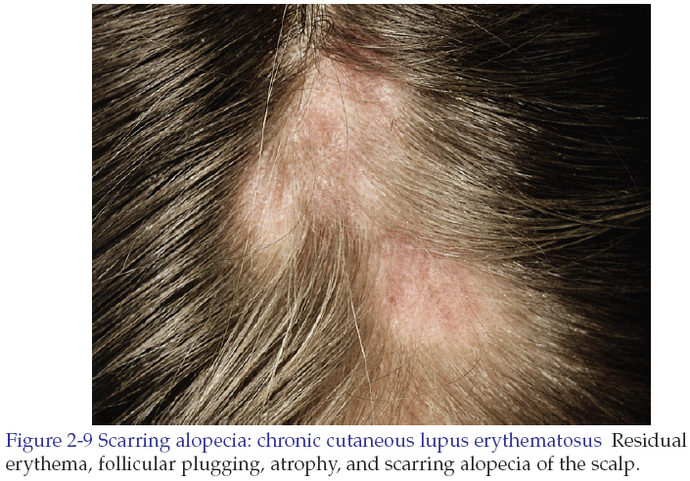

Slide 34
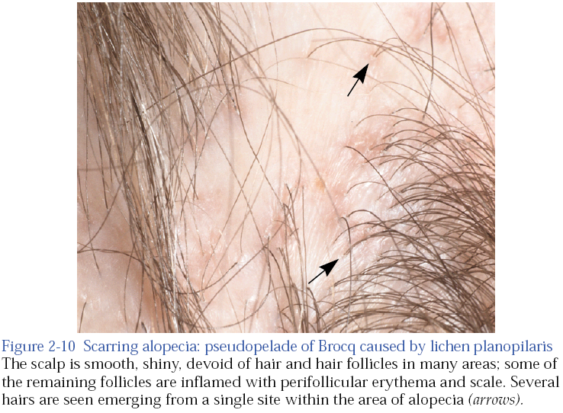

Slide 35
Hirsutism
Is the presence of terminal (thick, dark) hairs of male-like pattern in female such as on the face, chest, and areolae.
Hirsutism is usually benign and of cosmetic concern.
Virilization is the combination of hirsutism plus other signs of masculinization, such as deepening of the voice, frontotemporal balding, decrease in breast size, increased muscle mass, and heightened libido.

Slide 36
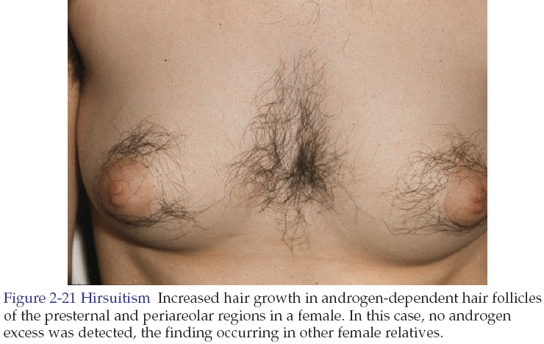

Slide 37
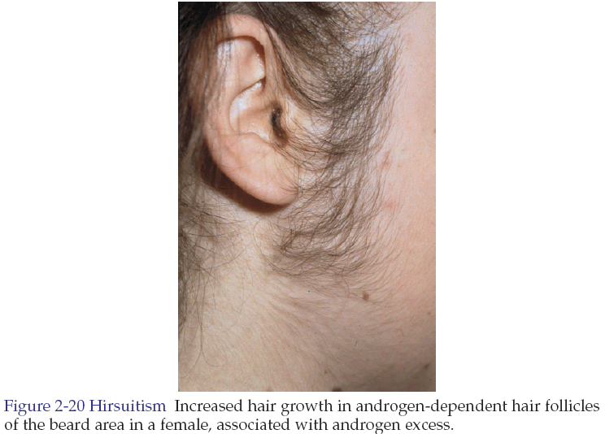

Slide 38
Causes of hirsutism
Hirsutism without virilization:
Idiopathic hirsutism in 20% of cases.
Genetic: polycystic ovary syndrome.
Physiologic: puberty, pregnancy, and menopause.
Endocrine: hypothyroidism, acromegaly.
Drugs: androgens, diazoxide, glucocorticoids.
Hirsutism with virilization:
Ovarian: polycystic ovary syndrome, tumors.
Adrenal: congenital adrenal hyperplasias.
Tumors.
ACTH-dependent cushing’s syndrome.

Slide 39
Treatment of hirsutism
Hirsutism cannot be cured, only suppressed.
Treatment begins after ovarian and adrenal diseases have been investigated.
Option 1: Combination Oral Contraceptives (COCs). The most effective COC is one with low androgenic progestin (e.g. Norgestimate) and moderate to high estrogen contents (Ethinyl estradiol). COCs is used for at least 12 cycles.

Slide 40
Option 2: androgen receptor blockers. Spironolactone 25-50 mg twice daily. Oral contraceptives may be taken with spironolactone.
Option 3: Finasteride (5α-reductase type 2 inhibitor, blocks the formation of DHT from testosterone) 5 mg (Proscar) daily. Oral contraceptives may be taken with finasteride.
Option 4: Electrolysis: is permanent follicular destruction with an electrical probe passed directly into the follicle.

Slide 41
Options 5: Laser and flash lamp technology. Lasers selectively destroy the hair follicles without damage to adjacent tissues by using the principle of selective photothermolysis. Hair removal is most successful in patients with lighter skin colors and dark-colored hairs.

Slide 42
Thanks with my best wishes

