Slide 1
Ped pneum. 2
Dr M AGZ

Slide 2
1.lung fields ( opacity , atelectasis, consolidation , nodules, vascularity )
2. pleura ( effusion , pneumothorax )
3. diaphragm (elevated ,double shadow , loss of definition )
4. major fissure in the RT lung
5. trachea position and hilum
6 costophrenic angle ( intact or obliterated )
7. Mediastinum ( central or shift ,widened )
8. position of the sternal ends of the clavicle in relation to the spine processes )

Slide 3
1. increase opacification of the lt lung mid and lower zone .
2.Moderate Lt pleural effusion .
3. loss of definition of the Lt hemidiaphragm ( due to associated pleural effusion )
4 . non symmetric hilum ( lt hilar enlargement and displaced upward LAP ??).
5 .obliterated LT costophrenic angle ( due to associated pleural effusion )
In conclusion LT. bronchopneumonia with hilar enlargement and pleural effusion

Slide 4
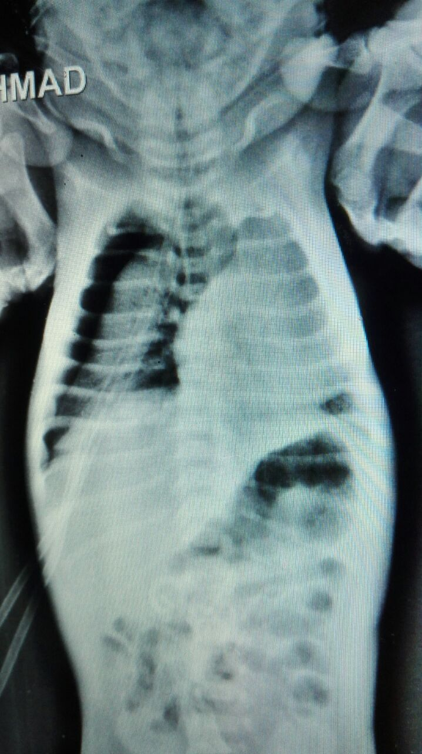
1.lung fields ( opacity , atelectasis, consolidation , nodules, vascularity )
2. pleura ( effusion , pneumothorax )
3. diaphragm (elevated ,double shadow , loss of definition )
4. major fissure in the RT lung
5. trachea position and hilum
6 costophrenic angle ( intact or obliterated )
7. Mediastinum ( central or shift , widened )
8. position of the sternal ends of the clavicle in relation to the spine processes )

Slide 5
1 collapsed RT lung (severe )
2. Rt sided tension pneumothorax
3. mediastinal shift to the Lt side
4. pediatric oxygen mask

Slide 6
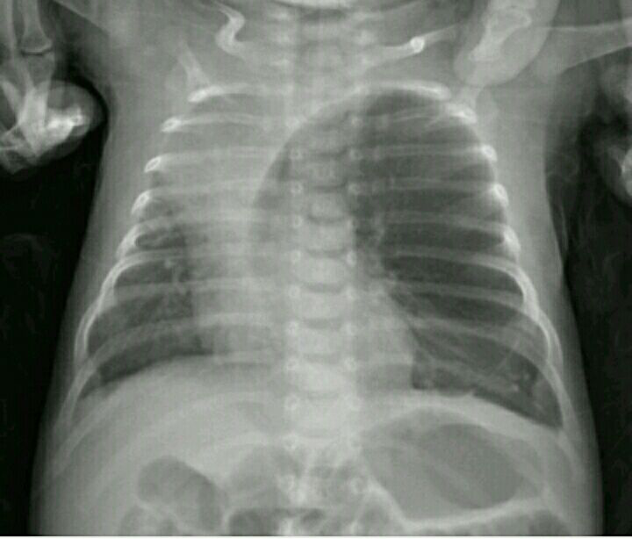
1.lung fields ( opacity , atelectasis, consolidation , nodules, vascularity )
2. pleura ( effusion , pneumothorax )
3. diaphragm (elevated ,double shadow , loss of definition )
4. transverse major fissure 0f the RT lung
5. trachea position
6 costophrenic angle ( intact or obliterated )
7. Mediastinum ( central or shift ,widened )
8. position of the sternal ends of the clavicle in relation to the spine processes )

Slide 7
1 right upper lobe collapse consolidation with compensatory hyper inflated LT lung herniating to the RT side.
2. elevated rt hemidiaphragm
3.Upwared displaced transverse fissure due to collapsed upper lobe
4. trachea shifted to the Rt side
5 .mediastinal shift to the Rt side

Slide 8
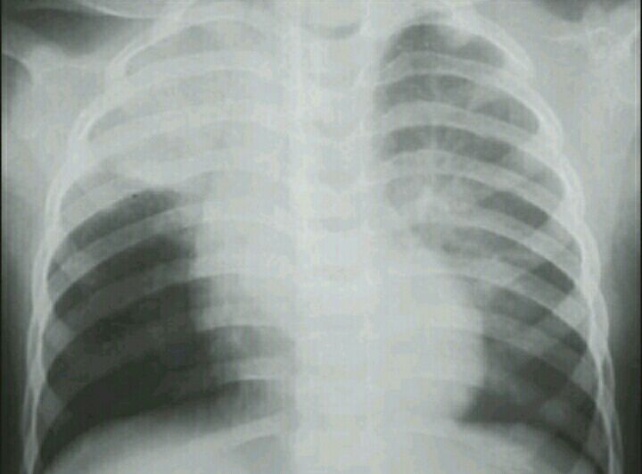
1.lung fields ( opacity , atelectasis, consolidation , nodules, vascularity )
2. pleura ( effusion , pneumothorax )
3. diaphragm (elevated ,double shadow , loss of definition )
4. transverse major fissure 0f the RT lung
5. trachea position
6 costophrenic angle ( intact or obliterated )
7. Mediastinum ( central or shift ,widened )
8. position of the sternal ends of the clavicle in relation to the spine processes )

Slide 9
Right upper lobe consolidation suggesting RT upper lobe pneumonia

Slide 10
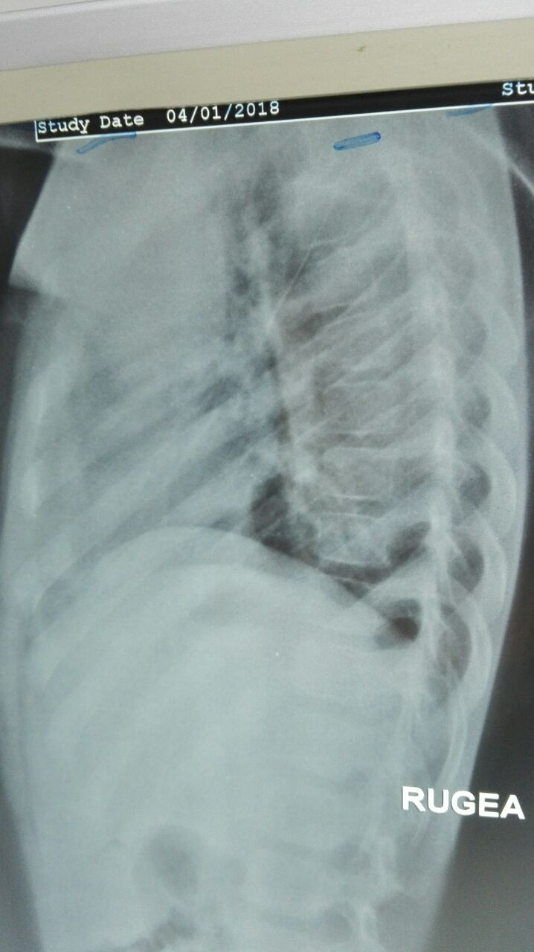
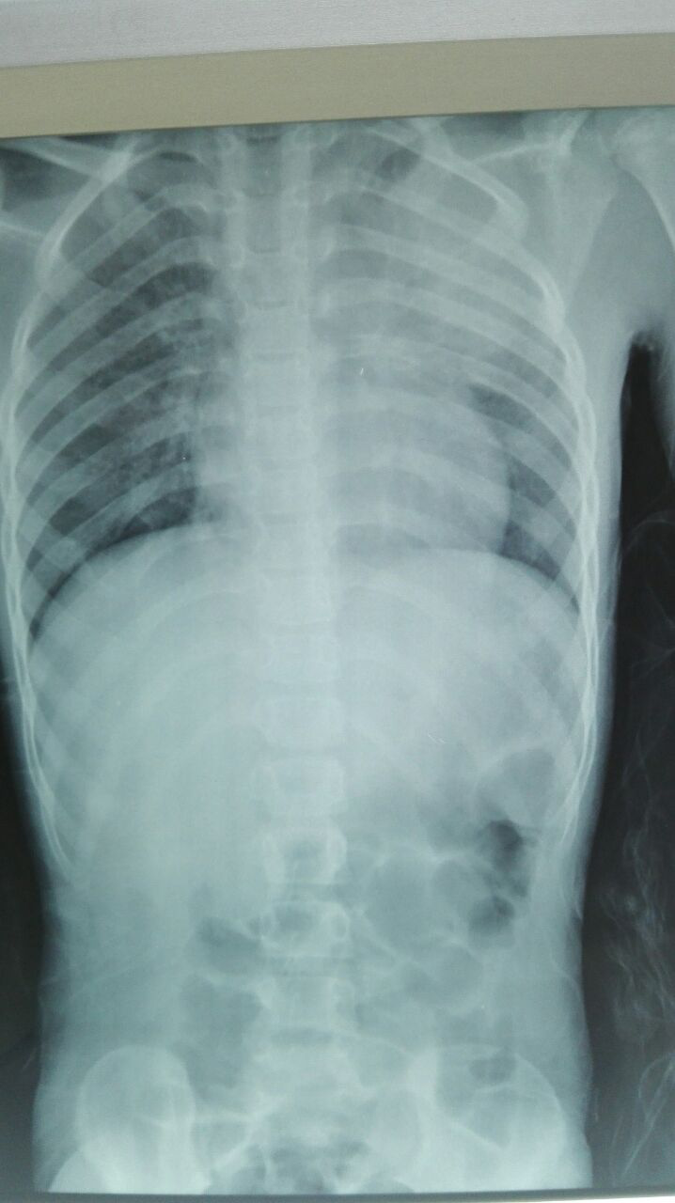
1.lung fields ( opacity , atelectasis, consolidation , nodules, vascularity )
2. pleura ( effusion , pneumothorax )
3. diaphragm (elevated ,double shadow , loss of definition )
4. transverse major fissure 0f the RT lung
5. trachea position
6 costophrenic angle ( intact or obliterated )
7. Mediastinum ( central or shift ,widened )
8. position of the sternal ends of the clavicle in relation to the spine processes )

Slide 11
Left sided upper lobe consolidating pneumonia

Slide 12
thanks

Slide 13
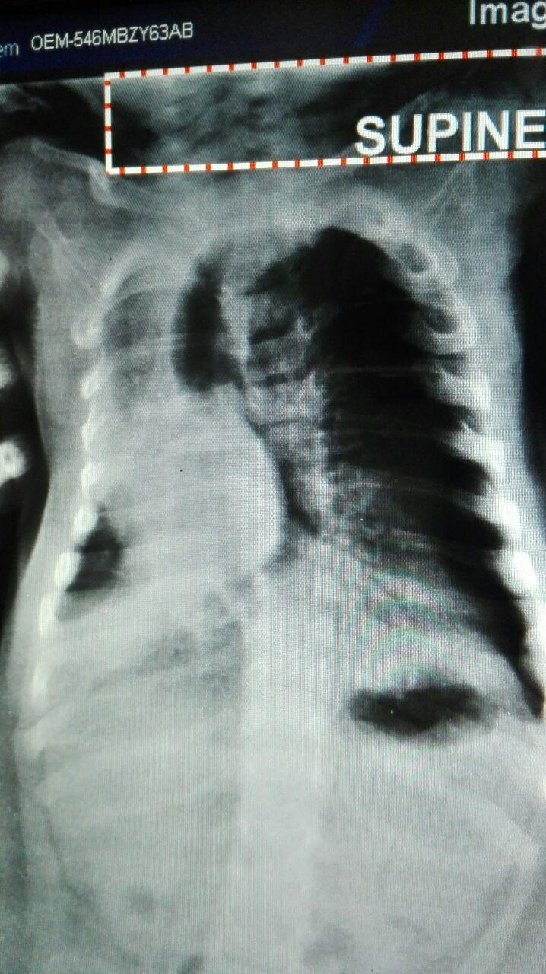
Tow months old baby presented with difficult breathing ,and fever , describe CXR finding and give a provisional DX enumerate findings according to red labeling .
1.lung fields ( opacity , atelectasis, consolidation , nodules, vascularity )
2. pleura ( effusion , pneumothorax )
3. diaphragm (elevated ,double shadow , loss of definition , depressed )
4. transverse major fissure 0f the RT lung
5. trachea position
6 costophrenic angle ( intact or obliterated )
7. Mediastinum ( central or shift ,widened )
8. position of the sternal ends of the clavicle in relation to the spine processes )

