Slide 1
Haemopoiesis MSC
Ass.prof. Abeer Anwer Ahmed

Slide 2
Hemopoiesis: the process of production of new blood cells (RBC, WBC, Plt) from the stem cells
Erythropoiesis: the process of new RBC production.
Hemopoiesis starts in the yolk sac.
After the 12th week of gestation, the liver & spleen become the main sites.
The bone marrow becomes active from week 20 onwards & it is the only site in the postnatal life.
During the first 3 years of life active bone marrow is found in all bones. Later; the active (red) marrow will be replaced gradually by yellow (fatty) marrow.
o in adults, the red marrow is confined to the axial skeleton: sternum, ribs, cranium, vertebrae & pelvis. However, increased demand will result in expansion of the red marrow into the yellow marrow & to extramedullary sites (liver & spleen).

Slide 3
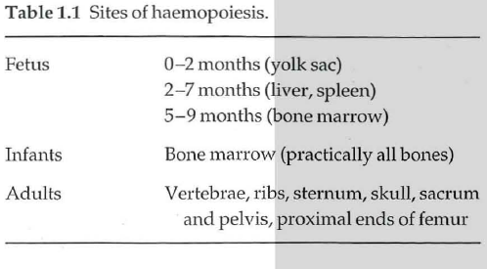

Slide 4
Haemopoietic stem and progenitor cells
Haemopoiesis starts with a pluripotential stem
cell that can give rise to the separate cell lineages
This haemopoietic stem cell is rare, perhaps 1 in
every 20 million nucleated cells in bone marrow.
Although its exact phenotype is unknown, on
immunological testing it is CD34+ CD38- and has
the appearance of a small or medium-sized lymphocyte
Cell differentiation occurs from the stem cell via the committed haemopoietic progenitors which are restricted in their developmental potential

Slide 5
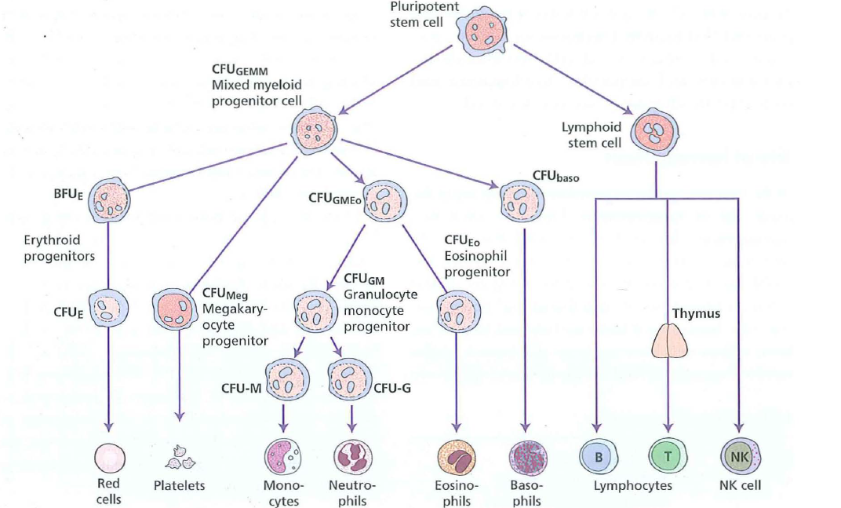

Slide 6
Bone marrow stroma
The bone marrow forms a suitable environment for stem cell survival, growth and development.
It is composed of stromal cells and a microvascular network
The stromal cells include :
adipocytes,
Fibroblasts
endothelial cells
macrophages
they secrete extraceliular molecules such as :
collagen,
glycoproteins (fibronectin and thrombospondin)
and glycosaminoglycans (hyaluronic acid and
chondroitin derivatives)
to form an extracellular matrix.
In addition, stromal cells secrete
Several growth factors necessary for stem cell survival.

Slide 7
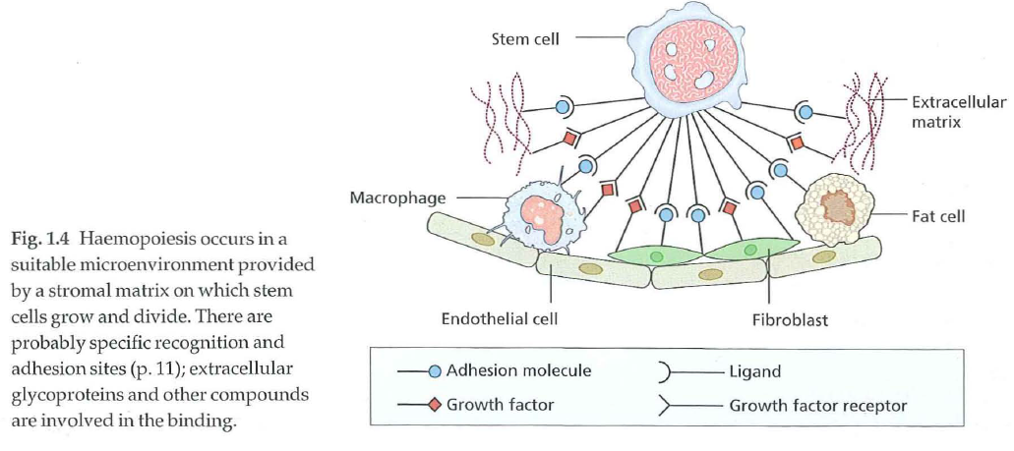

Slide 8
Mesenchymal stem cells are thought to be critical
in stromal cell formation.
Stem cells are able to traffic around the body and
are found in peripheral blood in low numbers.
In order to exit the bone marrow, cells must cross
the blood vessel endothelium and this process of
mobilization is enhanced by administration of
cytokines such as granulocyte colony-stimulating factor (G-CSF) or granulocyte-macrophage colony stimulating
factor (GM-CSF)
The reverse process of stem cell homing appears to depend on a chemokine gradient in which the stromal derived
factor (SDF-l) is critical.

Slide 9
Several interactions maintain stem cell viability and production in the stroma including stem cell factor
(SCF) and Jagged proteins expressed on stroma and
their respective receptors c-Kit and Notch expressed
on stem cell.
Stem cell plasticity
There is some evidence that adult stem cells in
different organs are pluripotent and can generate
various types of tissue
Studies in patients and animals who have received haemopoietic stem cell transplants have suggested that donor cells may contribute to tissues such as neurons,
liver and muscle.

Slide 10
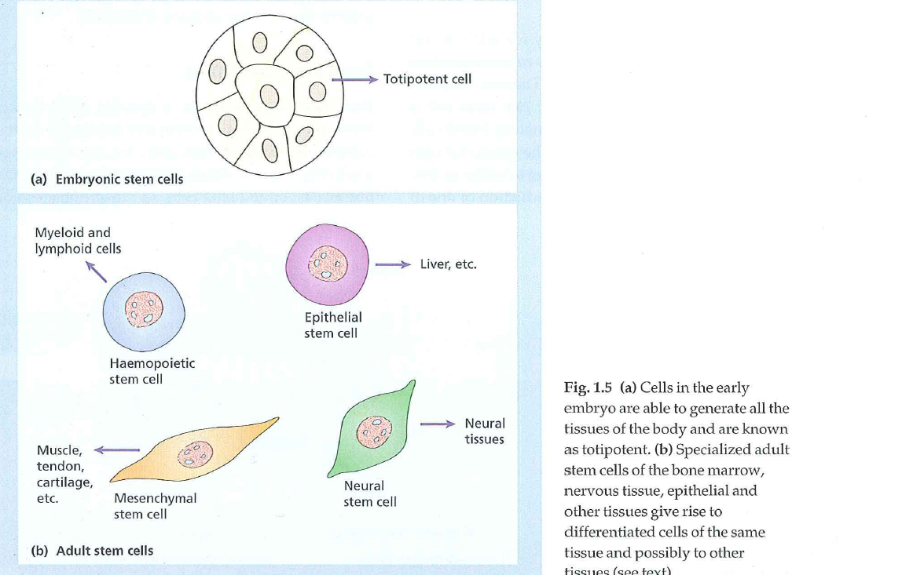

Slide 11
The regulation of haemopoiesis
Haemopoiesis starts with stem cell division in
which one cell replaces the stem cell (self-renewal)
and the other is committed to differentiation.
These early committed progenitors express low levels of
transcription factors that may commit them to discrete
cell lineages.
Which cell lineage is selected for differentiation may depend both on chance and on the external signals received by progenitor cells.
Several transcription factors that regulate differentiation:
PU.1 commits cells to the myeloid lineage
GATA-1 has an essential role in erythropoietic and megakaryocytic differentiation.

Slide 12
Haemopoietic growth factors
The haemopoietic growth factors are glycoprotein
hormones that regulate the proliferation and differentiation of haemopoietic progenitor cells and the function of mature blood cells.
They may act locally at the site where they are produced by cell-cell contact or circulate in plasma.
They also bind to the extracellular matrix to form niches to which stem and progenitor cells adhere.
The growth factors may cause cell proliferation but can also stimulate differentiation, maturation, prevent apoptosis and affect the function of mature cells

Slide 13
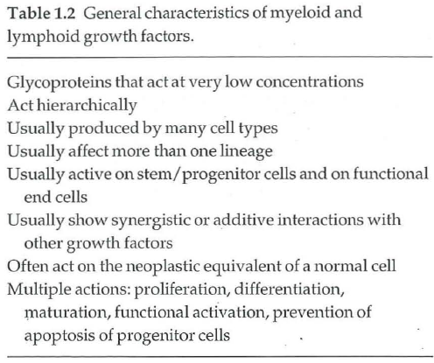

Slide 14
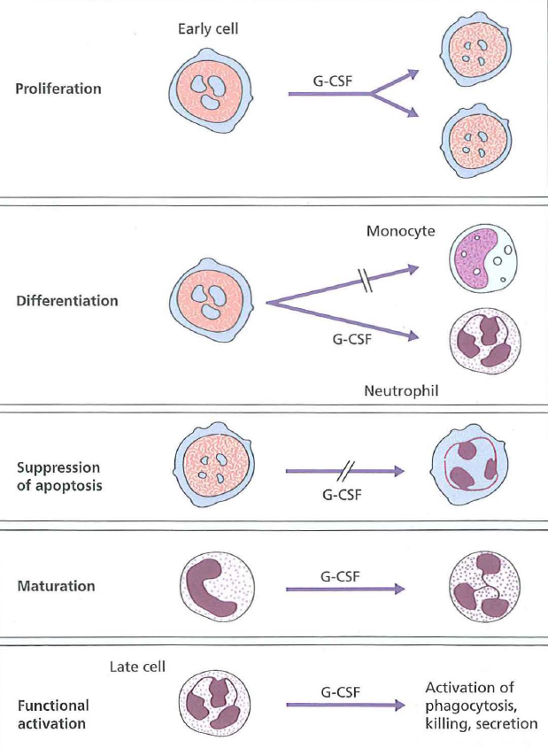

Slide 15
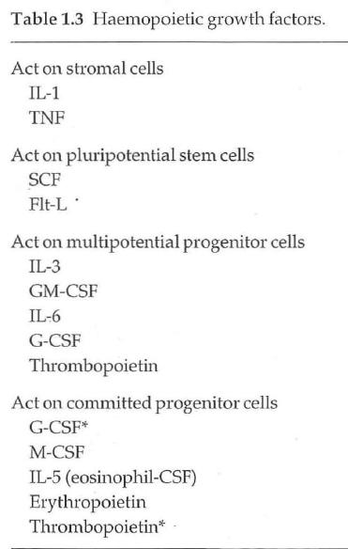

Slide 16
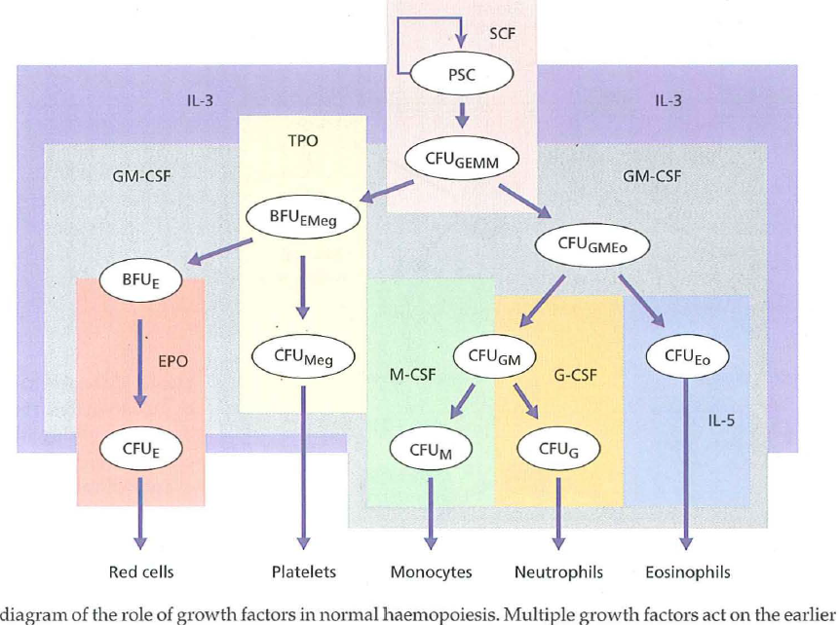

Slide 17
The biological effects of growth factors are mediated
through specific receptors on target cells.
Many receptors (e.g. erythropoietin (epa) receptor (R), GMCSF-
R) are from the haematopoietin receptor superfamily
which dimerize after binding their ligand.
Dimerization of the receptor leads to activation of a complex series of intracellular signal transduction pathways of which the three major ones are :
JAK (The Janus associated kinase) /STAT(signal transducer
and activator of transcription)
mitogen activated protein (MAP) kinase
the phosphatidylinositol 3 (PI3) kinase pathways .

Slide 18
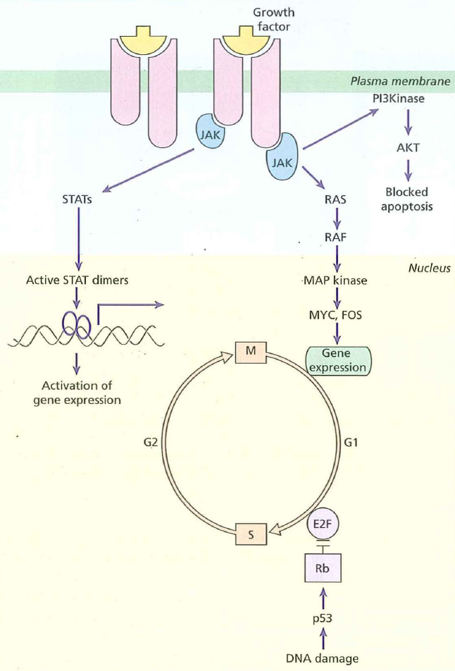

Slide 19
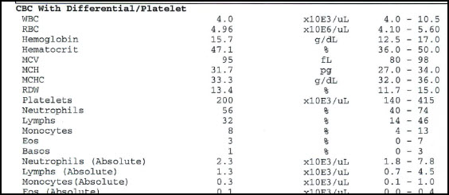
Full Blood Count:
This term refers to a group of tests that performed simultaneously on a blood sample to assess whether there is any hematological abnormality.

Slide 20
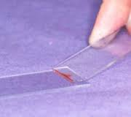
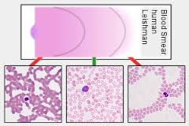

Slide 22
erythropoiesis
the first recognizable erythrocyte precursor in
the bone marrow, the pronormoblast.
The pronormoblast is a large cell with dark blue cytoplasm,
a central nucleus with nucleoli and slightly clumped
chromatin
It gives rise to a series of progressively
smaller normoblasts by a number of cell divisions.
They also contain progressively more haemoglobin (which stains pink) in the cytoplasm; the cytoplasm stains paler blue as it loses its
RNA and protein synthetic apparatus while nuclear chromatin
becomes more condensed

Slide 23
The nucleus is finally extruded from the late normoblast within the marrow
and a reticulocyte results, which still contains some ribosomal RNA and is still able to synthesize haemoglobin
This cell is slightly larger than a mature red cell, and circulates in the peripheral blood for 1–2 days before maturing,

Slide 24
A completely pink‐staining mature
erythrocyte results which is a non‐nucleated biconcave disc.
One pronormoblast usually gives rise to 16 mature red cells
Nucleated red cells (normoblasts) are not present
in normal human peripheral blood
They appear in
the blood if erythropoiesis is occurring outside the marrow
(extramedullary erythropoiesis) and also with some marrow
diseases.

Slide 28
Erythropoietin
Erythropoiesis is regulated by the hormone erythropoietin.
Erythropoietin is a heavily glycosylated polypeptide.
Normally, 90% of the hormone is produced in the peritubular interstitial cells of the kidney and 10% in the liver and elsewhere.
There are no preformed stores and the stimulus to erythropoietin production is the oxygen (O2) tension in the tissues of the kidney

Slide 29
Hypoxia induces synthesis of hypoxiainducible
factors (HIF‐1α and β), which stimulate erythropoietin
production and also new vessel formation and transferrin
receptor synthesis, and reduces hepcidin synthesis, increasing iron absorption.
Von Hippel‐Lindau (VHL) protein breaks
down HIFs and PHD2 hydroxylates HIF‐1α allowing VHL
binding
Abnormalities in these proteins may cause
polycythaemia

Slide 30
Erythropoietin production therefore increases in anaemia,
and also when haemoglobin for some metabolic or structural reason is unable to give up O2 normally,
when atmospheric O2 is low or when defective cardiac or pulmonary function
or damage to the renal circulation affects O2 delivery to the kidney

Slide 31
Conversely, increased O2 supply to the tissues (because of
an increased red cell mass or because haemoglobin is able to
release its O2 more readily than normal) reduces the erythropoietin
drive. Plasma erythropoietin levels can be valuable in
clinical diagnosis. They are high in anaemia unless this is due to
renal failure and if a tumour secreting erythropoietin is present,
but low in severe renal disease or polycythaemia vera

Slide 33
Haemoglobin synthesis
The main function of red cells is to carry O2 to the tissues and
to return carbon dioxide (CO2) from the tissues to the lungs.
In order to achieve this gaseous exchange they contain the specialized
protein haemoglobin.
Each molecule of normal adult haemoglobin
A (Hb A) (the dominant haemoglobin in blood after the
age of 3–6 months) consists of four polypeptide chains, α2β2, each
with its own haem group.
Normal adult blood also contains small
quantities of two other haemoglobins: Hb F and Hb A2. These
also contain α chains, but with γ and δ chains, respectively, instead
of β

Slide 36
Haem synthesis
occurs largely in the mitochondria by a
series of biochemical reactions commencing with the condensation of glycine and succinyl coenzyme A under the action
of the key rate‐limiting enzyme δ‐aminolaevulinic acid (ALA) synthase
Pyridoxal phosphate (vitamin B6) is a coenzyme
for this reaction.
Ultimately, protoporphyrin combines
with iron in the ferrous (Fe2+) state to form haem

Slide 38
A tetramer of four globin chains each with its own haem group
in a ‘pocket’ is then formed to make up a haemoglobin molecule

Slide 39
Haemoglobin function
The red cells in systemic arterial blood carry O2 from the lungs to the tissues and return in venous blood with CO2 to
the lungs.
As the haemoglobin molecule loads and unloads O2 the individual globin chains move on each other

Slide 41
The α1β1 and α2β2 contacts stabilize the molecule
When O2 is unloaded the β chains are pulled apart, permitting entry of the metabolite 2,3‐diphosphoglycerate
(2,3‐DPG) resulting in a lower affinity of the molecule for O2.
This movement is responsible for the sigmoid form of the haemoglobin O2 dissociation curve

Slide 42
The P50
(i.e. the partial pressure of O2 at which haemoglobin is half saturated with O2)
of normal blood is 26.6 mmHg.
With increased affinity for O2, the curve shifts to the left (i.e.the P50 falls)
while with decreased affinity for O2, the curve shifts to the right (i.e. the P50 rises).

Slide 43
Normally, in vivo, O2 exchange
operates between 95% saturation (arterial blood)
with a mean arterial O2 tension of 95 mmHg
and 70% saturation (venous blood)
with a mean venous O2 tension of 40 mmHg

Slide 44
The normal position of the curve depends on the concentration of 2,3‐DPG,
H+ ions
and CO2 in the red cell
and on the structure of the haemoglobin molecule.
High
concentrations of 2,3‐DPG, H+ or CO2, and the presence
of sickle haemoglobin (Hb S), shift the curve to the right
(oxygen is given up more easily) .
whereas fetal haemoglobin (Hb F) – which is unable to bind 2,3‐DPG – and certainrare abnormal haemoglobins associated with polycythaemia
shift the curve to the left because they give up O2 less readily
than normal.

