Slide 1
Basic anatomical structures
Al-Mustansiriyah university
College of medicine
Dept. of Human Anatomy
Skin, Fascia & Muscles
Objectives:
Identify the skin layers and their clinico-anatomical importance
Define fascia and differentiate its types & functions
Identify the types of muscles and how they function

Slide 2
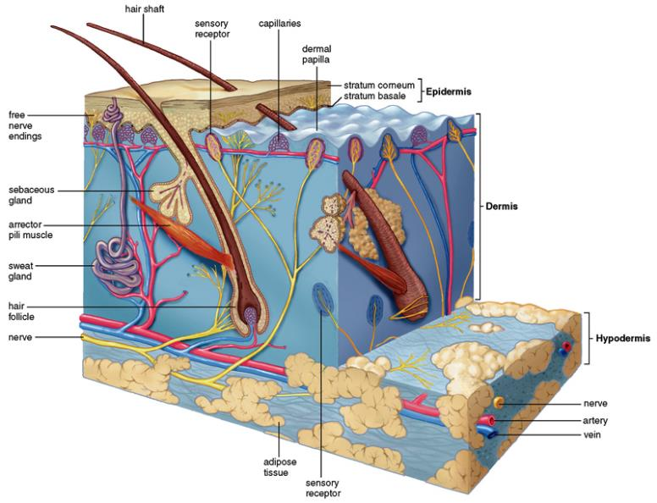
The skin

Slide 3
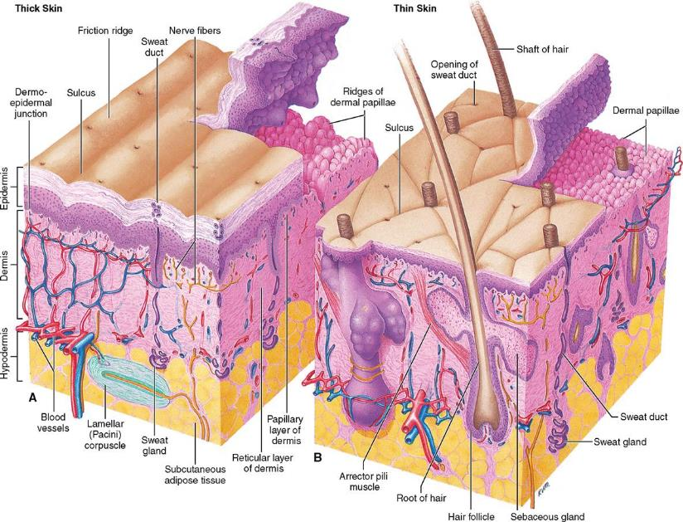
Thin vs Thick skin

Slide 4
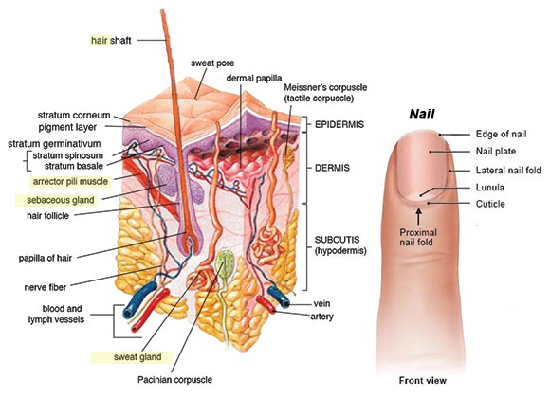
Epidermal appendages

Slide 5
Skin wrinkles / Creases

Slide 6
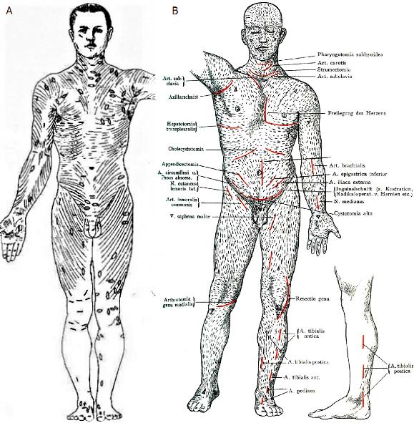
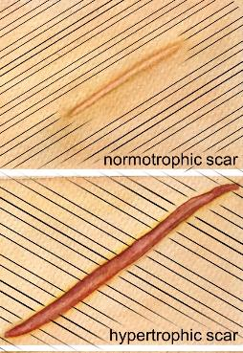
Tension lines of langer’s

Slide 7
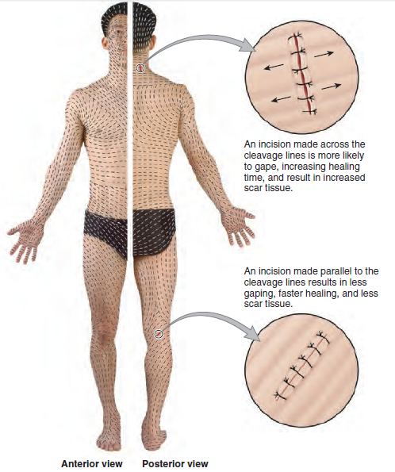
Tension lines

Slide 8
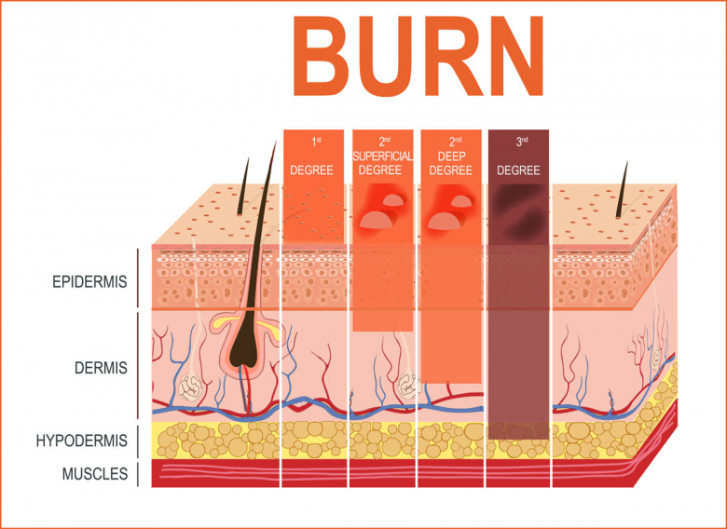
BURN DEGREES

Slide 9
FASCIA
Deep
(C.T.)
Periosteum
(bone)
Sheath
(blood vessels & nerves)
Superficial
Fatty T. all over the body
Epimysium
Septa
(muscles)
Epineurium
(nerve)

Slide 10
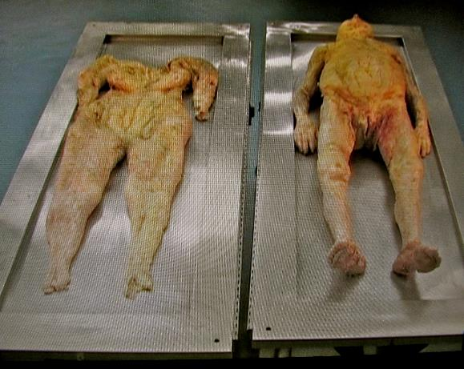
Superficial fascia
Contains:
Superficial veins & lymphatics
Cutaneous nerves & arteries
Occasionally, skeletal muscle

Slide 11
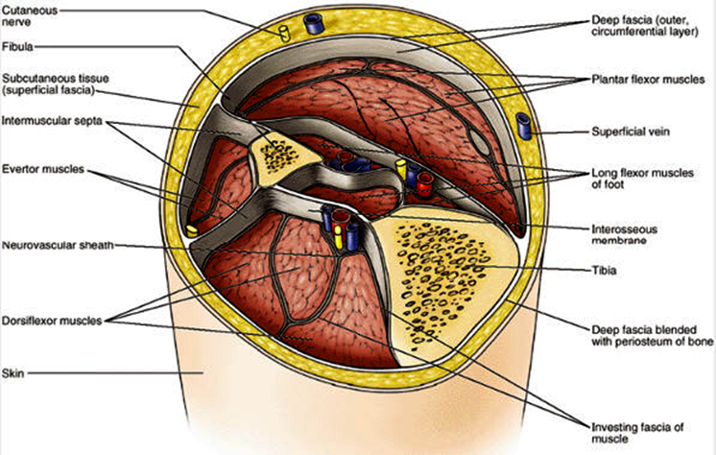
deep fascia

Slide 13
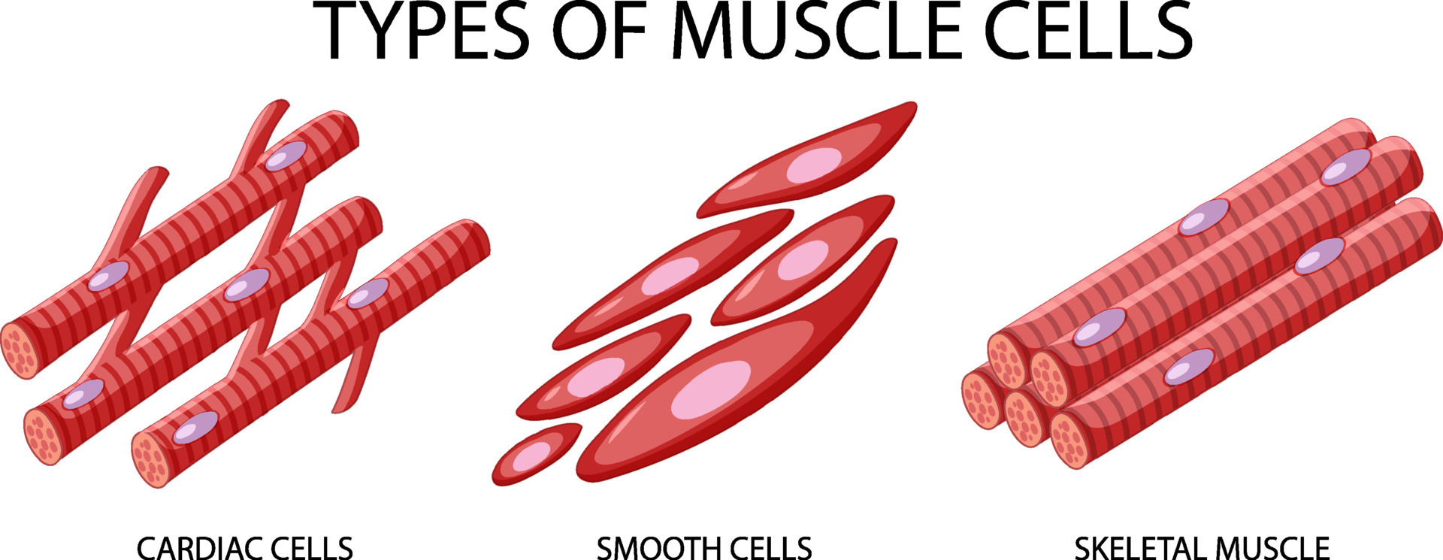

Slide 14
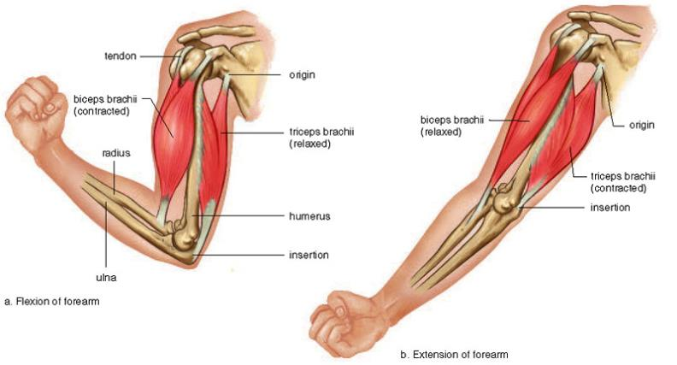
Skeletal muscle parts
From origin & insertion → Action (function)

Slide 15
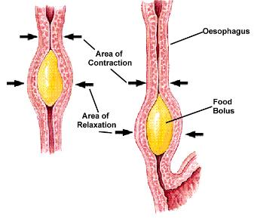
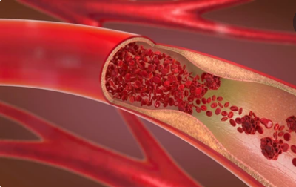
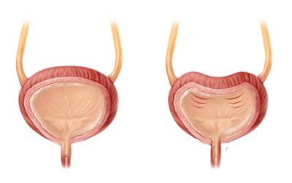
Smooth muscles
1. Tubes (Pulse / Peristalsis)
2. Hollow organs
(Evacuation)

Slide 16
Thank you

