Slide 1
Elbow joint & cubital fossa :
Al-Mustansiriyah university
College of medicine
Dept. of human anatomy
Dr. ahmed almusawi
Objectives:
Take a general knowledge about bones of elbow joint
Identify articulations in elbow joint
Study synovial membrane and joint capsule
Take a short notes about carrying angle and anastomosis around elbow
Summarize the movements of the joint
Define the cubital fossa and its contents
Gray’s anatomy for students pp: 753-760

Slide 2
Distal end of humerus

Slide 3
Proximal end of radius

Slide 4
Proximal ulna

Slide 5
Elbow joint

Slide 6
The synovial membrane

Slide 7
the joint capsule

Slide 8
The carrying angle of the elbow

Slide 9
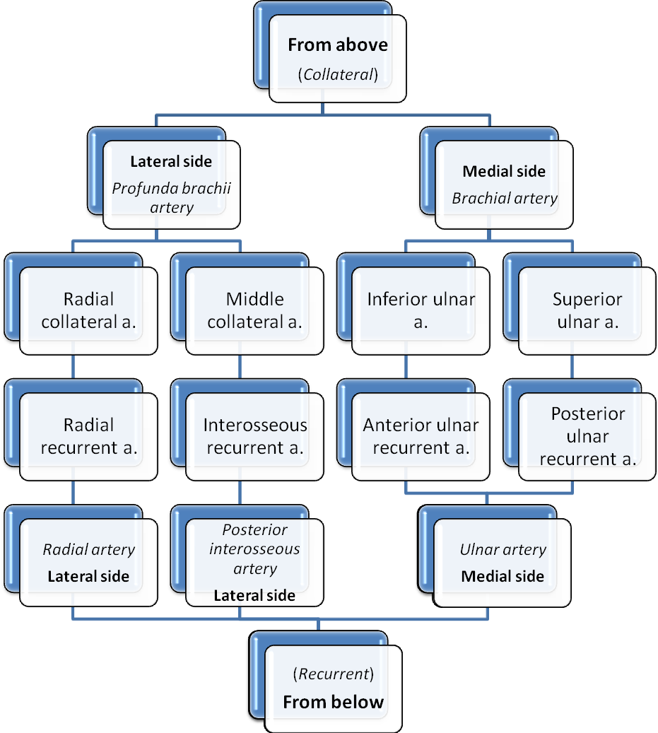
anastomosis around the elbow

Slide 10
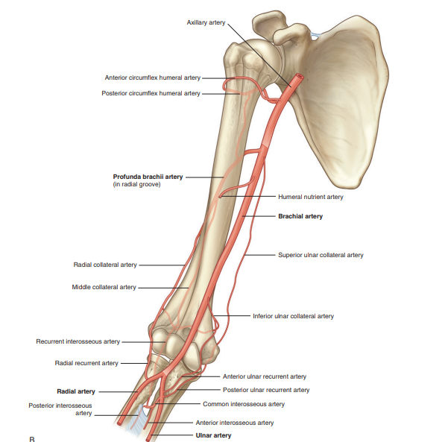

Slide 11
CUBITAL FOSSA

Slide 12
contents of the cubital fossa

Slide 13
Thank you

