Slide 1
An introduction to anatomy part 1: Anatomical terminology Objectives: - Understand the terms used in anatomical & medical studies (how and when to use them)
Al-Mustansiriyah university
College of medicine
Dept. of anatomy, Histology & embryology
Assist. Prof. Dr. Sameh Sameer Akkila
Supplementary text provided
Gray’s anatomy for students 4th edition pp.2-4

Slide 2
THE DEFINITION OF ANATOMY
Anatomy
Greek=to cut up, or dissect
The science that deals with the structures of the body
Kinds:
Gross Anatomy (Systematic, Regional)
Microscopic Anatomy (Cytology, Histology)
Developmental Anatomy (Embryology)
Comparative Anatomy
Describes & Relates

Slide 3
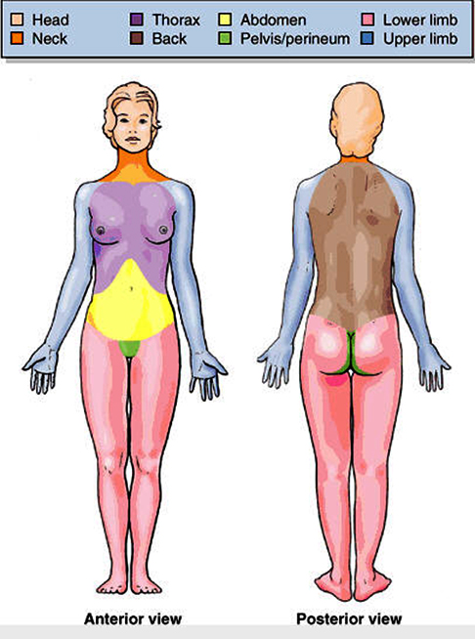
Body regions

Slide 4
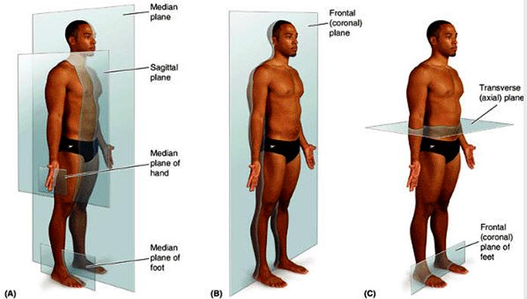
The body planes

Slide 5
Directional (relative) Terms of the Body
Directional terms are precise and brief, and for most of them there is a correlative term that means just the opposite.
The mouth is below the nose.
The mouth is under the nose.
The mouth is beneath the nose.
The mouth is underneath the nose.
Which one to use?

Slide 6
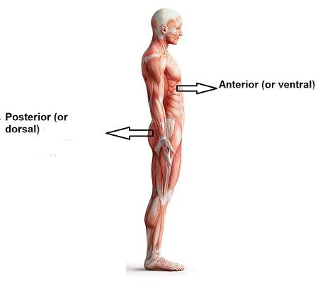
Relative and Directional Terms of the Body
Relative to front (belly side) or back (back side) of the body :
Anterior (ventral) = In front of; toward the front surface
Posterior (dorsal) = In back of; toward the back surface
e.g.
- The back is the posterior surface of the body. (position)
- The ear is posterior to the eye. (relation)

Slide 7
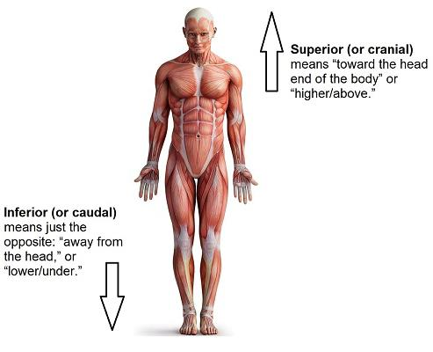
Relative and Directional Terms of the Body
Relative to the head or feet:
Superior (cranial) = Toward the head or upwards
Inferior (caudal)= Toward feet or downwards
e.g:
The ankle is an inferior joint in the lower limb. (position)
In the lower limb, the knee is superior to the ankle.(relation)

Slide 8
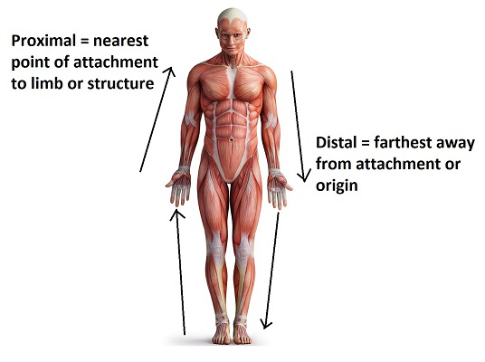
Relative and Directional Terms of the Body
Relative to point of attachment of the limb or structure:
Proximal = Closer to point of attachment to trunk
Distal = Further from point of attachment to trunk
e.g.
The shoulder is a proximal joint in the upper limb. (position)
The hand is distal to the forearm. (relation).

Slide 9
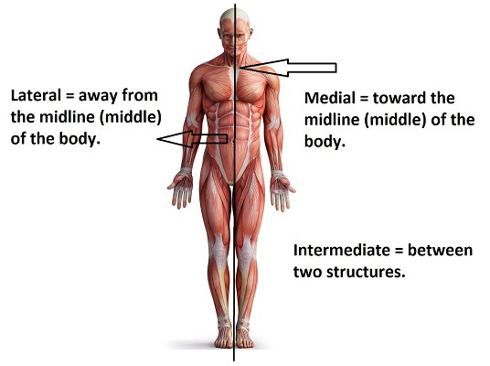
Relative and Directional Terms of the Body
Relative to the midline or center of the body:
Medial = Toward the midline of the body
Lateral = Away from the midline of the body
Intermediate= in between
e.g.
The forearm has two bones, one medial, the other is lateral. (position).
The arm is lateral to the chest. (relation).

Slide 10
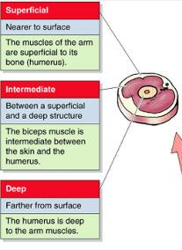
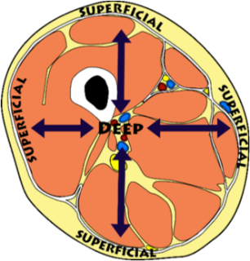
Relative and Directional Terms of the Body
Relative to the surface of the body (skin):
Superficial = Closer to the skin
Deep = Further from the skin
Intermediate = in between
e.g.
The bone is deep to the skin and the muscles are intermediate.

Slide 11
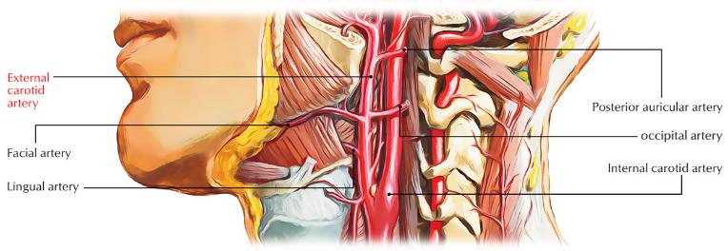
Relative and Directional Terms of the Body
Relative to the surface of an organ or region
External = Closer to the surface
Internal = Further from the surface
Intermediate = in between
e.g.
There are two carotid arteries in the neck, one external and the other internal.

Slide 12
The anatomical compass
???
Superior
Medial
Inferior
Lateral
???
Superior
Posterior
Inferior
Anterior
A,P>>S,I>>L,M
e.g.
The nose is anteromedial to the ear.
The thigh in inferolateral to the navel.
The buttock is posteroinferior to the chest.

Slide 13
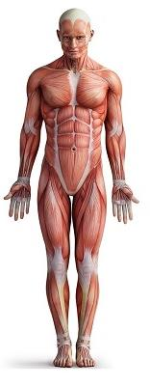
The anatomical position
Anatomic position is a fixed body position in which an individual stands upright with the feet kept together parallel and flat on the floor.
The head is level, and the eyes look forward toward the observer.
The arms are at either side of the body with the palms facing forward and the thumbs pointing away from the body.

Slide 14
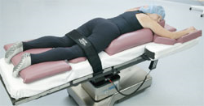
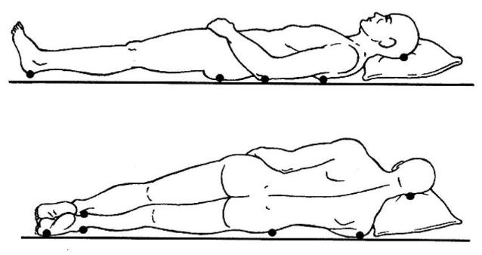
Other positions
PRONE
SUPINE
LATERAL
DECUBITUS
(recumbent)

Slide 15
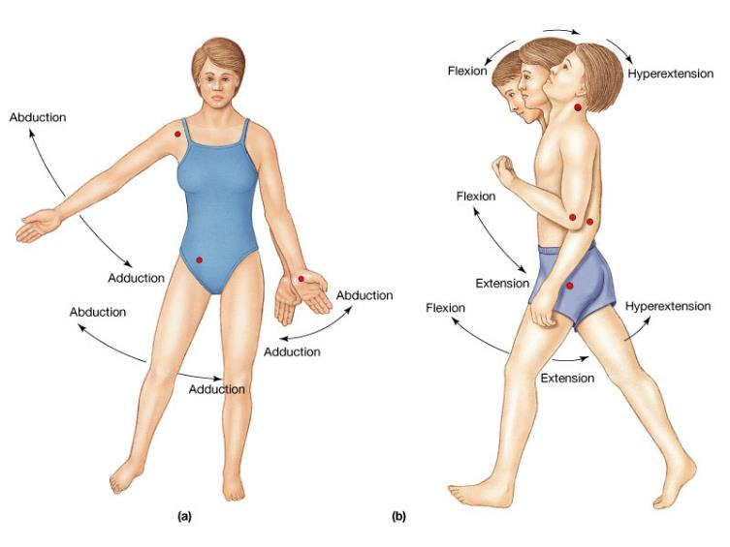
Angular movements
Flex (flexion): to fold X Extend (extension): to unfold
Abduct (abduction): to move away X Adduct (adduction) to move inward

Slide 16
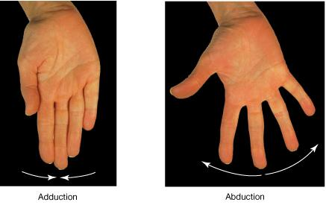
finger movements

Slide 17
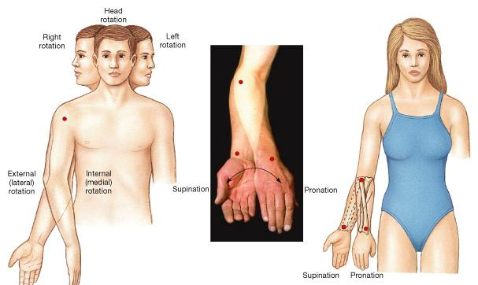
circular movements

Slide 18
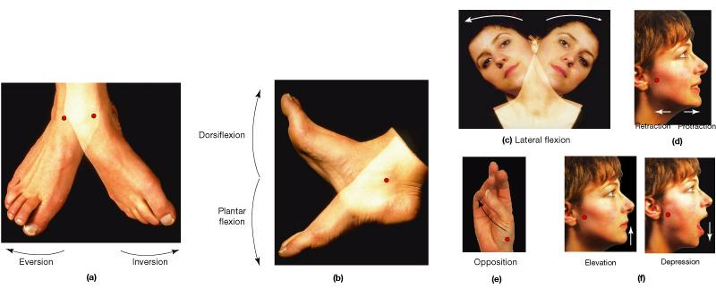
other movements

Slide 19
test your knowledge
Fill in the blanks:
The arm is ……………. To the chest
If the ear is posterolateral to the nose, then the nose is……………… to the ear.
In the anatomical position the palms are directed……………….
Turning the forearm so that the palm is facing backwards is called…………………….
The angular movement that moves the thigh away from the midline is called……………………..
Turning the head to the side is………………………………. Of the neck

Slide 20
Basic anatomical structures
Al-Mustansiriyah university
College of medicine
Dept. of anatomy, Histology & embryology
Skin, Fascia & Muscles
Objectives:
Identify the skin layers and their clinicoanatomical importance
Define fascia and differentiate its types & functions
Identify the types of muscles and how they function

Slide 21
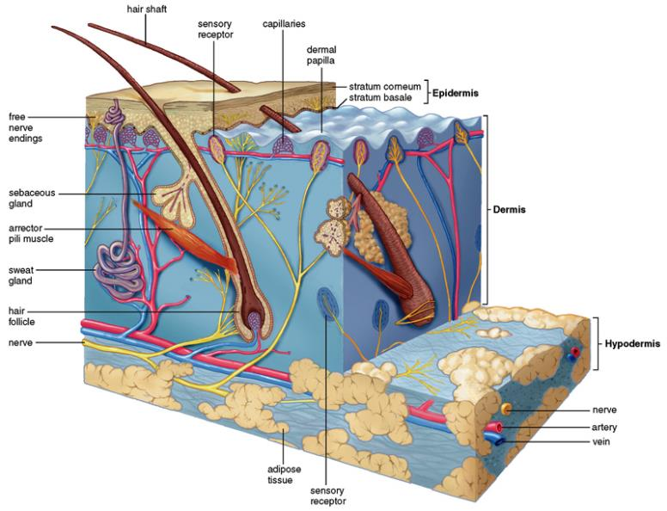
The skin

Slide 22
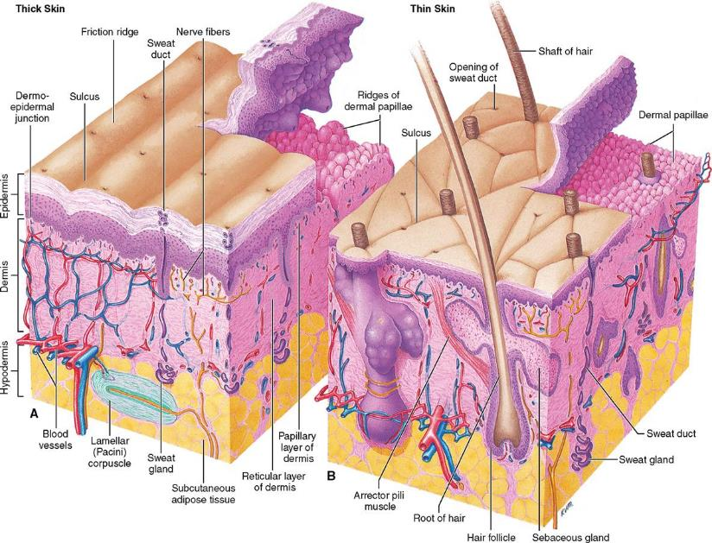
Thin vs Thick skin

Slide 23
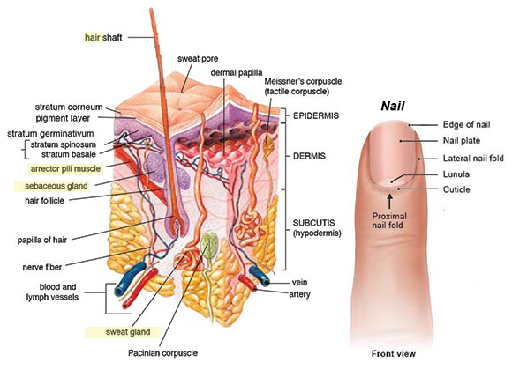
Epidermal appendages

Slide 24
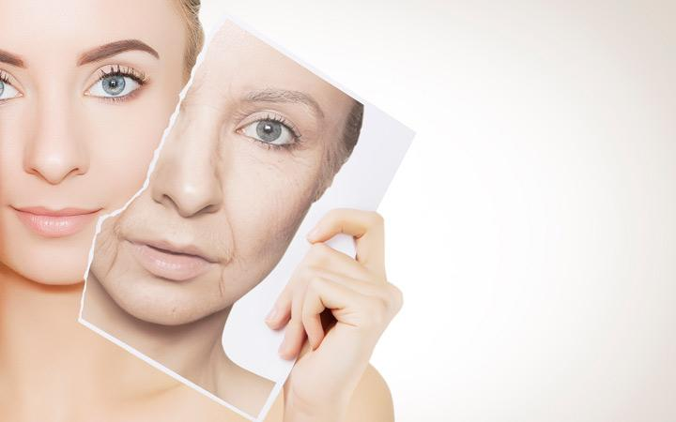
Skin wrinkles / Creases

Slide 25
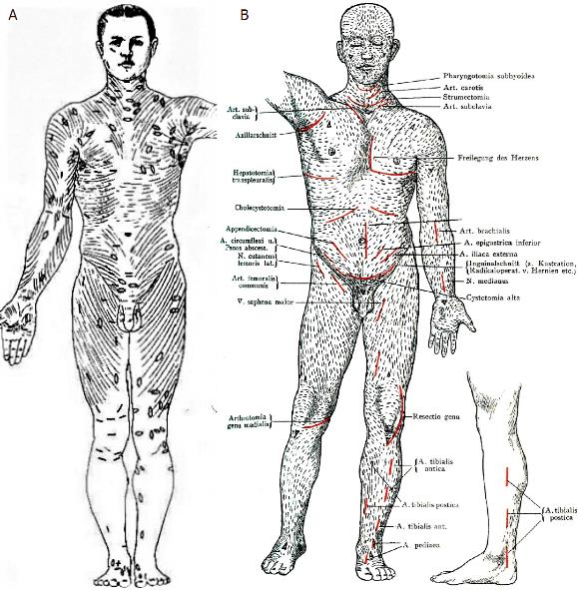
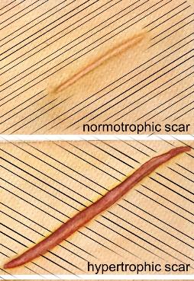
Tension lines of langer’s

Slide 26
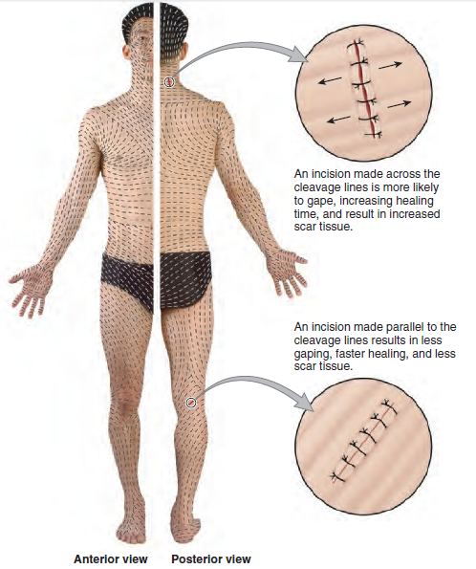
Tension lines

Slide 27
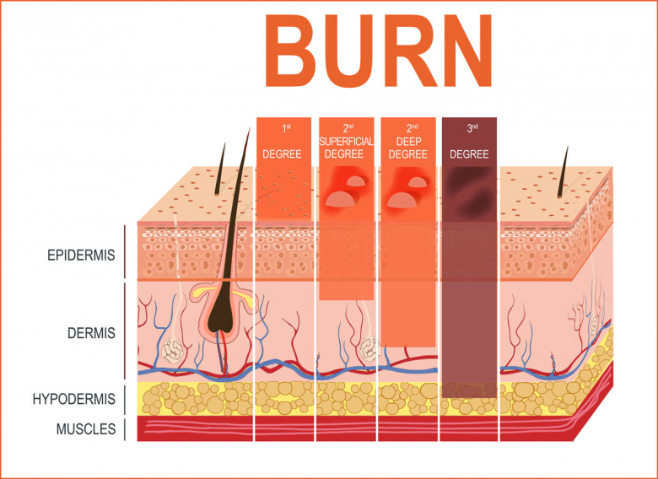
BURN DEGREES

Slide 28
FASCIA
Deep
(C.T.)
Periosteum
(bone)
Sheath
(blood vessels & nerves)
Superficial
Fatty T. all over the body
Epimysium
Septa
(muscles)
Epineurium
(nerve)

Slide 29
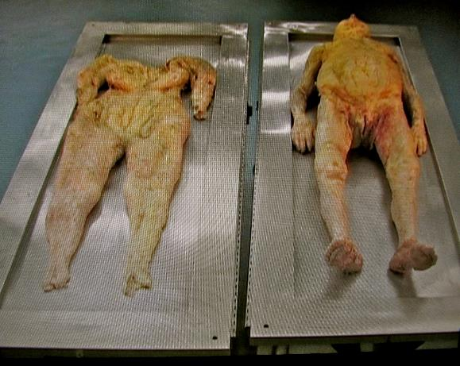
Superficial fascia
Contains:
Superficial veins & lymphatics
Cutaneous nerves & arteries
Occasionally, skeletal muscle

Slide 30
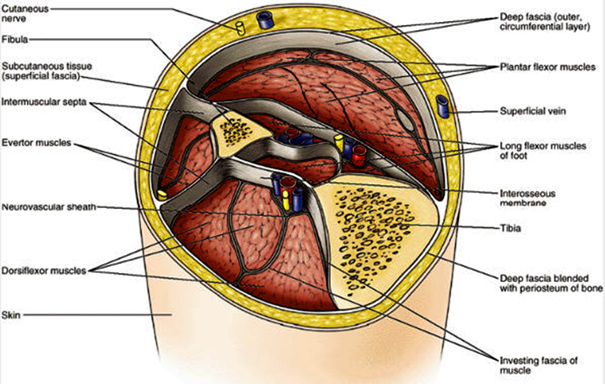
deep fascia

Slide 31
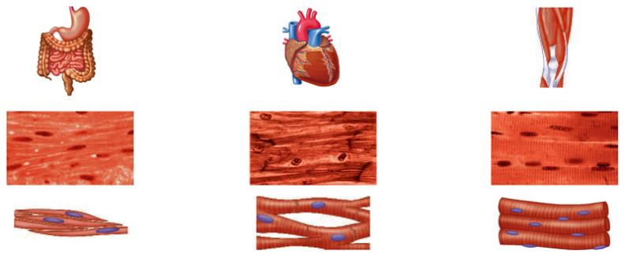
Muscle types

Slide 32
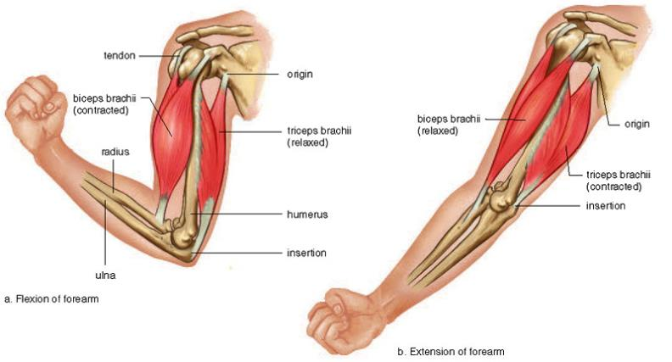
Skeletal muscle parts
From origin & insertion → Action (function)

Slide 33
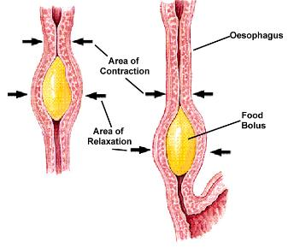
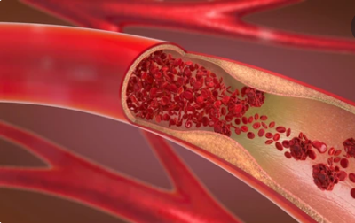
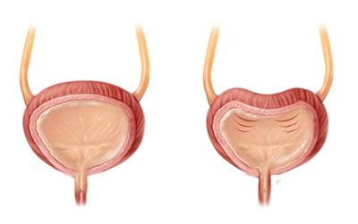
Smooth muscles
1. Tubes (Pulse / Peristalsis)
2. Hollow organs
(Evacuation)

Slide 34
test your knowledge
Fill in the blanks:
First degree burns affect the…………………
With advancing age, loss of …………… fibers in the……………. Leads to appearance of wrinkles.
The functions of superficial fascia are…………………….
The part of the skeletal muscle that moves the most is………….
Contraction of the smooth muscles of the uterus leads to…………

Slide 35
Basic anatomical structures
Al-Mustansiriyah university
College of medicine
Dept. of anatomy, Histology & embryology
Vessels & Glands
Objectives:
Identify the different types of blood vessels, how they differ and how to study them.
Define lymph & understand the clinical importance of lymphatic circulation
Identify the two major types of glands

Slide 36
VESSELS
Blood
Arteries
Lymphatic
Afferent & Efferet
Veins
Capillaries

Slide 37
Blood circulation

Slide 38
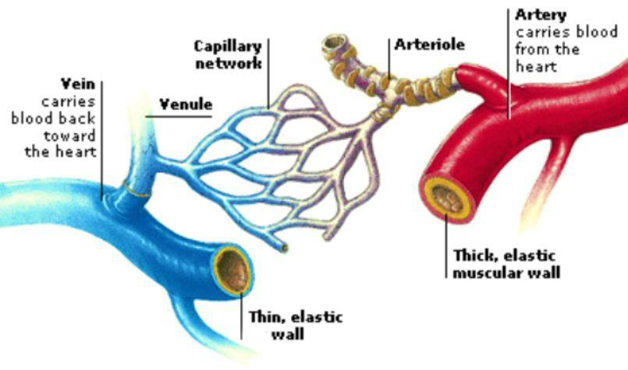
Arteries, veins, capillaries
branch
tributary

Slide 39
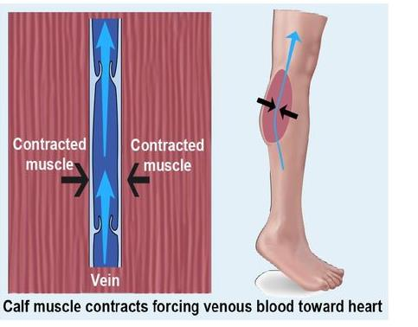
Venous emptying

Slide 40
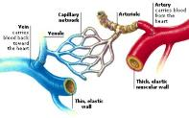
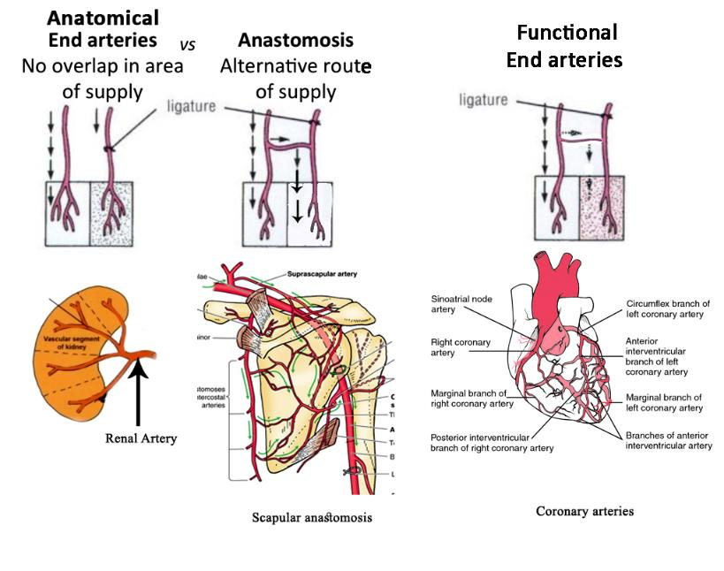
Anastomosis & venous plexus

Slide 41
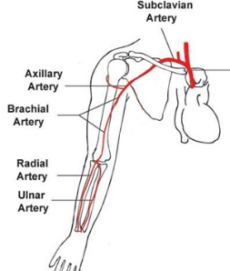
How to study arteries & veins
A
Ending point
Starting point
Course & tributaries
Course & branches
Ending point
B
Starting point

Slide 42
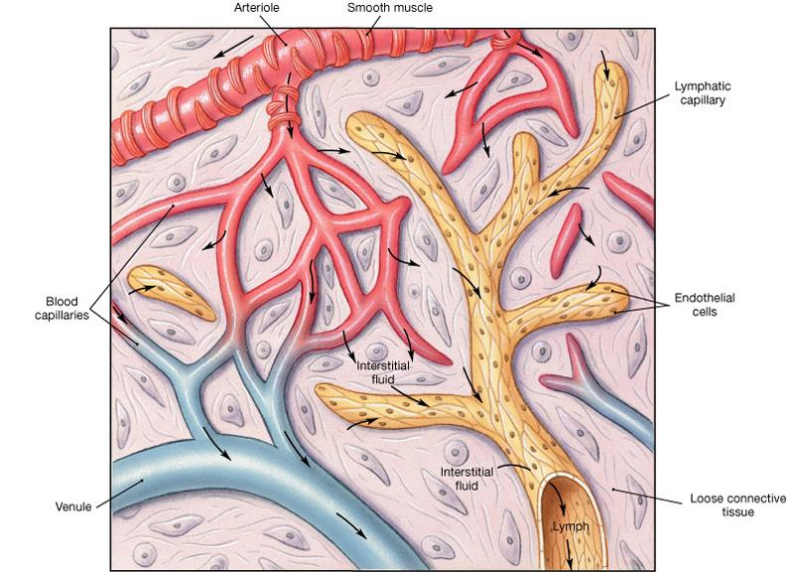
Interstitial fluid & lymph

Slide 43
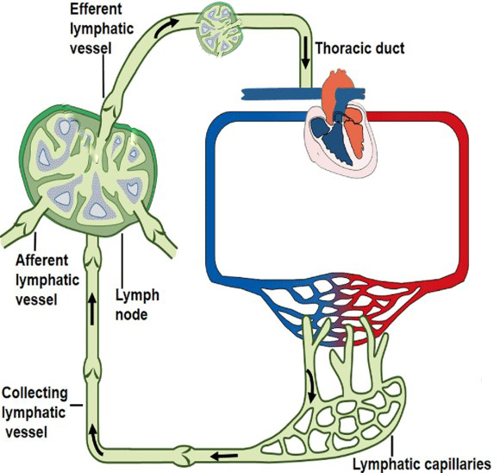
Lymphatic circulation
2
1

Slide 44
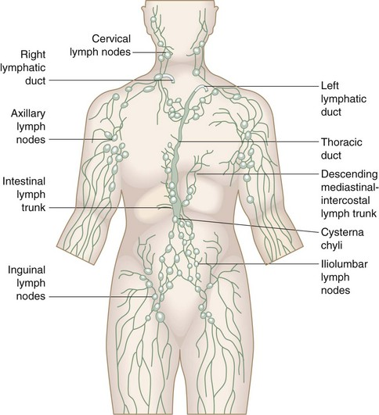
Lymph node groups

Slide 45
Lymphadenopathy (enlarged lymph node)

Slide 46
test your knowledge
Fill in the blanks:
As veins travel through the body, they receive……………….. and they ………………….. in diameter.
Arteries that do not communicate with each other via anastomosing channels are called…………………. arteries. An example is…………………… arteries.
The lymphatic vessels carrying lymph away from a lymph node is called…………………… lymphatic.

Slide 47
Basic anatomical structures
Al-Mustansiriyah university
College of medicine
Dept. of anatomy, Histology & embryology
Bones, Cartilage & Joints
Objectives:
Identify the anatomical & histological types of bone & cartilage
Identify the parts of the human skeleton
Define joints and differentiate their types

Slide 48
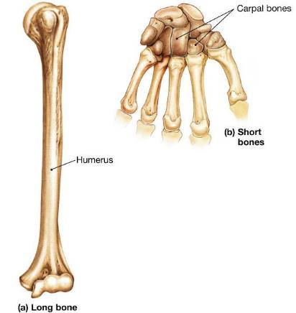
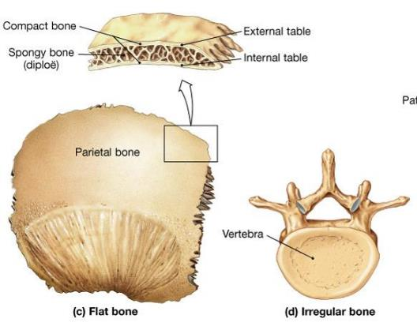
BONES: Anatomical types

Slide 49
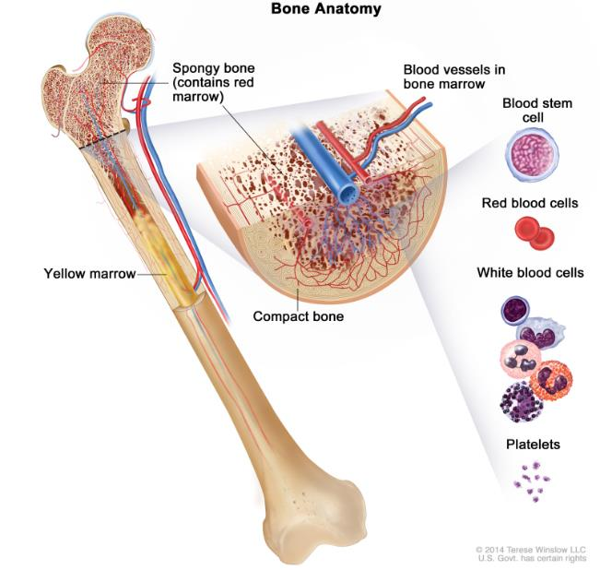
BONES: histological types

Slide 50
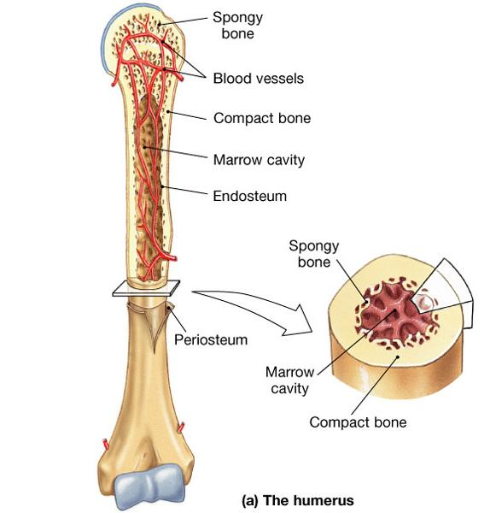

Slide 51
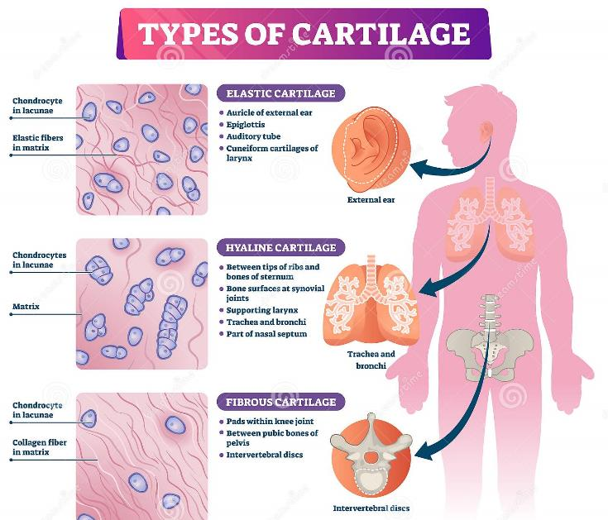
Cartilage

Slide 52
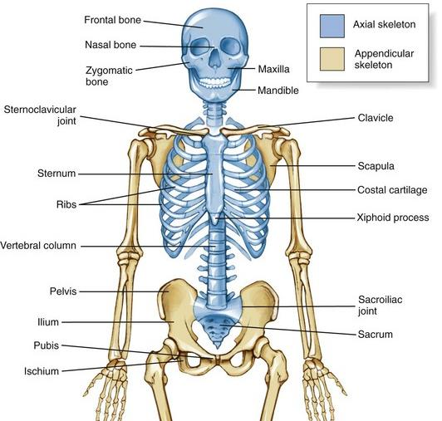
The human skeleton

Slide 53
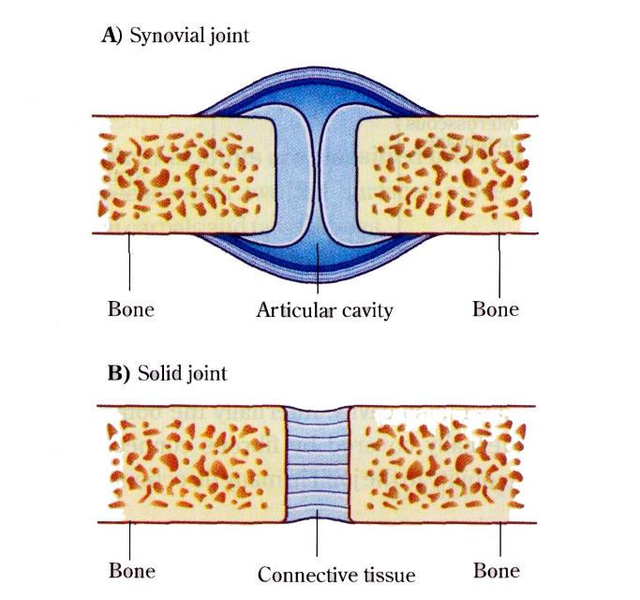
Major types of joints

Slide 54
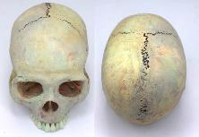
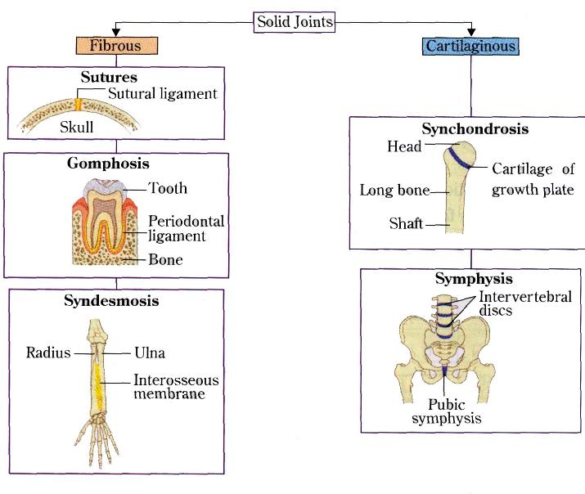
Solid joints

Slide 55
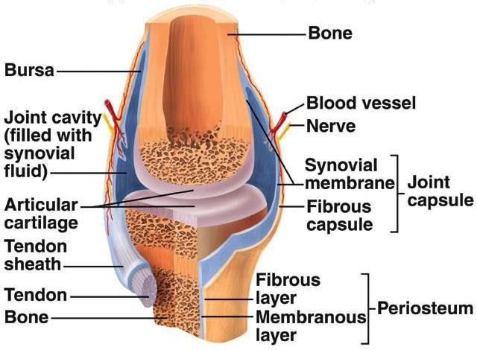
Synovial joint structure

Slide 56
Synovial joints types
Synovial joints
According to movement
Uniaxial
Biaxial
According to shape
Plane
Multiaxial
Ball-and-socket
Hinge
Pivot
Ellipsoid
(Condyloid)
Saddle

Slide 57
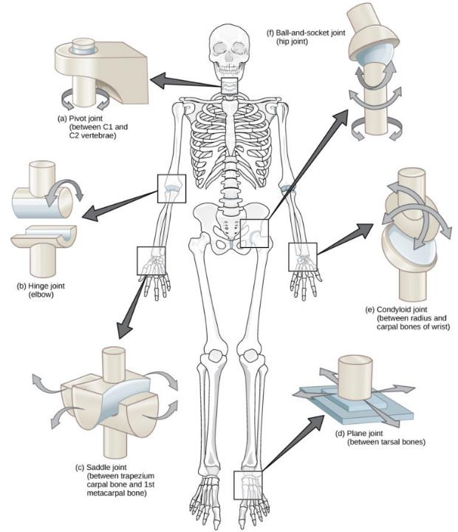
Synovial joints types
How to study joints:
Type
Articulating bones
Joint capsule attachments
Stabilizing factors (shape, ligaments, muscles)
Weakening factors
Neurovascular supply
Related bursae, sheaths …etc.
Clinical notes

Slide 58
test your knowledge
Fill in the blanks:
Yellow bone marrow is found in the …………………………
The thigh bone (femur) is an example of a …………….. bone
Cartilage of the auricle is ………… cartilage
The articulating bones of synovial joints are covered with………………….. Cartilage
A………………. is a sac of synovial fluid separating the joint from adjacent structures.
The knee is an example of a …………………….. synovial joint which is (according to movement) is……………………..
A pivot joint allows ……………………… movement

Slide 59
Basic anatomical structures Nerves & the nervous system objectives:
Al-Mustansiriyah university
College of medicine
Dept. of anatomy, Histology & embryology
Assist. Prof. Dr. Sameh Sameer Akkila
Recognize the anatomical and functional divisions of the nervous system
Define the nerve and study its components
Study the structure of spinal nerves
Understand the function and anatomical location of the autonomic nervous system

Slide 60
Anatomical divisions of the NS
Central (CNS)
Peripheral (PNS)
Brain
(in skull)
a. 12 pairs of cranial nerves (CN I-CN XII)
b. Spinal cord
(in vertebral column)
b. 31 pairs of spinal nerves

Slide 61
Functional divisions of the ns
NS
SOMATIC
Efferent
(Motor)
→ skeletal muscles
AUTONOMIC
(Sympathetic & Parasympathetic)
Afferent
Sensory
Efferent
→ smooth muscles, heart, glands
Afferent
(Visceral sensation)

Slide 62
The neuron
Motor (multipolar) neuron
Sensory (Unipolar) neuron

Slide 63
Vertebral (spinal) column anatomy

Slide 64
The vertebral column, spinal cord & spinal nerves

Slide 65
30 Vertebrae & 31 spinal nerves ?
7
C1 – C7
12
T1 – T12
5
L1 – L5
5
S1 – S5

Slide 66
The nerve

Slide 67
The nerve

Slide 68
The spinal nerve

Slide 69
The spinal nerve

Slide 70
Spinal nerve plexuses

Slide 71
Functional divisions of the ns
NS
SOMATIC
Efferent
(Motor)
→ skeletal muscles
AUTONOMIC
(Sympathetic & Parasympathetic)
Afferent
Sensory
(General & Special)
Efferent
→ smooth muscles, heart, glands
Afferent
(Visceral sensation)

Slide 72
The autonomic nervous system
Sympathetic : fight or flight…..Danger/ Stress
Parasympathetic: relax and maintain

Slide 73
The fight or flight response vs Relaxation / maintenance

Slide 74
Sympathetic = Thoracolumbar
[T1-L2 (L3)]
Sympathetic trunk
All Spinal nerves
CN IX, X, XII
Organs
Short pregagnglionic
Long postganglionic
Parasympathetic = Craniosacral
[CN III, VII, IX, X
+ S2, S3, S4]
Ganglia
Organs
Long pregagnglionic
Short postganglionic

Slide 75
test your knowledge
Fill in the blanks:
Bipolar neurons are………………………… neurons
The nerve fiber is the………….. of the nerve cell which is surrounded by deep fascial layer called the…………………
The ventral root of spinal nerve contains pure…………… fibers
Spinal nerve trunks emerge from the vertebral canal via the……………………….. foramina
C7 spinal nerve emerges……………….. To C8 vertebra
The sympathetic system arises from the………………… region of the spinal cord
The cranial nerves carrying parasympathetic fibers are................, ……………….., ………………. & ……………

