Slide 1
White blood cell (WBC) count

Slide 2
Introduction and principle
White blood cell count denotes the number of white blood cells per unit volume of whole blood.
Normal WBC count range from 4000 - 11000 cell / mm³ this count varies with age.
WBC count is useful to indicate infections or may be employed to follow the progress of certain diseases.
White blood cells in the circulation are not white in the sense that a sheet of white paper is white, but in the sense that they are transparent and not coloured. White cells are fewer in number than red cells.
White blood cells are counted in a similar manner to red cells, using a haemocytometer.

Slide 3
Methods
1- Manual method.
2- Electronic cell counting
.

Slide 4
Manual method
Materials & instrument
Anticoagulated whole blood or capillary blood can be used.
Turk’s solution composed of :
3 ml Glacial acetic acid to haemolyze RBCs.
1 ml Aqueous Gention violet (1% w/v) to color WBC nuclei
Up to 100 ml Distilled water
WBC pipette: it is composed of a stem, mixing chamber, white bead inside the mixing chamber, aspiration tube (rubber sucking tube)
Haemocytometer (Neubauer’s counting chamber) with a cover slip.
Microscope.
Lancet.
Cotton

Slide 5
Procedure:
Obtain a drop of blood in the same manner as in RBC count. Draw blood up to the mark 0.5 using WBC pipette.
Aspirate diluting fluid up to mark 11. The dilution is 1:20.
Remove blood from outside of the pipette with a clean gauze
Gently rotate the pipette horizontally with your hand to ensure a proper amount of mixing for 3 minutes.
After mixing discard the first four drops of the mixture.

Slide 6
6-Fill the counting chamber with diluted blood by holding the pipette at 45º with the slide and allow the mixture to seep under the cover slip, the filled chamber should be allowed to stand for a minute prior
to counting.
7-Count the WBCs using the low power 10 x objectives.
8-Count all WBCs in four large corner squares and add the result together to obtain the total number of cells counted. In counting the cells that touch the outside lines of the large square, count only those that touch the left and lower outside margin. The WBCs look like black dots.

Slide 7
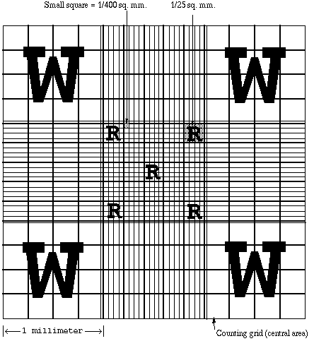
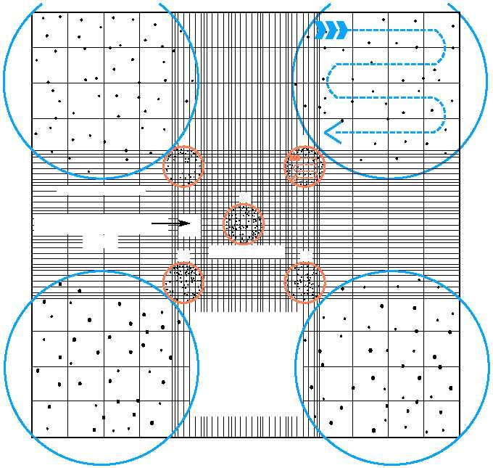

Slide 8
Calculation:
Count the number (N) of cells in the large squares located at the four corners of the chamber.
The size of each large squares = 1 mm x 1 mm x 1/10 mm x 4 = 4/10 mm³
1 mm is the length of each sideline of each square
1/10 mm is the depth of the counting chamber between coverslip and the ruling
4 is the number of large squares used to count.
The total numbers of cells in 1 mm³ are = N x 10/4 (diluted sample)
The actual total number of cells before dilution should be = N x 10/4 x 20 = N x 50

Slide 9
Medical considerations
Leucocytosis: increased WBCs number which could be physiological (at afternoon, eating, physical activity, stress, pregnancy, and labor) or pathological
(e.g. acute infection, drugs, after surgical removal of the spleen (splenectomy)).
Leucopenia: decreased WBCs number which could be physiological (at morning, newborns, and infants) or pathological (e.g. chronic infection, drugs)
Leukemia: a group of malignant disorders of the haemopoietic tissue in which there is failure of cell maturation with proliferation of primitive WBCs (blast cells) in the bone marrow and spread into the blood.

