Slide 1
Triple Antibiotic Pastes and their role in Regenerative Endodontics

Slide 2
Triple Antibiotic Paste
Introduction
TAP composition
Application of TAP in Endodontics
Efficacy
Regenerative Endodontic Therapy
History of Regenerative Endodontics
Uses of TAP in Regenerative Endodontics
Biocompatibility
Drawbacks
Ultimate goal

Slide 3
Introduction
Endodontic therapy or root canal therapy is a sequence of treatment for the infected pulp of a tooth, which results in the elimination of infection and the protection of the decontaminated tooth from future microbial invasion.
The infection of the canal system is considered to be poly microbial infection both aerobic & non aerobic bacteria.
Because of complexity of root canal infection, it is unlikely to consider that single antibiotic gives sterile canal system.

Slide 4
Uses of antibiotics in endodontics first reported in 1951 by Grossman, known as poly antibiotic paste (Penicillin, Bacitracin, Streptomycin, Caprylate Sodium).
Hoshino et al, 1996 each antibiotic used alone is in effective against bacteria. Therefore It is essential to use combination of antibiotics to act against all endodontic pathogens and to prevent resistance.
Sato et al,1996 developed Triple Antibiotic Paste ( Metronidazole, Ciprofloxacin, Minocycline).
Metronidazole selectively toxic to anaerobic bacteria, Protozoa.
Ciprofloxacin (bactericidal) act against gram –ve bacteria.
Minocycline (bacteriostatic) act against gram +ve, -ve Bacteria.

Slide 5
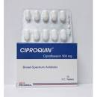
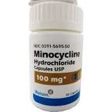
:TAP composition
Antibiotic (3mix) ratio (1:1:1)
Metronidazole
Ciprofloxacin
Minocycline
Carrier (MP) ratio (1:1)
Macrogol ointment, Propylene glycol
(3 mix) incorporated into (MP) using the
Following
1:5 ( MP: 3 Mix)
Metronidazole
Ciprofloxacin
Minocycline

Slide 6
Application of TAP in Endodontics
Large periradicular cyst like lesion
TAP changed every month until elimination of symptoms to facilitate bone healing .
1st visit Access, instrumentation, dressing Ca(OH) (1-3 weeks)
TAP (3 months)

Slide 7
Application of TAP in Endodontics
Endodontic filling material in primary teeth
Access, root canal orifice enlarged, TAP, Glass Ionomer cement, Composite.
Good clinical success, low radiographic evidance 2 years follow up.

Slide 8
Efficacy
Hashino et al study:
Preclinical model(dog study)
60 teeth accessed and infected
X-ray: Apical periodontitis
Sampled :
before irrigation
After irrigation 1.25% NaOCL
2 weeks after delivery of TAP

Slide 9
Conclusion of study:
Before irrigation, all teeth +ve culture anaerobic bacteria
After irrigation 1.25% NaOCL, 10% teeth bacteria free
2 weeks after delivery of TAP, 70% teeth bacteria free

Slide 10
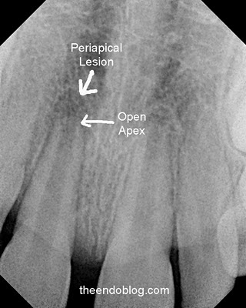
There are several procedures to treat incompletely formed roots that occur when the pulp become
infected.

Slide 11
Apexification: method induce calcified barrier in a root with open apex
Apexogenesis : vital pulp therapy procedure performed to encourage continuous
physiological development & formation
of the root end.

Slide 12
Regenerative Endodontic Therapy
It is biologically based procedure designed to restore function to a damaged and non functioning pulp and subsequent completion of root development.
Mesenchymal stem cell differentiated into odontoblast like cell.
Scaffolds (clot) and growth factors guiding development.

Slide 13
History of Regenerative Endodontics
Nygard Ostby : pioneer of regenerative endodontic procedures in early 1960.
Iwaya et al, 2001 : described a procedure which they termed Revascularization.
Strobl et al, 2003: Radiographic asssessments, laser Doppler Flometry.
Banchs & Trope, 2004 : Revascularization, necrotic immature permanent premolar with open apex and large apical lesion.
Claus et al, 2004 ; Ritter et al, 2004: Histological tissue regeneration in animals.
Trope, 2008 : Revascularization; nature of tissue formed posttreatment unpredictable.

Slide 14
History con.
7. Huang , 2008: Revascularization; restoration of vascularity to tissue or organ.
8. Wang et al, 2010: studies on animals; apposition material may be dentin, cementum or even bone.
9. Lenzi & Trope, 2012: Revitalization; nonspecific vital tissue forms in the root canal.
10. Emi shimizu et al, 2012: Histological evaluation of revascularization procedure.

Slide 15
Regenerative Procedure
1st stage regenerative procedure
Access opening
irrigation
Triple antibiotic paste
Temporary filling

Slide 16
Regenerative Procedure
2nd stage regenerative procedure
Remove TAP
Irrigation
Bleeding
Capping material MTA

Slide 17
Uses of TAP in Regenerative :Endodontics
Used to create an environment favorable for ingrowth of vasculature and regenerative cells by reducing or eradicating bacteria in the canal space of teeth with necrotic pulp and incompletely formed apices.

Slide 18
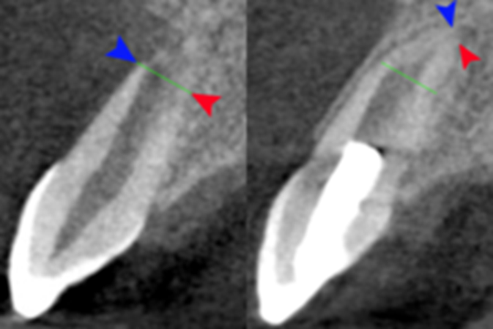
Biocompatibility
Iwaya et al, 2001 apical pathosis healed & root lengthened (Metro..,Cipro..)
Banchs & Trope, 2004 apical pathosis healed & root lengthened (Metro..,Cipro.., Minocycline)

Slide 19
Drawbacks:
May stain the teeth (Minocycline : staining crown and root above gingival margin).
Allergic reactions( Induction of inflammatory response).
Concern TAP it may cause bacterial resistance.

Slide 20
Ultimate Goal
In clinical trials, besides immature permanent teeth with necrotic pulp, regenerative endodontic therapy has been employed to treat 1. mature permanent teeth with necrotic pulps. 2. teeth with persistent apical periodontitis after primary root canal therapy.
3. traumatized teeth associated horizontal root fractures, root resorption, and avulsion.

