Slide 1
Lecture 7
Drying

Slide 2
Drying of solids
The moisture in a solid can be expressed on a wet-weight or dry-weight basis.
Wet-weight basis: loss on drying
%LOD = wt. of water in sample × 100
total wt. of wet sample
Dry-weight basis: moisture content
%MC = wt. of water in sample × 100
wt. of dry sample

Slide 3
Example: if exactly 5 g of moist solid is brought to a constant dry weight of 3 g:
MC = $\frac{5−3}{3}$ x 100 = 66.7%
Whereas LOD = $\frac{5−3}{5}$ x 100 = 40%

Slide 4
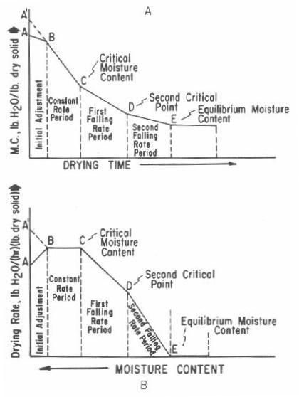
Behavior of solids during drying
The rate of drying shows certain phases in which the change in moisture content is plotted against time.
Steps of drying:
Wet solid is placed in a drying oven, it begins to absorb heat and increase in temp.
At the same time, the moisture begins evaporating and cools the drying solid.
(This period of initial adjustment is shown as segment of AB).

Slide 5
At point B, After a period of initial adjustment, the rates of heating and cooling became equal and the temp. of drying material stabilizes.
Between point B and C, the moisture evaporating from the surface is replaced by water from the interior of the solid at a rate equal to the rate of evaporation. The rate of drying is constant. Known as the constant-rate period.
At point C, the surface water is no longer replaced at a rate fast enough to maintain continuous film. Drying spots begin to appear, the rate of drying begins to fall off. The moisture occur referred to as the critical moisture content.

Slide 6
Between point C and D, the No. and area of dry spots continue to grow, and the rate of drying falls steadily. The time CD is known as first falling-rate period (or unsaturated surface drying).
At Point D, the film of continuous water is completely evaporated, and the rate of drying depends on rate of diffusion of moisture to the surface of solid. This point is known as second critical point.
Between point D and E, the rate of drying falls rapidly than the first falling rate, and time DE is called second falling rate period.
At point E, When dying state is equal to zero, the equilibrium moisture period begins, and the solid is in equilibrium with its surroundings (Temp. and moisture content remain constant). Continued drying is waste of time and energy.

Slide 7
Classification of solids on drying behavior
1- Granular or crystalline solids (water is held in shallow and open surface pores as well as in interstitial spaces between particles that are easily accessible to the surface).
Ex: calcium sulfate, zinc oxide, magnesium oxide
2- Amorphous, fibrous or gelatinous solids (moisture is an integral part of the molecular structure as well as being physically entrapped in fine capillaries and small interior pores).
Ex: starch, insulin and aluminum hydroxide.
Note: Amorphous solids are difficult to dry than granular or crystalline solids.

Slide 8
(Drying) Moisture removal in these 2 categories:
Moisture in crystalline solids is lost with little hindrance by either gravitational or capillary force.
(Inorganic substances – not effected by heat unless temp. is high enough to hydrate, represent by high constant rate period while the equilibrium moisture contents are close to zero).
Moisture movement in amorphous is slow, such that liquid diffuses through structural obstacles caused by molecular configuration.
(The second drying rate period is high since it depends on diffusion rate of water through solids. Equilibrium moisture is high because most of water remains associated within the molecular interstitial spaces of substance.
The drying of these substances requires: low temp., reduced pressure and increase airflow.

Slide 9
Definitions:
Equilibrium Moisture Content (EMC): It is a moisture content at which material exerts a water vapor pressure equal to the vapor pressure of the surrounding atmosphere, thus no driving mass transfer. Differ in value according to crystalline or amorphous form.
Equilibrium Relative Humidity (ERH): It is the relative humidity surrounding a material at which material neither gains or loses moisture.
Water Activity ($a_{w}$): Is the ratio of water vapor pressure exerted by the material to the vapor pressure of pure water at the same temp.
Note: Pure water is assigned an $a_{w}$ of unity, equivalent to an ERH of 100% (ERH of 50% corresponds to an $a_{w}$ of 0.5)

Slide 10
Classification of dryers:
Classification based on the method of solids handling and is divided into the following types:
In which there is no relative movement among the solid particles being dried. Only a fraction of the total number of particles is directly exposed to heat sources.
The exposed surface can be increased by decreasing the thickness of the bed and allowing drying air to flow through it.
1- Static-bed dryers- systems

Slide 11
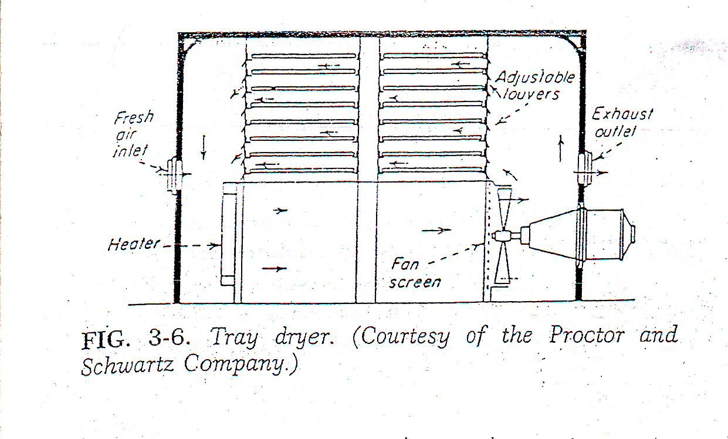
A- tray and truck dryers: Also called (shelf, cabinet, or compartment dryers) it consist from cabinet in which the material dried is spread on tiers of trays .
The number of trays varies with the size of dryer.
while truck dryer with wheels is preferred over the tray dryer in plant operation because it offers greater convenience in loading .

Slide 12
Note: Tray and truck dryers is a batch procedure.
Types of Tray dryers used in pharmaceutical industry are:
1- Direct type in which heating is accomplished by the force circulation of large volumes of heated air.
2- Indirect type utilize heated shelves or radiant heat sources inside the drying chamber to evaporate the moisture which is then removed by either a vacuum pump or a small amount of circulated gas.

Slide 13
B- tunnel and conveyor dryer:
1-Tunnel dryer is an adaptation of truck dryer for continuous drying.
Trucks are moved through the drying tunnel by a moving chain loaded on one side then allowed to reside in the heating chamber.
The operation is more accurately described as a semi-continuous (because each truck requires individual loading and unloading before and after the drying cycle).
Heat is supplied by direct convection or radiant energy.
2- Conveyor dryer are improvement over tunnel dryer because the are truly continuous (by providing uninterrupted loading and unloading) therefore it is more convenient for large volume of materials.

Slide 14
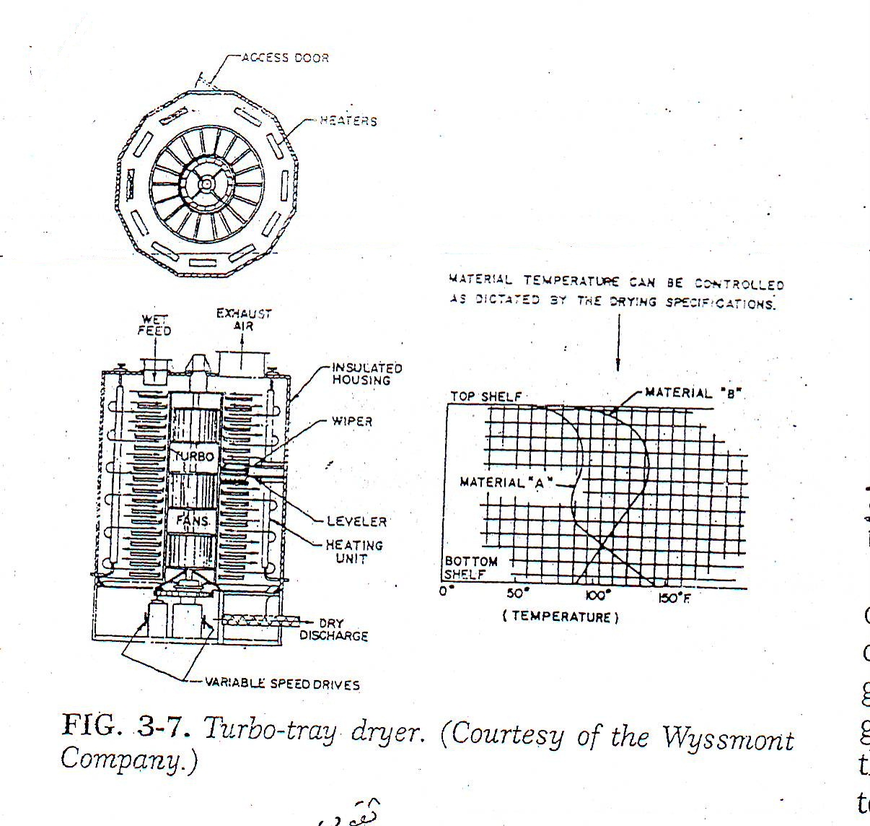
2- moving-bed dryers-systems
The drying particles are partially separated so that they flow over each other.
Motion may be induced by either gravity or mechanical agitation.
A. turbo-tray dryer: is a continuous shelf moving–bed dryer .
B. pan dryer: operate under atmospheric pressure or vacuum.
Heat is supplied by steam or hot water used to dry small batches of pastes or slurries.

Slide 15
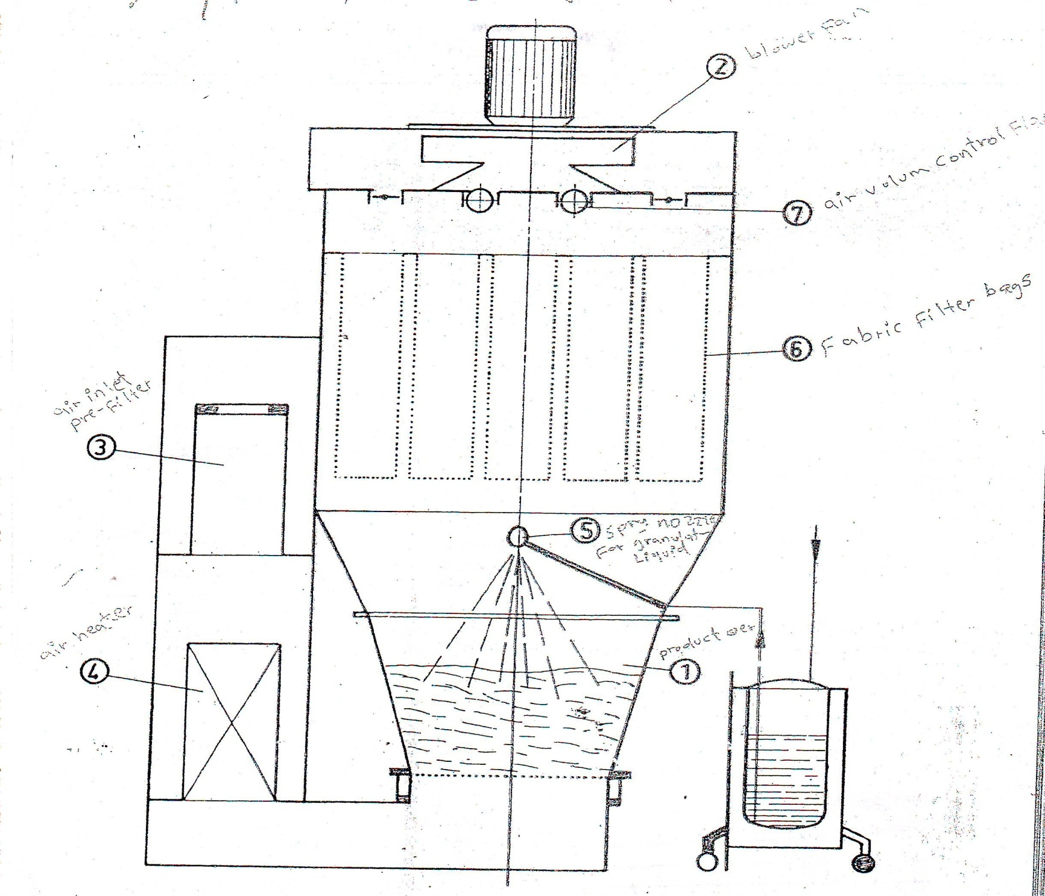
3- fluidized - bed dryers systems
Principle: Solid particles are partially suspended in upward moving gas steam.
Mechanism: particles are lifted and then fall back in a random manner so the resultant mixture of solid and gas act like a liquid then the solid are said to be fluidized. The solid particles are caught up in eddies and fall back in a random boiling motion.
This result in better heat (temp.) and mass transfer (composition and particle size distribution) than in static and moving bed.

Slide 16
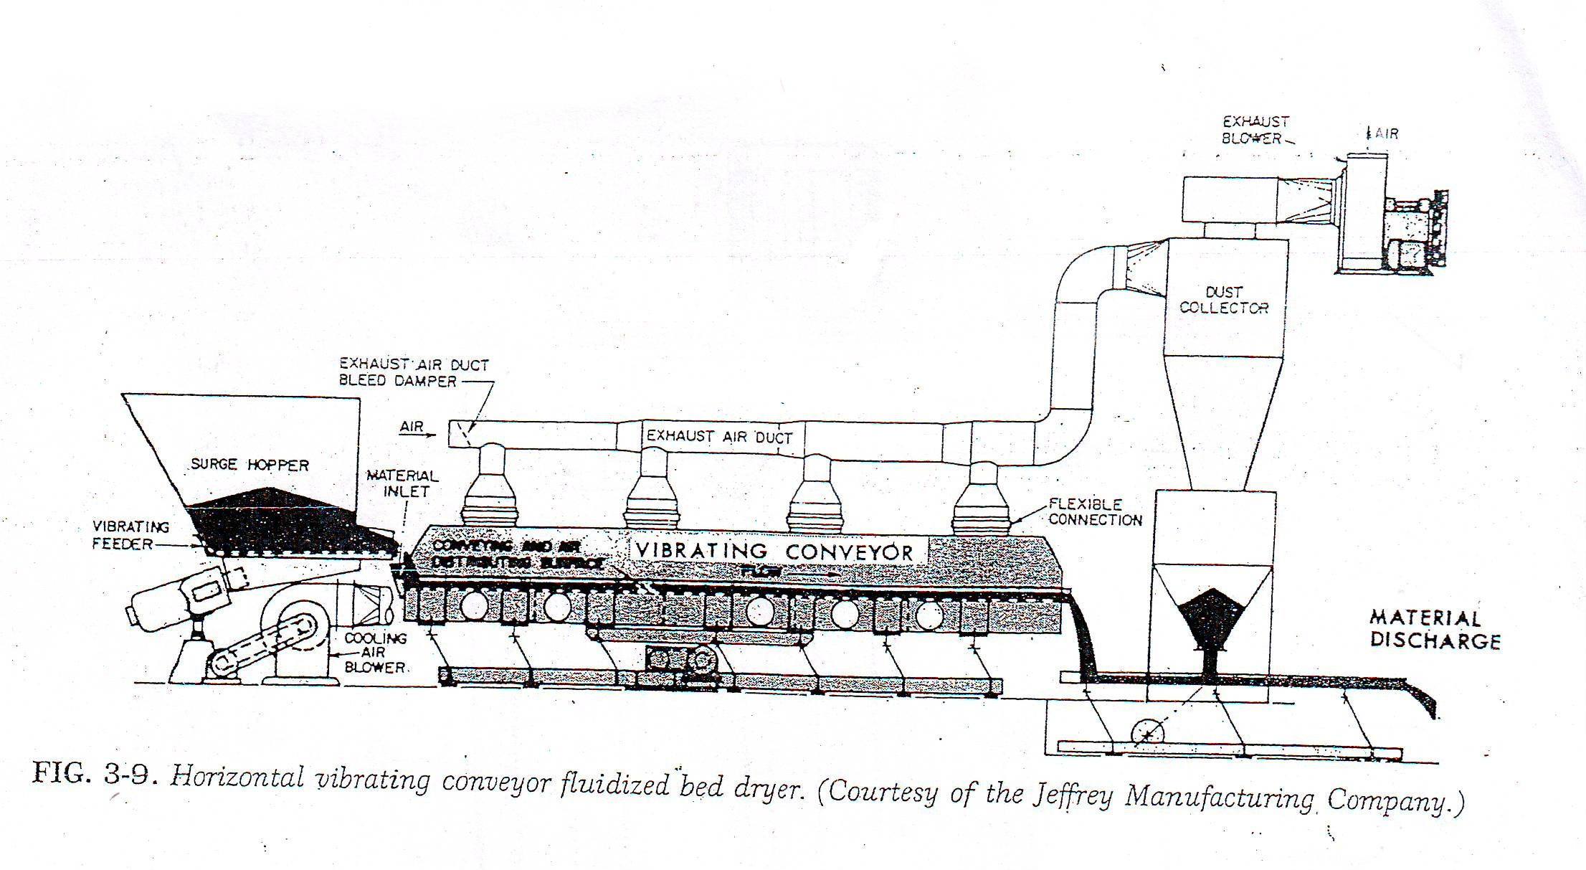
Benefits: 1- Efficient for drying of granular solids (because each particle is surrounded by the drying gas).
2-In this type of dryer a faster drying and handling time than tray dryer.
Problems: The only requirement that granules not so wet they stick together on drying.
2 type of fluidized bed dryer is horizontal and vertical .

Slide 17
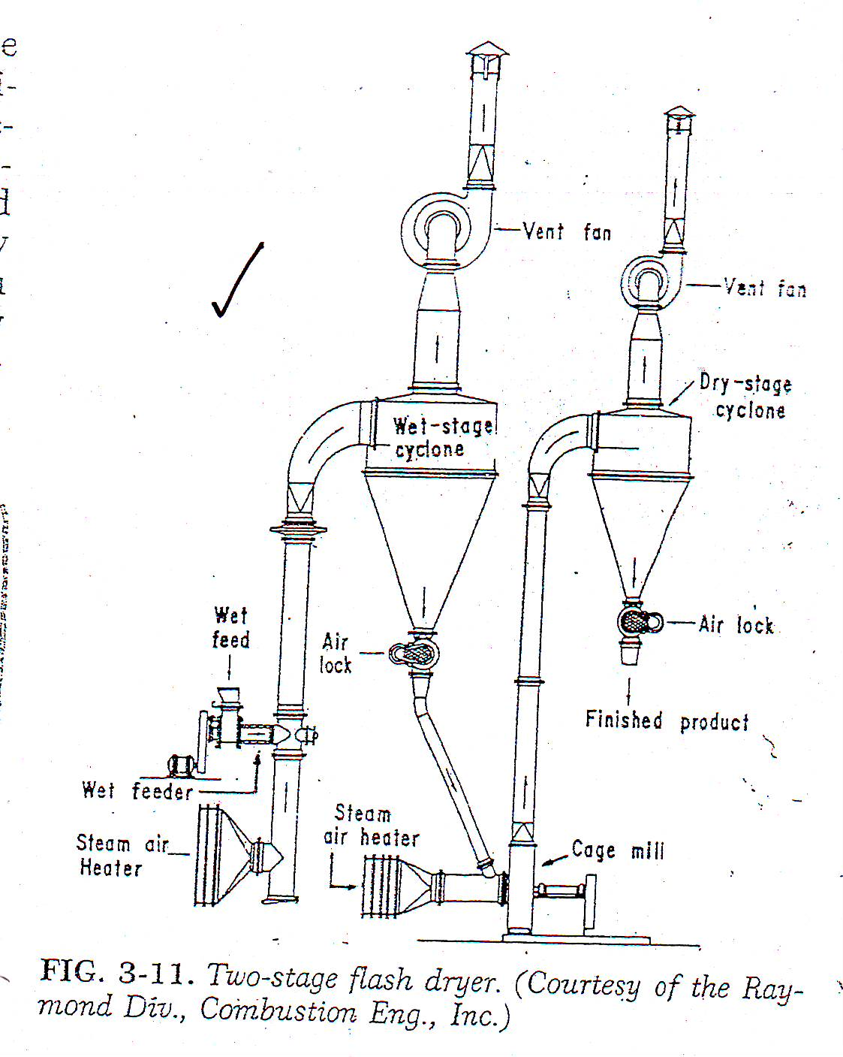
4- pneumatic dryers system
Principle: Drying particles are entrained and conveyed in a high velocity gas stream.
It is consider as a further improve on fluidized beds because:
1- No channeling or short-circuiting of the gas flow path through a bed of particles.
2- Drying time here is short because each particle is surrounded by an envelope of drying gas so the resultant heat and mass transfer is extremely rapid.

Slide 18
A. spray dryer: handle only fluid materials (solution, slurries and thin pastes).
Mechanism: Fluid is dispersed as fine droplets into a moving stream of hot gas, where they evaporate rapidly before they reach the wall of the drying chamber, thus the product dries into fine powder which is carried by gas current and gravity flow into a collection system.
3 basic types: pneumatic atomizers, pressure nozzles and spinning disc atomizer .
B. spray congealing: useful in coating and encapsulation. (mask taste and odor also improve stability by sustained action)
Coating: solid particles coated by spray drying a suspension of material in solution of coating agent, thus solvent is evaporated and coating material envelops the suspended particle.
Encapsulation: particles suspending in molten coating material and pumped the resultant slurry into dryer in which cold air is circulated.

Slide 19
The major uses for spray drying :
1) drying heat sensitive materials.
2) changing the physical form of materials for use in tablet and capsules.
3) encapsulating solid and liquid particles.

Slide 20
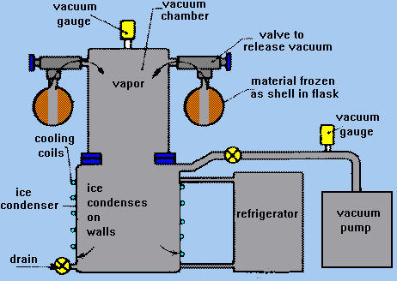
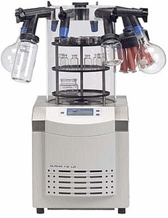
5- specialized drying methods :
A- Freeze dryer: also referred to lyophilization, gelsiccation or drying by sublimation.
Consist of 4 basic components: (1- chamber for vacuum drying, 2- vacuum source, 3- heat source, 4- vapor removal system) .
This method of drying is used for heat sensitive materials and that react with oxygen.
Materials used for such dryings: Blood serum, plasma, hormones, antibiotics, vaccines and bacterial cultures.

Slide 21
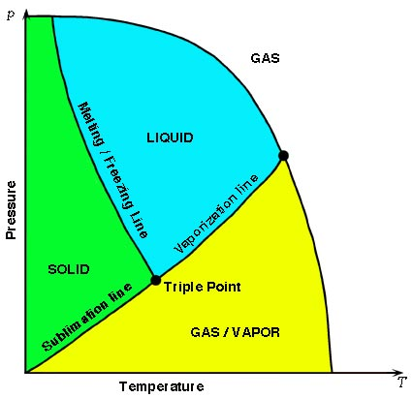
Mechanism: To stabilize these types of materials we use phenomena of sublimation (whereby water containing dissolved solids passes directly from solid state (ice) to the vapor state without passing through the liquid state –melting-).
Thus sublimation can take place at pressure below the triple point [eutectic point] (4.579 mm Hg and 0.0099°C).
[the materials frozen first and then subjected under high vacuum to heat (supplied from conduction, radiation or both) so the frozen liquid in dried material sublimed (frothing) leaving only the solid].

Slide 22
B- microwave drying:
Mechanism: here instead of applying heat externally to material, energy in form of microwaves is converted into internal heat by interaction with material itself
This permits extremely rapid heat transfer throughout the material
Rapid drying.

