Slide 1
Lecture 5
Delivery of Proteins: Routes of Administration and Absorption Enhancement

Slide 2
The parenteral Route of Administration
Parenteral administration is defined as administration via those routes where a needle is used, including intravenous (IV), intramuscular (IM), subcutaneous (SC) and intraperitoneal (IP) injections.
The blood half-life of biotech products can vary over a wide range. For example, the circulation half-life of t-PA is a few minutes, while monoclonal antibodies (MAB) reportedly have half-lives of a few days

Slide 3
Obviously, one reason to develop modified proteins through site directed mutagenesis is to enhance circulation half-life.
A simple way to expand the mean residence time for short half-life proteins is to switch from IV to IM or SC administration.
One should realize that by doing that, changes in disposition may occur, with a significant impact on the therapeutic performance of the drug.

Slide 4
These changes are related to
The prolonged residence time at the IM or SC site of injection compared to IV administration and the enhanced exposure to degradation reactions (peptidases) and
Differences in disposition.

Slide 5
Regarding point 1
Prolonged residence time at IM or SC site of injection and the enhanced exposure to degradation reactions.
for instance, diabetics can become “insulin resistant” through high tissue peptidase activity.
Other factors that can contribute to absorption variation are related to differences in exercise level of the muscle at the injection site.

Slide 6
the state of the tissue, for instance the occurrence of pathological conditions, may be important as well

Slide 7
Regarding point 2
Differences in disposition. Upon administration, the protein may be transported to the blood through the lymphatic or may enter the blood circulation through the capillary wall at the site of injection.
The fraction of the administered dose taking this lymphatic route is molecular weight dependent.

Slide 8
Routes of uptake of SC or IM injected drugs
Blood
Capillary wall
Low Mwt drugs
Site of injection
lymph
High Mwt drugs

Slide 9
Molecular weight of different proteins
rIFN alpha-2a (Mw 19 kDa)
Cytochrome C (Mw 12.3 kDa)
Inulin (Mw 5.2 kDa)
FUdR (Mw 256.2 Da)
The following Figure shows
Cumulative recovery in the efferent lymph from the right popliteal lymph node following SC administration into the lower part of the right hind leg of sheep

Slide 10
Correlation between the molecular weight and cumulative recovery

Slide 11
Lymphatic transport takes time (hours) and uptake in the blood circulation is highly dependent on the injection site.
On its way to the blood, the lymph passes through draining lymph nodes and contact is possible between lymph contents and cells of the immune system such as macrophages, B- and T-lymphocytes residing in the lymph nodes.

Slide 12
The Oral Route of Administration
oral delivery of protein drugs would be preferable because
it is patient friendly and no intervention by a healthcare professional is necessary to administer the drug.
oral bioavailability, however, is usually very low.

Slide 13
The two mean reasons for failure of uptake after oral administration
Protein degradation in the gastrointestinal (GI) tract and
Poor permeability of the wall of the GI tract in case of a passive transport process.

Slide 14
Regarding point 1
protein degradation in the GI tract.
The human body has developed a very efficient system to break down proteins in our food to amino acids, or di- or tri-peptides.
These building stones for body proteins are actively absorbed for use wherever necessary in the body.

Slide 15
In the stomach pepsins, a family of aspartic proteases, are secreted. They are particularly active between pH 3 and 5 and lose activity at higher pH values.
Pepsins are endopeptidases capable of cleaving peptide bonds distant from the ends of the peptide chain. They preferentially cleave peptide bonds between two hydrophobic amino acids

Slide 16
Other endopeptidases are active in the GI tract at neutral pH values, e.g., trypsin, chymotrypsin, and elastase.
They have different peptide bond cleavage characteristics that more or less complement each other.
Exopeptidases, proteases degrading peptide chains from their ends, are present as well. Examples are carboxypeptidase A and B.

Slide 17
In the GI lumen the proteins are cut into fragments that effectively further break down to amino acids, di- and tri-peptides by brush border (microvillus) and cytoplasmic proteases of the enterocytes (intestinal absorptive cells).

Slide 18
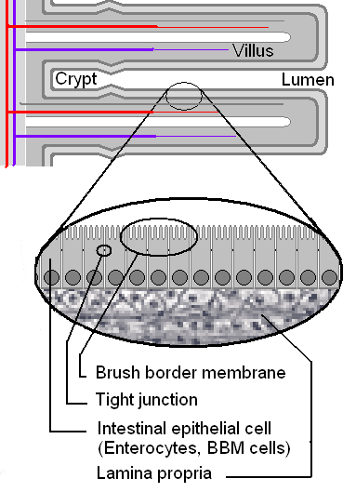

Slide 19
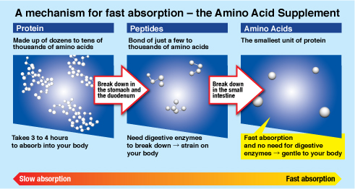

Slide 20
Regarding point 2
permeability.
High molecular weight molecules do not readily penetrate the intact and mature epithelial barrier if diffusion is the sole driving force for mass transfer.
Their diffusion coefficient decreases with increasing molecule size.
Protein are no exception to this rule.

Slide 21
Active transport of intact therapeutic recombinant proteins over the GI-epithelium has not been described yet.

Slide 22
Conclusion
The above analysis leads to the conclusion that nature, unfortunately, does not allow us to use the oral route of administration for therapeutic protein if high (or at least constant) bioavailability is required.

Slide 23
However, for the category of oral vaccines the above-mentioned hurdles of degradation and permeation are not necessarily prohibitive.
For oral immunization, only a (small) fraction of the antigen (protein) has to reach its target site to elicit an immune response.

Slide 24
The target cells are lymphocytes and antigen presenting accessory cells located in Peyer’s patches.
The B-lymphocyte population includes cells that produce secretory IgA antibodies.
These Peyer’s patches are macroscopically identifiable follicular structures located in the wall of the GI tract

Slide 25
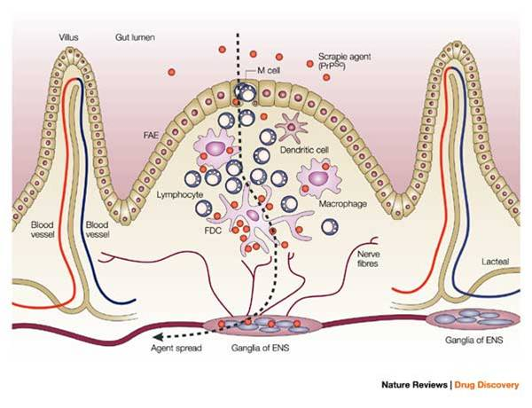

Slide 26
Peyer’s patches are overlaid with microfold (M) cells that separate the luminal contents from the lymphocytes.
These M cells have little lysosomal degradation capacity and allow for antigen sampling by the underlying lymphocytes.
Moreover, mucus producing goblet cell density is reduced over Peyer’s patches.
This reduces mucus production and facilitates access to the M cell surface for luminal contents.

Slide 27
Attempts to improve antigene delivery via the Peyer’s patches and to enhance the immune response are made by using microspheres, liposomes or modified live vectors, such as attenuated bacteria and viruses.

Slide 28
