Slide 1
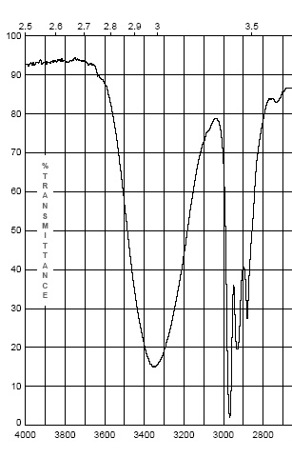
Infrared Spectroscopy
The IR Spectrum
Each stretching and bending vibration occurs with a characteristic frequency as the atoms and charges involved are different for different bonds
The y-axis on an IR spectrum is in units of % transmittance
In regions where the EM field of an osc. bond interacts with IR light of the same ν – transmittance is low (light is absorbed)
In regions where no osc. bond is interacting with IR light, transmittance nears 100%

Slide 2
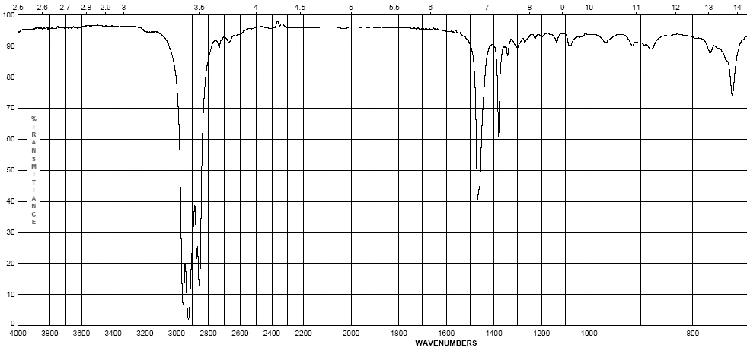
IR Spectroscopy
The IR Spectrum
The x-axis of the IR spectrum is in units of wavenumbers, ν, which is the number of waves per centimeter in units of cm⁻¹ (Remember E = hν or E = hc/λ)

Slide 3
IR Spectroscopy
The IR Spectrum
This unit is used rather than wavelength (microns) because wavenumbers are directly proportional to the energy of transition being observed
High frequencies and high wavenumbers equate higher energy
is quicker to understand than
Short wavelengths equate higher energy
This unit is used rather than frequency as the numbers are more “real” than the exponential units of frequency
IR spectra are observed for the mid-infrared: 600-4000 cm⁻¹
The peaks are Gaussian distributions of the average energy of a transition

Slide 4
IR Spectroscopy
The IR Spectrum
In general:
Lighter atoms will allow the oscillation to be faster – higher energy
This is especially true of bonds to hydrogen – C-H, N-H and O-H
Stronger bonds will have higher energy oscillations
Triple bonds > double bonds > single bonds in energy
Energy/ν of oscillation

Slide 5
Infrared Spectroscopy
The IR Spectrum – The detection of different bonds
As opposed to chromatography or other spectroscopic methods, the area of a IR band (or peak) is not directly proportional to concentration of the functional group producing the peak
The intensity of an IR band is affected by two primary factors:
Whether the vibration is one of stretching or bending
Electronegativity difference of the atoms involved in the bond
For both effects, the greater the change in dipole moment in a given vibration or bend, the larger the peak.
The greater the difference in electronegativity between the atoms involved in bonding, the larger the dipole moment
Typically, stretching will change dipole moment more than bending

Slide 6
Infrared Spectroscopy
The IR Spectrum – The detection of different bonds
It is important to make note of peak intensities to show the effect of these factors:
Strong (s) – peak is tall, transmittance is low (0-35 %)
Medium (m) – peak is mid-height (75-35%)
Weak (w) – peak is short, transmittance is high (90-75%)
* Broad (br) – if the Gaussian distribution is abnormally broad
(*this is more for describing a bond that spans many energies)
Exact transmittance values are rarely recorded

Slide 7
Infrared Spectroscopy
II. Infrared Group Analysis
A. General
The primary use of the IR is to detect functional groups
Because the IR looks at the interaction of the EM spectrum with actual bonds, it provides a unique qualitative probe into the functionality of a molecule, as functional groups are merely different configurations of different types of bonds
Since most “types” of bonds in covalent molecules have roughly the same energy, i.e., C=C and C=O bonds, C-H and N-H bonds they show up in similar regions of the IR spectrum
Remember all organic functional groups are made of multiple bonds and therefore show up as multiple IR bands (peaks)

Slide 8
Infrared Spectroscopy
II. Infrared Group Analysis
A. General
The four primary regions of the IR spectrum
Bonds to H
Triple bonds
Double bonds
Single Bonds
O-H N-H C-H | C≡C C≡N | C=O C=N C=C | Fingerprint Region C-C C-N C-O
4000 cm⁻¹
2700 cm⁻¹
2000 cm⁻¹
1600 cm⁻¹
600 cm⁻¹

Slide 9
Infrared Spectroscopy
Octane
Alkanes – combination of C-C and C-H bonds
C-C stretches and bends 1360-1470 cm⁻¹
CH₂-CH₂ bond 1450-1470 cm⁻¹
CH₂-CH₃ bond 1360-1390 cm⁻¹
sp³ C-H between 2800-3000 cm⁻¹
(w – s)
(m)

Slide 10
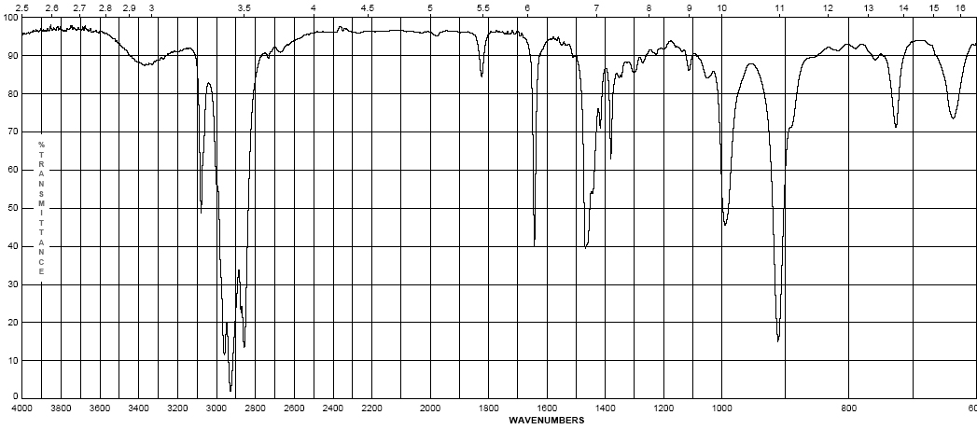
Infrared Spectroscopy
1-Octene
Alkenes – addition of the C=C and vinyl C-H bonds
C=C stretch at 1620-1680 cm⁻¹ weaker as substitution increases
vinyl C-H stretch occurs at 3000-3100 cm⁻¹
The difference between alkane, alkene or alkyne C-H is important! If the band is slightly above 3000 it is vinyl sp² C-H or alkynyl sp C-H if it is below it is alkyl sp³ C-H
(w – m)
(w – m)

Slide 11
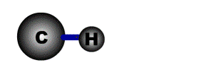
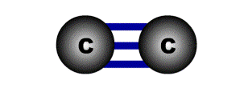
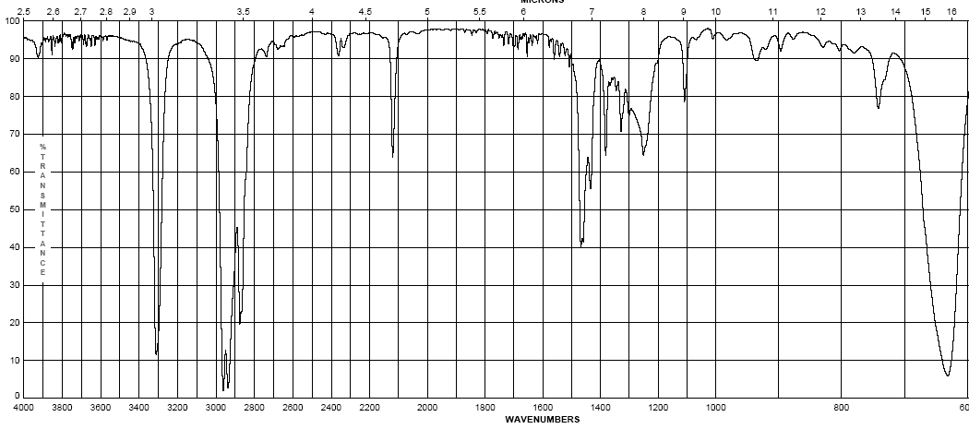
Infrared Spectroscopy
1-Octyne
Alkynes – addition of the C=C and vinyl C-H bonds
C≡C stretch 2100-2260 cm⁻¹; strength depends on asymmetry of bond, strongest for terminal alkynes, weakest for symmetrical internal alkynes
C-H for terminal alkynes occurs at 3200-3300 cm⁻¹
Internal alkynes ( R-C≡C-R ) would not have this band!
(w-m)
(m – s)

Slide 12
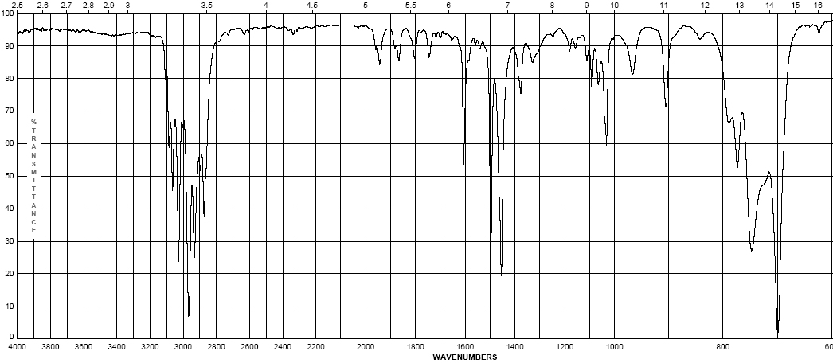
Infrared Spectroscopy
Ethyl benzene
Aromatics
Due to the delocalization of e⁻ in the ring, C-C bond order is 1.5, the stretching frequency for these bonds is slightly lower in energy than normal C=C
These show up as a pair of sharp bands, 1500 & 1600 cm⁻¹, (lower frequency band is stronger)
C-H bonds off the ring show up similar to vinyl C-H at 3000-3100 cm⁻¹
(w – m)
(w – m)

