Slide 1

Sterilization
Industrial Pharmacy
Part 2

Slide 2

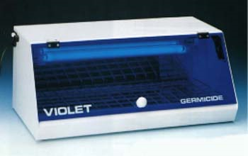
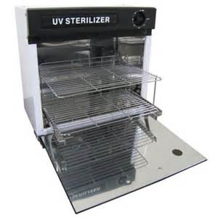
Non-thermal Methods
Ultraviolet Light
It aids in the reduction of contamination in (air and on surfaces) within the processing environment.
Ex: The germicidal light produced by (mercury vapor lamps) is emitted almost exclusively at a wave length of 2537 Angstrom units.
Places of effectiveness:
Ultraviolet light penetrates clean air and pure water well.
Places of ineffectiveness:
But an increase in the salt content and/or the suspended matter in water or air causes a rapid decrease in the degree of penetration.

Slide 3
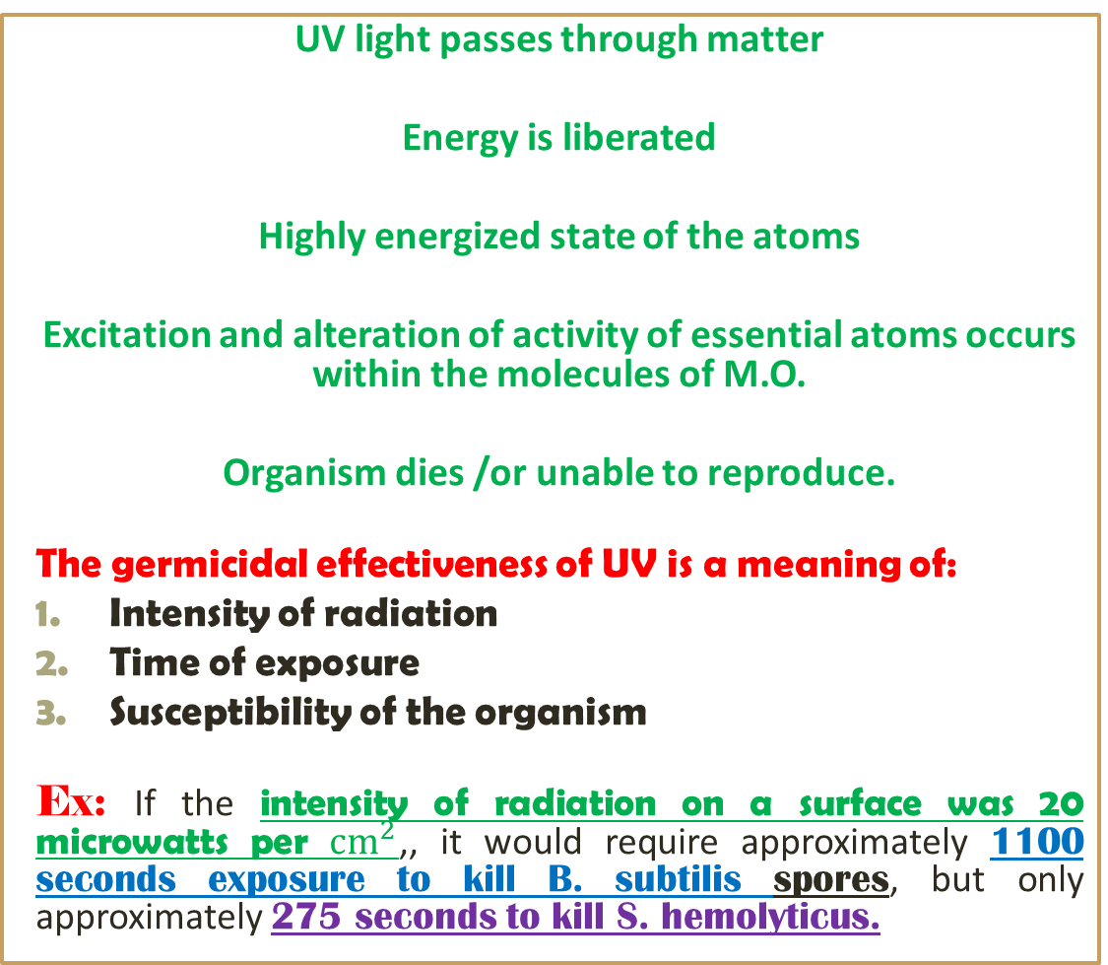
Lethal action of UV sterilization
UV light passes through matter
Energy is liberated
Highly energized state of the atoms
Excitation and alteration of activity of essential atoms occurs within the molecules of M.O.
Organism dies /or unable to reproduce.
The germicidal effectiveness of UV is a meaning of:
Intensity of radiation
Time of exposure
Susceptibility of the organism
Ex: If the intensity of radiation on a surface was 20 microwatts per ${cm}^{2}$,, it would require approximately 1100 seconds exposure to kill B. subtilis spores, but only approximately 275 seconds to kill S. hemolyticus.
Absorbed energy
Alters their reactivity

Slide 4
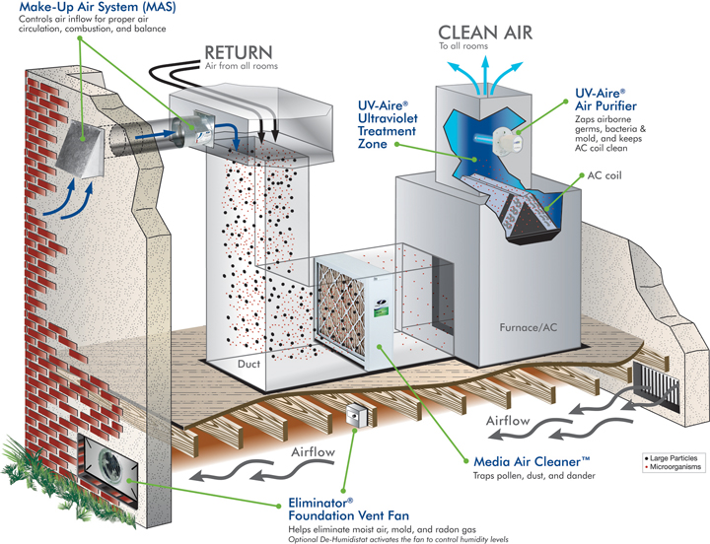
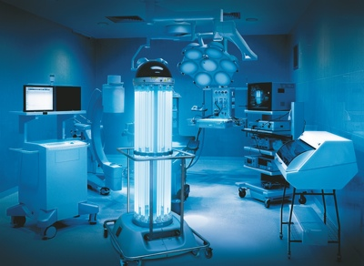
Maintenance, Uses and installation of UV light
Maintenance: to maintain maximum effectiveness.
UV lamps must be kept free from dust, grease, and scratches [because of the large reduction in emission intensity will occur].
Replaced when emission levels decrease (about 30 to 50%) [owing to energy-induced changes in the glass that inhibits the emission].
Uses: UV lamps are used primarily:
Germicidal effect on surfaces
Penetrating effect through clean air and water.
Installation:
Rooms
Air ducts
Large equipment in which the radiation can pass through, irradiate the air and reach exposed surfaces.
Water supplies

Slide 5
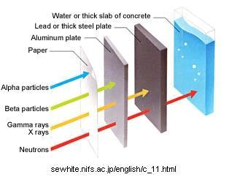
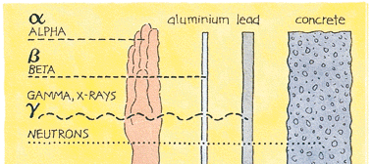
Ionizing Radiations
Ionizing radiations type:
Gamma (X) rays: high-energy radiations emitted from radioactive isotopes such as cobalt-60.
Cathode rays and beta rays: mechanical acceleration of electrons that reaches to very high velocities and energies.
Gamma rays
Advantages
Absolutely reliable, no mechanical breakdown
Providing a higher and more uniform dose rate output.
Disadvantages
Expensive.
Emission cannot be shut off as it can from the mechanical source of accelerated electrons.

Slide 6
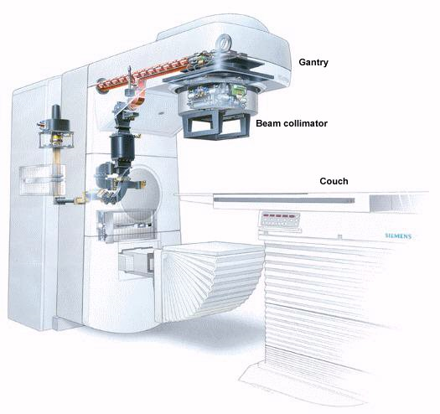
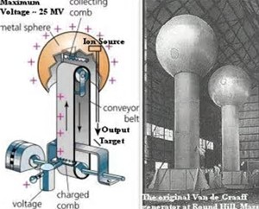
Electron Accelerators
Electron accelerators are of two general types:
linear accelerators
Principle: very high-frequency microwaves (radar) collect electrons from a cathode
Accelerate electrons as they travel through the vacuum tube reaching the speed of light
The electrons are emitted and directed to the target at an energy range of 3 to 9 million electron volts (meV).
The Van de Graaff accelerators
Are capable of energy potentials up to 3 meV.
Principle: utilize the force exerted on a charged particle by a high voltage potential in an electric field as a means of direct particle acceleration.

Slide 7

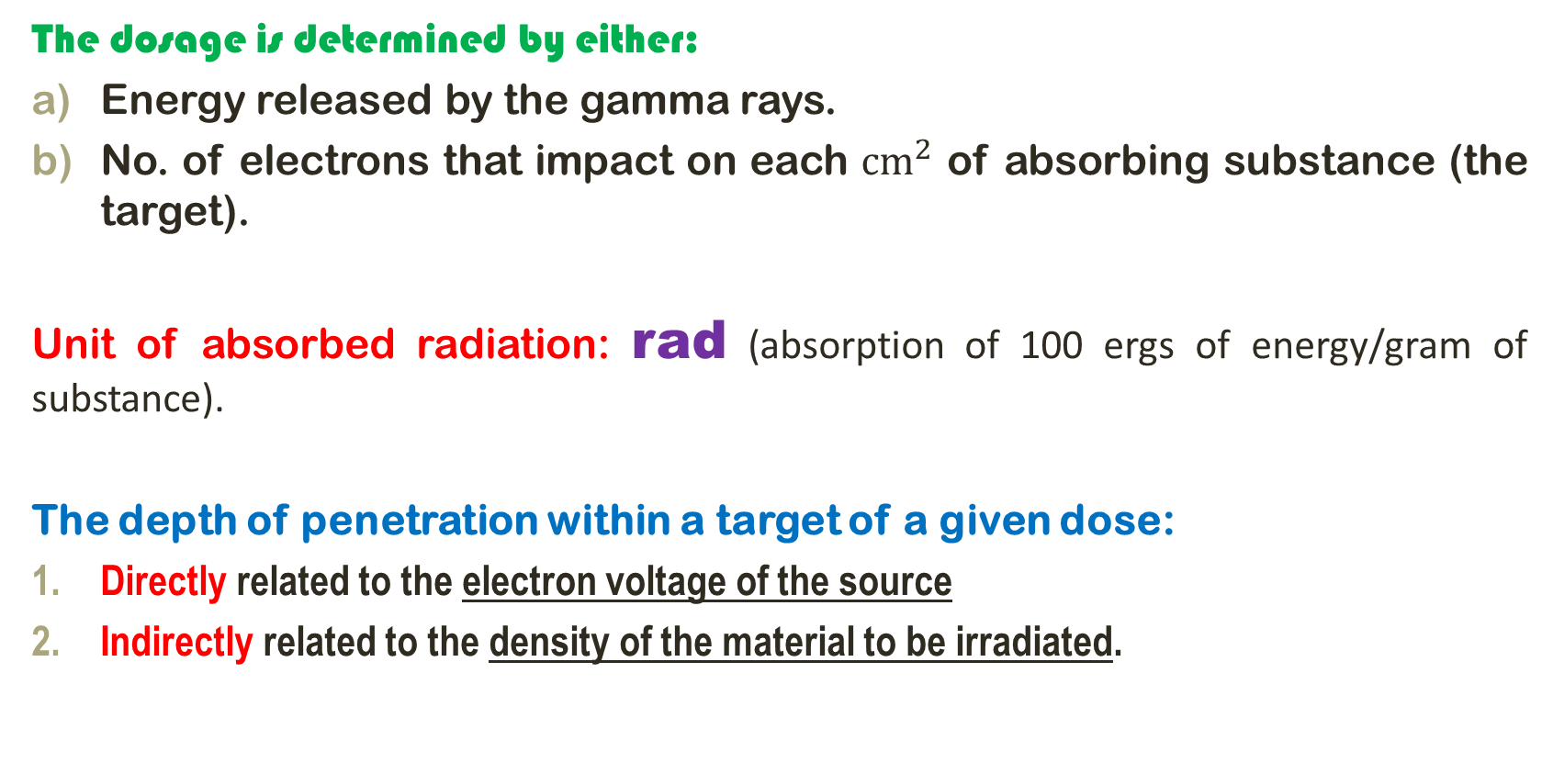
Determination of Dosage
The dosage is determined by either:
Energy released by the gamma rays.
No. of electrons that impact on each ${cm}^{2}$ of absorbing substance (the target).
Unit of absorbed radiation: rad (absorption of 100 ergs of energy/gram of substance).
The depth of penetration within a target of a given dose:
Directly related to the electron voltage of the source
Indirectly related to the density of the material to be irradiated.

Slide 8
Lethal Action and Dosage
Lethal action: ionizing radiations destroy M.O. by stopping reproduction as a result of lethal mutations.
Mutations by direct-hit theory [transfer of radiation beam energies to receptive molecules in their path].
Mutations by indirect action [water molecules are transformed into highly energized entities such as hydrogen and hydroxyl ions].
Bring energy changes in nucleic acids and other molecules
eliminating their availability for the metabolism of the bacterial cell.
Dose: Bacterial spores and viruses are generally four to five times more resistant than vegetating bacteria and molds.
A dose of 2 to 2.5 megarads, is adequate to ensure sterility.
Both 1 and 2

Slide 9
Applications for Sterilization
Note: A) Accelerated electrons or gamma rays used to sterilize select products by a continuous process.
B) Most other product sterilization procedures performed in batches.
Assurance of adequate dose delivery determined by:
Photographic film
Biologic indicator (Bacillus pumilus).
Application of radiation:
Sterilization of medical plastic devices.
No. of vitamins, antibiotics, and hormones in the dry state.
Not Applied: Liquid pharmaceuticals are difficult to sterilize
[Because of the potential effect of the radiations on the vehicle system as well as the drug].

Slide 10

Filtration
Filtration used for:
Removal of particles (M.O.) from solutions and gases without the application of heat and not alter the solution or gas (neither removing desired constituents nor imparting undesired components).
Note: 1- all currently in use filters with parenteral solutions and gases are of the membrane type (tissue-thin material) removing particles primarily by sieving.
Mechanism: remove constituents from a solution due to the phenomenon of adsorption (surface phenomenon) which occurs during only the first portion of the filtration, then the surface of the filter is saturated with the adsorbed molecule or ion.

Slide 11
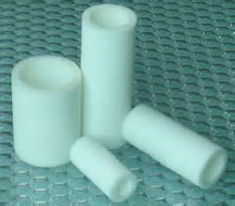
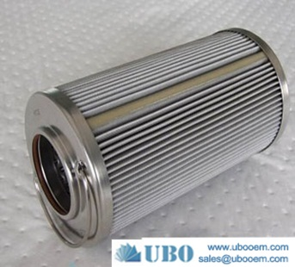
2- Development of membrane filters composed of materials having high resistance to most pharmaceutical solvents has further reduced this problem.
Composition of membrane filters:
Plastic polymers (cellulose acetate and nitrate, nylon, polyvinyl chloride, polycarbonate, polysulfone and Teflon).
Sintered metals (stainless steel and silver) used when highly durable characteristics are required.

Slide 12

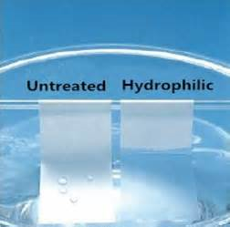
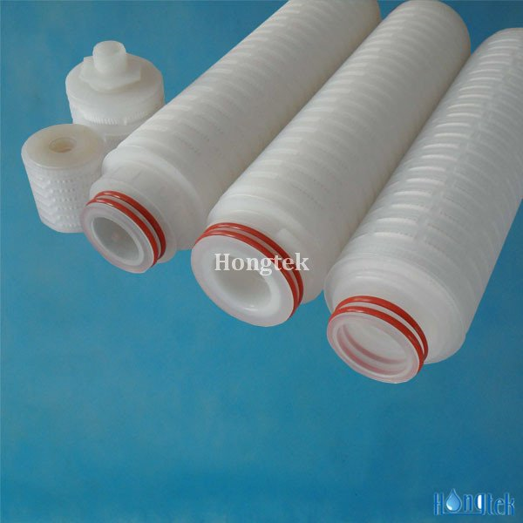
Note: most membrane filters are disposable (problem of cleaning after use is limited to the reusable filter housing and support screen).
Made of stainless steel or tough plastic polymers that are cleaned rather easily that might introduce contamination in subsequent use.
Type of membranes:
Hydrophilic membranes: rendered hydrophilic by treatment with a surface active agent at the time of manufacture.
Note: If this is not done, particularly at the lower porosities, an aqueous solution cannot be forced through the filter except under very high pressure.
Hydrophobic membranes: when nonwetting with water is desired as with non-aqueous solvents as ethanol and inert gases, the polymer is left in its hydrophobic form.

Slide 13

Function of Filters
Membrane filters function primarily by sieving
Screening particles from a solution or gas.
Mechanism of depth filter (glass and paper): little entrapment within the filter medium because of the nature of membrane filters and thickness.
Membrane filters by electrostatic attraction [filtration of dry gases], in which electrostatic charges tend to increase because of the frictional effect of the flowing gas.
The pores, or holes, through any filter medium consist of a range of sizes:
Filter with diameter of 0.2 micron (used in sterilization).
Filter with diameter as large as 0.5 micron (few or rare in number of a microbial spore finding) [not acceptable as an absolute means of sterilizing a solution].
retaining them on the filter surface

Slide 14
How to increase the probability of achieving a sterile filtrate??
Solution passed through a series of two 0.2-micron porosity filters.
Using 0.1-micron porosity filter but this would greatly reduce the flow rate.
Problem: Using membrane filters and particles may present in the solution so retained on the surface if the content is relatively high and plug the filter so that the flow of solution decreases and perhaps stops.
Solution: the solution processed by passing it through one or more prefilters (porous depth filter).
Avoid: prolong filtration time or high pressure differential, or frequent fluctuation of the pressure.
Because particles may gradually migrate through the filter

Slide 15
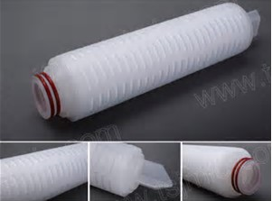
Liquid Flow Through a Filter
The flow rate of a liquid through a filter is affected by:
Size of pores through filter
Pore volume (proportion of open space to solid matrix)
S.A. of filter
Pressure differential across filter
Viscosity of liquid.
Problem 1: How to increase flow rate if there is a difficulty of increasing S.A. of filter.
Solution: folded filter in a cartridge form is used large increase in surface area within a small overall dimension of the filter unit.
Problem 2: How to decrease pressure differential with the preventing of negative pressure in the filtrate chamber as the vacuum may be drawn downstream of the filter.
Solution: filtrations designed to render solutions sterile, positive pressure is applied on the liquid upstream of the filter using a gas filtered to be free from microorganisms.

Slide 16
Problem3: Solutions having a high viscosity normally have a slow flow rate.
Solution: the rate can be increased by warming the solution, thereby reducing its viscosity provided the warming does not have an adverse affect on the solution.
Problem4: High amount of solid matrix is in proportion to the pore spaces, the lower are the pore volume and the flow rate.
Solution: as the flow rate through a filter is depending on the relative pore volume of the filter so all filters must have a lower amount of solid matrix that forms the framework for the pores.

Slide 17
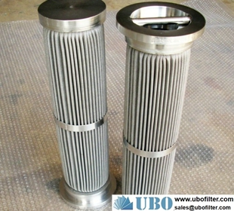
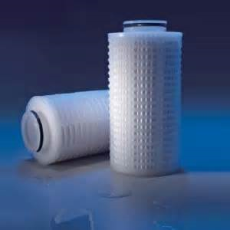
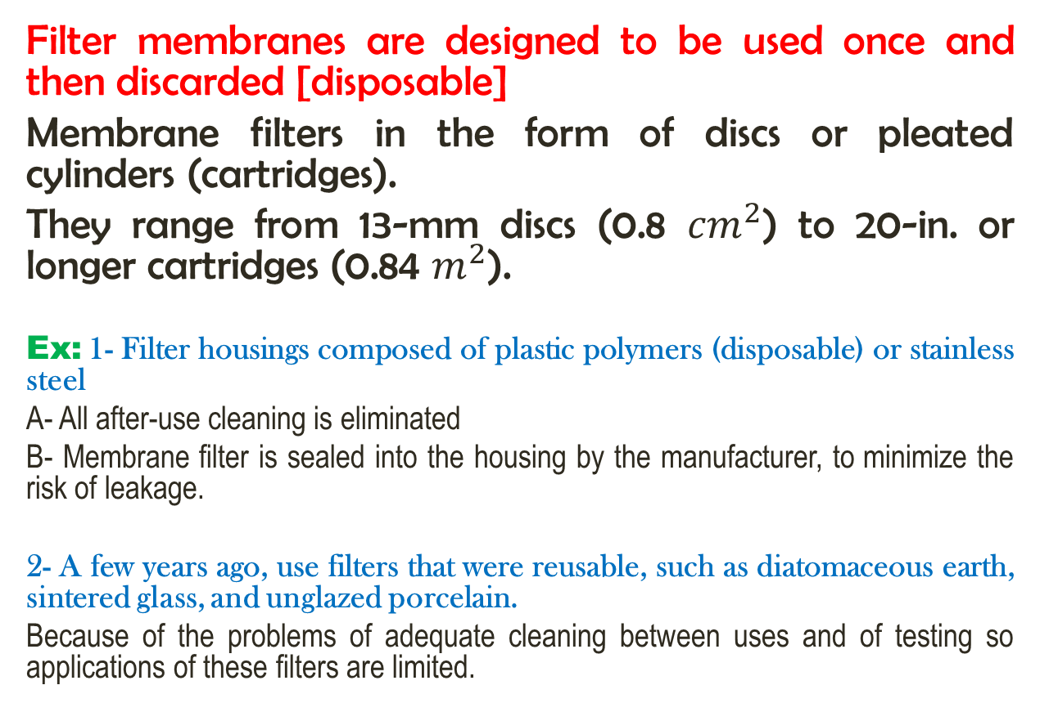
Types of Filters
Filter membranes are designed to be used once and then discarded [disposable]
Membrane filters in the form of discs or pleated cylinders (cartridges).
They range from 13-mm discs (0.8 ${cm}^{2}$) to 20-in. or longer cartridges (0.84 $m^{2}$).
Ex: 1- Filter housings composed of plastic polymers (disposable) or stainless steel
A- All after-use cleaning is eliminated
B- Membrane filter is sealed into the housing by the manufacturer, to minimize the risk of leakage.
2- A few years ago, use filters that were reusable, such as diatomaceous earth, sintered glass, and unglazed porcelain.
Because of the problems of adequate cleaning between uses and of testing so applications of these filters are limited.

Slide 18
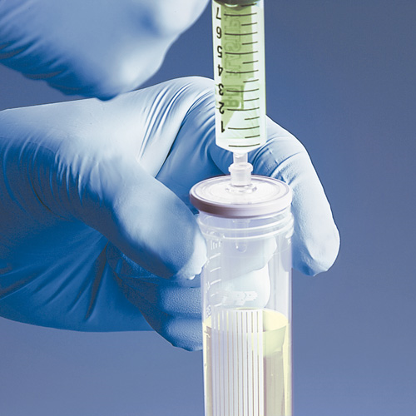
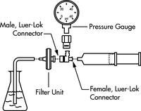
Testing of Filters
Testing the pore size and integrity of the filter membrane filters should be checked before use.
bubble point test [The least complicated method]
A- Hydrophilic membrane: test is performed by applying air pressure, or other gas pressure, to the upstream side of a hydrophilic filter in which the pores are filled with water.
The pressure is gradually increased until bubbles pass through the filter and are detected in a liquid downstream.
Note: bubble point pressure is inversely proportional to the diameter of the pores, and thus is a measure of the largest pores. Even a pinhole or similar defect in the filter, bubbling occurs at a much lower pressure than expected.
B- Hydrophobic membranes: filter is usually wet with ethanol or methanol prior to application of the air pressure.

Slide 19
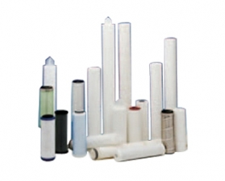
C- cartridge-type filters (measure diffusion of air, or other gas, through the water-filled pores of the filter medium because of the large surface area).
Mech.: Pressure is applied to the upstream side of the filter at approximately 10% of the bubble test pressure.
Filtration rate is measured by the volume of the air collected downstream or by the loss of pressure from the upstream side as the air diffuses.
Microbial challenge test (direct test with respect to the ability of a filter to retain microorganisms)
A standardized culture containing a large number of small microorganisms, such as Pseudomonas diminuta, is filtered.
The objective: finding oversized pores in the filter by the challenge of a large number of small microorganisms.
After filtration: the presence of bacteria in the filtrate constitutes a failure of the filter to sterilize the liquid (part of Q.C. program manufacturer) but rarely used in the pharmaceutical plant for individual filters.

Slide 20
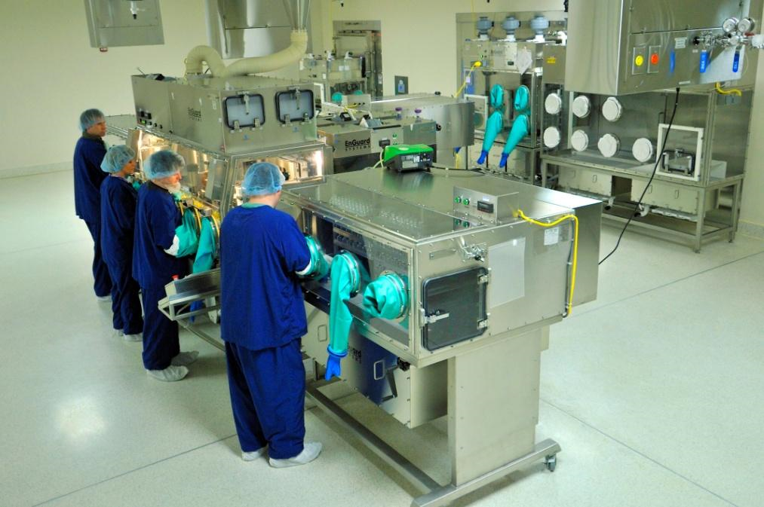
Aseptic Processing
The objective of this process:
Sterilization of a solution by filtration provides an extremely clean solution, removing dirt particles as well as M.O.
Filtrate transferred from the receiver and subdivided into the individual final containers.
Accomplishing requires a rigidly controlled aseptic environment and technique.
Application: solutions adversely affected by heat, may be the only way in which sterilization is accomplished.

Slide 21
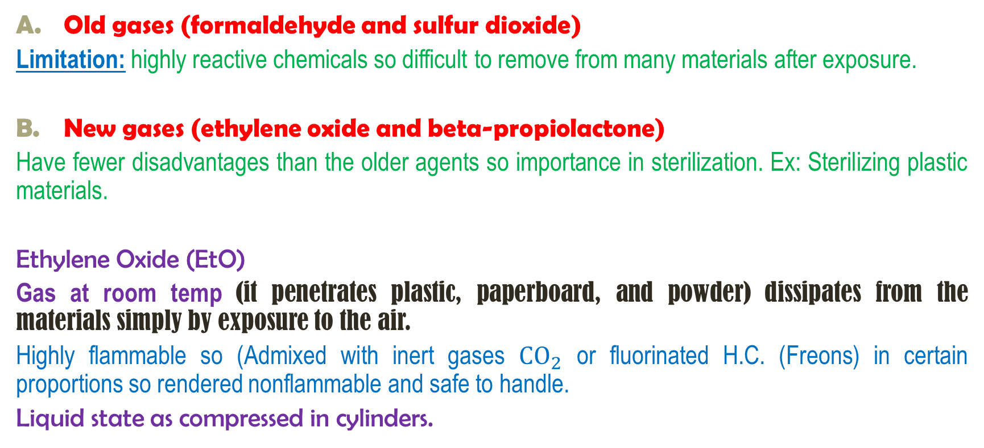
Chemical Processes of Sterilization
Gas Sterilization
Old gases (formaldehyde and sulfur dioxide)
Limitation: highly reactive chemicals so difficult to remove from many materials after exposure.
New gases (ethylene oxide and beta-propiolactone)
Have fewer disadvantages than the older agents so importance in sterilization. Ex: Sterilizing plastic materials.
Ethylene Oxide (EtO)
Gas at room temp (it penetrates plastic, paperboard, and powder) dissipates from the materials simply by exposure to the air.
Highly flammable so (Admixed with inert gases ${CO}_{2}$ or fluorinated H.C. (Freons) in certain proportions so rendered nonflammable and safe to handle.
Liquid state as compressed in cylinders.

Slide 22
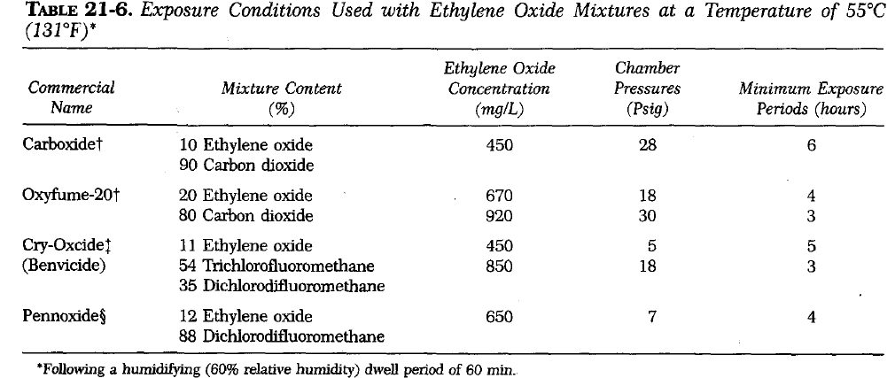
Sterilizing Process
Sterilization with EtO is validated procedure using a pressure chamber:
The material is placed in a room or chamber and exposed to a relative humidity of up to 98% for a period of 60 min or longer.
Then placed in chamber previously heated to 55°C and an initial vacuum of 27 in. Hg is drawn.
EtO is introduced with moisture to achieve a relative humidity of 50 to 60% to the pressure required to give the desired concentration of ethylene oxide which is maintained throughout the exposure period (6-24h)
Gas is exhausted and a vacuum of 25 inches Hg is drawn.
Filtered air is then introduced into the chamber until atmospheric pressure is attained.

Slide 23
Factors affecting sterilization time with EtO
A heated chamber is decreasing the time required for this sterilization process.
A temperature of 55°C has no adverse effect on most substances then a rise in temp of 17°C permits the shortening of the exposure period by about one half.
Moisture found to exert a significant effect on the sterilization process.
A moisture up to 95% RH should be the first step in every sterilizing cycle as an aid in the distribution and absorption of moisture by the material to be sterilized then a relative humidity (RH) of 30% or more is essential for effective antibacterial activity.
Note: M.O. must be hydrated if to be killed by EtO within the usual cycle time.
The exposure conditions with EtO conc. higher than the min. effective conc. of 450 mg/liter of chamber volume reduce the exposure period.
Note: The conc. employed are directly related to the pressure of the various mixtures required to attain that conc.

Slide 24
Note: liquid ethylene oxide is frequently used by vaporized into the sterilizing chamber previously evacuated to at least 28 in. Hg.
How to evacuate of EtO??
Dissipation of EtO from materials is accomplished at the end of a sterilizing cycle by the evacuation followed by a short period of aeration, that is, exposure to the normal atmosphere.
Disadvantages:
Rubber, certain plastics, and leather-have a strong affinity for EtO and may require prolonged aeration, as long as 12 to 24 hours, before items safely be used.
Tissue irritation may result if the Eto is not entirely dissipated.
Carcinogenic and mutagenic properties of EtO and residues in materials for human use.

Slide 25
Mechanism of Action of Ethylene oxide: exert lethal effect upon M.O. by alkylating essential metabolites, affecting particularly the reproductive process.
The alkylation occurs by replacing an active hydrogen on sulfhydryl, amino, carboxyl, or hydroxyl groups with a hydroxyethyl radical.
The altered metabolites are not available to the M.O., and so it dies without reproducing.
Limitation: Alkylation occur with drug molecules in liquid state so EtO sterilization is limited
Application:
dry powders of substances are unaffected
plastic materials, rubber goods, and delicate optical instruments.
stainless steel equipment has a longer useful life when sterilized with ethylene oxide instead of steam.
sterilize parenteral administration sets, hypodermic needles, plastic syringes due to effective penetrability of EtO.

Slide 26
Surface Disinfection
The use of chemical disinfectants to reduce microbial population so that asepsis can be maintained in a limited, controlled environment.
The effectiveness of a disinfectant depends on:
Nature of the surface
Nature and degree of contamination
Microbicidal activity of the agent.
Important notes:
Hard smooth surfaces are much easier to disinfect than rough porous ones.
Most disinfectants are not effective against spores, only vegetative forms of M.O. killed so it is essential to select an agent that has been proven effective against the common contaminants.

Slide 27
1- A germicides for smooth hard surfaces contain:
2% solution of one of the phenolic germicide cleaners for floors and walls, and 1:1000 concentrations of quaternary ammonium solutions or 1 to 2% solutions of phenolic.
2- A germicides for metallic object contain:
0.2% sodium nitrite added to the quaternary ammonium solutions and 0.5% sodium bicarbonate to the phenolic to prevent rusting.
Higher concentrations of disinfectants normally would be expected to be more effectively bactericidal.

Slide 28


