Slide 1
ANTI HYPERTENSIVE DRUGS

Slide 2
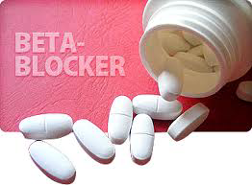

Slide 3
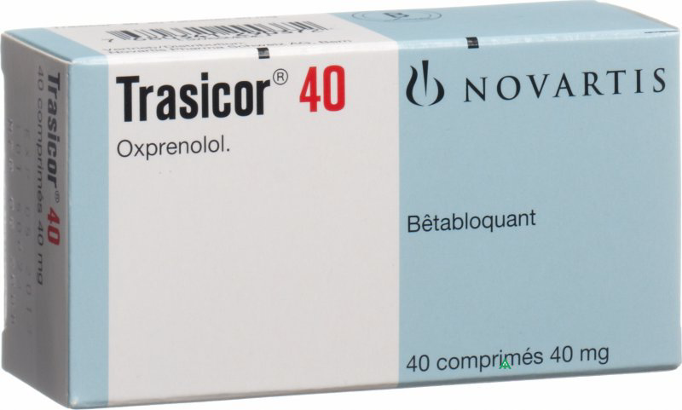
Beta-adrenoceptor blocking drugs
Beta-adrenoceptor blocking drugs (beta-blockers) block the beta-adrenoceptors in the heart, peripheral vasculature, bronchi, pancreas, and liver.
Intrinsic sympathomimetic activity (ISA, partial agonist activity) represents the capacity of beta-blockers to stimulate as well as to block adrenergic receptors.they tend to cause less bradycardia than the other beta-blockers and may also cause less coldness of the extremities.
Oxprenolol , pindolol , acebutolol, and celiprolol
ISA
Partial agonist

Slide 4
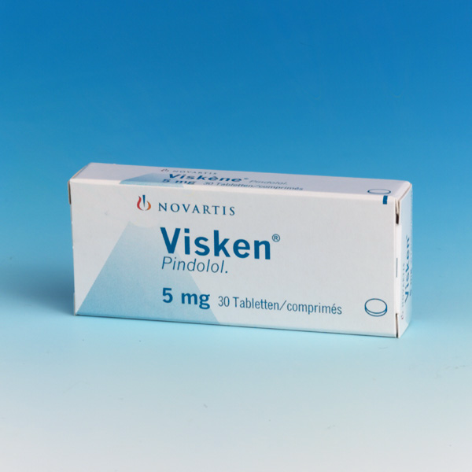
ISA
Partial agonist

Slide 5
Some beta-blockers are lipid soluble and some are water soluble.
Atenolol, celiprolol, nadolol, and sotalol hydrochloride are the most water soluble; they are less likely to enter the brain, and may therefore cause less sleep disturbance and nightmares.
Water-soluble beta-blockers are excreted by the kidneys and dosage reduction is often necessary in renal impairment.
Beta-blockers with a relatively short duration of action have to be given two or three times daily. Many of these are, however, available in modified-release formulations so that administration once daily is adequate for hypertension.
For angina twice-daily treatment may sometimes be needed even with a modified-release formulation

Slide 6
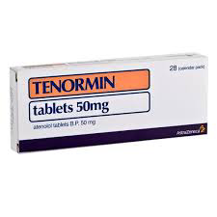
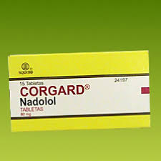
water soluble

Slide 7
Beta-blockers slow the heart and can depress the myocardium; they are contra-indicated in patients with second- or third-degree heart block.
Beta-blockers should also be avoided in patients with worsening unstable heart failure; care is required when initiating a beta-blocker in those with stable heart failure.
Beta-blockers can precipitate bronchospasm and should therefore usually be avoided in patients with a history of asthma. When there is no suitable alternative, it may be necessary for a patient with well-controlled asthma, or chronic obstructive pulmonary disease (without significant reversible airways obstruction), to receive treatment with a beta-blocker for a co-existing condition (e.g. heart failure or following myocardial infarction). In this situation, a cardioselective beta-blocker should be selected and initiated at a low dose by a specialist.
cardioselective beta-blocker
Atenolol, bisoprolol , metoprolol , nebivolol, and (to a lesser extent) acebutolol
.

Slide 8
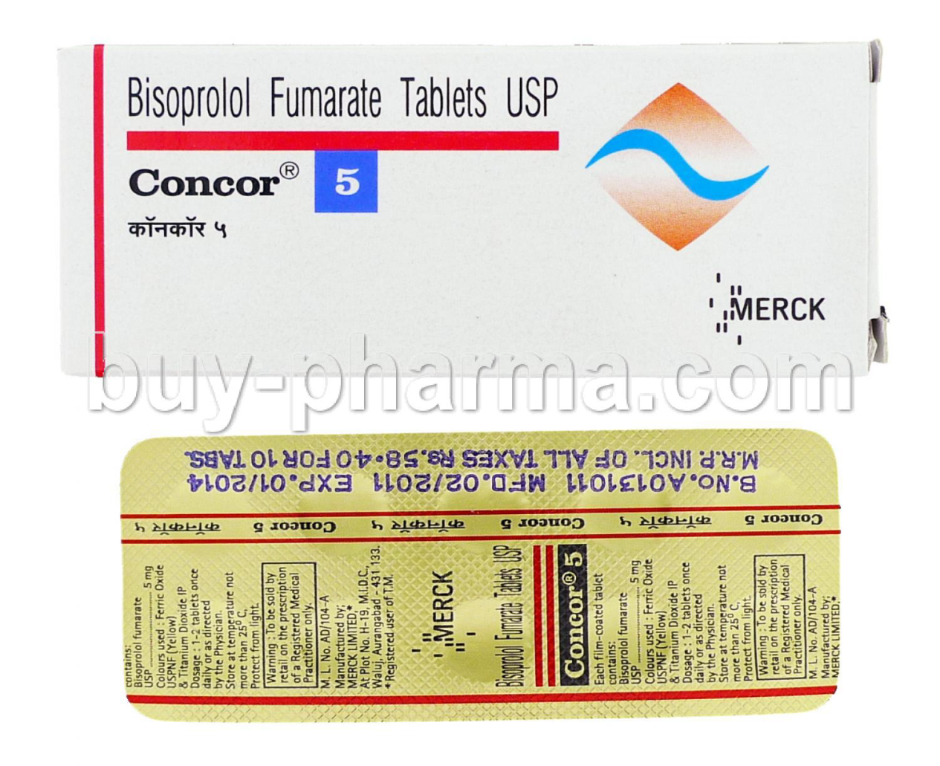
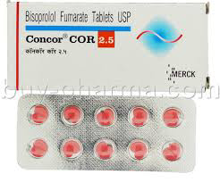
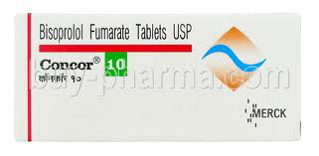
Water Soluble
Selective

Slide 9
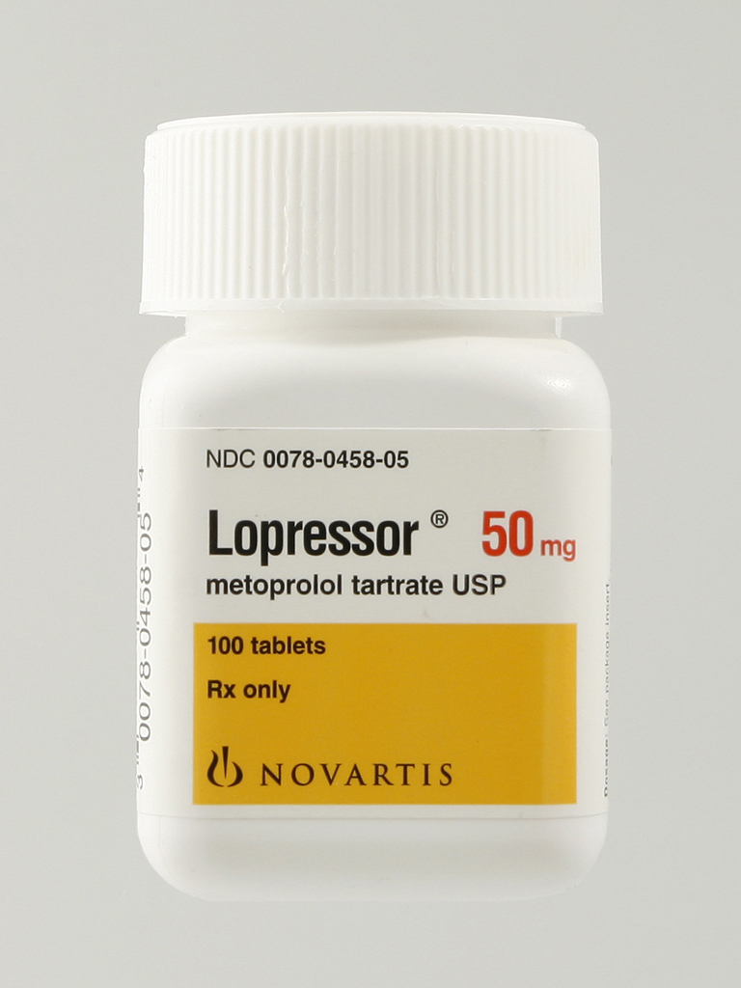
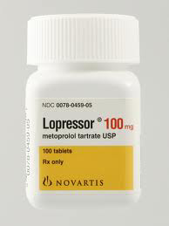
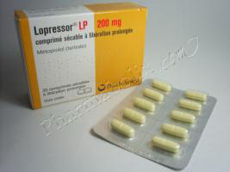

Slide 10
Beta-blockers can affect carbohydrate metabolism, causing hypoglycaemia or hyperglycaemia in patients with or without diabetes; they can also interfere with metabolic and autonomic responses to hypoglycaemia, thereby masking symptoms such as tachycardia.
However, betablockers are not contra-indicated in diabetes, although the cardioselective beta-blockers may be preferred.
Betablockers should be avoided altogether in those with frequent episodes of hypoglycaemia.
Beta-blockers, especially when combined with a thiazide diuretic, should be avoided for the routine treatment of uncomplicated hypertension in patients with diabetes or in those at high risk of developing diabetes.

Slide 11
Clinical Use
1-Hypertension
2-Angina By reducing cardiac work beta-blockers improve exercise tolerance and relieve symptoms in patients with angina.. Sudden withdrawal may cause an exacerbation of angina and therefore gradual reduction of dose is preferable when beta-blockers are to be stopped. There is a risk of precipitating heart failure when beta-blockers and verapamil are used together in established ischaemic heart disease .
3-Myocardial infarction some beta-blockers can reduce the recurrence rate of myocardial infarction. Atenolol and metoprolol may reduce early mortality after intravenous and subsequent oral administration in the acute phase, while acebutolol, metoprolol, propranolol, and timolol have protective value when started in the early convalescent phase. Sudden cessation of a beta blocker can cause a rebound worsening of myocardial ischaemia

Slide 12
4-Arrhythmias
They can be used in conjunction with digoxin to control the ventricular response in atrial fibrillation, especially in patients with thyrotoxicosis.
Beta-blockers are also useful in the management of supraventricular tachycardias.
5-Heart failure
Bisoprolol and carvedilol reduce mortality in any grade of stable heart failure; nebivolol is licensed for stable mild to moderate heart failure in patients over 70 years. Treatment should be initiated by those experienced in the management of heart failur
6-Thyrotoxicosis
Beta-blockers are used in pre-operative preparation for thyroidectomy. Administration of propranolol hydrochloride can reverse clinical symptoms of thyrotoxicosis within 4 days. Routine tests of increased
thyroid function remain unaltered. The thyroid gland is rendered less vascular thus making surgery easier.

Slide 13
Other uses
1-Beta-blockers have been used to alleviate some symptoms
of anxiety; probably patients with palpitation, tremor, and tachycardia respond best.
2-Beta-blockers are also used in the prophylaxis of migraine.
3-timolol maleate are used topically in glaucoma.
contrindications Asthma . cardiogenic shock .hypotension . marked bradycardia . metabolic acidosis .phaeochromocytoma Prinzmetal’s angina . second-degree AV block .severe peripheral arterial disease . sick sinus syndrome. third-degree AV block . uncontrolled heart failure.

Slide 14
cautions
Diabetes . first-degree AV block . history of obstructive airways disease (introduce cautiously) myasthenia gravis . portal hypertension (risk of deterioration in liver function) . psoriasis . symptoms of hypoglycaemia may be masked . symptoms of thyrotoxicosis may be masked
Side-effects
gastro-intestinal disturbances; bradycardia, heart failure, hypotension, conduction disorders, peripheral vasoconstriction (including exacerbation of intermittent claudication and Raynaud’s phenomenon); . Beta-blockers associated with fatigue, coldness of the extremities (may be less common with those with ISA), and sleep disturbances with nightmares (may be less common with the water-soluble beta blockers).
bronchospasm , dyspnoea;headache, fatigue, sleep disturbances, paraesthesia, dizziness, vertigo, psychoses;
sexual dysfunction; purpura, thrombocytopenia; visual disturbances; exacerbation of psoriasis, alopecia; rarely rashes and dry eyes (reversible on withdrawal).

Slide 15
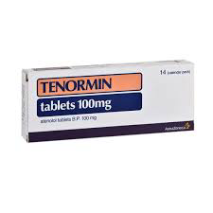
Water Soluble
Selective

Slide 16
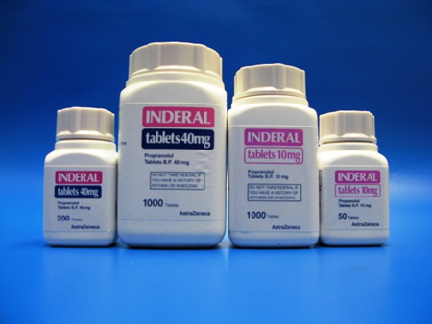
Lipid soluble β-blocker

Slide 17
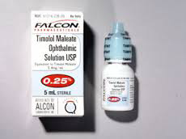
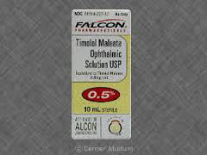
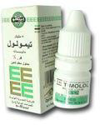
Glucoma

Slide 19
Calcium-channel blockers
Calcium-channel blockers (less correctly called ‘calcium-antagonists’) interfere with the inward displacement of calcium ions through the slow channels of active cell membranes. They influence the myocardial cells, the cells within the specialised conducting system of the heart, and the cells of vascular smooth muscle. Thus,
myocardial contractility may be reduced, the formation and propagation of electrical impulses within the heart may be depressed, and coronary or systemic vascular tone
may be diminished.

Slide 20
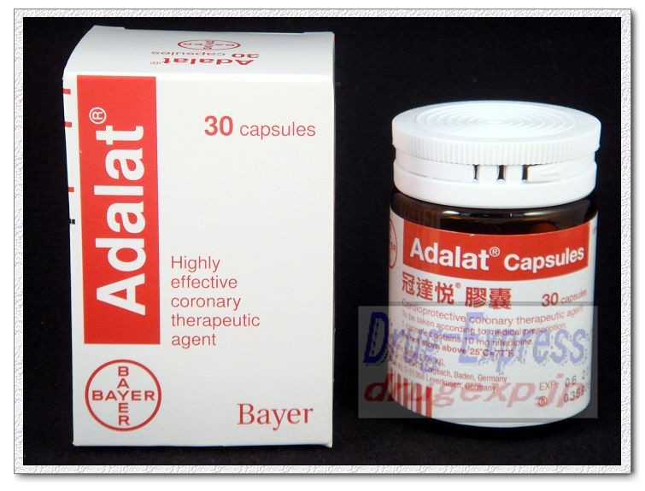
Nifedipine
relaxes vascular smooth muscle and dilates coronary and peripheral arteries. It has more influence on vessels and less on the myocardium than does verapamil hydrochloride, and unlike verapamil hydrochloride has no
anti-arrhythmic activity. It rarely precipitates heart failure

Slide 21
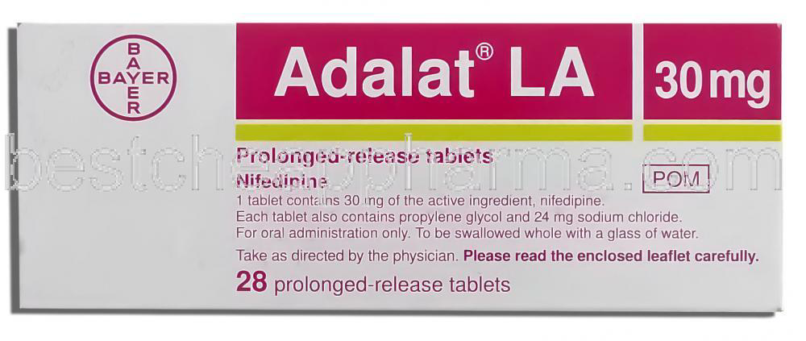
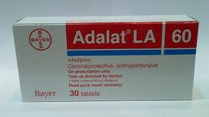

Slide 22
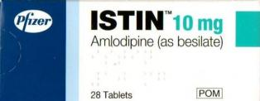
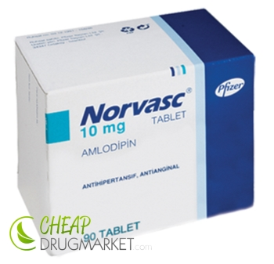

Slide 23
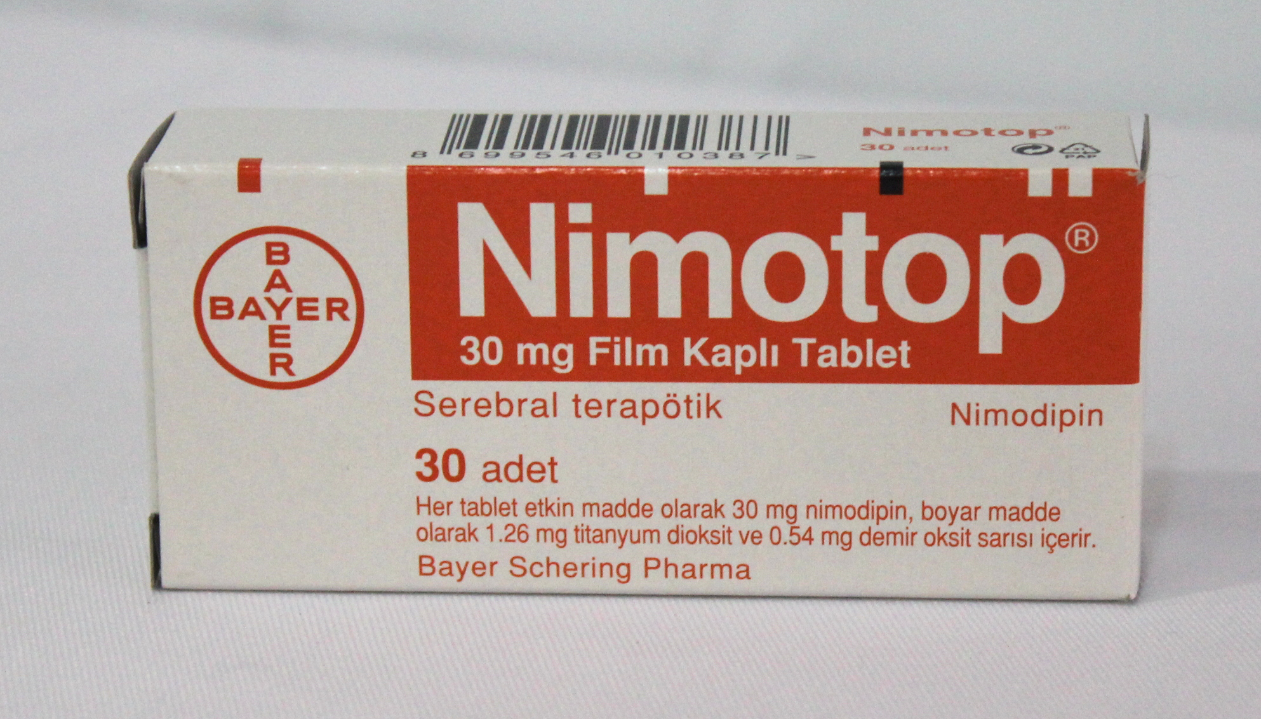
Nimodipine
is related to nifedipine but the smooth muscle relaxant effect preferentially acts on cerebral arteries. Its use is confined to prevention and treatment of vascular spasm following aneurysmal subarachnoid haemorrhage.

Slide 24
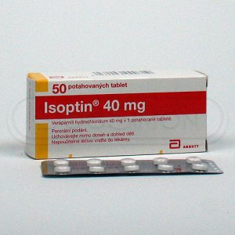
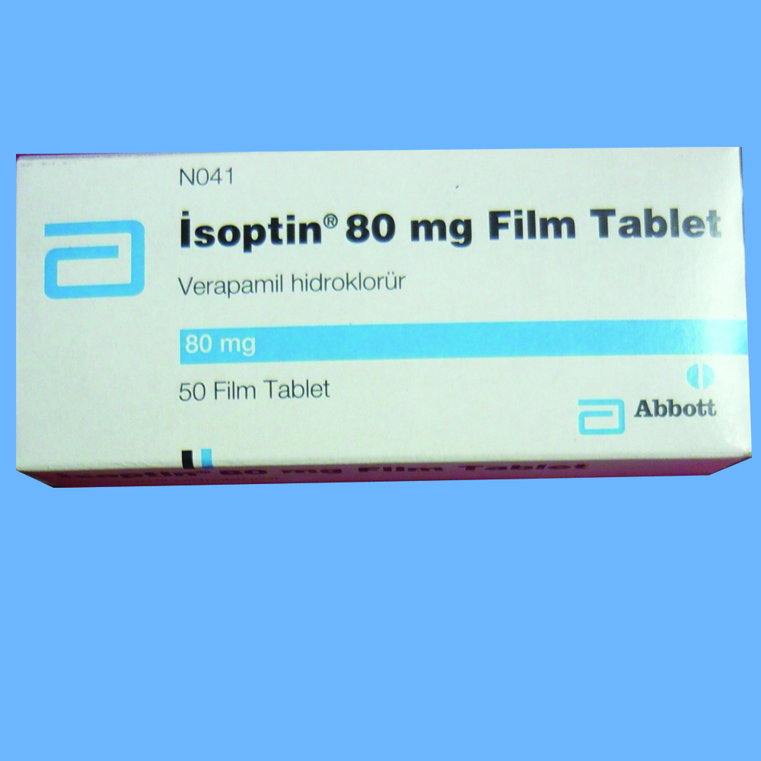
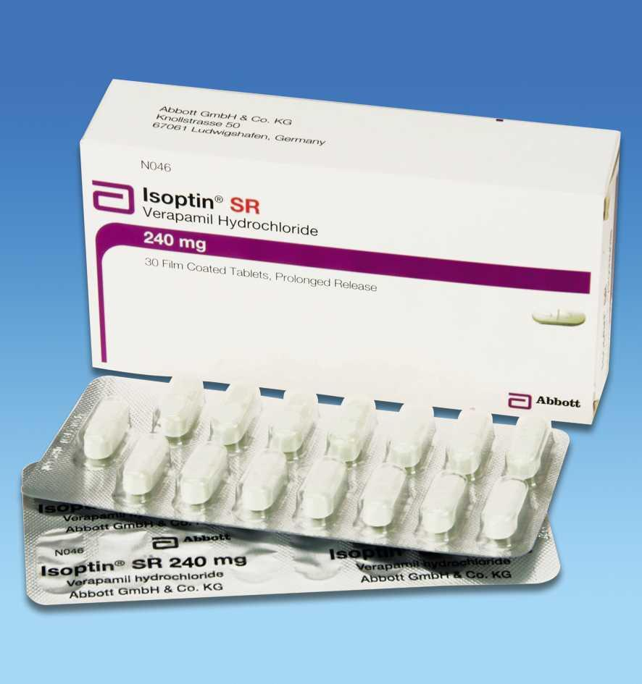
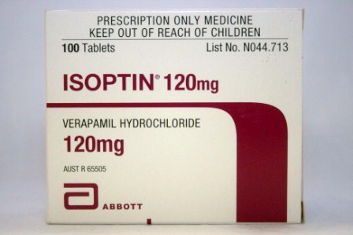

Slide 25
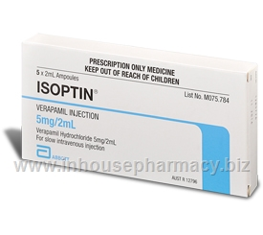
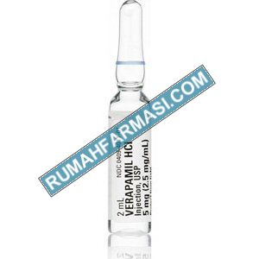
Verapamil is used for the treatment of angina, hypertension, and arrhythmias. It is a highly
negatively inotropic calcium channel-blocker and it reduces cardiac output, slows the heart rate, and may impair atrioventricular conduction. It may precipitate heart failure,
exacerbate conduction disorders, and cause hypotension at high doses and should not be used with beta-blockers.
Constipation is the most common side-effect.

Slide 26
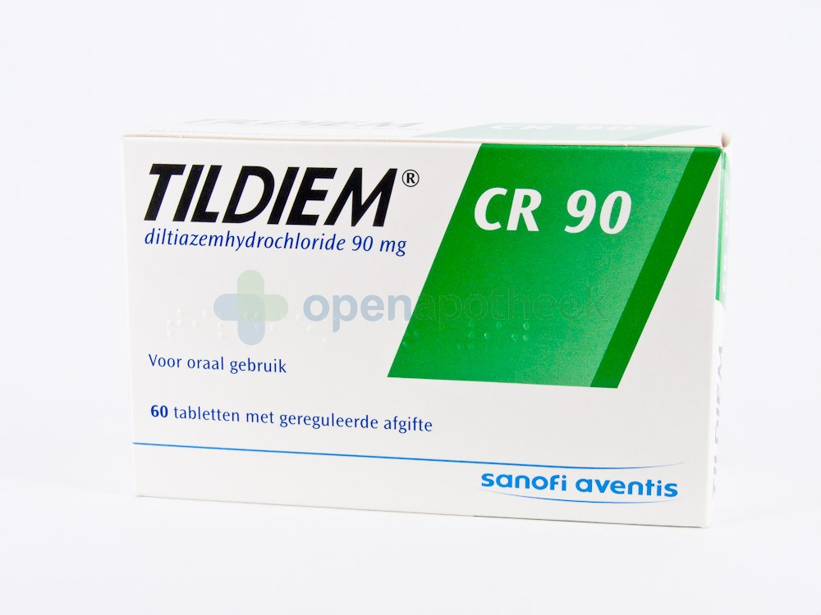
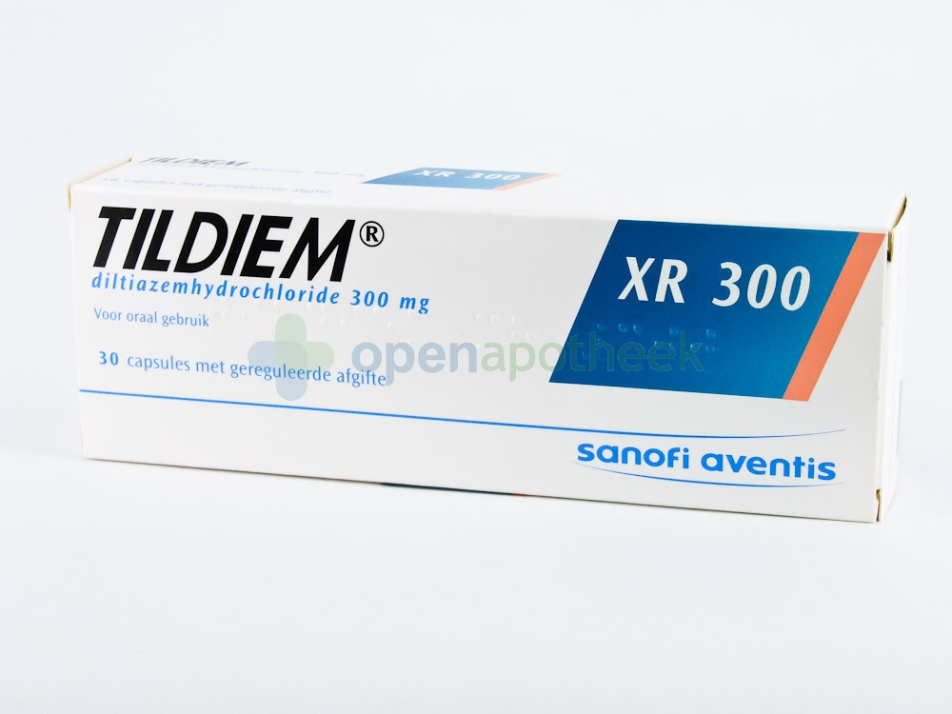
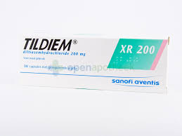

Slide 27
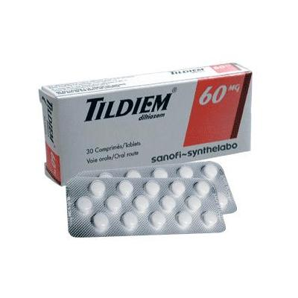
Verapamil hydrochloride and diltiazem hydrochloride should usually be avoided in heart failure because they may further depress cardiac function and
cause clinically significant deterioration.

Slide 28
Centrally Acting Agents

Slide 29
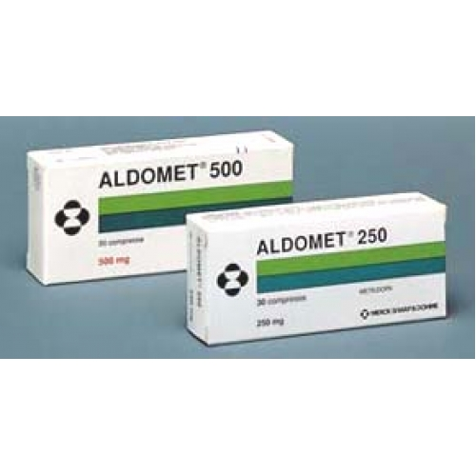

Slide 30
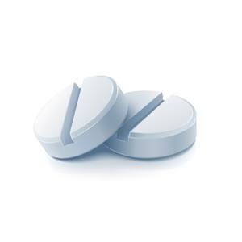
Vasodilators

Slide 31
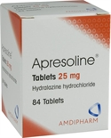
Mechanism of action
Direct relaxation to the vascular smooth muscl
Clinical uses:
Vasodilators have a potent hypotensive effect, especially when used in combination with a beta-blocker and a thiazide.
Hydralazine is given by mouth as an adjunct to other antihypertensives for the treatment of resistant hypertension but is rarely used.
Sodium nitroprusside is given by intravenous infusion to control severe hypertensive crises on the rare occasions when parenteral treatment is necessary.

Slide 32
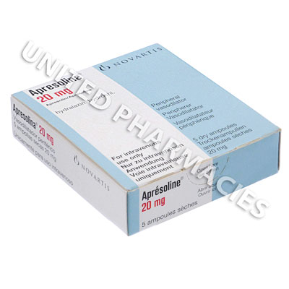
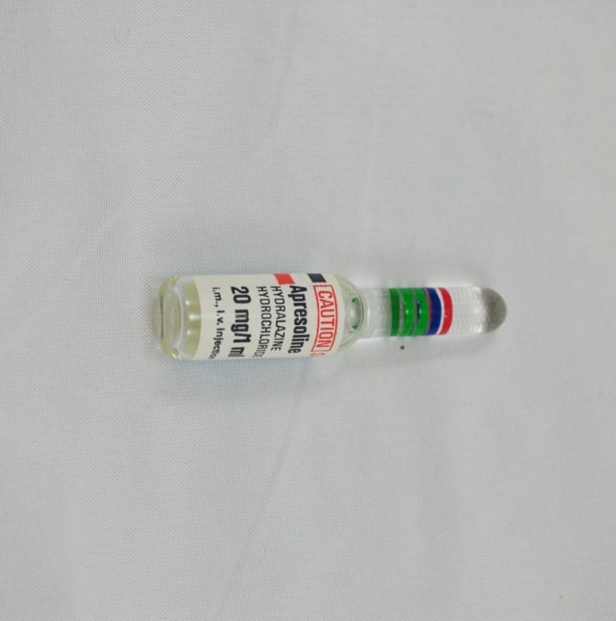

Slide 33
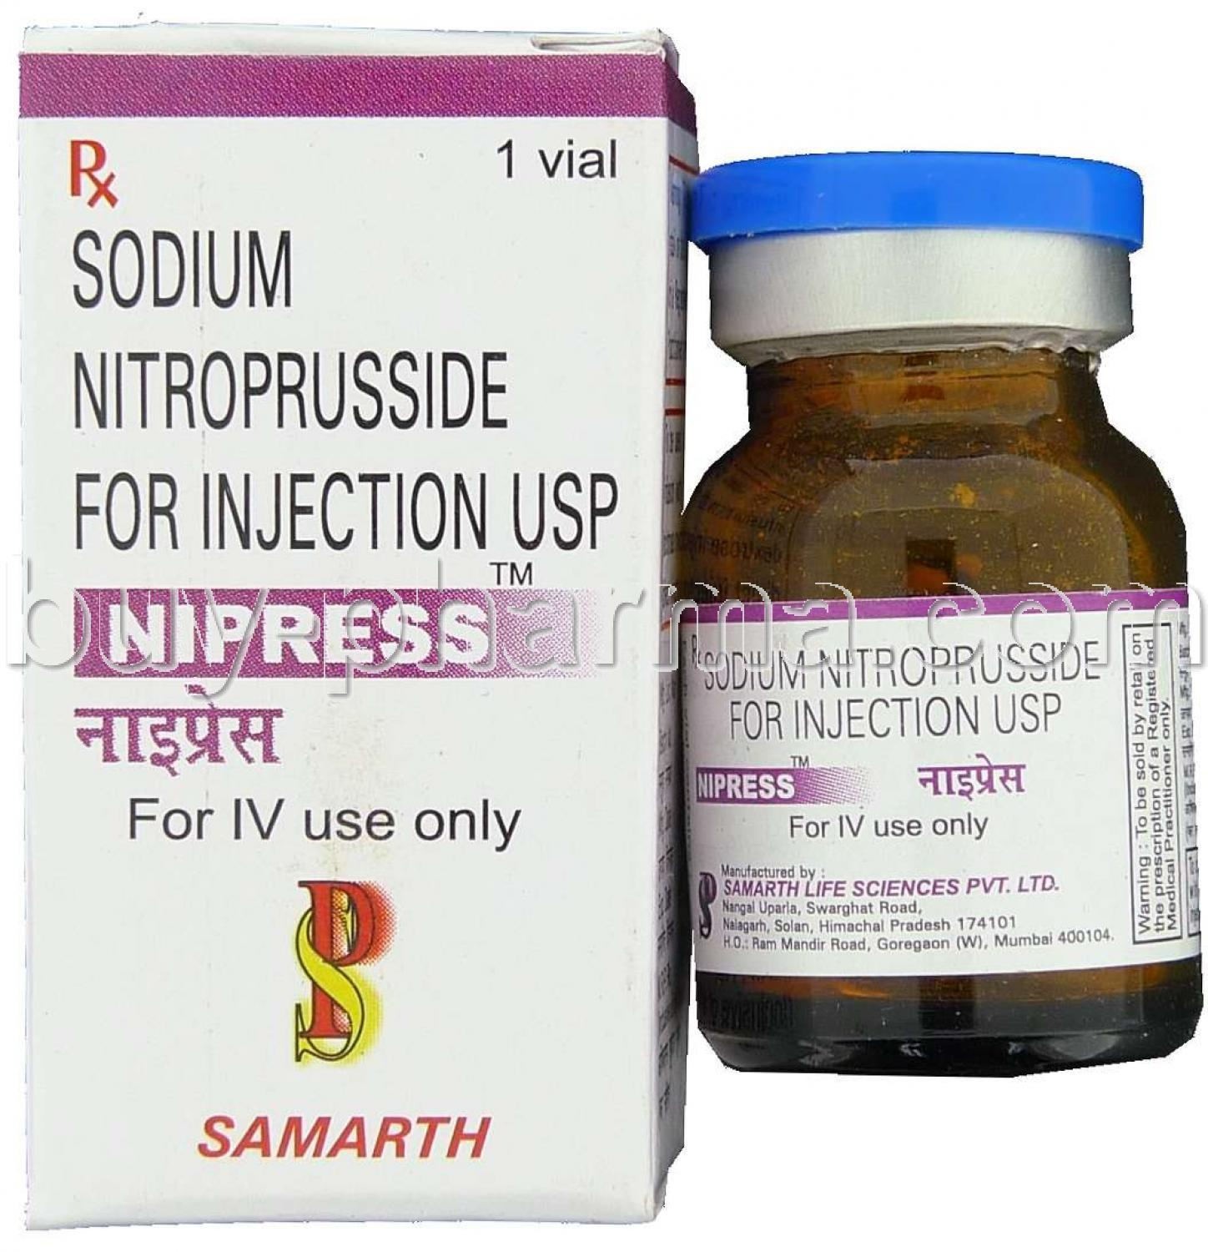

Slide 35
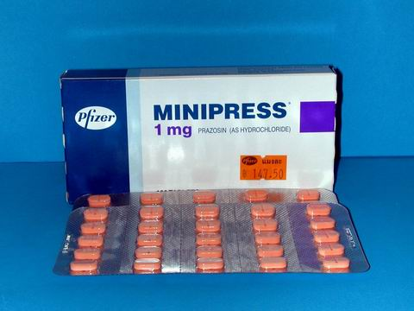
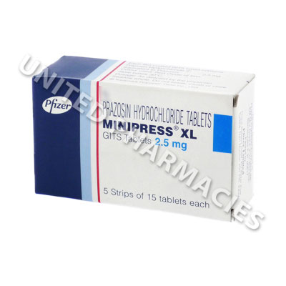

Slide 36
