Slide 1
Therapeutic Drug Monitoring
Lec. 2

Slide 2
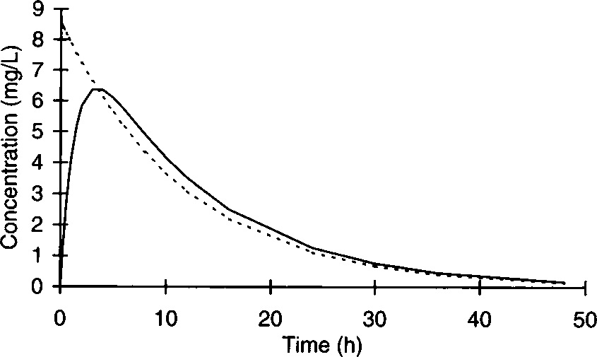
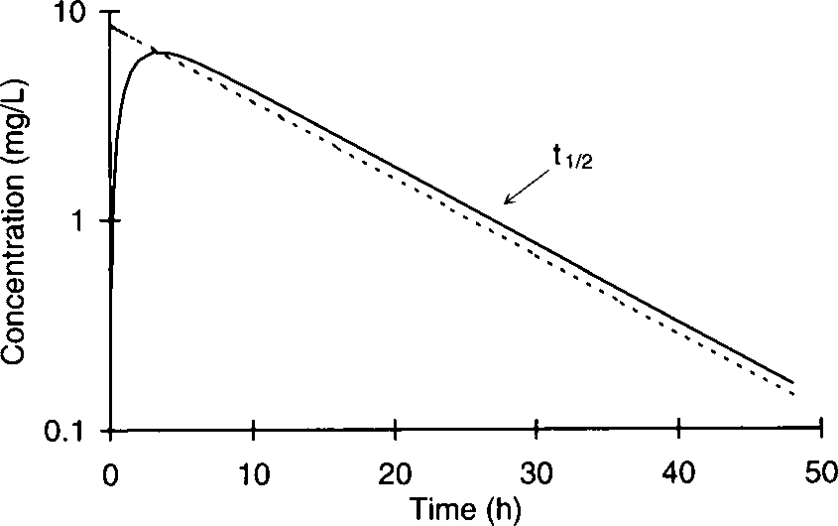
HALF-LIFE & ELIMINATION RATE CONSTANT
When drugs that follow linear pharmacokinetics are given to humans, serum concentrations decline in a curvilinear fashion, but when plotted on a semilogarithmic axis, serum concentrations decrease in a linear fashion after drug absorption and distribution phases are complete.

Slide 3
HALF-LIFE & ELIMINATION RATE CONSTANT
The decline part of the curve is known as the elimination phase. The time that it takes for serum concentrations to decrease by 1/2 in the elimination phase is a constant and is called the half-life (t1/2).
The half-life describes how quickly drug serum concentrations decrease in a patient after a medication is administered, and the dimension of half-life is time (hour, minute, day, etc.).
Measurement used to denote how quickly drug serum concentrations decline in a patient is the elimination rate constant (ke). The dimension for the elimination rate constant is reciprocal time (hour−1, minute−1, day−1, etc.).
The elimination rate constant and the amount of drug in the body (AB): elimination rate = AB ⋅ ke.
The half-life and elimination rate constant are related to each other by the following equation, so it is easy to compute one once the other is known: t1/2 = 0.693/ke.

Slide 4
HALF-LIFE & ELIMINATION RATE CONSTANT
The elimination rate constant can also be measured graphically by computing the slope of the log concentration versus time graph during the elimination phase: using:
log ke/2.303= −(log C1 − log C2)/(t1 − t2)
or using natural logarithms:
ke = −(ln C1 − ln C2)/(t1 − t2).
The half-life is important because it determines the time needed to achieve steady state during the continuous dosing of a drug and the dosage interval.
If a drug is administered on a continuous basis for 3 half-lives, serum concentrations are ~90% of steady-state values; 5 & 7 half-lives, gives serum concentrations equal ~95% & ~99% of steady-state values; respectively.
Generally, drug serum concentrations used for pharmacokinetic monitoring can be safely measured after 3–5 estimated half-lives

Slide 5
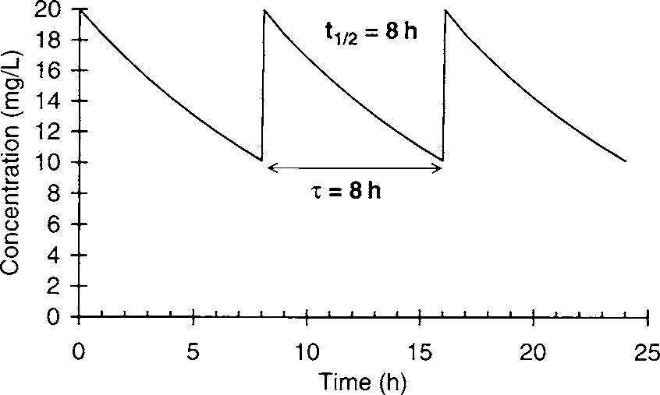
HALF-LIFE & ELIMINATION RATE CONSTANT
The dosage interval for a drug is also determined by the half-life of the medication. For example, if the therapeutic range of a drug is 10–20 mg/L, the ideal dosage interval would not let maximum serum concentrations exceed 20 mg/L or allow the minimum serum concentration to go below 10 mg/L

Slide 6
HALF-LIFE & ELIMINATION RATE CONSTANT
The half-life and elimination rate constant are known as dependent parameters because their values depend on the clearance (Cl) and volume of distribution (V) of the agent:
t1/2 = (0.693 ⋅ V)/Cl ke = Cl/V.
The half-life and elimination rate constant for a drug can be changed either because of a change in clearance or a change in the volume of distribution.
Because the values for clearance and volume of distribution depend solely on physiological parameters and can vary independently of each other, they are known as independent parameters.

Slide 7
Michaelis-Menten or Saturable PKs
Drugs that are metabolized by the cytochrome P-450 enzymes and other enzyme systems may undergo Michaelis-Menten or saturable pharmacokinetics. This is the type of nonlinear pharmacokinetics that occurs when the number of drug molecules overwhelms or saturates the enzyme’s ability to metabolize the drug.
In this case the rate of drug removal is described by the classic Michaelis- Menten relationship that is used for all enzyme systems: rate of metabolism = (Vmax ⋅ C)/(Km + C)
Vmax = the maximum rate of metabolism
C = the substrate concentration
Km = the substrate conc. where the rate of metabolism = Vmax/2.

Slide 8
Michaelis-Menten or Saturable PKs
The clinical implication of Michaelis-Menten pharmacokinetics is that the clearance of a drug is not a constant as it is with linear pharmacokinetics, but is concentration or dose-dependent. As the dose or concentration increases, the clearance rate (Cl) decreases as the enzyme approaches saturable conditions: Cl = Vmax/(Km + C).
Example: phenytoin follows saturable pharmacokinetics with average Michaelis-Menten constants of Vmax = 500 mg/d and Km = 4 mg/L. The therapeutic range of phenytoin is 10–20 mg/L.
Cl = Vmax/(Km + C)
Cl = (500 mg/d) / (4 mg/L +10 mg/L) = 36 L/d
Cl = (500 mg/d)/(4 mg/L + 20 mg/L) = 21 L/d
The therapeutic range of phenytoin is 10–20 mg/L. As the steady-state concentration of phenytoin increases from 10 mg/L to 20 mg/L, clearance
decreases from 36 L/d to 21 L/d

Slide 9
Michaelis-Menten or Saturable PKs
The volume of distribution (V) is unaffected by saturable metabolism and is still determined by the physiological volume of blood (VB) and tissues (VT) as well as the unbound concentration of drug in the blood (fB) and tissues (fT):
V = VB + (fB/fT)VT.
As doses or concentrations increase for a drug that follows Michaelis-Menten pharmacokinetics, clearance decreases and half-life becomes longer for the drug: ↑t1/2 =(0.693 ⋅ V)/↓Cl.
Under steady-state conditions the rate of drug administration equals the rate of drug removal. Michaelis-Menten equation can be used to compute the maintenance dose (MD) required to achieve a target steady-state serum concentration (Css):
MD = Vmax . Css/Km + Css

Slide 10
Michaelis-Menten or Saturable PKs
When the therapeutic range for a drug is far below the Km value for the enzymes that metabolize the drug Css, this equation simplifies to:
MD = (Vmax/Km)Css or, since Vmax/Km is a constant, MD = Cl ⋅ Css.
So when Km >> Css, drugs that are metabolized follow linear pharmacokinetics (known as First-order pharmacokinetics).
When the therapeutic range for a drug is far above the Km value, the rate of metabolism becomes a constant equal to Vmax. Under these conditions only a fixed amount of drug is metabolized because the enzyme system is completely saturated and cannot increase its metabolic capacity (known as Zero-order pharmacokinetics).
Most medications are metabolized following linear pharmacokinetics due to the therapeutic ranges of most drugs are far below the Km for the enzymes that metabolize the agent. However, even in these cases saturable drug metabolism can occur in drug overdose (drug concentration far exceeds the therapeutic range).

Slide 11
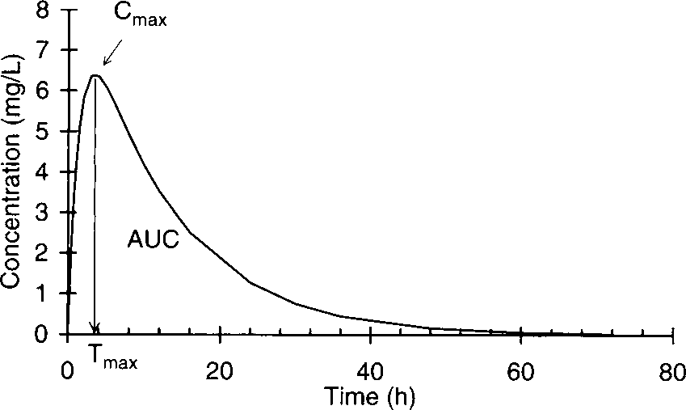
BIOAVAILABILITY
The fraction of the administered dose that is delivered to the systemic circulation is known as the bioavailability for the drug and dosage form.
When medications are given orally, intramuscularly, subcutaneously, or by other extravascular routes, the drug must be absorbed across several biologic membranes before entering the vascular system.
In these cases, drug serum concentrations rise while the drug is being absorbed into the bloodstream, reach a maximum concentration (Cmax).
The primary bioavailability parameters:
AUC = area under the serum concentration/time curve
Cmax = maximum concentration
Tmax = the time that the maximum
concentration occurs

Slide 12
BIOAVAILABILITY
The bioavailability for a drug can be calculated by taking the ratio of the AUCs for each route of administration. For example, if 10 mg of a drug were administered to a subject on two separate occasions by intravenous (IV) and oral (PO) routes of administration, the bioavailabilty (F) would be computed by dividing the AUC after oral administration (AUC_{PO}) by the AUC after intravenous administration (AUC_{IV}):
F = AUC_{PO}/AUC_{IV}
If it is not possible to administer the same dose intravenously and extravascularly because poor absorption or presystemic metabolism yields serum concentrations that are too low to measure, the bioavailability calculation can be corrected to allow for different size doses for the different routes of administration:
F = (AUC_{PO}/AUC_{IV})(D_{IV}/D_{PO})
D_{IV} is the intravenous dose
D_{PO} is the oral dose.

Slide 13
Clinical Pharmacokinetic Equations and
Calculations
One-Compartment Model Equations for linear Pharmacokinetics

Slide 14
- The body can be represented as a series of discrete sections. - The simplest model is the one-compartment model which depicts the body as one large container where drug distribution between blood and tissues occurs instantaneously. - Drug is introduced into the compartment by infusion (ko), absorption (ka), or IV bolus; distributes immediately into a volume of distribution (V); and is removed from the body via metabolism and elimination via the elimination rate constant (ke). - The simplest multicompartment model is a two-compartment model which represents the body as a central compartment into which drug is administered and a peripheral compartment into which drug distributes. - The central compartment (1) is composed of blood and tissues which equilibrate rapidly with blood. The peripheral compartment (2) represents tissues that equilibrate slowly with blood. Rate constants (k1-2, k2-1) represent the transfer between compartments and elimination from the body (k1-0).

Slide 15
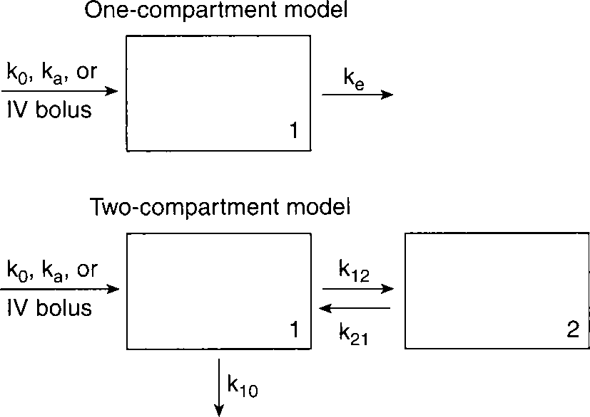

Slide 16
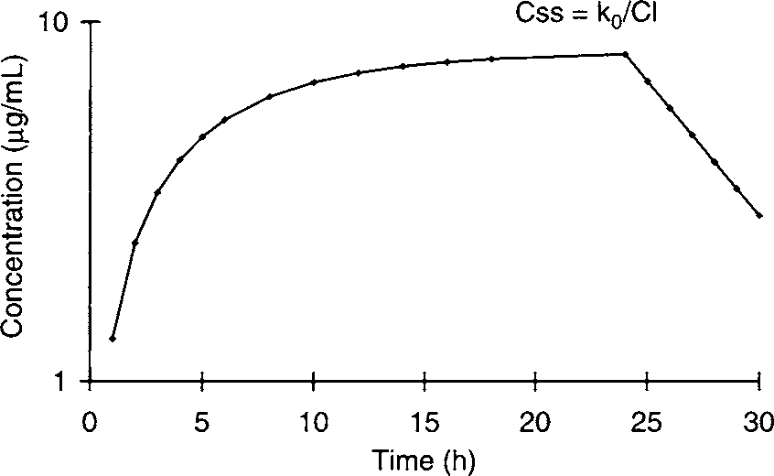
Continuous and Intermittent Intravenous
Infusion Equations
If a drug is given as a continuous intravenous infusion, serum concentrations
increase until a steady-state concentration (Css) is achieved in 5–7 half-lives.
The steady-state concentration is determined by the
quotient of the infusion
rate
k0
and
drug
clearance
C,
Css
=
k0/Cl.
When
the
infusion
is
discontinued,
serum
concentrations
decline
in
a
straight
line.

Slide 17
Continuous and Intermittent Intravenous
Infusion Equations
•
In
this
case, a one
compartment model
intravenous
infusion
equation can be used to compute concentrations
)C(
while
the
infusion is
running:
C = (k0/Cl)(1 – e
^{-ke t}(
C = [k0/(ke V)](1 – e
^{-ke t}(
k₀ :the drug infusion rate (amount per unit time, such as mg/h or µg/min) Cl :the drug clearance
K_{e}: elimination rate constant
t: the time that the infusion has been running

Slide 18
Continuous and Intermittent Intravenous
Infusion Equations
•
If the infusion is allowed to continue until
steady
)Css(
state is
achieved, the
calculated easily:
steady-state concentration
can
be
^{Css = k}0^{/Cl}
Css = k₀ /(k_{e} V(

Slide 19
Continuous and Intermittent Intravenous
Infusion Equations
If the infusion is stopped, postinfusion serum concentrations
•
^{)C}postinfusion⁽
can be computed by the following
equation:
^{C}postinfusion ^{C}end
e
^{-k}e ^{t}postinfusion
=
ke:
elimination rate constant
tpostinfusion:
postinfusion time
t
postinfusion
= 0 at end of infusion and increases from that point

Slide 20
Continuous and Intermittent Intravenous
Infusion Equations
•
For
example, a
patient is
administered
60
mg/h
of
^{theophylline, V = 40 L and k}e ^{= 0.139}
h⁻¹.
•
The serum concentration of theophylline after receiving
drug for 8 hours and at steady state can be calculated:
C = (k₀/Cl)(1 − e−ket)
= [k₀/(keV)](1 − e−ket)
= [(60 mg/h)/(0.139 h−1 ⋅ 40 L)](1 − e−(0.139 h−1)(8 h))
= 7.2 mg/L
the

Slide 21
Continuous and Intermittent Intravenous
Infusion
Equations
^{Css = k}0^{/(k}e ^{V(}
= (60 mg/h)/(0.139 h−1 ⋅ 40 L)
= 10.8 mg/L.
•
If the infusion only ran for 8 hours, the serum
hours after the infusion stopped would be:
concentration
6
^{C}postinfusion ^{C}end
e^{-ke tpostinfusion}
=
= (7.2 mg/L)e−(0.139 h−1)(6 h) = 3.1 mg/L.

Slide 22
Continuous and Intermittent Intravenous
Infusion Equations
If the infusion run until steady state was achieved, the serum concentration 6 hours after the infusion ended would be:
•
^{C}postinfusion ^{C}end
e^{-ke tpostinfusion}
=
= (10.8 mg/L)e−(0.139 h−1)(6 h)
= 4.7 mg/L.

Slide 23
Continuous and Intermittent Intravenous
Infusion Equations
Even if serum concentrations exhibit a distribution phase after the drug infusion has ended, it is still possible to use one compartment model intravenous infusion equations for the drug without a large amount of error.
•
•
The strategy used in this instance is to infuse the medication
and
wait for
the
distribution
phase to be
over
before
measuring serum drug concentrations in the patient.

Slide 24
Continuous and Intermittent Intravenous
Infusion Equations
•
For
example, gentamicin,
tobramycin,
hour.
and
amikacin
are
usually infused over one-half
•
When administered this way,
have distribution phases that
these aminoglycoside antibiotics
last about one-half hour.
•
Using this strategy, aminoglycoside serum concentrations are
obtained no sooner than one-half hour after a 30-minute
infusion in order to avoid the distribution phase.

Slide 25
Continuous and Intermittent Intravenous
Infusion Equations
•
If aminoglycosides are infused over 1 hour,
phase is very short and serum concentrations
the distribution
can be obtained
immediately

Slide 26
Continuous and Intermittent Intravenous
Infusion Equations
For example, a patient is given an intravenous infusion of gentamicin 100 mg over 60 minutes. it is known that the volume of distribution is 20 L, the elimination rate constant = 0.231 h−1, and the half-life = 3 h
(t1/2 = 0.693/ke = 0.693/0.231 h−1 = 3 h).
To compute the gentamicin concentration at the end of infusion, a one compartment model intravenous infusion equation can be employed:
C = [k0/(keV)](1 − e−ket)
= [(100 mg/1 h)/(0.231 h−1 ⋅ 20 L)](1 − e−(0.231 h−1)(1 h))
= 4.5 mg/L.

Slide 27
Continuous and Intermittent Intravenous
Infusion Equations
Pharmacokinetic constants can also be calculated for use the equations.
•
in
•
If a steady-state concentration is obtained after a continuous
intravenous infusion has been running uninterrupted for 3–5
half-lives,
the drug
clearance
)Cl(
can
be
calculated
by
rearranging the steady-state infusion formula:
^{Cl = k}0^{/Css}

Slide 28
Continuous and Intermittent Intravenous
Infusion Equations
•
For example, a patient receiving procainamide via intravenous infusion (k₀ = 5 mg/min) has a steady-state procainamide concentration measured as 8 mg/L. Procainamide clearance can be computed using the following expression:
Cl
^{= k}0^{/Css}
= (5 mg/min) / (8 mg/L) = 0.625 L/min.

Slide 29
Continuous and Intermittent Intravenous
Infusion Equations
If the infusion did not run until steady state was achieved, it is still possible to compute pharmacokinetic parameters from postinfusion concentrations.
•
•
Example,
a
patient
was given
a
single
120-mg
dose
of
tobramycin as a 60-minute infusion,
end of infusion (6.2 mg/L) and 4
ended (1.6 mg/L) were obtained.
and concentrations at the
hours after the infusion
^{C}postinfusion ^{C}end
e
^{-k}e ^{t}postinfusion
=

Slide 30
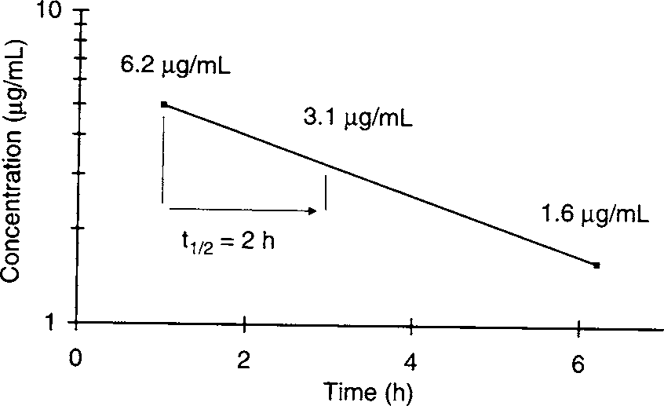
.
Tobramycin concentrations are plotted on semilogarithmic axes,
and a straight line is drawn connecting the concentrations. Half-
life (t1/2) is determined by measuring the time needed for serum
concentrations
to
decline
by
one-half from 6.2 mg/L to
3.1
^{mg/L, (ke) can be calculated} by:
ke = 0.693/t1/2 = 0.693/2 h = 0.347 h−1

Slide 31
Continuous and Intermittent Intravenous
Infusion Equations
• Alternatively, the elimination rate constant can be calculated
without
equation:
plotting the
concentrations using
the
following
ke = −(ln C₁ − ln C₂)/(t₁ − t₂)
t₁ and C₁ are the first time/concentration pair and t₂ and C₂ are the second time/concentration pair;
ke = −[ln (6.2 mg/L) − ln (1.6 mg/L)] / (1 h − 5 h)
= 0.339 h−1
t1/2 = 0.693/ke
=0.693/0.339 h−1
= 2 h.

Slide 32
Continuous and Intermittent Intravenous
Infusion Equations
•
The volume of distribution (V(
can be computed
using
the
following
equation:
^{K}0 ⁽¹
– e
^{- ke t‘(}
V =
^{K}e
]^{C}max
–
) ^{C}predose
e
^{- ke t}[ ^{(‘}
^{K}0
infusion rate
ke: elimination rate constant
t‘: infusion time
Cmax:
maximum concentration at the end of infusion
Cpredose:
predose concentration

Slide 33
Continuous and Intermittent Intravenous
Infusion Equations
120)mg/1h) (1 – e
^{– (0.339 – h-1) (1h((}
V =
0.339
h⁻¹
6.2]mg/L – (0 mg/L · e
^{– (0.339 – h-1) (1h} [⁽⁽
16.4 = L

Slide 34
Extravascular Equation
•
When
a
drug
is
administered
extravascularly
)e.g.,
orally,
etc.(,
place.
intramuscularly,
subcutaneously,
transdermally,
absorption into the systemic vascular system must take
•
If
serum
concentrations
decrease
in
a straight
line
when
plotted
on semilogarithmic
axes
after
drug
absorption
is
complete, a one compartment model extravascular equation
can be used to describe the serum concentration/time curve.

Slide 35
Extravascular Equation
^{C = {(Fk}a^{D)/[V(k}a ^{- k}e^{)]}(e}
-ket
-
e
^{-kat}(
t: time after the extravascular dose was given
)t = 0 at the time the dose was
C: concentration at time = t
F: bioavailability fraction
k_{a}: absorption rate constant
D: dose
V: volume of distribution
k_{e}: elimination rate constant.
administered(

Slide 36
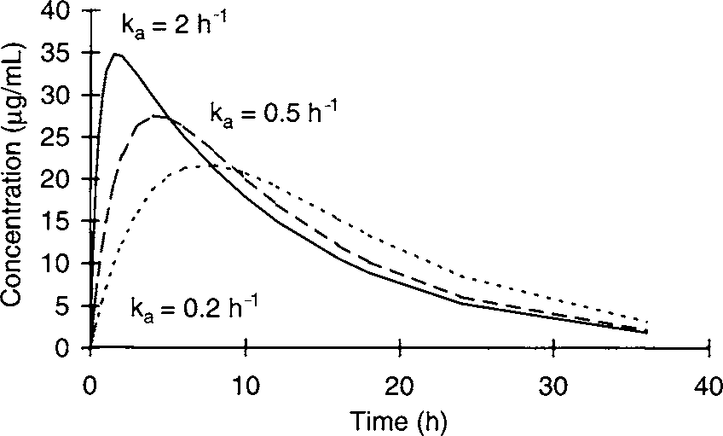
Serum concentration/time curves for extravascular drug administration for
agents following a one-compartment pharmacokinetics. The absorption rate
constant
)ka (
controls
how
quickly
the
drug
enters
the
body.
A large
absorption rate constant allows drug to enter the body quickly while a small
absorption rate constant permits drug to enter the body more slowly.

Slide 37
Extravascular Equation
•
An example of the use of
this equation would be a patient
that
is
administered
500
mg
of
oral
procainamide
as
a
capsule.
•
It is known from prior clinic
visits that the
patient has
^{t=}
4 hours
^{k}e ^{= 0.173}
h⁻¹
V = 175 L
Ka = 2
h⁻¹
F = 0.85

Slide 38
Extravascular Equation
•
The procainamide serum concentration
dose would be equal to:
4
hours
after
a
single
^{FK}a^{D}
C
=
)e
^{-ket} - ^{-kat}(
e
^{V (k}a ^{– k}e⁽
(0.85) 2 )h⁻¹)(500mg(
C
=
)e
-^{(0.173h-1)(4h)}
- e
^{–(2h-1)(4h)})
175) L)(2h⁻¹ – 0.173h⁻¹)
=
1.3 mg/L

Slide 39
Extravascular Equation
•
If the serum concentration/time curve displays a distribution
phase,
it is
still
possible
to
use
one
compartment
model
equations after an extravascular dose is administered.
•
In order to do this, serum concentrations are obtained
the postdistribution phase.
only in
•
Since the absorption rate constant is also hard to measure in
patients, it is
concentrations
situations.
also desirable to
avoid drawing drug serum
during
the
absorption
phase
in
clinical

Slide 40
Extravascular Equation
•
When
only
postabsorption,
postdistribution
serum
concentrations are obtained for a drug that is administered
extravascularly, the equation simpliﬁes to:
C = [(FD)/V]e-ket

