Slide 1
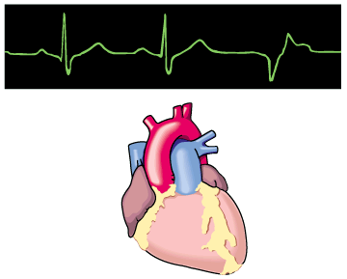
ANTIDYSRHYTHMICS

Slide 2
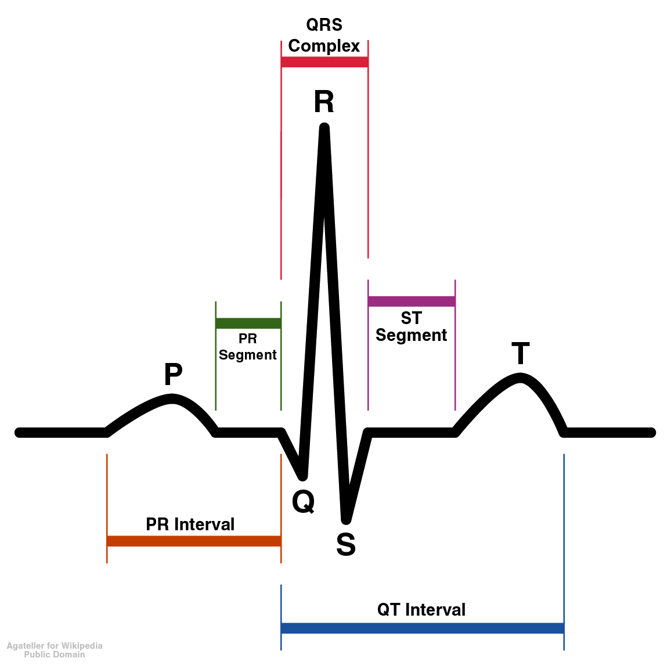
ECG
Contraction of ventricles
Repolarization of ventricles
Contraction of atria

Slide 3
Cardiac Arrhythmias result from disorders of impulse formation, conduction, or both.
Causes of arrhythmias
Cardiac ischemia
Excessive discharge or sensitivity to autonomic transmitters
Exposure to toxic substances
Unknown etiology

Slide 4
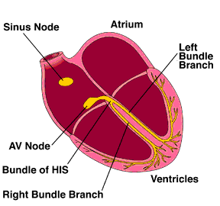
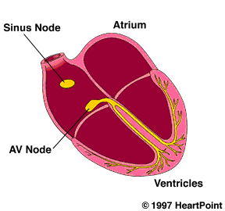
Normal heartbeat and atrial arrhythmia
Normal rhythm
Atrial arrhythmia
AV septum

Slide 5
Ventricular Arrhythmia

Slide 6
Antidysrhythmics modify impulse generation and conduction by interacting with various membrane sodium, potassium, and calcium ion channels.

Slide 7
Classification of antiarrhythmics (based on mechanisms of action)
Class I – blocker’s of fast Na⁺ channels
Subclass IA
Quinidine – 1st antiarrhythmic used, treat both atrial and ventricular arrhythmias
Procainamide
Disopyramide – extended duration of action, used only for treating ventricular arrthymias

Slide 8
Toxicity
Disopyramide
The anticholinergic property of disopyramide leads to symptoms of urinary retention, constipation, dry mouth, and blurred vision. Patients with preexisting ventricular dysfunction may experience further decline in contractility and report dyspnea, edema, and decreased exercise tolerance.
Procainamide
Nausea, vomiting, diarrhea, bitter taste, and light-headedness. Long-term use of procainamide is associated with the development of antinuclear antibodies and drug-induced systemic lupus erythematosus syndrome characterized by arthralgias, myalgias, rash, and fever.

Slide 9
Quinidine
Cinchonism, a syndrome characterized by GI symptoms (abdominal cramping, nausea, vomiting, and diarrhea), tinnitus, and altered mental status may occur in both chronic and acute toxicity. Patients on quinidine may report neuroglycopenic or adrenergic symptoms of hypoglycemia, as the drug acts on potassium channels in the pancreatic islet cells.

Slide 10
Subclass IB
Includes
Lidocane (also acts as local anesthetic) – blocks Na+ channels mostly in ventricular cells, also good for digitalis-associated arrhythmias
Mexiletine - oral lidocaine derivative, similar activity
Phenytoin – anticonvulsant that also works as antiarrhythmic similar to lidocane

Slide 11
Lidocaine
Symptoms include drowsiness, light-headedness, vision changes, tinnitus, and paresthesias.
Mexiletine
Nausea and vomiting, neurotoxic adverse effects similar to those that occur with lidocaine.

Slide 12
Phenytoin
Mouth -Gingival hyperplasia is the most common adverse effect
Hypotension, bradycardia
Hirsutism, acne
Right upper quadrant tenderness, Hepatomegaly
Fetal hydantoin syndrome if used by pregnant women

Slide 13
Subclass IC
Includes
Flecainide (initially developed as a local anesthetic)
Slows conduction in all parts of heart,
Also inhibits abnormal automaticity
Propafenone
Also slows conduction
Weak β – blocker
Also some Ca²⁺ channel blockade

Slide 14
Flecainide
Worsening congestive heart failure, CNS symptoms that patients may report are headache, irritability, and confusion.
Propafenone
Alteration in taste, blurred vision, and dizziness. nausea, vomiting, and constipation. Asthmatic patients may report worsening symptoms, owing to the weak beta-blocking effects of propafenone.

Slide 15
Class II – β–adrenergic blockers
Based on two major actions
1) blockade of myocardial β–adrenergic receptors
2) Direct membrane-stabilizing effects related to Na⁺ channel blockade
Includes
Propranolol
causes both myocardial β–adrenergic blockade and membrane-stabilizing effects
Slows SA node and ectopic pacemaking
Can block arrhythmias induced by exercise.
Other β–adrenergic blockers have similar therapeutic effect
Metoprolol
Nadolol
Atenolol
Acebutolol
Pindolol
Satolol
Timolol
Esmolol

Slide 16
Class III – K⁺ channel blockers
Includes
Amiodarone
Ibutilide
Bretylium – first developed to treat hypertension but found to also suppress ventricular fibrillation associated with myocardial infarction
Dofetilide

Slide 17
Amiodarone
Pulmonary toxicity is the most concerning adverse effect (cough, fever, dyspnea)
Hepatotoxicity leading to cirrhosis is uncommon.
skin changes such as photosensitivity and bluish discoloration.
Patients may also report symptoms suggestive of both hyperthyroidism and hypothyroidism.
Patients on amiodarone long term may report vision loss from corneal deposition, optic neuropathy, or optic neuritis.

Slide 18
Ibutilide
Headache, Light-headedness from hypotension.
Dofetilide
Headache , chest pain, and light-headedness.

Slide 19
Bretylium
Hypotension and postural hypotension have been the most frequently reported adverse reactions
Renal dysfunction, diarrhea , abdominal pain , hiccups

Slide 20
Class IV – Ca²⁺ channel blockers
slow rate of AV-conduction in patients with atrial fibrillation
Includes
Verapamil – blocks Na⁺ channels in addition to Ca^{2+;} also slows SA node in tachycardia
Diltiazem

Slide 21
UNCLASSIFIED: ADENOSINE
Adenosine, a nucleoside found in all cells, is released from myocardial cells under physiologic and pathophysiologic conditions. It is administered as a rapid IV bolus to terminate reentrant supraventricular tachycardia. The resultant hyperpolarization of adenosine reduces the rate of cellular firing.

Slide 22
Reentrant circuit

Slide 23
The adverse effects of adenosine
Transient asystole, dyspnea, chest tightness, flushing, hypotension, and atrial fibrillation.
headache.

Slide 24
Diagnosis
The most important diagnostic test for patients with acute antidysrhythmic toxicity is electrocardiography.
Serum electrolytes should be obtained.
Serum drug levels are not likely to be helpful, but levels of quinidine, lidocaine, and propafenone can be measured in the acute care setting.

Slide 25
Chest radiographs it should be obtained in patients taking amiodarone and presenting with pulmonary symptoms.
Thyroid function tests should be obtained in patients taking amiodarone who present with signs and symptoms of hypothyroidism or hyperthyroidism.

Slide 26
Management of Class IA Antidysrhythmic
Assessment and correction of cardiovascular dysfunction. Following airway evaluation and IV line placement, continuous ECG monitoring. Appropriate gastrointestinal decontamination is recommended when the patient is sufficiently stabilized and should include whole-bowel irrigation if a sustained-release preparation is involved.

Slide 27
For patients who have widening of the QRS complex duration, bolus administration of IV hypertonic sodium bicarbonate is indicated.

Slide 28
Management of Class IB Antidysrhythmic Toxicity
The initial management for IV lidocaine-induced cardiac arrest is continuous cardiopulmonary resuscitation to allow lidocaine to redistribute away from the heart. Apart from this setting, management of hemodynamic compromise includes fluid replacement and other conventional strategies. Resistant hypotension may require dopamine or norepinephrine administration.

Slide 29
Bradydysrhythmias typically do not respond to atropine, requiring the administration of a chronotrope such as dopamine, norepinephrine, or isoproterenol.
Lidocaine-induced seizures and those related to lidocaine analogs are generally brief in nature and do not require specific therapy. For patients requiring treatment, an IV benzodiazepine generally used; rarely, a barbiturate is required.

Slide 30
Enhanced elimination techniques are limited after IV poisoning because of the rapid time course of poisoning.
After oral poisoning by a class IB drug, activated charcoal should be administered.

Slide 31
Management of Class IC Antidysrhythmic Toxicity
Initial stabilization should include standard management strategies for hypotension and seizures. Additionally, therapy for hypotension and the electrocardiographic manifestations of class IC poisoning includes IV hypertonic
sodium bicarbonate to overcome the Na + channel blockade.

Slide 32
Amiodarone has been benefecial in the setting of flecainide-induced ventricular fibrillation refractory to other therapy.
hemodialysis is successful in removing propafenone after overdose.

Slide 33
Management of Class III Antidysrhythmic Toxicity
Isoproterenol has been used successfully to treat patients with amiodarone-induced torsades de pointes.
Amiodarone may reduce the “torsadogenic” effects of the other class III antidysrhythmics. This effect is likely mediated by its calcium channel–blocking activity.
Multiple-dose activated charcoal may be helpful if used shortly after overdose. Hemodialysis is not expected to be beneficial in general, either because of extensive protein binding or because of large volumes of distribution

Slide 34
Management of adenosine toxicity
Overdose of adenosine has not been reported. Treatment is supportive because of the rapid elimination of the drug.

Slide 35
Implantation of Pacemaker

Slide 36
Torsades (a polymorphic ventricular tachycardia) with a characteristic illusion of a twisting of the QRS complex

