Slide 1
Diarrhea and Constipation
Prepared by:
Assist . Lect: Rasha Saadi Abbas

Slide 2
Constipation
Treatment Options:
1. Stimulant laxatives (e.g. sennosides and bisacodyl)
2. Bulk laxatives (e.g. ispaghula, methylcellulose and sterculia)
3. Osmotic laxatives (e.g. lactulose, Epsom salts and Glauber’s salts)

Slide 3
Stimulant Laxative

Slide 4
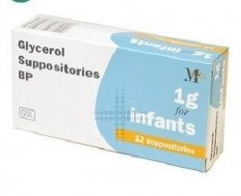
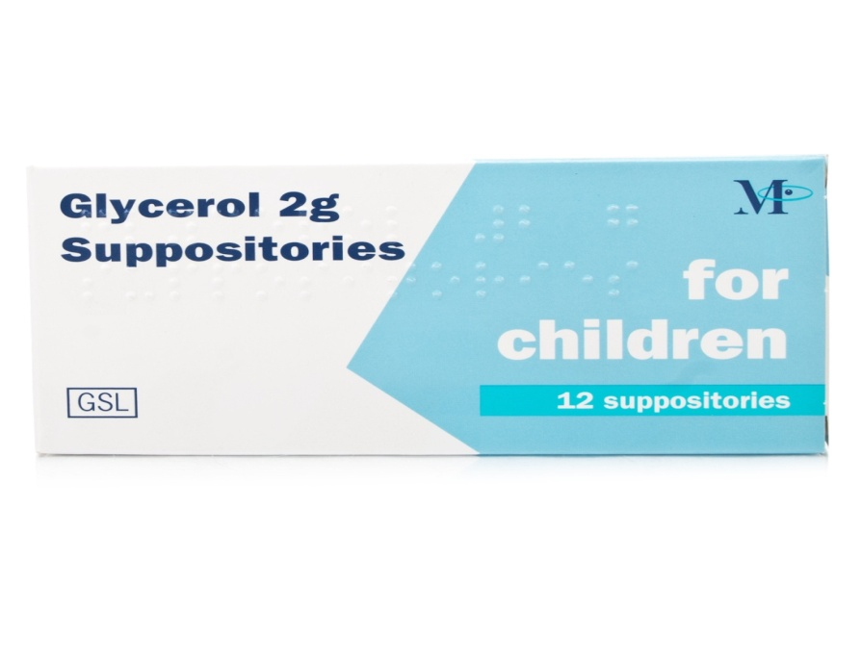
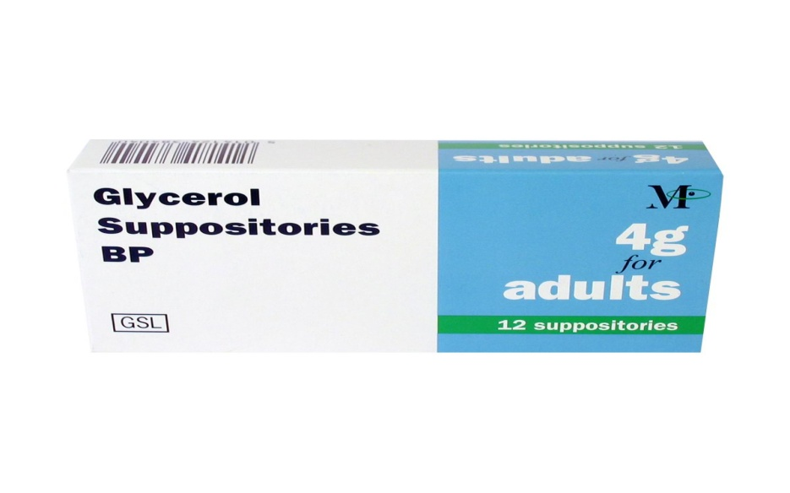
Glycerol

Slide 5
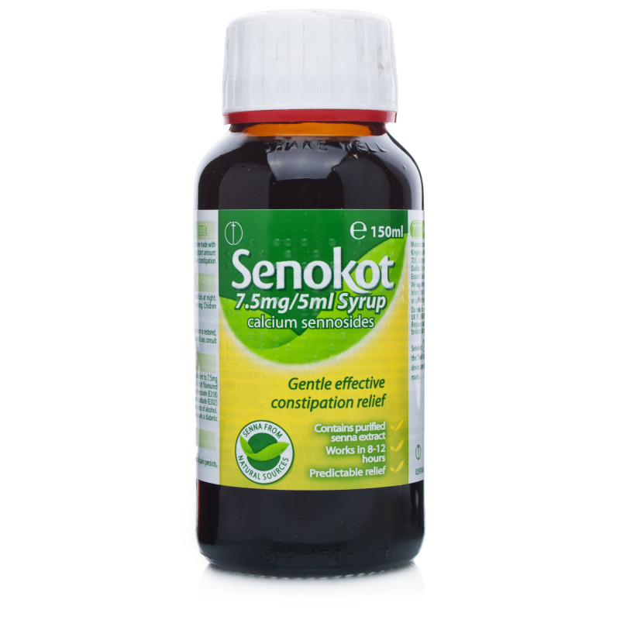
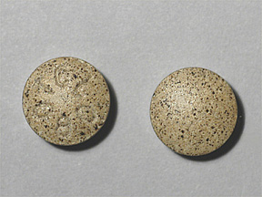
Senna

Slide 6
Sodium Picosulfate

Slide 7
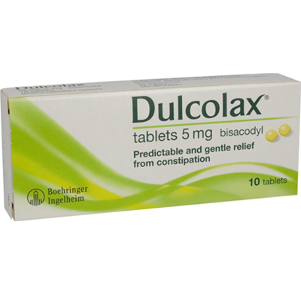
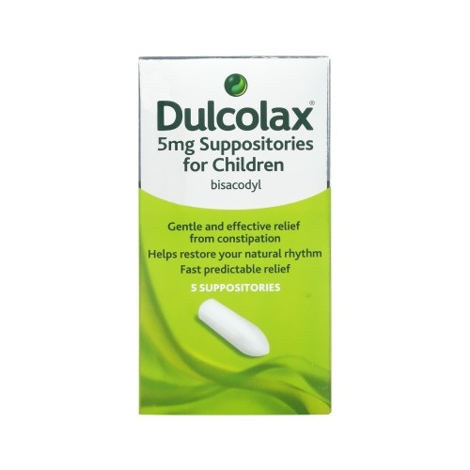
Bisacodyl

Slide 8
Castor Oil

Slide 9
Bulk forming Laxative

Slide 10
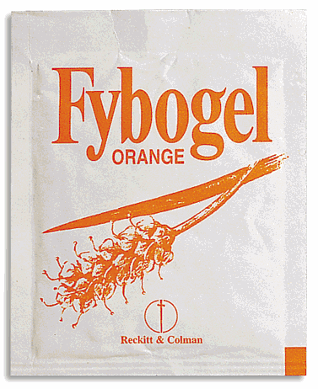
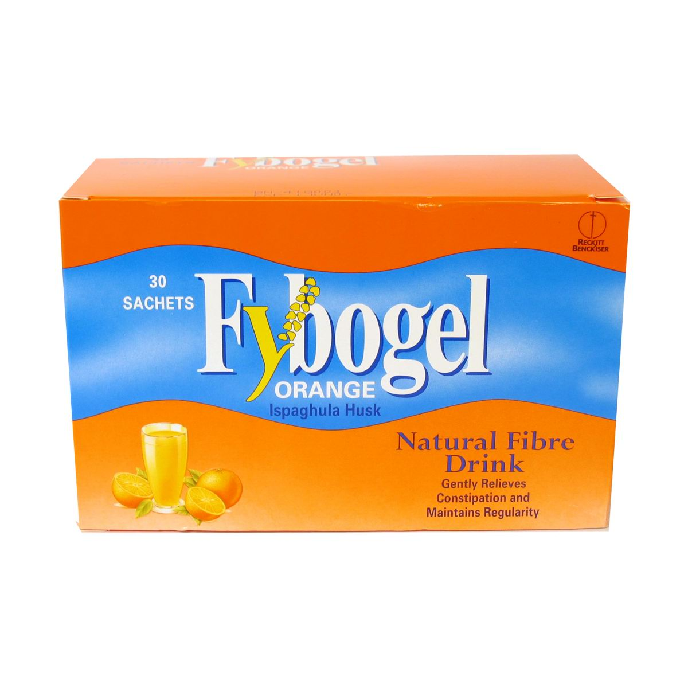
Ispaghula husk

Slide 11
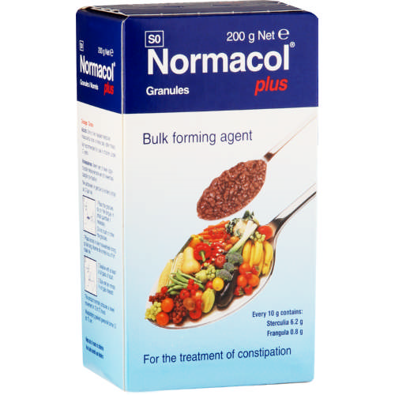
Sterculia with Frangula

Slide 12
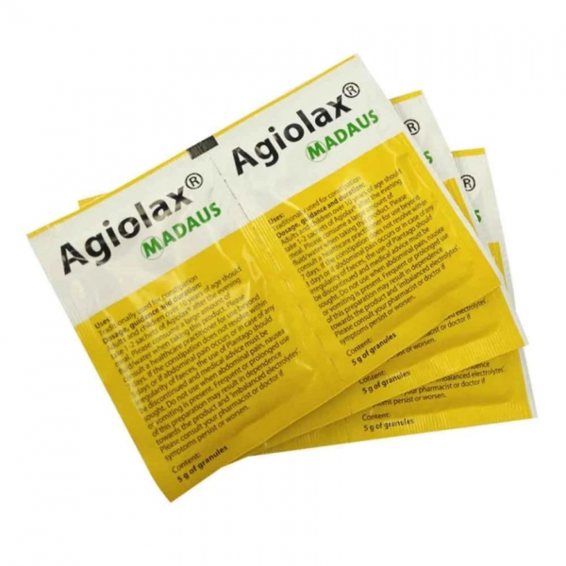
Agiolax
Seeds of Plantago ovata 52.0 g Isphagula husk 2.2 g Tinnevelly Senna pods 12.4 g

Slide 13
Osmotic Laxative

Slide 14
Lactulose

Slide 15
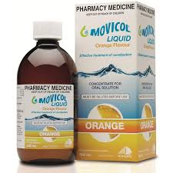
Movicol
Macrogol 3350
Sodium chloride
Sodium bicarbonate
Potassium chloride

Slide 16
Diarhhoea

Slide 17
ORT or ORS

Slide 18
Pectokoalin

Slide 19
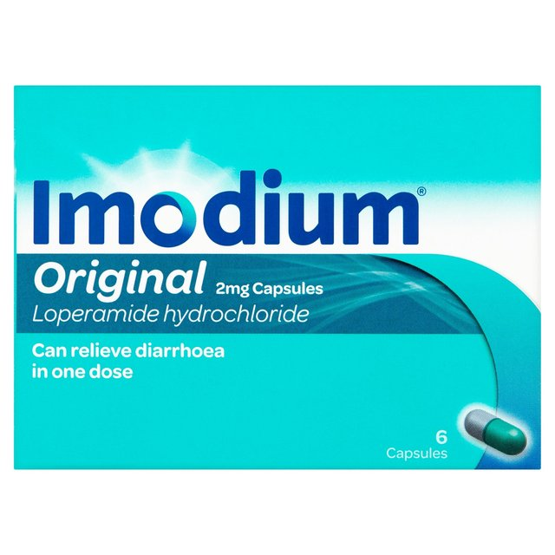
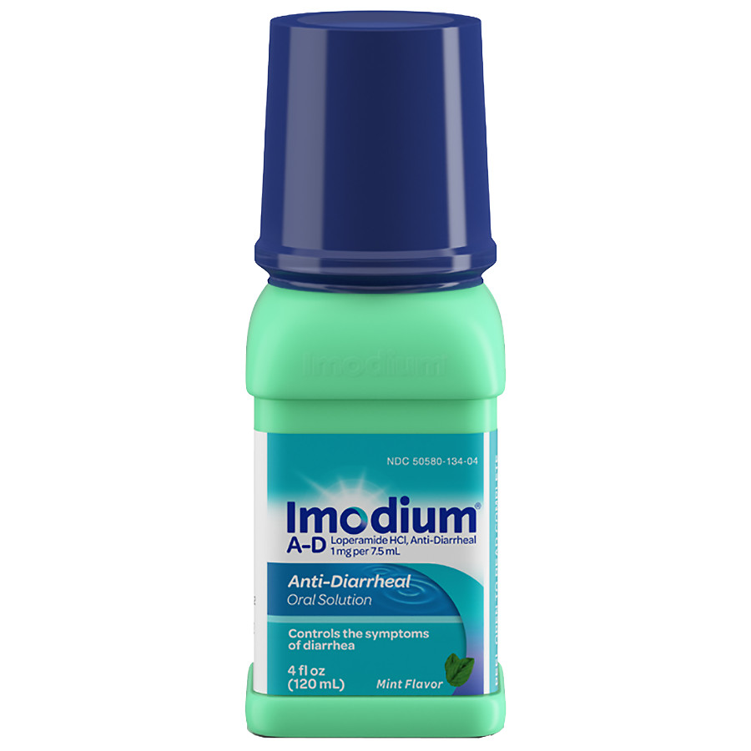
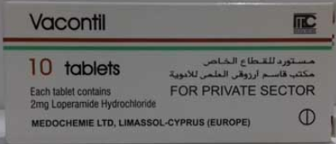
Loperamide

Slide 20
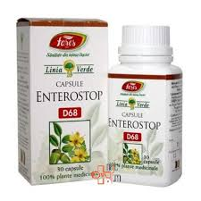
Co-Phenotrope

