Slide 2
Asthma
Inflammation
Bronchoconstriction
Hyper-responsive

Slide 3
narrowing of the airways that causes airflow obstruction

Slide 4
Hyper-responsive
Hyper-responsiveness is an increased tendency of the airway to react to stimuli or triggers to cause an asthma attack.
Most asthmatic patients have chronic bronchitis and allergic rhinitis.

Slide 5
Table 25.1: Examples of asthma triggers
Allergens: Pollens, moulds, house dust mite, animals..
Industrial chemicals…
Drugs: Aspirin, ibuprofen and other prostaglandin synthetase inhibitors, β-adrenoceptor blockers
Foods

Slide 6
Clinical manifestations
persistent cough
difficulty in breathing (dyspnoea)
wheezing
chest tightness and shortness of breath
Symptoms of asthma are often intermittent, and the frequency and severity of an episode can vary from individual to individual

Slide 7
Pathophysiology
eosinophilic
‘extrinsic asthma’
This is more common in children
allergen such as dust mite, cause IgE production is thought to be the cause.
non-eosinophilic
‘Intrinsic asthma’
develops in adulthood
triggered by non-allergenic factors such as a viral infection, irritants which cause epithelial damage and mucosal inflammation, triggering mediator release from mast cells.

Slide 8
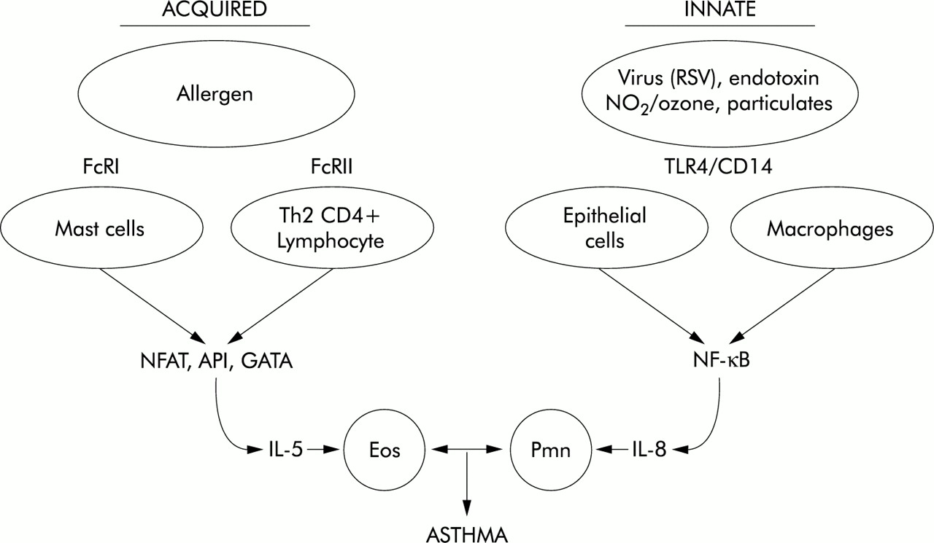

Slide 9
Role of mucus in the pathology of asthma
In asthma patients, there is an increase in the size of bronchial glands and goblet cells that produce mucus.
Mucus transport is dependent on its viscosity.
If it is very thick, it plugs the airways, which also become blocked with epithelial and inflammatory cell debris.
Mucociliary clearance is also decreased due to inflammation of epithelial cells.

Slide 10
Acute severe asthma
Acute severe asthma is a dangerous condition that requires hospitalisation and immediate emergency treatment.
patient is breathless at rest and has a degree of cardiac stress.
Expiration is particularly difficult and prolonged as air is trapped beneath mucosal inflammation.
The pulse rate increase to more than 110 beats/min in adults.
Breathing can become rapid (>30 breaths/min) and shallow,
low oxygen saturation (SpO2 < 92%) with the patient becoming fatigued, cyanosed, confused and lethargic.
Hypercapnia (high PaCO2 level) that does not diminish is a more severe problem and indicates progression towards respiratory failure.

Slide 11
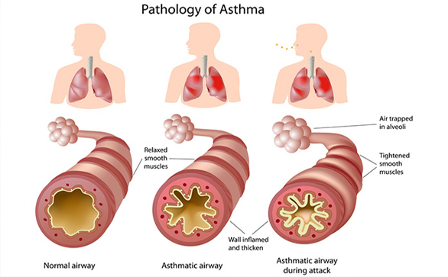

Slide 12
Investigations
Forced Expiratory Volume (FEV)
The FEV1 is a measure of the FEV in the first second of exhalation
The forced vital capacity (FVC)
[maximum volume of air exhaled with maximum effort after maximum inspiration].
FEV1/FVC ratio

Slide 13
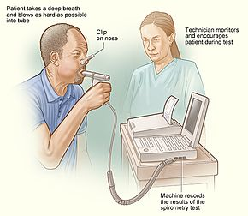
SPIROMETER

Slide 14
FEV1/FVC ratio
This ratio is a useful and highly reproducible measure of the capabilities of the lungs.
Normal individuals can exhale at least 70% of their total capacity in 1 second.
In obstructive lung disorders, such as asthma, the FEV1 is usually decreased, the FVC normal or slightly reduced and the FEV1/FVC ratio decreased, usually <0.7

Slide 15
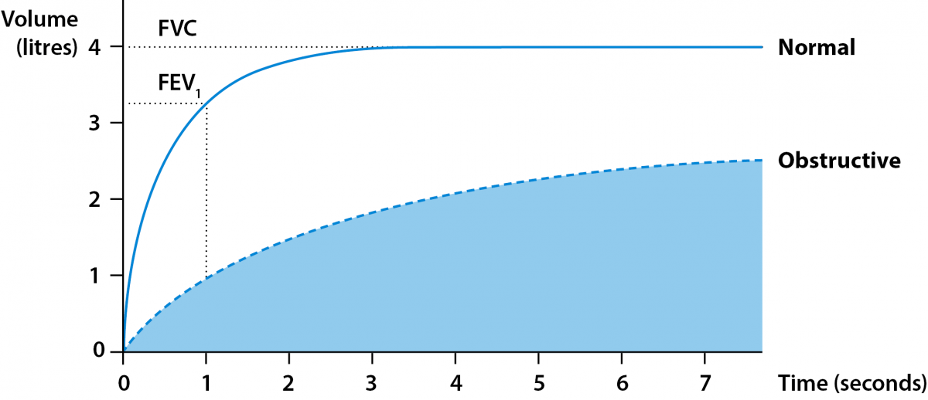

Slide 16
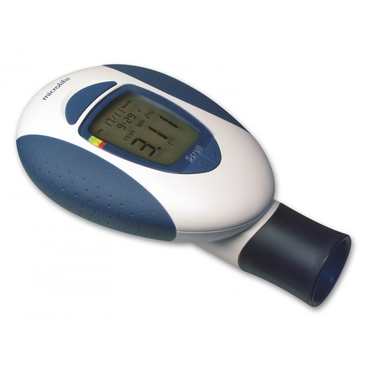
A peak flow meter
self-assessment for the patient, can do regular tests at home with a hand-held meter.
It gives slightly less reproducible results than the spirometer
The peak flow meter measures peak expiratory flow (PEF) rate, the maximum flow rate that can be forced during expiration.
The PEF can be used to assess the improvement or deterioration in the disease as well as the effectiveness
of treatment.

Slide 17
Treatment
Avoidance of recognized trigger factors
Anti-inflammatory drugs
Bronchodilators

Slide 18
RELIEVERS Inhaled B2-Agonist Antimuscaranic Bronchodilators Theophylline
PREVENTORS Corticosteroids Cromoglycate Leukotriene R-antagonist

Slide 19
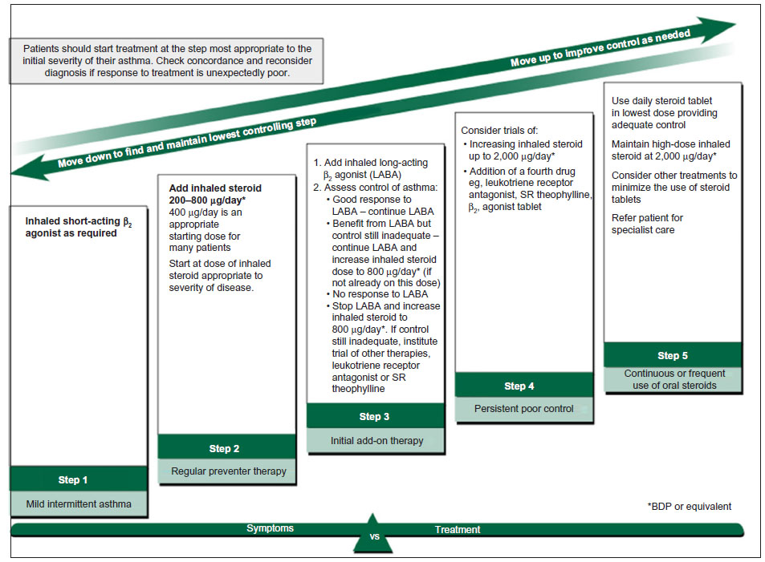
Fig. 25.3 Summary of stepwise management in adults

Slide 20
Short-acting β2 agonist bronchodilators.
mainstay of asthma management.
Salbutamol and terbutaline are selective β2-agonists
have few β1-mediated side effects such as cardiotoxicity.
β2-Receptors are, however, also present in myocardial tissue;
cardiovascular stimulation resulting in tachycardia and palpitations

Slide 21
Bronchodilators
Inhaled Short-acting B2 agonist
Inhaled anticholinergic agents
Inhaled Long acting B2 agonist
Oral bronchodilators, THEOPHYLLINE

Slide 22
Anti-inflammatory agents… Inhaled corticosteroids (ICSs)
the threshold frequency of β2-agonist use which prompts the start of ICSs:
Exacerbations of asthma in the past 2 years
Using inhaled β2-agonists three times a week or more
Symptoms three times a week or more
Waking one night a week with symptoms

Slide 23
Other controller…
Cromones. Inhaled sodium cromoglicate and nedocromil sodium are less effective than corticosteroids in asthma. Although rarely used, they may be possible alternatives
Leukotriene receptor antagonists. Two leukotriene receptor antagonists, montelukast and zafirlukast
monoclonal antibodies. Omalizumab
Oral corticosteroids
Steroid-sparing agents. Immunosuppressive agents, Methotrexate, ciclosporin

Slide 24
Acute severe asthma
Prevention. The ideal way of treating an acute attack is to empower patients to recognize when their condition is deteriorating.
If the condition deteriorates further, hospital admission may become necessary.

Slide 25
In hospital….
Oxygen is administered to achieve an oxygen saturation of 92% or more.
β2-agonist.. (MDI, Nebulizer)
Corticosteroids.. (Oral or IV)

Slide 26
If life-threatening features are present
higher dose bronchodilators: nebulised salbutamol 5 mg with ipratropium bromide 500 μcg ….. &/or
anticholinergic such as ipratropium…. &/or
Intravenous aminophylline with a bolus dose of 250 mg over 30 min

Slide 27
Thank u…

