Slide 2
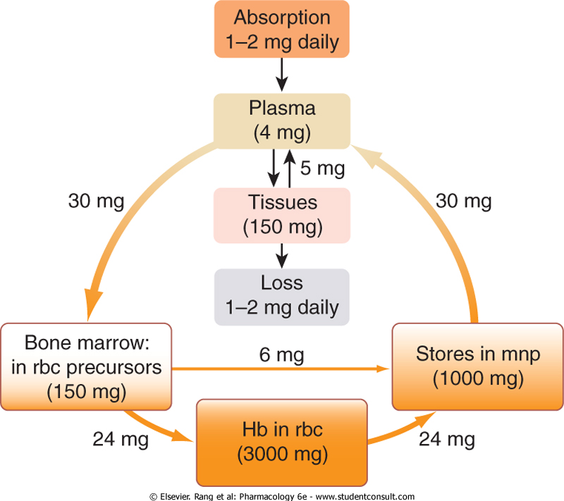

Slide 3
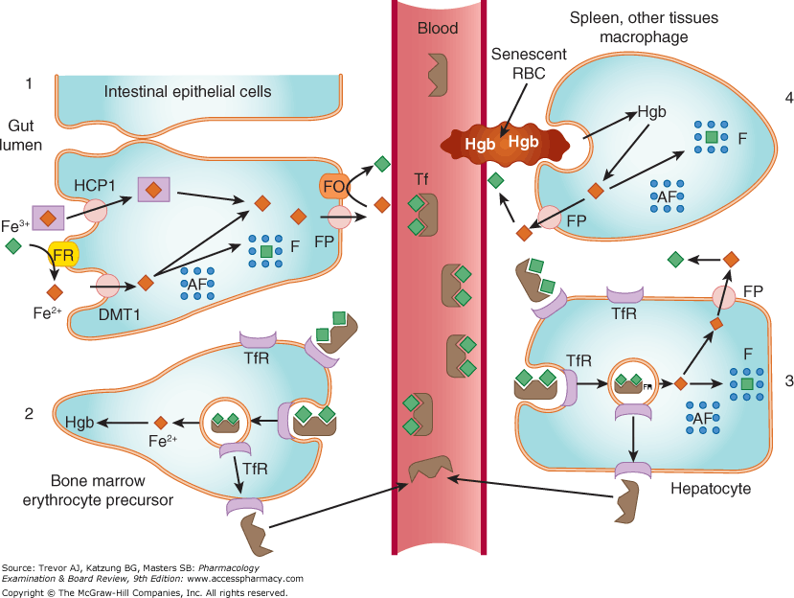

Slide 4
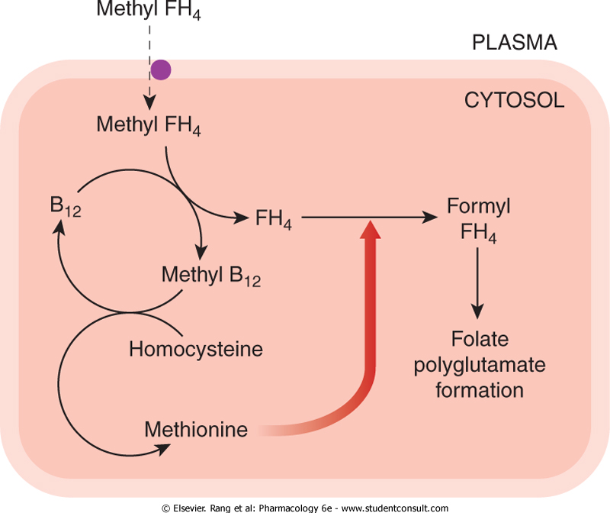

Slide 6
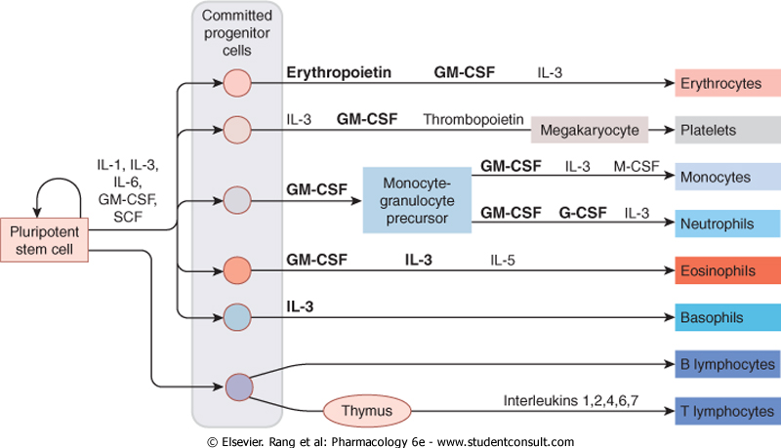

Slide 8
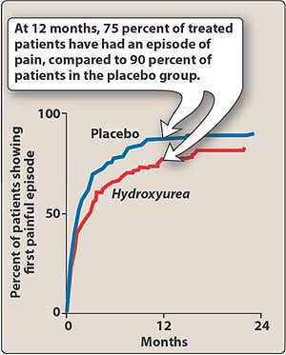

Slide 9
Checklist
When you complete this chapter, you should be able to:
Name the 2 most common types of nutritional anemia, and, for each, describe the most likely biochemical causes.
Diagram the normal pathways of absorption, transport, and storage of iron in the human body.
Name the anemias for which iron supplementation is indicated and those for which it is contraindicated.
List the acute and chronic toxicities of iron.
Sketch the dTMP cycle and show how deficiency of folic acid or deficiency of vitamin B₁₂ affects the normal cycle.
Explain the major hazard involved in the use of folic acid as sole therapy for megaloblastic anemia and indicate on a sketch of the dTMP cycle the biochemical basis of the hazard.
Name 3–5 major hematopoietic growth factors that are used clinically and describe the clinical uses and toxicity of each.
Explain the advantage of covalently attaching polyethylene glycol to filgrastim.

