Slide 1
1.2 Piecewise-Defined Functions
Sometimes a function is described in pieces by using different formulas on different parts of its domain.

Slide 2
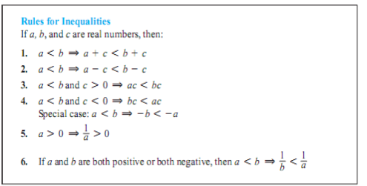
Inequalities

Slide 3
Intervals

Slide 4
