Slide 1
Helminths
Nematods

Slide 4
1 Ascaris lumbricoides
Morphology:
It causes: Ascariasis.
It’s found in the small intestine of man, and may be in other organs.
The worm is elongated, cylindrical, and tapers both anteriorly and posteriorly to relatively blunt conical ends.
The female worms bigger in its thickness than male worms, it could be recognizing the male from the posterior end which is curved in the male and straight in female.

Slide 6
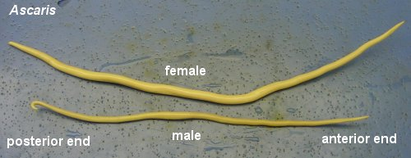
Ascaris lumbricoides male & female (adult)

Slide 10
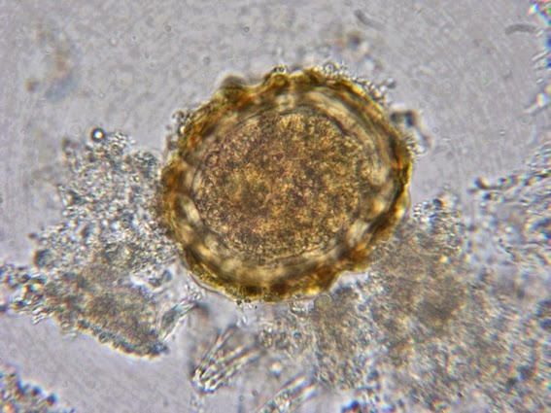

Slide 13
2. Ancylostoma duodenale
It causes: Ancylostomiasis.
The adult worms found in the small intestine of man, hanging with the mucosa, feeding on the blood and tissue fluids.
The living adult worm are pinkish in color.
The body is narrow anteriorly with curved head dorsally.
The buccal cavity is wide and ovoid in shape; the cup-shaped mouth capsule is heavily reinforced and provided from the anterior ventral side with two pairs of conspicuous, slightly curved, subequal teeth and a third pair rudimentary on either side of the median ventral line.

Slide 15
The eggs
Ovoid in shape , have a thin transparent shell.
Contant (2-8) stages (immature).
Embryonation to the first rhabditoid larval stage takes placein (24-48)hrs.
The rhabditoid larva passing through molting to produce the strongyliform larva which feeding on the bacteria and other substances which found in the feces.

Slide 16
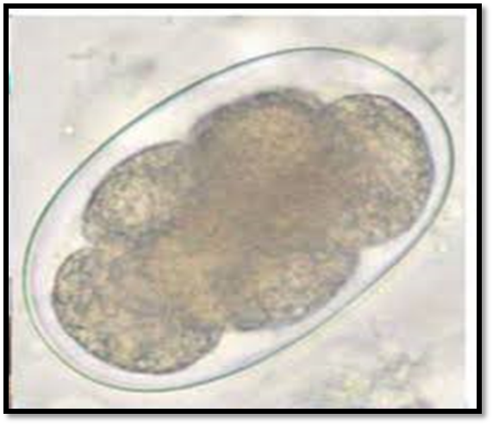

Slide 19
3 Enterobius vermicularis
It causes: Enterobiasis or Oxyuriasis).
It is called (pin worm) or (seat worm).
Adult worms characterized by its spindle shape, the mouth of the adult worm have (3) lips and the anterior end of the worm bears dorsal and ventral bladder like inflations that can be thrust forward to form a vestibule around the mouth.
The male worm measures (2-5)mm long and (0.1-0.2)mm width. With its strongly curved posterior end, the lateral view of the worm forms an inverted question mark.
The female is considerably longer than male, having a length of (8-13)mm and (0.3-0.5)mm width. The sharply pointed postanal portion is nearly a third of the total length.
The male has a copulatory spicule about (70)µ in length, and caudal alae as well as the papillae, the males always less in number than female worms and rarely seen. The posterior part of the female is the cause of the name (pin worm).

Slide 20
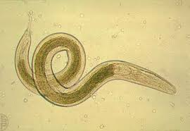
male
female
Enterobius vermicularis (adult worm)

Slide 21
The eggs

Slide 22
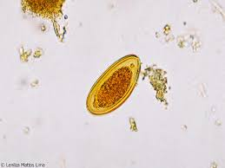
Enterobius vermicularis (egg)

Slide 25
Diagnosis
Demonstration of the eggs at the anus. Occasionally eggs are found in the feces.
The cellophane tape technique for recovery of pinworm eggs from around the anus has been demonstrated to be the most satisfactory. It is doing by pressing transparent adhesive tape (cellulose-tape) on the perianal skin and then examining the tape placed on a slide. These preparations are more likely to be positive when perianal impression specimens are taken in the early morning before defecation or a shower or bath.
Anal swabs or "Swab tubes" (a paddle coated with adhesive material) can also be used. Eggs can be found.

Slide 26
cellophane tape technique

