Slide 2
Tuberculosis
Tuberculosis (TB) is a bacterial infection, treatable by anti-TB drugs.
It is a global problem, with the incidence varying across the world.
In 2008, there were an estimated 9 million cases of tuberculosis (TB) and 2 million deaths from the disease worldwide.

Slide 3
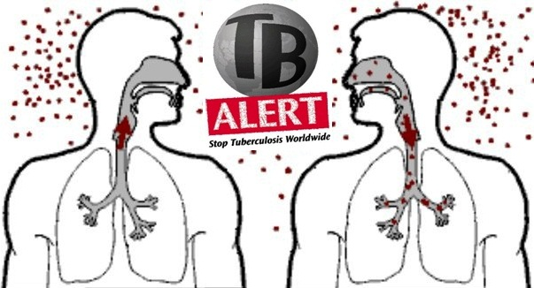
One-third of the world's population is infected with the tubercle bacillus.
TB infection usually occurs by the respiratory route.

Slide 4
CAUSES
TB is caused by tubercle bacilli, which belong to the genus Mycobacterium.
Mycobacterium species include:
M. tuberculosis complex: M. Tuberculosis 99%, M. Bovis 0.4%, M. africanum 0.5%.
Mycobacteria other than tuberculosis: Around 15 are recognised as pathogenic to humans and some cause pulmonary disease resembling TB. They have been found in soil, milk and water. They are also referred to as atypical mycobacteria.
Mycobacterium leprae: The cause of leprosy.

Slide 5
initially infection
Infection with tubercle bacilli occurs mainly by the respiratory route.
The lung lesions caused by infection commonly heal, leaving no residual changes….
Except occasional pulmonary or tracheobronchial lymph node calcification.
The primary lesion heals without intervention
But may be the bacilli survive in a latent form, which may then reactivate later in life.

Slide 6
About 5% of those initially infected
Will develop active primary disease
This can include pulmonary disease, through local progression in the lungs, or by lymphatic or haematogenous spread of bacilli, to pulmonary, meningeal or other extrapulmonary involvement,

Slide 7
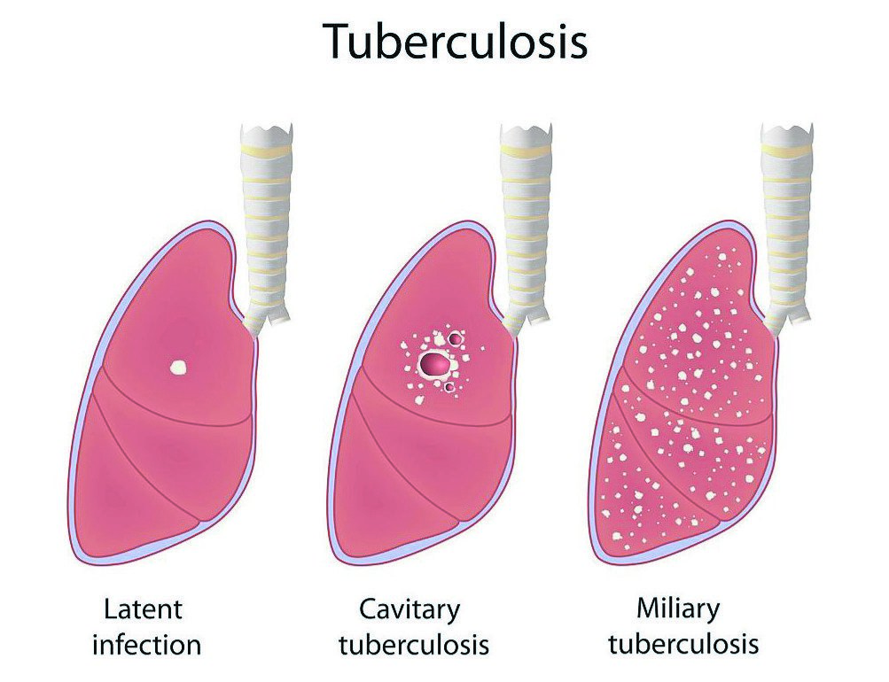

Slide 8
Susceptible patients
Infants,
Adolescents
Immunosuppressed people
Are more susceptible to the more serious forms of TB such as miliary or meningeal TB.

Slide 9
Two types of TB
Pulmonary (respiratory) TB is more common.
Extrapulmonary (non-respiratory) TB.
Sites of extrapulmonary disease include the pleura, lymph nodes, pericardium, kidneys, meninges, bones and joints, larynx, skin, intestines, peritoneum and eyes.

Slide 10
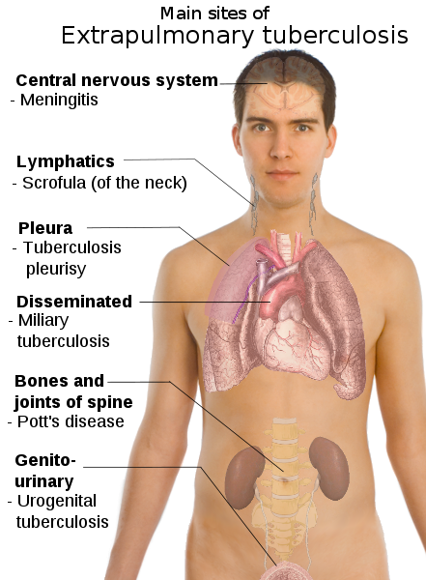

Slide 11
Incubation period
The incubation period from infection to demonstrable primary lesion ranges from 2 to 10 weeks.
Latent infection may persist for a lifetime.
HIV infection appears to shorten the interval for the development of clinically apparent TB.

Slide 12
Transmission
Exposure to tubercle bacilli in air-borne droplet nuclei produced by people with pulmonary or respiratory tract TB during expiratory efforts such as coughing or sneezing.
TB cannot be acquired from individuals with latent TB infection (LTBI).

Slide 13
When we consider these Patients have TB infection?
If they have sputum smear-positive pulmonary disease
(i.e. they produce sputum containing sufficient tubercle bacilli to be seen on microscopic examination of a sputum smear) or Laryngeal TB.
Patients with smear-negative pulmonary disease (three
Sputum samples) are less infectious than those who are smear positive. The relative transmission rate from smear-negative
compared with smear-positive patients has been estimated to be 22%

Slide 14
Risk groups
Close contacts of patients with TB, especially those with sputum smear-positive pulmonary disease
Casual contacts (e.g. work colleagues) if they are immunosuppressed
People from countries with a high incidence of TB.
People with certain medical conditions are at increased risk of developing active TB if they have LTBI.

Slide 16
For complete cure without complications
Knowing the alert symptoms
Early diagnosis
Prompt treatment

Slide 17
Clinical diagnosis will based on…
symptoms and signs in the patient,
chest radiography,
microscopy and culture of sputum,
tuberculin skin testing,
Blood-based immunological tests.

Slide 18
Symptoms
Cough for 3 weeks or more/productive cough
Sputum usually mucopurulent or purulent
Haemoptysis not always a feature
Fever may be associated with night sweats
Tiredness
Weight loss variable
Anorexia variable
Malaise.

Slide 19
Differential diagnoses for the symptoms
TB should be considered in the of patients with a chronic cough if:
There is no other likely cause,
The individuals with chest infections not responding to treatment.

Slide 20
Investigations
1-The tuberculin skin test is used for detection of TB infection. After a positive tuberculin skin test result, a chest radiograph (x-ray) and sputum cultures are required to distinguish between active vs. latent TB.
2-A patient with active TB infection usually presents with symptoms, a positive tuberculin skin test, and an abnormal chest radiograph. This patient will require isolation and pharmacologic treatment.
3-Latent TB presents with no symptoms but with a positive tuberculin skin test and radiographic evidence of prior TB

Slide 21
Treatment
In treating TB, a number of factors are important:
Choice of drugs
Length of treatment
Co-morbidity especially HIV infection, liver and renal diseases
Adherence to treatment by the patient.

Slide 22
Treatment with anti-TB drugs has two main purposes:
To cure people with TB, provided the bacilli are drug sensitive;
To control TB, by either preventing the development of
Infectious forms or reducing the period of infectivity of
People with infectious disease.

Slide 23
Most regimens involve
Isoniazid
rifampicin,
pyrazinamide
ethambutol.
Monotherapy can be used only for latent TB infection

Slide 24
The recommended standard treatment regimen for respiratory and most other forms of TB
Initial Phase: rifampicin, isoniazid, pyrazinamide and ethambutol for the initial 2 months.
Continuation Phase: a further 4 months of rifampicin and isoniazid.

Slide 25
Duration Of Treatment of TB
Respiratory TB ---- 6months
TB of peripheral lymph nodes ---- 6months
Meningeal TB ----- 12 months
Bone and joint TB------- 6months
Disseminated TB -------- 6months
Pericardial TB -------- 6months

Slide 26
Meningeal TB
Rifampicin and isoniazid with pyrazinamide, for 12 months
With ethambutol, Only the first 2 months.
Ethambutol (and streptomycin) only reach cerebrospinal fluid through inflamed meninges.

Slide 27
Corticosteroids
1-Corticosteroids in moderate to severe tuberculous meningitis appear to reduce sequelae (complications) and prolong survival. The mechanism for this benefit is likely owing to reduction of intracranial pressure. Adjunctive therapy with corticosteroids may also be of benefit for patients with tuberculous pericarditis.
2-They should be avoided in most other circumstances because they detract from the immune response to TB.

Slide 28
Glucocorticoids
Adults: equivalent to prednisolone 20–40 mg if on rifampicin, otherwise 10–20 mg
Children: equivalent to prednisolone 1–2 mg/kg, maximum 40 mg.

Slide 29
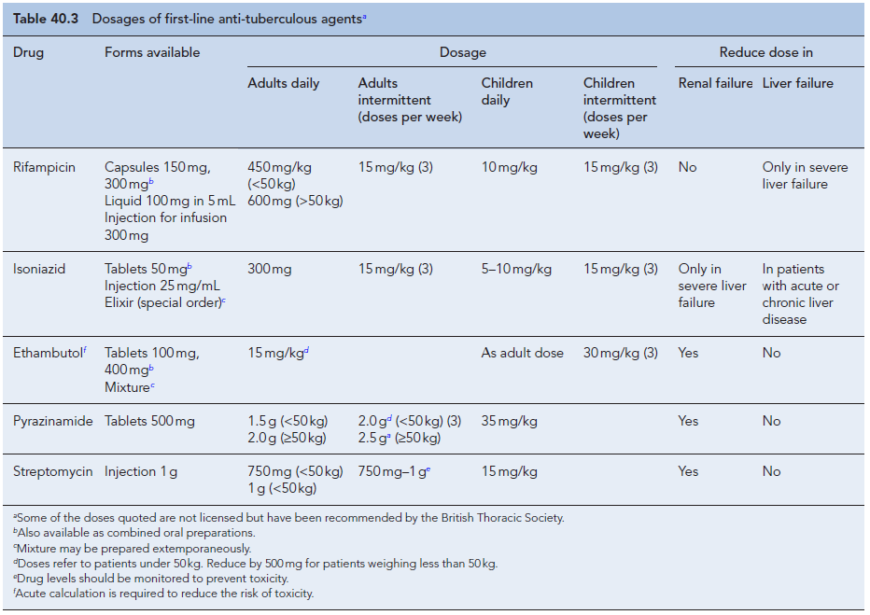

Slide 30
Monitoring treatment
In pulmonary TB, sputum examination and culture are the most sensitive markers of treatment success.
Patients taking regimens containing rifampicin and isoniazid should be non-infectious within 2 weeks.
If a patient does not become culture negative, it may be due to either drug resistance or non-adherence, the latter being more likely.
Good adherence is essential if treatment is to be successful and checking this can be difficult, especially when a patient is unwilling to cooperate.

Slide 31
Adverse reactions

