Slide 1
Column Chromatography (CC)
This includes chromatographic methods in which:
The stationary phase is packed into a column.
The mobile phase is a moving liquid or gas.
According to the mechanism of separation of solutes, five major types of CC are distinguished. Usually, one mechanism predominates but does not exclude the others

Slide 2
Different Types of chromatography
Mechanism | Mobile phase | Stationary phase | Mode or type
Solutes move at different rates according to the forces of attraction to the stationary phase. | Liquid or gas | Solid that attracts the solutes | Adsorption Chromatography (CC)
Solutes equilibrate between the 2 phases according to their partition coefficients | Liquid or gas | Thin film of liquid formed on the surface of a solid inert support | Partition Chromatography (Paper & TLC)
Solute ions of charge opposite to the fixed ions are attracted to the resin by electrostatic forces & replace the mobile counterions. | Liquid containing electrolytes | Solid resin that carries fixed ions & mobile couterions of opposite charge attached by covalent bonds | Ion Exchange Chromatography
Molecules separate according to their size: Smaller molecules enter the pores of the gel, and need a larger volume of eluent. Larger molecules pass through the column at a faster rate. | Liquid | Porous gel with no attractive action on solute molecules | Molecular Exclusion Chromatography
Special kind of solute molecules interact with those immobilized on the stationary phase | Liquid or gas | Solid on which specific molecules are immobilized | Affinity Chromatography

Slide 3
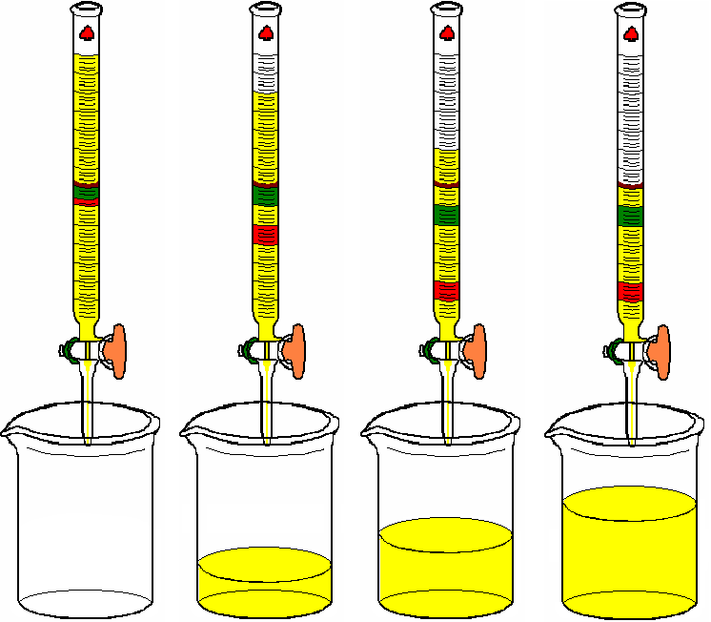
Column Chromatography
Column chromatography
Stationary phase is held in a narrow tube through which the mobile phase is forced under pressure or under the effect of gravity

Slide 4
Definition | Term
Mobile liquid phase with no affinity to the stationary phase (i.e. inert towards it) & no effect on solutes. | Solvent
Any liquid with more affinity to the stationary phase than the solvent but less than solutes and just capable to move them through the column. | Developer
Any liquid that passes out of the column. | Effluent
Any liquid that has lesser affinity to the stationary phase than solutes but is capable to move them out of the column. | Eluent
Fraction of eluent containing a required specific substance. | Eluate
(or retardation volume): Volume of mobile phase that passes out of the column, before elution of a specific substance. | Retention volume (V_{R})

Slide 5
Open Column Chromatography (Traditional column chromatography)
Traditional column chromatography is characterized by addition of mobile phase under atmospheric pressure and the stationary phase is packed in a glass column.

Slide 6
Packing & operating the column 1- Packing
The selection of the method of packing depends mainly on the density of the solid.Techniques used are the wet, dry & slurry methods.
In all cases avoid inclusion of air bubbles

Slide 7
2- Sample Application
Apply evenly & in a concentrated solution to the top of the column which is protected from disturbance (e.g. add glass wool or filter paper).

Slide 8
Elution techniques
Procedure | Technique
Addition of solvent mixture of fixed composition during the whole process. | Isocratic elution
Continuous or linear elution: in which there is continuous change in the composition of the mobile phase over a period of time (e.g. polarity, pH or ionic strength). | Gradient elution
Step wise or fractional elution: in which the change is not continuous i.e. a sudden change in the composition of the mobile phase is followed by a period where the mobile phase is held constant.

Slide 9
4- Detection
On-column detection for colored or fluorescent compounds directly after developing the chromatogram.
Monitoring of eluted fractions (PC or TLC).
Using special detectors connected to the column such as refractive index, UV detectors, etc…

Slide 10
Factors affecting solutes separation in CC
( Factors affecting column efficiency)
Effect | Factor
Decrease of size improves separation (but very small particles need high pressure). | Particle size of solid stationary phase (or of support)
Efficiency increases as ratio length / width increases. | Column dimensions
Non uniform packing results in irregular movement of solutes through column & less uniform zone formation, (i.e. band broadning or tailing). | Uniformity of packing
Increase in column temperature results in speed of elution but does not improve separation (tailing). | Column temperature
Solvents should be of low viscosity (to give efficient resolution) & high volatility (to get rapid recovery of the substances). | Eluting solvent
Uniform & low flow rate gives better resolution. | Solvent flow rate
Discontinuous flow disturbs resolution | Continuity of flow
Deactivation of adsorbent decreases separation. | Condition of adsorbent
Substances of high concentration move slowly. | Concentration of solutes

Slide 11
Adsorption Column Chromatography
Adsorbents:
The most common are Alumina & Silica gel in which the interactions with solute molecules is due to OH groups present on their surface.
More polar molecules are adsorbed more strongly & thus, will elute more slowly
Strength of adsorption of polar groups (solutes) on polar support is in the following order:
-C=C- < O-CH3 < -COOR < >C = O < -CHO < -NH2 < -OH < -COOH
Olefins < Ethers < Esters < Lactones < Aldehydes < Amines < Phenols < Acids.

