Slide 1
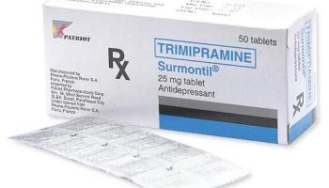
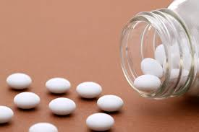
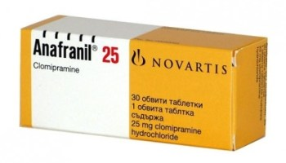
Anti depressants Toxicity
Clinical toxicology lab-6
5th Year
Lecturer. Wrood Salim
2019-2020

Slide 2
Overview
Depression is a potentially life-threatening mood disorder that affects 1 in 6 persons in the United States, or approximately 17.6 million Americans each year. Depressed patients are more likely to develop type 2 diabetes and cardiovascular disease.
Morbidity associated with depression is difficult to quantify, but the lethality of depression takes the measurable form of completed suicide, the in the United States. tenth leading reported cause of death

Slide 3
Physiologic factors in depression
Depression is thought to involve changes in receptor-neurotransmitter relationships in the limbic system( It includes the hypothalamus, the hippocampus, the amygdala, and several other nearby areas)
Serotonin and norepinephrine are thought to be the primary neurotransmitters involved, but dopamine has also been related to depression.
Typically, neurotransmitters are passed from neuron to neuron; subsequently, either they are reabsorbed into the neuron—where they are either destroyed by an enzyme or actively removed by a reuptake pump and stored until needed—or they are destroyed by monoamine oxidase (MAO) located in the mitochondria.
A decrease in the functional balance of these neurotransmitters causes certain types of depression (ie, decreased norepinephrine causes dullness and lethargy, and decreased serotonin causes irritability, hostility, and suicidal ideation

Slide 4
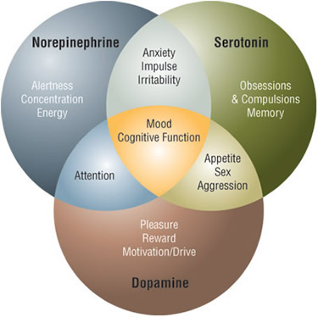
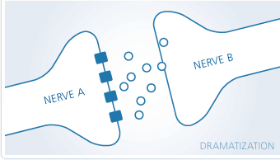
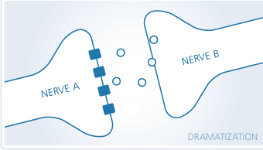
Anti-depressant drugs
Normal
Depression

Slide 5
Alterations in the balance of neurotransmitters and/or their function include the following:
Impaired synthesis of neurotransmitters
Increased breakdown or metabolism of neurotransmitters
Increased pump uptake of neurotransmitters

Slide 6
Signs and symptoms of depression
Persistently sad, anxious, or empty moods
Loss of pleasure in usual activities (anhedonia)
Feelings of helplessness, guilt, or worthlessness
Crying, hopelessness, or persistent pessimism
Fatigue or decreased energy
Loss of memory, concentration, or decision-making capability
Restlessness, irritability, Sleep disturbances
Change in appetite or weight
Physical symptoms that defy diagnosis and do not respond to treatment - (very commonly pain and gastrointestinal complaints)
Thoughts of suicide, death, or suicide attempts
Poor self-image or self-esteem

Slide 7
Anti-depressants toxicity
The antidepressants are a leading cause of drug-related self-poisonings in the developed world, primarily because of their ready availability to people with depression who by virtue of the disease are at high risk for overdose.

Slide 8
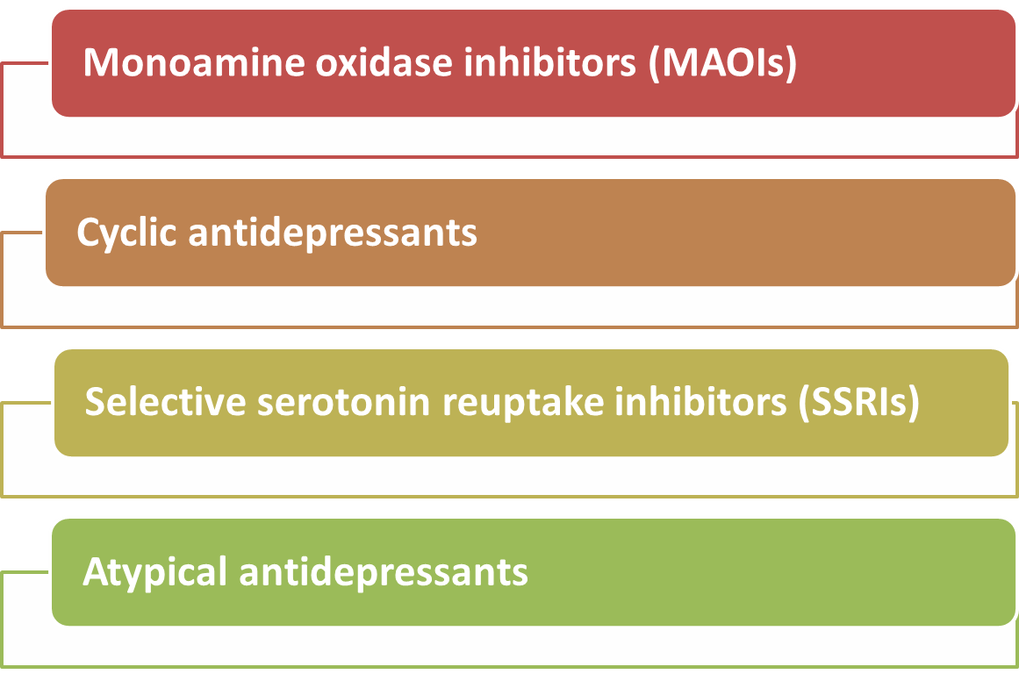
Classes of Anti-depressant drugs

Slide 9
Anti-depressant drugs
4 major classes of antidepressant drugs
Monoamine oxidase inhibitors
Used only to treat depression which is resistant to the other classes of antidepressants because of their serious toxicity
Phenlzine, Tranylcypromine, and Isocarboxazid
Selective Serotonin Reuptake Inhibitors SSRI
obsessive-compulsive disorders, panic
disorder, alcoholism, obesity, migraine headache, and chronic pain syndromes
Citalopram, and Fluoxetine
Less side effects
Cyclic Antidepressants
Neuralgic pain, migraines, enuresis, and attention deficit hyperactivity disorder
NE and serotonin reuptake inhibition, anti-muscarinic activity
Imipramine, amitriptyline, maprotiline and amoxapine
Atypical Antidepressants
Serotonin reuptake inhibition with other neurotransmitter activity
Venlafaxine, Duloxetine, and Bupropion

Slide 10
1- Tricyclic antidepressants
Although selective serotonin reuptake inhibitors (SSRIs) have overtaken them to become first-line therapy for depression, TCAs remain widely prescribed for depression and an increasing number of other indications including anxiety disorders, attention deficit disorder, pediatric enuresis, and chronic pain syndromes.
The toxic effects of tricyclics are caused by four main pharmacological properties:
Inhibition of norepinephrine and seretonin reuptake at nerve terminals.
Direct adrenergic action
A membrane stabilising or quinidine-like effect on the myocardium; sodium channel blocking.
Anticholinergic action

Slide 11
Clinical manifestations of acute toxicity:
Acute Toxicity
Acute cardiovascular toxicity
Acute central nervous system toxicity
Other clinical effects

Slide 12
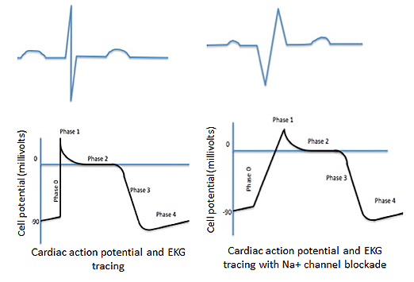
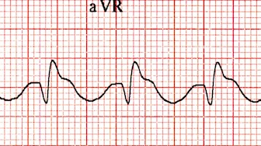
Cyclic Antidepressants toxicity
Acute cardiovascular toxicity is primarily responsible for the morbidity and mortality
Sinus tachycardia is the most common dysrhythmia((rate 120–160 beats/min in an adult), QRS, & QT interval prolongation
Refractory hypotension is probably the most common cause of death from CA overdose (Na channel blockade)
Seizures and altered mental status are the primary manifestations of CNS toxicity
Anticholinergic effects
Dilated Pupils, dry mouth, dry flushed skin, hyperthermia, urinary retention

Slide 13
Management:
Patients with ECG changes should be monitored in the intensive care unit (ICU) until the mental status is baseline, the patient is asymptomatic, & the ECG has returned to normal for 24 hours.
Supportive measures:
Maintain airway; intubate if indicated.
Monitor arterial blood gases.
Administer oxygen if necessary.
Treat hypotension with IV crystalloids , inotropes (dopamine), vasopressors (noradrenaline), as necessary.
Reduce drug absorption:
Gastric lavage
Single dose activated charcoal.
Enhance drug elimination:
Multiple-dose activated charcoal.
Diuresis & haemodialysis are not effective. Why??

Slide 14
Management:
Alkalinization & sodium loading with hypertonic sodium bicarbonate &/or hypertonic saline along with controlled ventilation (if clinically indicated) should be administered to all CA overdose patients presenting with major cardiovascular toxicity & altered mental status. Vasopressors such as NE is recommended for refractory hypotension
Conventional antiarrhythmics may also be necessary. Quinidine, disopyramide, & procainamide are contraindicated.
Benzodiazepines for Seizures.

Slide 15
2- MAO inhibitors toxicity
The clinical toxicity of MAOIs falls into 3 clinical syndromes
Acute toxicity from overdose
-Symptoms may be delayed 6 to 24 hours
-Sympathetic hyperactivity
which is followed by cardiovascular collapse
-Hyperthermia, seizures, and hypertension
-Renal failure and dehydration
Serotonin syndrome
-Life threatening complication of antidepressant
-Altered mental status, increased neuromuscular
tone, and autonomic excitation
-Prolonged duration of risk for the development
of the syndrome after the discontinuation of the drug due to long duration of action
-“washout” period of at least 2 weeks
Hypertensive crises
-Food-drug and drug-drug interactions
-Pharmacologically active dietary amines (eg, tyramine) are ingested by Patients
-Indirectly acting sympathomimetic
agents (eg, cocaine, amphetamine)
-Hypertension and tachycardia, headache,
and altered mental status
-Usually last only several hours compared to MAOI overdoses in which symptoms can last several days

Slide 16
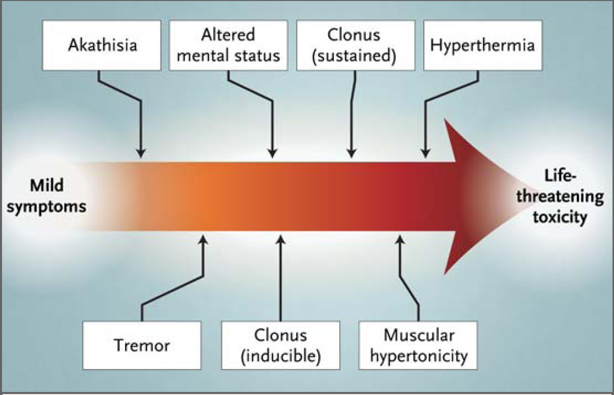
3- SSRI Toxicity
Wide therapeutic index
Mild or no symptoms after an overdose
Acute signs and symptoms include nausea, vomiting, dizziness, blurred vision, tachycardia, and CNS depression
Serotonin Syndrome “serotonin toxicity”
Uncommon
Clinical manifestations may range from mild confusion, tachycardia, and tremor to coma, hyperthermia, and muscular rigidity
Combination of serotonergic agents

Slide 17
Managment
ABC.
Treat hyperthermia with cooling blankets, fans, ice packs, and IV fluids. Antipyretics are not indicated.
Administer activated charcoal if a potentially lethal amount or combination of proserotonergic agents has been ingested and if the presentation is within 1-2 hours.
Treat neuromuscular abnormalities with benzodiazepines.
Severely ill patient treated 5-HT antagonists, such as cyproheptadine (monitoring for hyperthermia. why?)

Slide 18
Antidepressants and suicide
In October 2003, the US Food and Drug Administration (FDA) issued a public health advisory regarding reports of suicidality in pediatric patients being treated with antidepressant medications for major depressive disorder.
The FDA advisors recommended:
A "black-box" warning label be placed on all antidepressants, indicating that they increase the risk of suicidal thinking and behavior (suicidality)
A patient information sheet (Medication Guide) be provided to the patient and their caregiver with every prescription
The results of controlled pediatric trials of depression be included in the labeling for antidepressant drugs

Slide 19
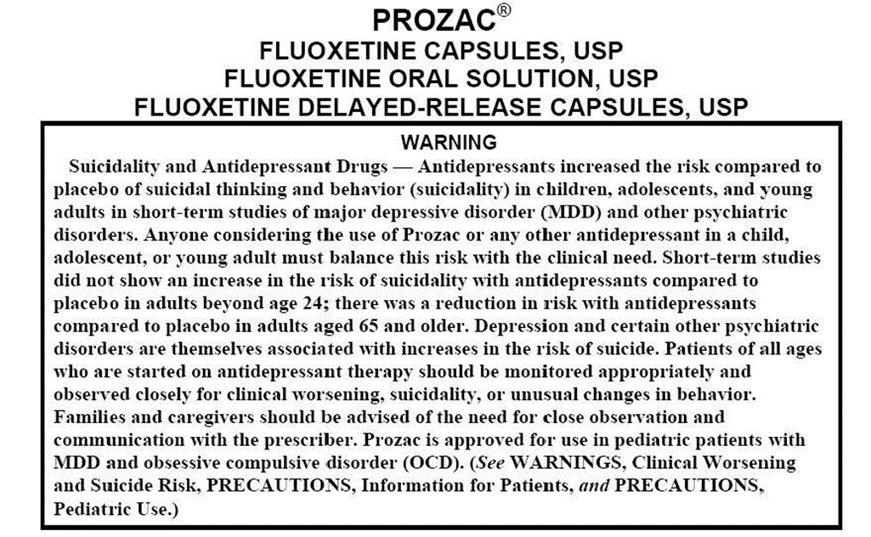
Antidepressants and suicide

Slide 20
Dorothy Dandridge, 1965
Imipramine overdose
The first African-American to be nominated for an Academy Award for Best Actress, the 42-year-old Dandridge was found dead by her manager from what was diagnosed as “acute drug intoxication.” Her death was ruled to be due to an accidental overdose of Tofranil, an antidepressant that she took for what today might be diagnosed as bipolar disorder
Oscar-winning actor and comedian Robin Williams was found hanged
Williams had reportedly been battling depression, according to a statement from his press representative

Slide 21
References:
Goldfrank’s Toxicologic Emergencies 9th Edition 2011.

