Slide 1
Characteristic Group Vibrations of Organic Molecules

Slide 2
Information obtained from IR spectra
IR is most useful in providing information about the presence or absence of specific functional groups.
IR can provide a molecular fingerprint that can be used when comparing samples. If two pure samples display the same IR spectrum it can be argued that they are the same compound.
IR does not provide detailed information or proof of molecular formula or structure. It provides information on molecular fragments, specifically functional groups.
Therefore it is very limited in scope, and must be used in conjunction with other techniques to provide a more complete picture of the molecular structure.

Slide 3
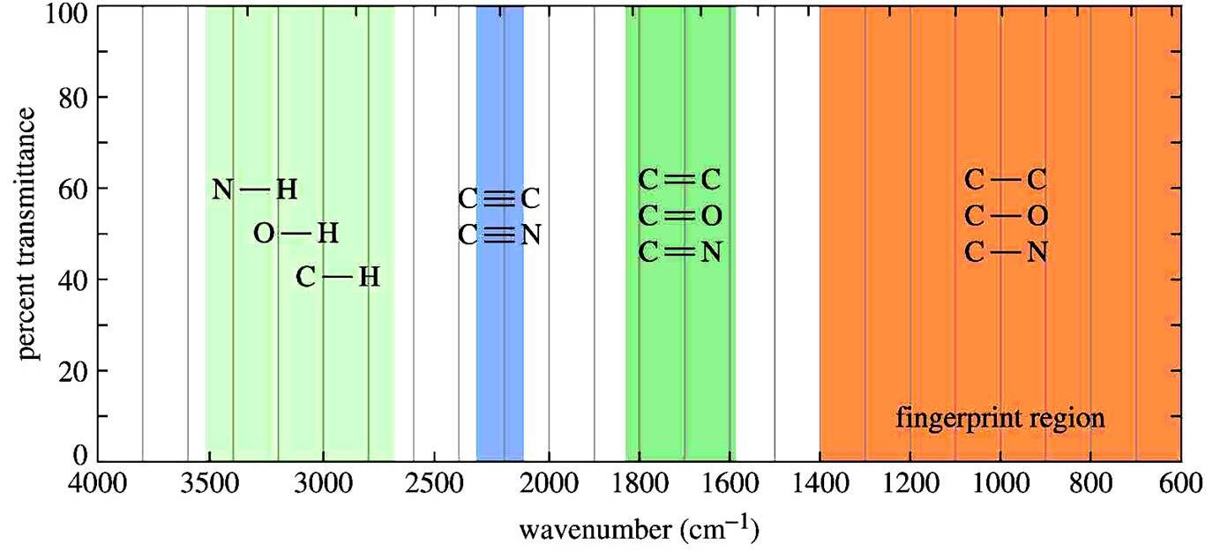
IR absorption range
The typical IR absorption range for covalent bonds is 600 - 4000 cm⁻¹. The graph shows the regions of the spectrum where the following types of bonds normally absorb. For example a sharp band around 2200-2400 cm⁻¹ would indicate the possible presence of a C≡N or a C≡C bond.
Graphics source: Wade, Jr., L.G. Organic Chemistry, 5th ed. Pearson Education Inc., 2003

Slide 4
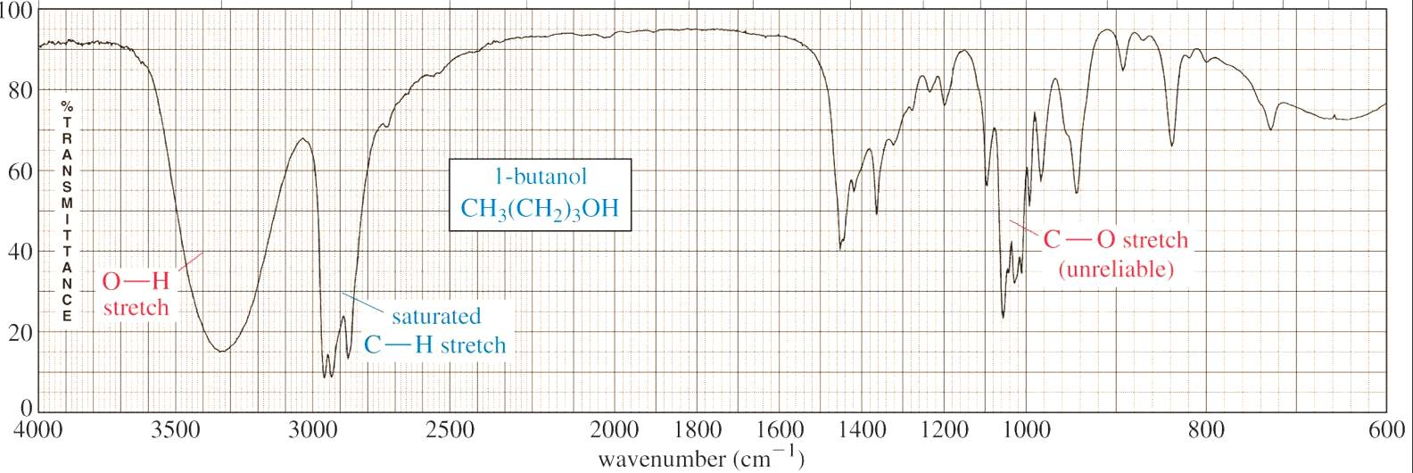
The fingerprint region
Although the entire IR spectrum can be used as a fingerprint for the purposes of comparing molecules, the 600 - 1400 cm⁻¹ range is called the fingerprint region. This is normally a complex area showing many bands, frequently overlapping each other. This complexity limits its use to that of a fingerprint, and should be ignored by beginners when analyzing the spectrum.
Focus your analysis on this region. This is where most stretching frequencies appear.
Fingerprint region: complex and difficult to interpret reliably.
Graphics source: Wade, Jr., L.G. Organic Chemistry, 6th ed. Pearson Prentice Hall Inc., 2006

Slide 5
Characteristic Group Vibrations of Organic Molecules
The region above 1400 cm⁻¹ often provides easily recognizable bands of various functional groups and thus much valuable structural evidence from relatively few of theses bands is obtained and total interpretation of the complete spectrum is seldom required.

Slide 6
Hydrocarbons C-H and C-C stretching and bending vibrations
Alkanes:
In simple hydrocarbons, only two types of atoms C and H and only two types of bonds (C-C) and (C-H) are present..
A hydrocarbon containing a methyl group (CH₃) usually shows two distinct bands, one at 2960 cm⁻¹ due to asymmetric stretching and the other at 2870 cm⁻¹ due to symmetric stretching.
The C -H bonds in methylene group (CH₂) undergo number of stretching and bending vibrations. The two stretching vibrations – asymmetrical and symmetrical occur at 2925 cm⁻¹ and appear in the spectrum.
The C-H bending vibrations of the methyl groups in the hydrocarbons normally occur at 1450 and 1375 cm⁻¹. The band at 1375 cm⁻¹ is due to methyl on the carbon atom and is quite sensitive to the electronegativity of the substituent present at the methyl group. within a range of + 10 cm⁻¹.
The (C-C) bond vibrations appear as weak bands in 1200-800 cm⁻¹ region and are seldom used for structural study. Whereas the (C-C) bending absorptions occur at < 500 cm⁻¹ and are usually below the range of IR – instrument.

Slide 7
The band shifts from as high as 1475 cm⁻¹ in CH₃-F to as low as 1150 cm⁻¹ in CH₃-Br. This band is extremely useful in detecting the presence of methyl group in a compound because it is sharp and of medium intensity and is rarely overlapped by absorptions due to methylene or methane deformations.
The intensity of this band usually increases with the number of methyl groups in the compound. However, the presence of two or more methyl groups on one aliphatic carbon atom (isopropyl or t-butyl groups) results in splitting of this band due to in-phase or out of phase interactions of the two symmetrical methyl deformations.
The methylene group, C-H bending vibrations such as scissoring, twisting, wagging and rocking normally appear at fairly different frequencies. If two or more CH₂ groups are present, the usually strong scissoring and rocking absorption bands appear at 1465 and 720 cm⁻¹, respectively. Whereas weak bands due to twisting and wagging vibrations appear at 1250 + 100 cm⁻¹. So, the scissoring absorption band of methylene around 1465 cm⁻¹ often overlaps with asymmetric bending vibration of methyl at 1450 cm⁻¹.

Slide 8
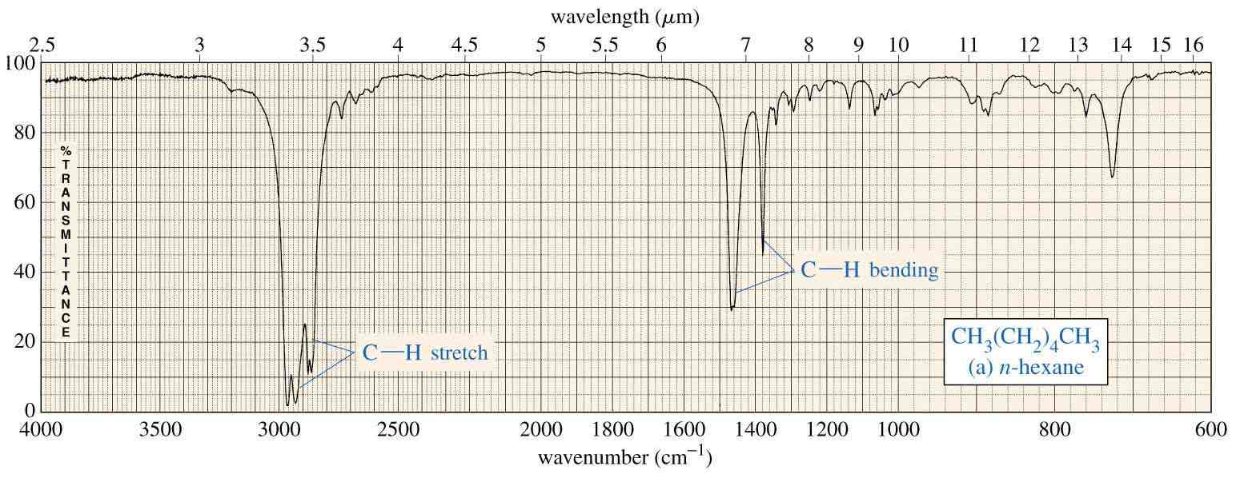
n-Hexane
2870-2960 cm⁻¹ (CH₂) 1470 cm⁻¹ 1375 cm⁻¹
Graphics source: Wade, Jr., L.G. Organic Chemistry, 5th ed. Pearson Education Inc., 2003

Slide 9
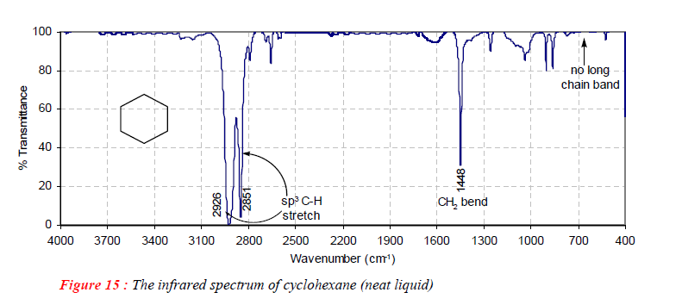
Cyclic aliphatic hydrocarbons
The C-H stretching frequencies are the same (2800 – 3000 cm⁻¹) as in the case of acyclic compounds, if the ring is unstrained. However, methylene (CH2) scissoring bands shift slightly to smaller wavenumber (1470 cm⁻¹ in hexane and 1448 cm⁻¹ in cyclohexane. In satirically strained cyclic compounds, the C-H stretching normally occurs at slightly higher wavenumber e.g. 3080 -3040 cm⁻¹ in cyclopropane.

Slide 10
Alkenes:
The (C=C) bond has a higher force constant than a (C-C) bond and in a non-conjugated olefin.
(C=C) stretching > (C-C) stretching
(1680-1620 cm⁻¹ ) (1200-800 cm⁻¹)
In completely symmetrical alkenes, such as ethylene, tetrachloroethylene etc., (C=C) stretching band is absent, due to lack of change in dipole moment in completely symmetrical molecule.
Non-symmetrically substituted double bonds exhibit strong absorption bands. The absorption bands are more intense for cis isomers than for trans isomers; for mono or tri substituted olefins than for di and tetra substituted ones.
(C=C) terminal olefins > (C=C) internal olefins
Similarly (C=C) groups conjugated with certain unsaturated group show stronger band than for non-conjugated ones.

Slide 11
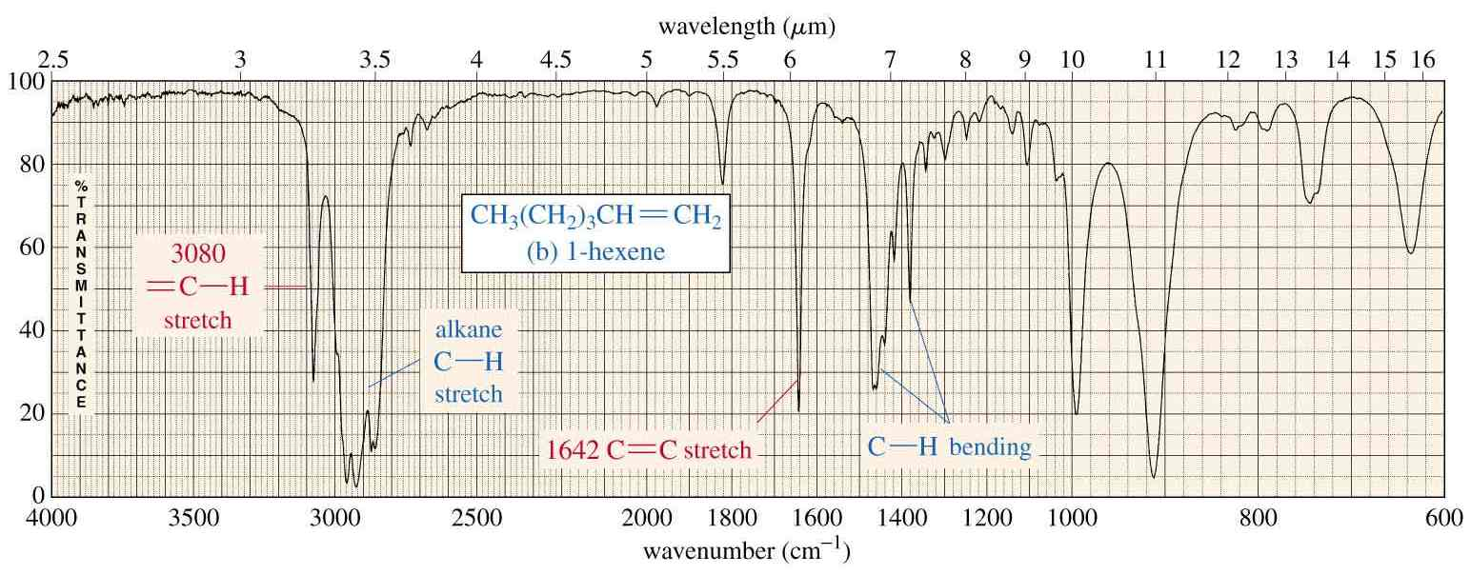
IR spectrum of alkene
(1680-1620 cm⁻¹ ) (1470-1375 cm⁻¹)
Graphics source: Wade, Jr., L.G. Organic Chemistry, 5th ed. Pearson Education Inc., 2003

Slide 12
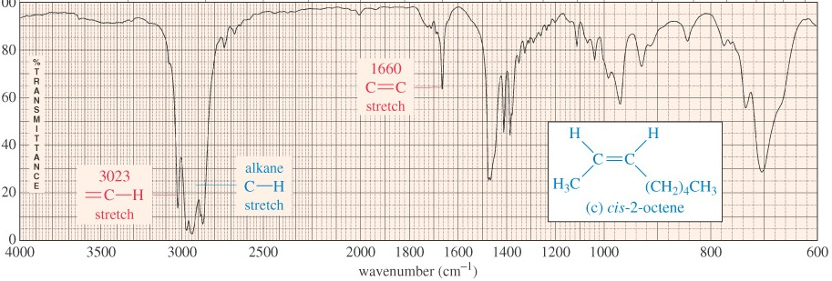
This spectrum shows that the band appearing around 3080 cm⁻¹ can be obscured by the broader bands appearing around 3000 cm⁻¹.
Graphics source: Wade, Jr., L.G. Organic Chemistry, 6th ed. Pearson Prentice Hall Inc., 2006

Slide 13
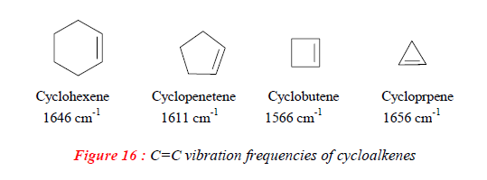
In case of olefins, conjugated with an aromatic ring, the (C=C) stretching appears at 1625 cm⁻¹ (s) and an additional band at ~1600 cm⁻¹ is observed due to aromatic double bond.
In compounds containing both olefinic and alkyl C-H bonds, the bands above 3000 cm⁻¹ are generally attributed to aromatic or aliphatic (C-H) stretching, whereas between 3000-2840 cm⁻¹ are generally assigned to the alkyl C-H stretching.
The absorption frequency of a (C=C) bond in a cyclic ring is very sensitive to ring size. The absorption frequency decreases as the internal angle decreases and is lowest in cyclobutene (90˚ angle). The frequency increases again for cyclopropane

Slide 14
The exocyclic (C=C) bonds exhibit an increase in frequency with decrease in ring size . The exocyclic double bond on six-membered ring absorbs at 1651 cm⁻¹ and it is shifted to 1780 cm⁻¹ in case of exocyclic (C=C) bond on cyclopropane.

Slide 15
Alkynes:
The most prominent band in alkynes corresponds to the (C≡C) bond. It shows as a sharp, weak band at about 2100 cm⁻¹. The reason it’s weak is because the triple bond is not very polar.
In highly symmetrical alkynes, it may not show at all due to the low polarity of the triple bond associated with those alkynes.
Terminal alkynes, (≡C-H) involving the sp carbon (the carbon that forms part of the triple bond). Therefore they may also show a sharp, weak band at about 3300 cm⁻¹ corresponding to the C-H stretch.
Internal alkynes, do not have C-H bonds to the sp carbon and therefore lack the aforementioned band.

Slide 16
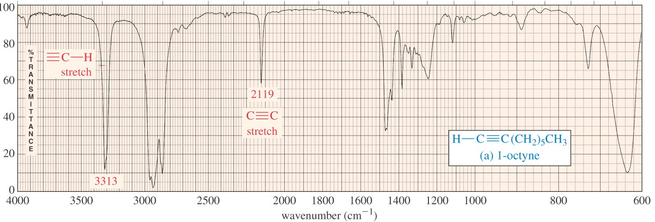
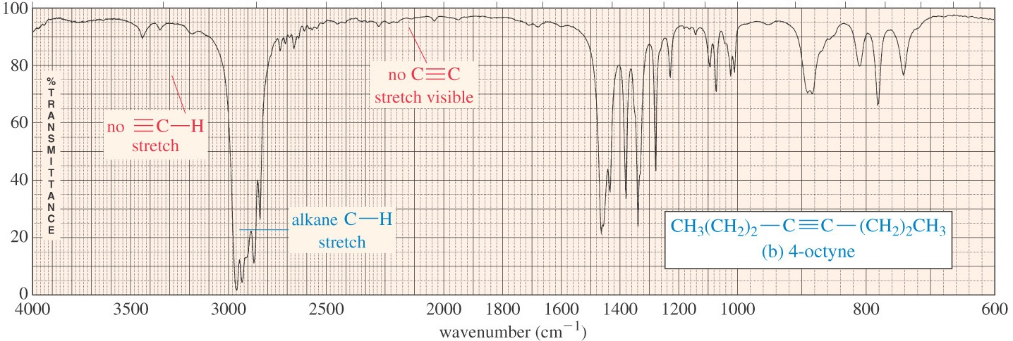
A comparison between an unsymmetrical terminal alkyne (1-octyne) and a symmetrical internal alkyne (4-octyne).
Graphics source: Wade, Jr., L.G. Organic Chemistry, 6th ed. Pearson Prentice Hall Inc., 2006

