Slide 1
NMR Spectroscopy
¹³C NMR spectroscopy

Slide 2
Nuclear Magnetic Resonance Spectroscopy
¹³C NMR
After hydrogen, the most useful atom providing information is carbon-13.
The overall intensity of a ¹³C signal is about 6400 times less than the intensity of an ¹H signal.
The chemical shift ranges over 220 ppm.
The reference compound is TMS.
Natural carbon contains about 1% of this isotope so the instruments for its detection need to be sensitive and spectra will take longer to record.
Only the chemical shift is important as each spectrum gives only single lines for each chemically equivalent carbon.
Carbon-13 nmr has wide applications in the study of natural products, biological molecules and polymers.

Slide 3
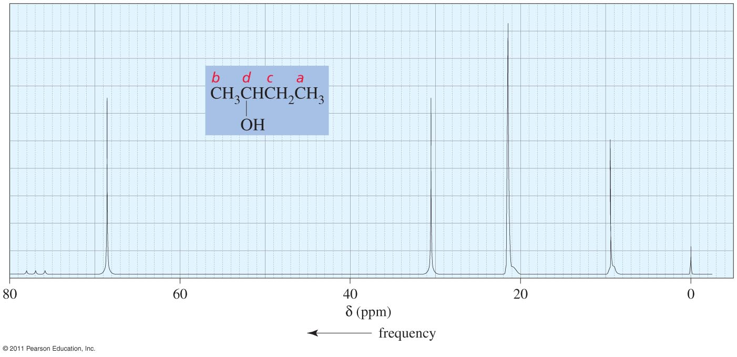
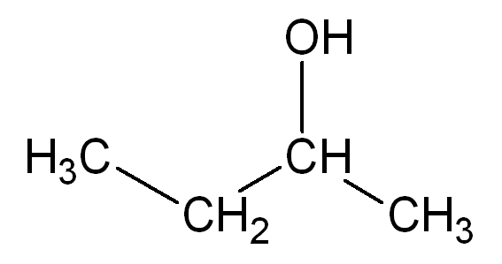
Nuclear Magnetic Resonance Spectroscopy
¹³C NMR
a
d
(˚2) higher δ than (˚1)
˚2
˚1
b
c
b
a
c
d

Slide 4
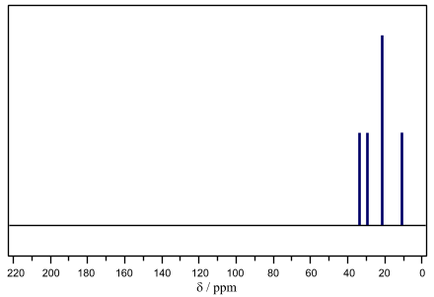
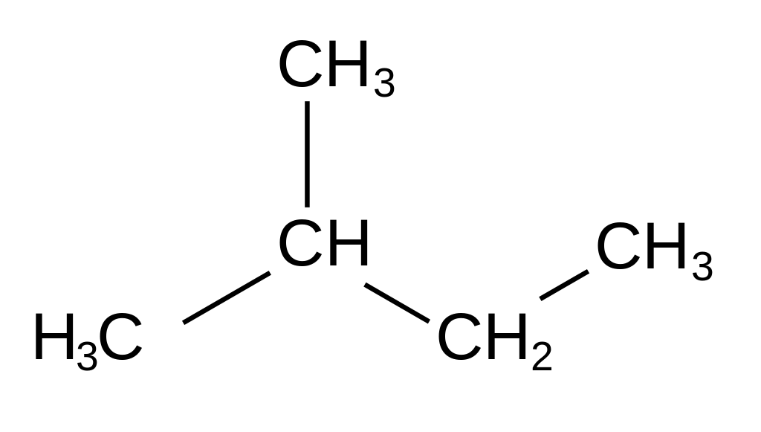
Nuclear Magnetic Resonance Spectroscopy
¹³C NMR
A score value depends on the type of C atom attached to the analysed carbon atom.
It can help to know which signal matches with its respective shift.
For example:
A score value of a is 3 because it attaches to b (tertiary carbon ˚3)
A score value of b is 4 because it attaches to (two primary carbon ˚1 for a) and a secondary carbon ˚2 for c….etc.
a
a
˚1
d
˚1
b
˚1
a
c
c
b
d
˚3
2
3
4
˚2
4

Slide 5
Nuclear Magnetic Resonance Spectroscopy
¹³C NMR
A score value depends on the type of C atom attached to the analysed C.
It can help to know which signal matches with its respective shift.
For example:
A score value of a is 3 because it attaches to b (tertiary carbon ˚3)
A score value of b is 4 because it attaches to (two primary carbon ˚1 for a) and a secondary carbon ˚2 for c….etc.
a
3
4
5
3
2
a
b
c
d
e
˚3
˚2
˚2
˚1
˚1
a
c
b
d
e
Sometimes :
˚1 > ˚2 > ˚3
Increase δ

Slide 6
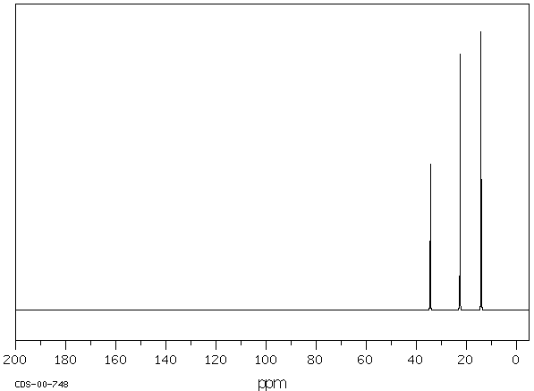
Nuclear Magnetic Resonance Spectroscopy
¹³C NMR
The C-13 NMR spectrum of pentane shows 3 signals with chemical shifts 14, 23, and 34 ppm. Match the carbon atoms with their respective shifts.
a
˚2
˚2
b
˚1
b
˚2
c
˚1
b
a
a
c
C atom | Score value
a | 2
b | 3
c | 4

Slide 7
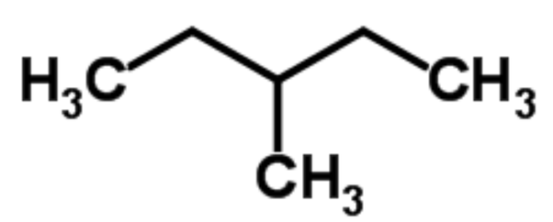
Nuclear Magnetic Resonance Spectroscopy
¹³C NMR
The C-13 NMR spectrum of 3-methylpentane shows 4 signals with chemical shifts 11, 19, 29 and 36 ppm. Match the carbon atoms with their respective shifts.
a
b
b
a
b
˚2
c
˚2
˚1
˚3
˚1
d
a
˚1
c
C atom | Score value
a | 2
b | 4
c | 5
d | 3
d

Slide 8
Nuclear Magnetic Resonance Spectroscopy
¹³C NMR: Effect of electronegativity of attached atoms
Environment | Chemical shift (ppm)
C - OH | 50 - 65
C - N | 35 - 65
C - Cl or C - Br | 30 - 70
EN
3.44
3.04
3.16
2.96
2.66
63
42
45
34
7
(High δ ) C-O > C-N > C-Cl > C-Br > C-I (low δ)

Slide 9
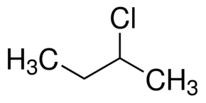
Nuclear Magnetic Resonance Spectroscopy
¹³C NMR
Which carbon atom will have a higher chemical shift, a or b?
45
11
a
c
Score value
26
b
b
3
35
60
I
2
3
II
When C atom is in the interior of a chain, it usually has a higher δ than an atom at the end of a chain
CH₃ in (II) is closest to Cl atom, so it will be deshielded (26 ppm)
CH₃ in (I) is too far from Cl, so it will be shielded (11 ppm)
The score value of c (C atom next to a ) is 3 BUT Cl atom has the powerful EN effect on a which makes appear at 45 ppm while c at 35 ppm.
So, we depended on the proximity to identify the signals.

Slide 10
Nuclear Magnetic Resonance Spectroscopy
¹³C NMR
Which carbon atom will have a higher chemical shift, a or b?
d
c
a
35
33
b
Score value 2 3 3 2
Carbon a will have a lower δ value than b although it attaches to Br atom because of the EN value of Br is less than of Cl atom
NOTE: we have to be aware when we deal with any alkyl halide, and notice if we have a powerful halogen like Cl, the proximity effect will dominate.
While, if we have Br atom in the compound, the score value will dominate.

Slide 11
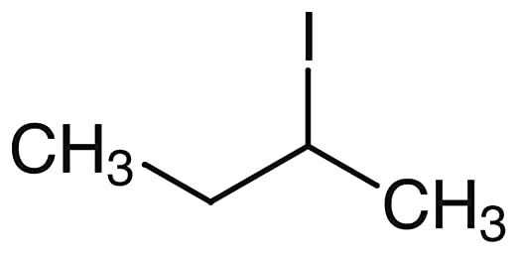
Nuclear Magnetic Resonance Spectroscopy
¹³C NMR
Which carbon atom will have a higher chemical shift, a or b?
b
a
Score value 3 3
Both a and b have the same score value, BUT b will be higher δ than a because of the EN values of (C = 2.55) and (I = 2.66), so I will not affect too much on C atom.
Iodine has the effect to lower the δ value for the attached carbon.
14
7

Slide 12
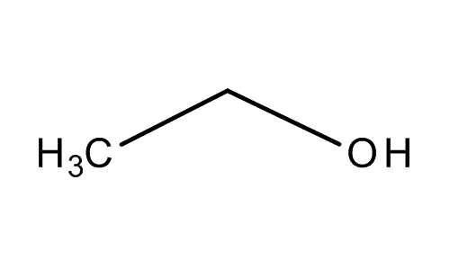
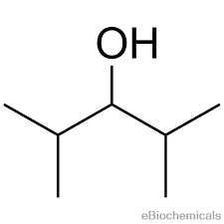
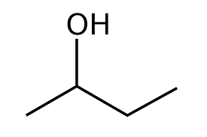
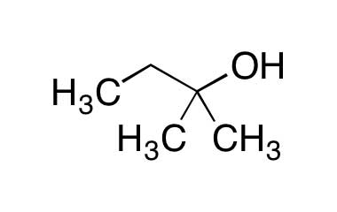
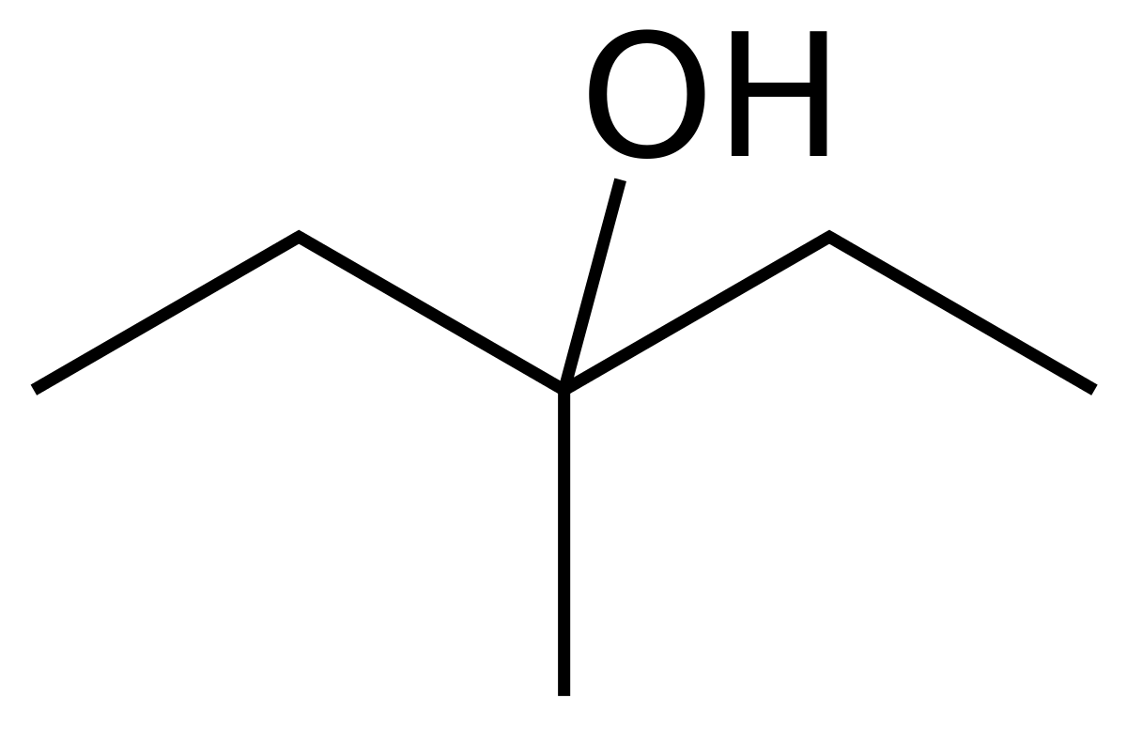
Nuclear Magnetic Resonance Spectroscopy
¹³C NMR: (C-O)
58
a
b
63
˚1
˚2
1
2
69
˚3
d
˚3
c
˚2
82
˚1
3
6
˚2
71
˚2
e
f
˚3
˚2
73
˚1
˚1
˚1
4
5
Score value
Chemical shift (C-O) = (50-100) ppm
Chemical shift

Slide 13
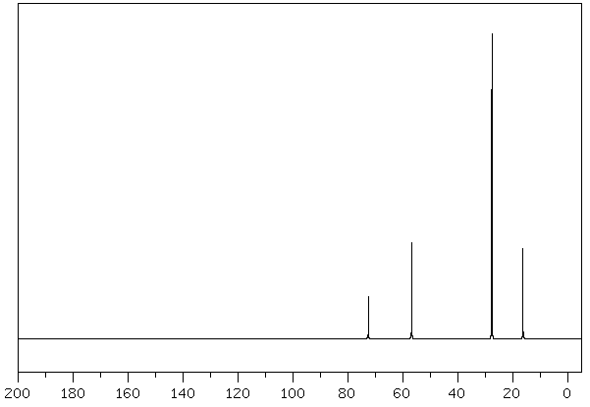
Nuclear Magnetic Resonance Spectroscopy
¹³C NMR: (C-O)
The C-13 NMR spectrum is shown below for a compound with a molecular formula C₆H₁₄O, propose a structure for the molecule.
Look at the possible functional groups locations.
(C-O) alcohol or ether (50-100) ppm
It can not be an ester because it should has two oxygen atoms
It can not be an aldehyde or ketone because there is no a significant signal at (150-200) ppm.
It is impossible to have a (C=C) or a ring because they appear at (100-150) ppm.
C₆H₁₄O

Slide 14
Nuclear Magnetic Resonance Spectroscopy
¹³C NMR: (C-O)
The C-13 NMR spectrum is shown below for a compound with a molecular formula C₆H₁₄O, propose a structure for the molecule.
Calculate index of hydrogen deficiency (IHD).
$${\left(IDH\right)}^{}=\frac{2\left(n\right){+2 −\#H}^{}}{2}$$
C₆H₁₄O
$${\left(IDH\right)}^{}=\frac{2\left(6\right){+2 −14}^{}}{2}$$
${\left(IDH\right)}^{}=$ 0
IDH = 0 means NO (=), (≡), or ring
IDH = 1 means (=), or ring
IDH = 2 means (≡)

Slide 15
Nuclear Magnetic Resonance Spectroscopy
¹³C NMR: (C-O)
The C-13 NMR spectrum is shown below for a compound with a molecular formula C₆H₁₄O, propose a structure for the molecule.
In alcohols, only one signal will appear between (50-100) ppm, while in ethers we will find two.
So, we have an ether.
Now, focus on the number of signals, as we have six carbon atoms and four signals, that means we have an equivalent atoms which give one signal.
C₆H₁₄O

Slide 16
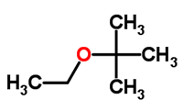
Nuclear Magnetic Resonance Spectroscopy
¹³C NMR: C₆H₁₄O
X
X
6
6
X
X
2
5
√
Number of signals
4

Slide 17
Nuclear Magnetic Resonance Spectroscopy
¹³C NMR: (C-O)
The C-13 NMR spectrum is shown below for a compound with a molecular formula C₆H₁₄O, propose a structure for the molecule.
Equivalent atoms give a one high peak, so a appears at 23 ppm, d will be the lower δ (16 ppm) according to the score values.
Both b and c are attached to O, and that gives the possibilities to find absorbance between 50 and 100 ppm.
According to the score values, b is the highest δ (74 ppm) than c (55 ppm).
a
a
C₆H₁₄O
b
a
d
c
a
Atom | Score value
a | 3
b | 5
c | 4
d | 2
c
d
b

Slide 18
Nuclear Magnetic Resonance Spectroscopy
¹³C NMR: (C≡C) (50-100) ppm
(70-100) ppm
b
a
a
b
Two signals
3
75
75
3
Normally, all methyl groups appear at (10-20)ppm, BUT the (≡) has a strong effect on the δ values of C atoms attached (alpha carbon).
It reduces δ of methyl group to 3 ppm.

Slide 19
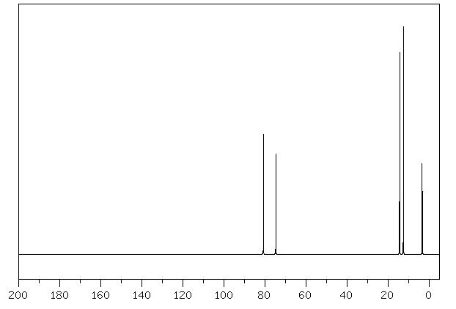
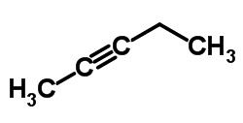
Nuclear Magnetic Resonance Spectroscopy
¹³C NMR: (C≡C) (50-100) ppm
(70-100) ppm
Calculate the score value.
We can differentiate between b and c by the score values, where c is higher in δ value (4) than b (3).
Both a and d are attached to the (≡C), BUT they have different score values, a (2) and d (3).
According to the score values, d should be higher in δ value than e, BUT because of the closeness of d to (≡C), the triple bond will decrease the chemical shift of d to be 13 ppm. While e will appear at 14 ppm.
d
e
c
e
b
3
d
a
4
2
3
2
c
b
a

Slide 20
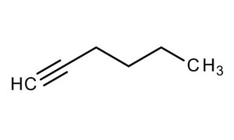
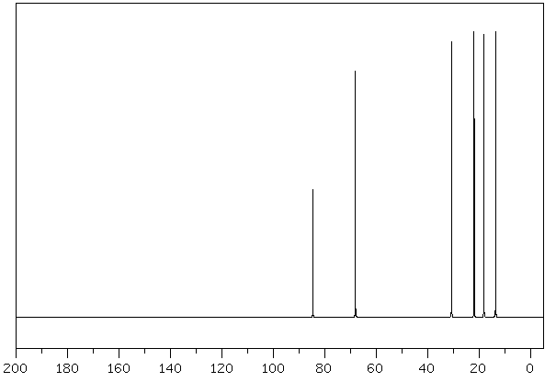
Nuclear Magnetic Resonance Spectroscopy
¹³C NMR: (C≡C) (50-100) ppm
(70-100) ppm
Determine the number of signals
Compare between a and b by score value
Calculate the score values for c, d, e, and f
Carbon c and d have the same score value, BUT c will be lower in (δ) than d because it is closer to the (≡C).
c
e
b
d
f
a
NOTE : chemical shifts (δ) of internal alkynes are fairly close, while they are not so close in terminal alkynes, by this way, we can differentiate between terminal and internal alkynes.
2
3
4
4
3
2
Chemical shift 68 85 18 31 22 14
e
f
d
c
a
b

Slide 21
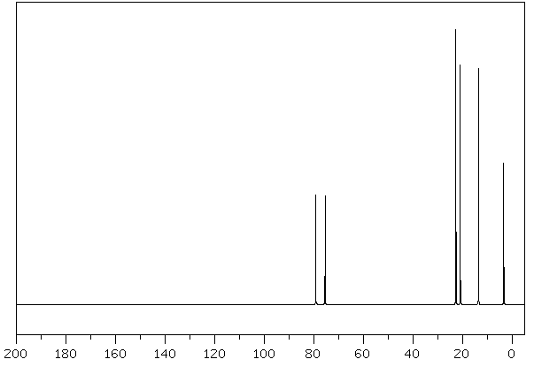
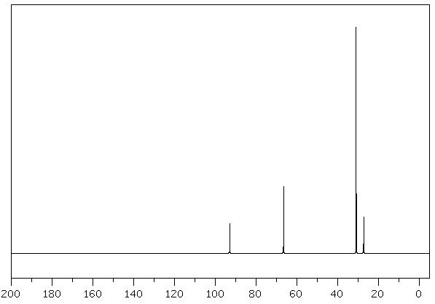
The two C-13 NMR spectra are shown below corresponded to different constitutional isomers of C₆H₁₀, propose a structure for each spectrum.
I
II
Calculate index of hydrogen deficiency (IHD).
$${\left(IDH\right)}^{}=\frac{2\left(6\right){+2 −10}^{}}{2}$$
${\left(IDH\right)}^{}=$ 2
That means we have either (≡) or 2(=)
Because the(C=C) appears at (100-150)ppm, it is impossible to have an alkene here
SO, we have an alkyne

Slide 22
The two C-13 NMR spectra are shown below corresponded to different constitutional isomers of C₆H₁₀, propose a structure for each spectrum.
I
II
Number of signals is 6 (no equivalent C)
The last two signals are too close (INTERNAL) alkyne
Number of signals is 4 (equivalent C)
The last two signals are not close (TERMINAL) alkyne

Slide 23
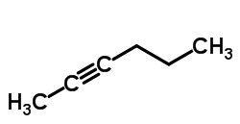
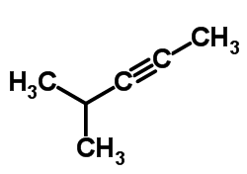
The two C-13 NMR spectra are shown below corresponded to different constitutional isomers of C₆H₁₀, propose a structure for each spectrum.
I
Six signals
Six signals
Three signals
Five signals

Slide 24
The two C-13 NMR spectra are shown below corresponded to different constitutional isomers of C₆H₁₀, propose a structure for each spectrum.
Carbon a will be the lowest δ value (3) because it attaches to (≡C) directly.
According to the score value, c will appear at higher chemical shift (79 ppm) than b (75 ppm).
Although d has a higher a score value than e, it will appear at low δ value (21 ppm), while e (23 ppm) because of the (≡) effect.
Carbon f is too far than (≡C), so it will appear at normal δ value (14 ppm).
e
d
f
c
e
d
f
b
4
2
a
3
4
3
2
a
b
c

Slide 25
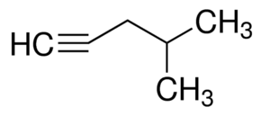
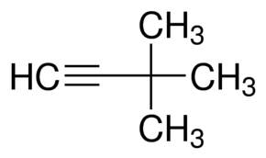
The two C-13 NMR spectra are shown below corresponded to different constitutional isomers of C₆H₁₀, propose a structure for each spectrum.
II
Four signals
Five signals
Four signals

Slide 26
The two C-13 NMR spectra are shown below corresponded to different constitutional isomers of C₆H₁₀, propose a structure for each spectrum.
Calculate the score values
Carbon b will appear at (93) ppm, while a will appear at (67) ppm.
Carbon c will be lower in δ value than d although it has high score value because of the (≡) effect.
Also, we can detect d in the chart because it contain three equivalent carbons which give a big single signal.
d
d
a
b
c
d
d
Atom | Score value
a | 2
b | 5
c | 5
d | 4
a
c
b

Slide 27
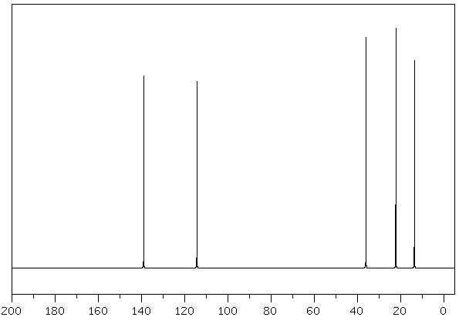
Nuclear Magnetic Resonance Spectroscopy
¹³C NMR: (C=C) (100-150) ppm
c
d
b
d
e
c
b
a
a
e
Score value 2 3 4 3 2
Double bond does not have the same effect of triple bond, that means it does not lower the chemical shift value at (alpha carbon)

Slide 28
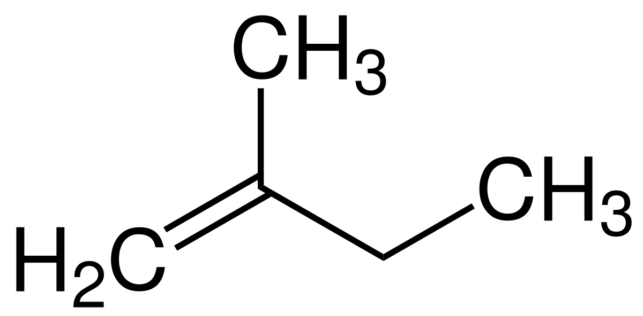
Nuclear Magnetic Resonance Spectroscopy
¹³C NMR: (C=C) (100-150) ppm
2 methyl-1-butane has five signals with chemical shifts 12, 22, 31, 109, and 148 ppm. Assign a chemical shift to each carbon atom.
Carbon a will have a lower chemical shift (109 ppm) than b (148 ppm) because it is terminal
according the score values, we can detect the other carbon atoms, c, d, and e
e
22
d
b
a
c
148
12
31
109
C atom | Score value
c | 4
d | 2
e | 3

Slide 29
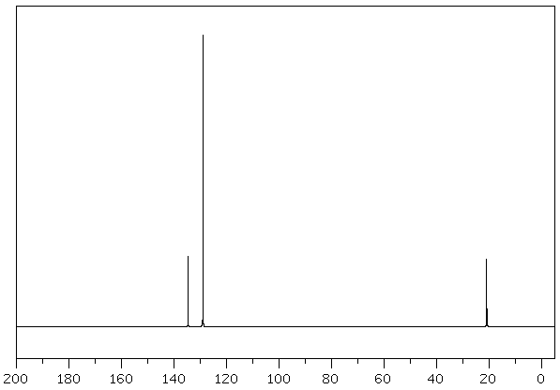
Nuclear Magnetic Resonance Spectroscopy
¹³C NMR: (C=C) (100-150) ppm
The C-13 NMR spectrum for C₈H₁₀ is shown below, propose a structure for this molecule.
Calculate index of hydrogen deficiency (IHD).
$${\left(IDH\right)}^{}=\frac{2\left(8\right){+2 −10}^{}}{2}$$
${\left(IDH\right)}^{}=$ 4
IDH value means that we have either 4(=) or a ring which they are appear at (100-150)ppm.
So we need to propose some structures which may fit with our outcomes.

Slide 30
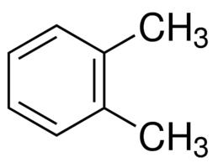
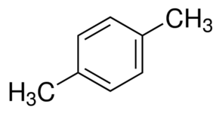
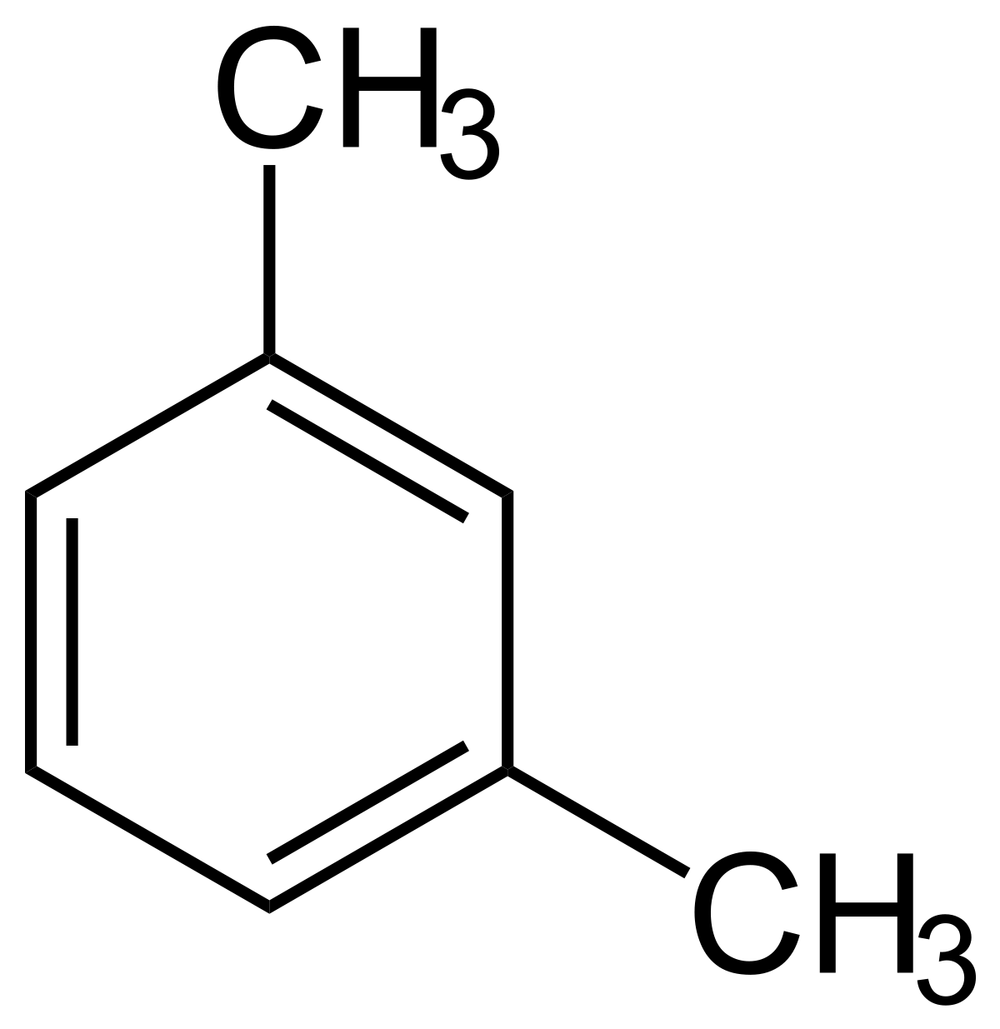
Nuclear Magnetic Resonance Spectroscopy
¹³C NMR: (C=C) (100-150) ppm
The C-13 NMR spectrum for C₈H₁₀ is shown below, propose a structure for this molecule.
Four signals
Three signals
Three signals
Five signals

Slide 31
Nuclear Magnetic Resonance Spectroscopy
¹³C NMR: (C=C) (100-150) ppm
The C-13 NMR spectrum for C₈H₁₀ is shown below, propose a structure for this molecule.
The C-13 NMR spectrum for C₈H₁₀ is shown below, propose a structure for this molecule.
It is clearly to find a at (21) ppm
There is four signals that corresponds to c, and two for b.
So c has to appear at (129) ppm, and b at (135) ppm.
SO, height plays an important role to determine benzene rings and its substitutions.
NOTE: The more carbon atoms are chemically equivalent will appear in a taller peak than the other ones.
c
c
a
c
b
a
b
c
c
b
a

Slide 32
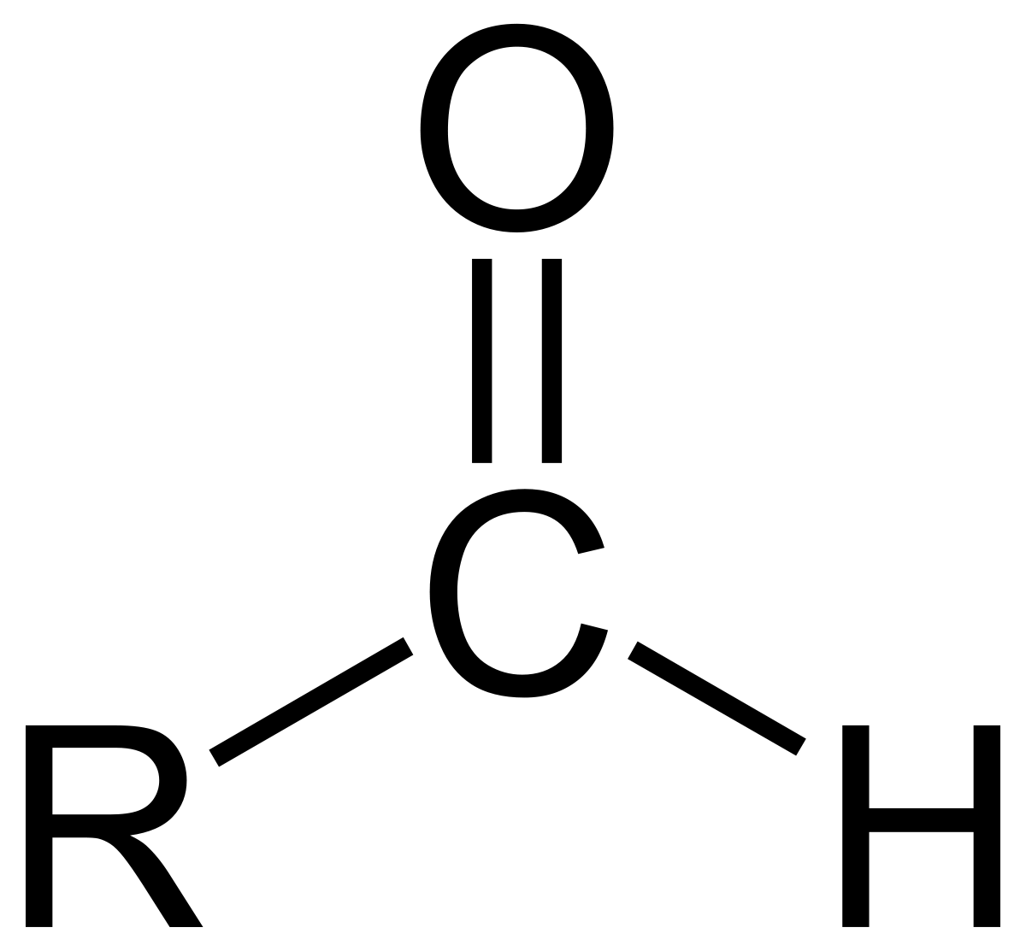
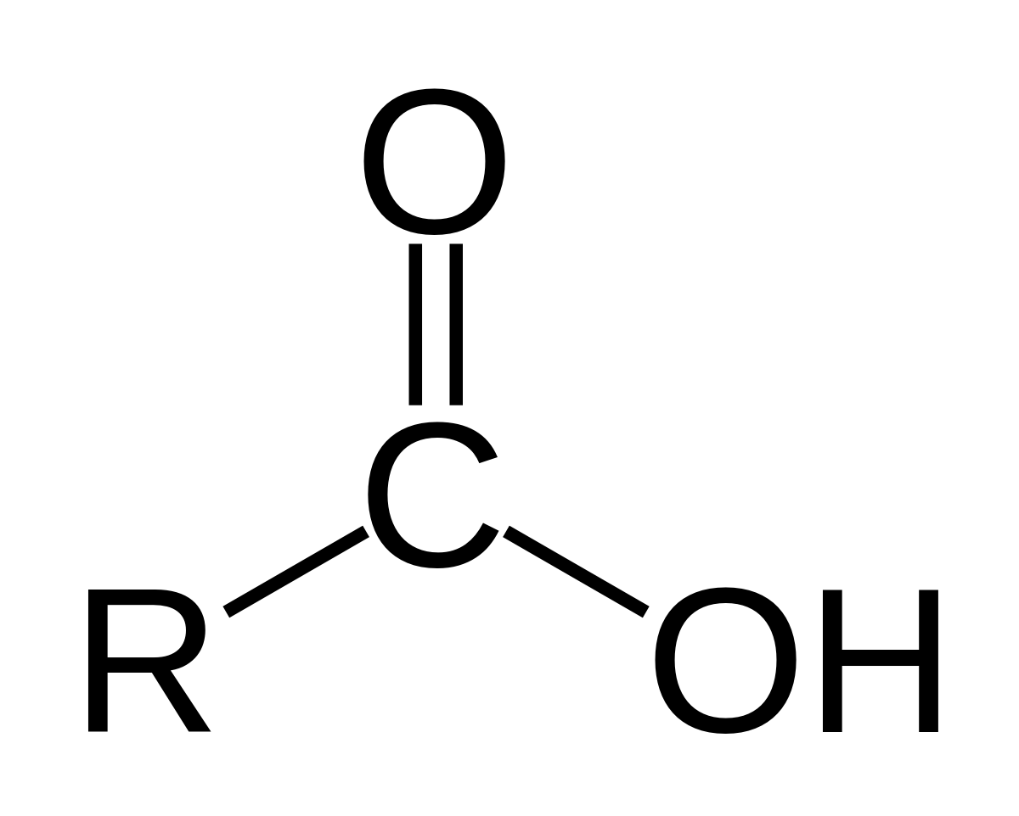
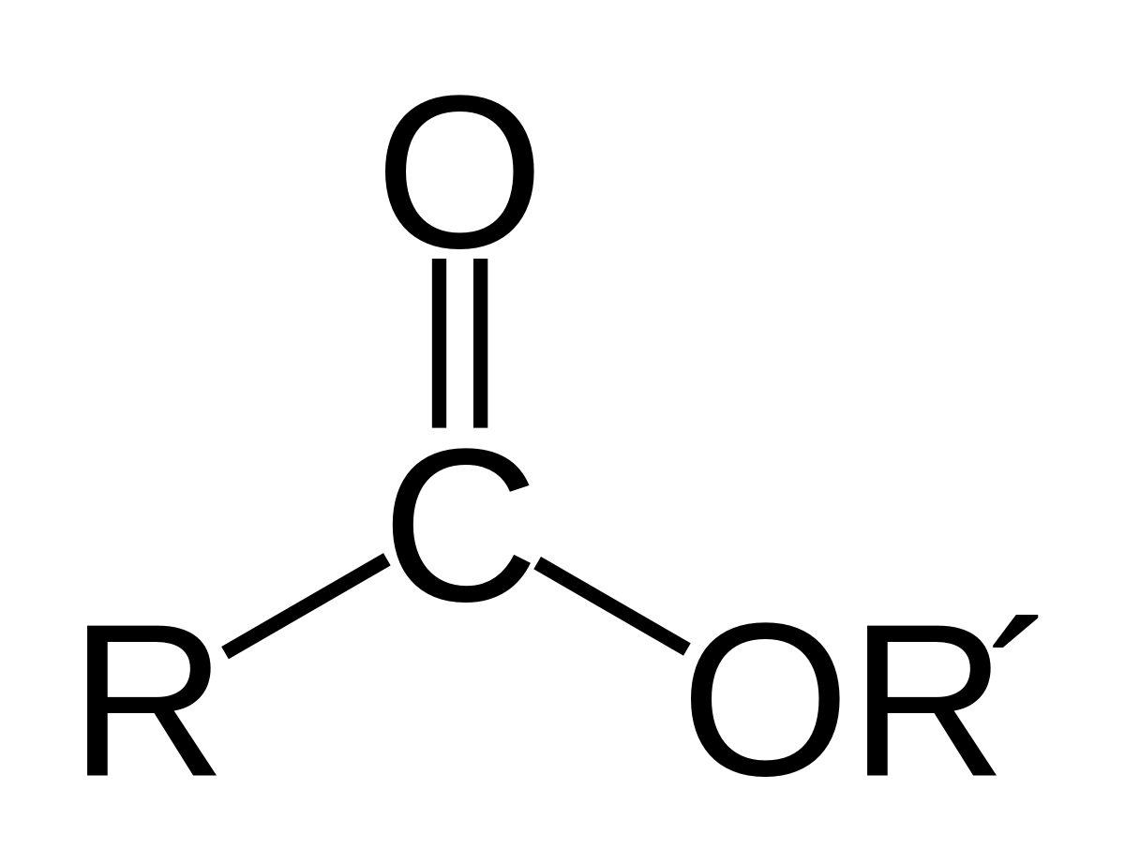
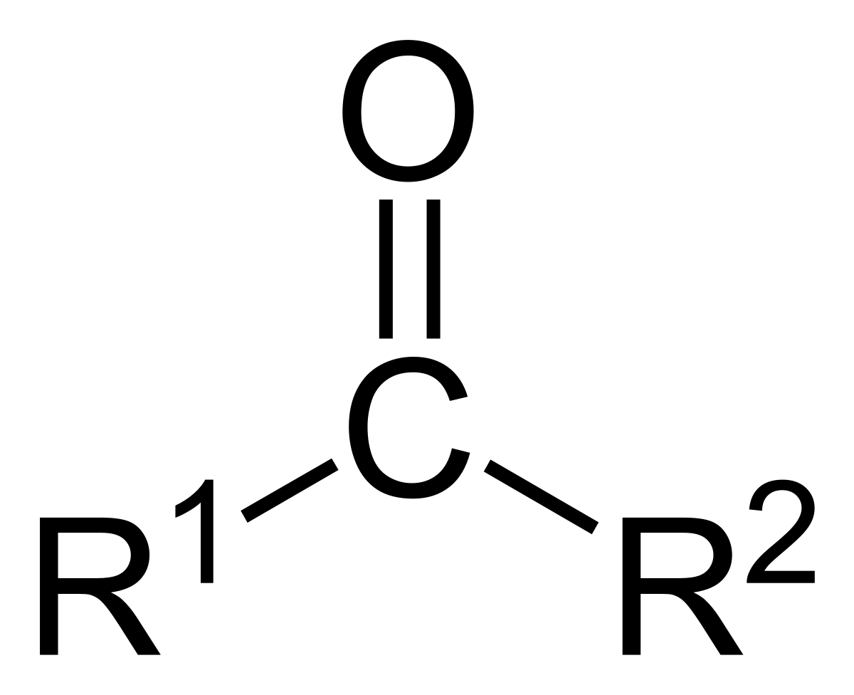
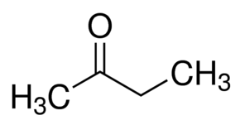
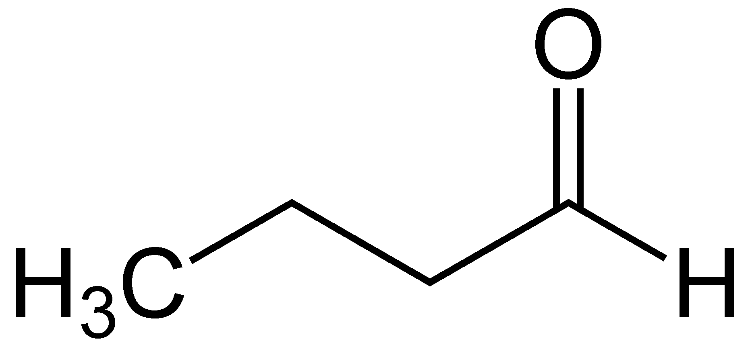
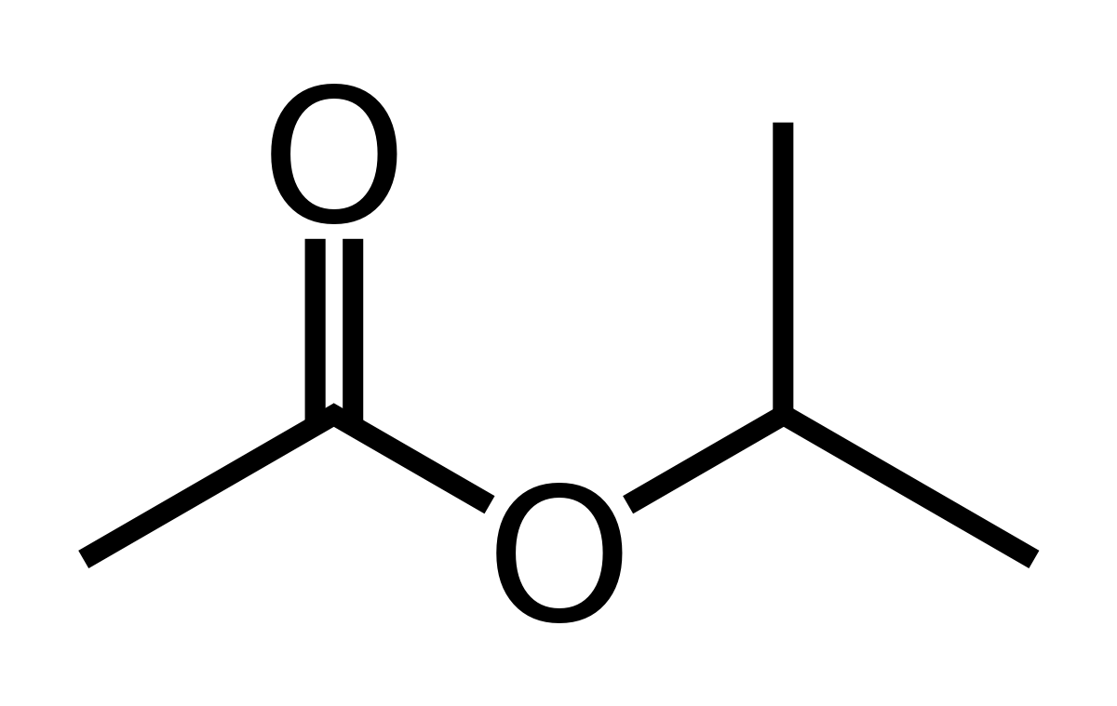
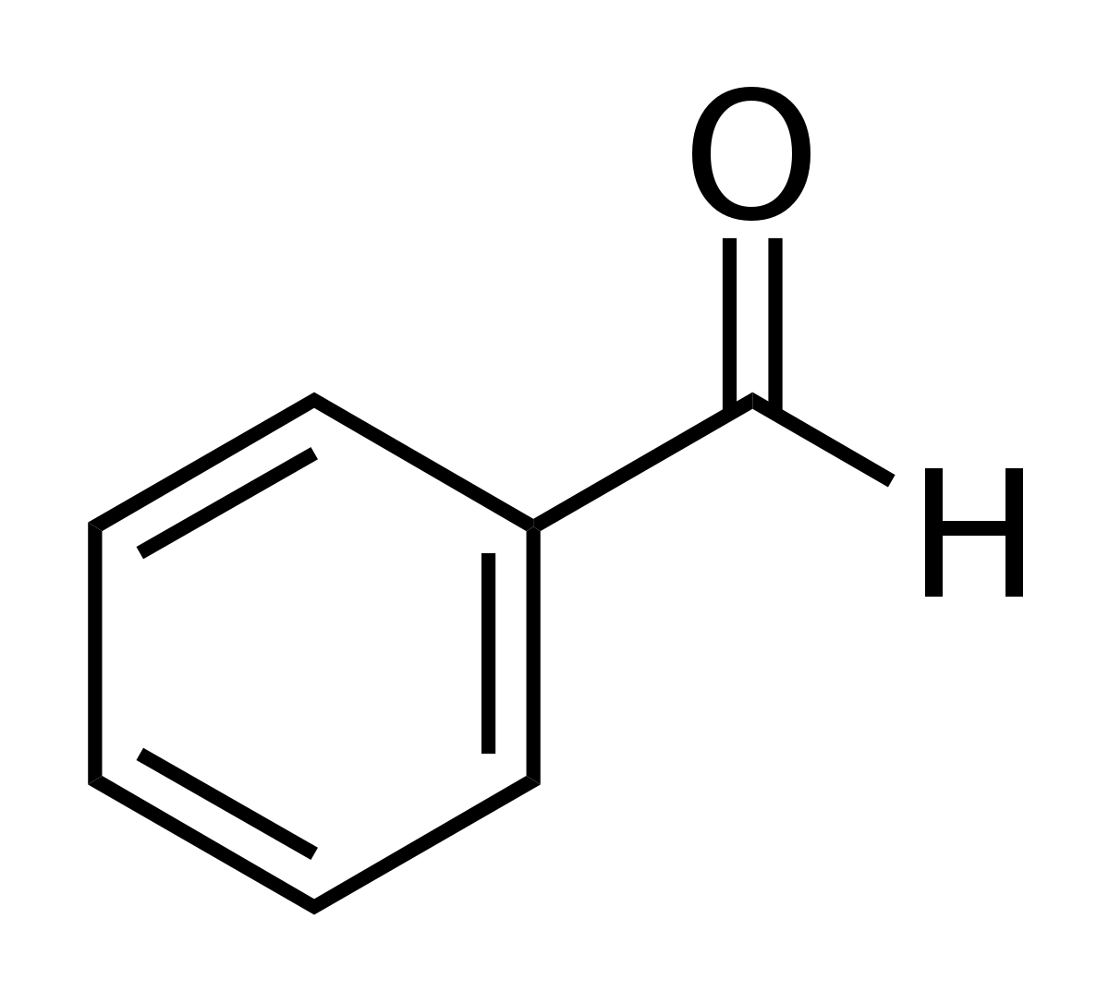
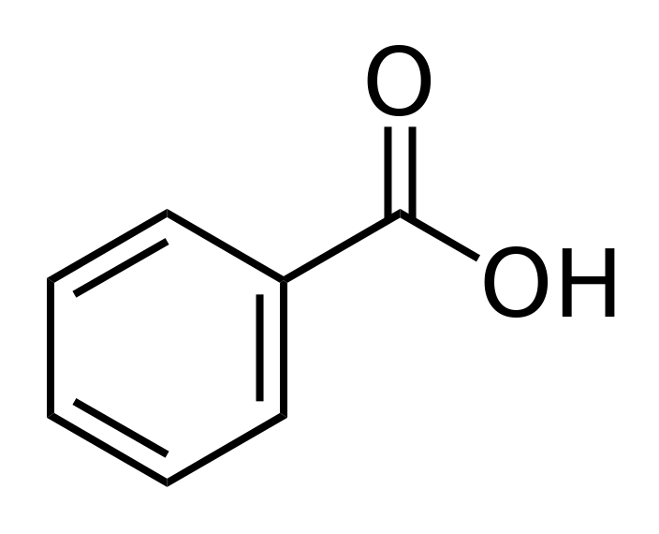
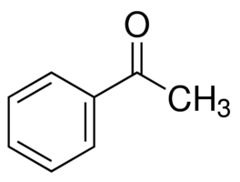
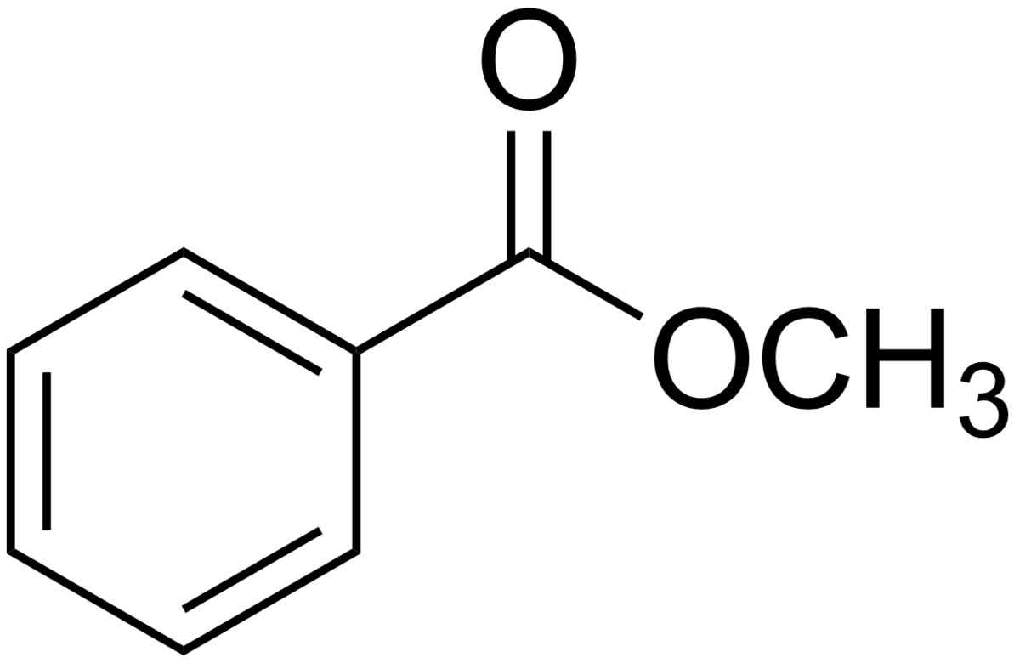
Nuclear Magnetic Resonance Spectroscopy
¹³C NMR: (C=O) (150-220) ppm
Chemical shifts | (205-220) | (190-205) | (175-185) | (165-175)
Chemical shifts | (209) | (203) | (181) | (170)
Chemical shifts | (198) | (192) | (172) | (167)

Slide 33
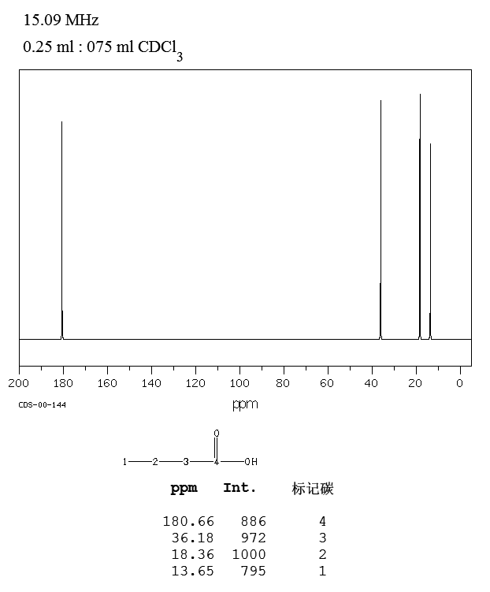
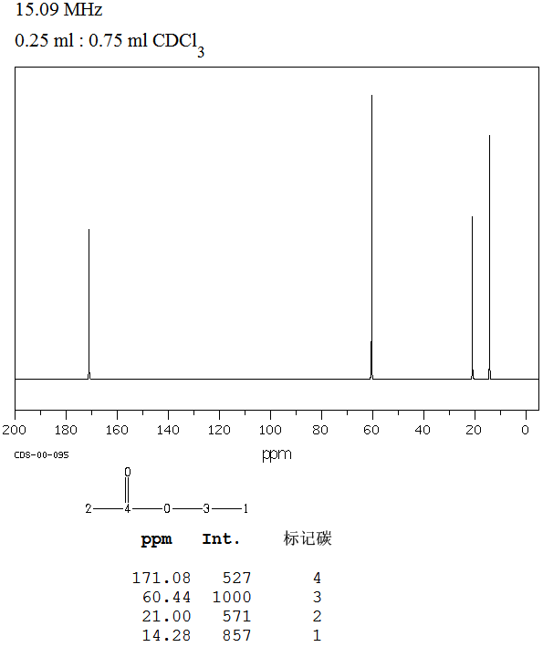
Nuclear Magnetic Resonance Spectroscopy
¹³C NMR: (C=O) (150-220) ppm
The C-13 NMR spectra for two constitutional isomers of C₄H₈O₂ are shown below, identify the functional groups corresponded for each spectrum.
I
II
Calculate index of hydrogen deficiency (IHD).
$${\left(IDH\right)}^{}=\frac{2\left(4\right){+2 −8}^{}}{2}$$
${\left(IDH\right)}^{}=$ 1
means we have (=) bond or a ring
Both charts include a signal in the range (150-220) ppm, which indicates the existence of (C=O). So we do not have an alkene or a ring.

Slide 34
Nuclear Magnetic Resonance Spectroscopy
¹³C NMR: (C=O) (150-220) ppm
The C-13 NMR spectra for two constitutional isomers of C₄H₈O₂ are shown below, identify the functional groups corresponded for each spectrum.
I
II
(C=O) means:
A ketone
An aldehyde
A carboxylic acid
An ester
In esters, a signal should appear around 60 ppm, that is clearly noticed in (II) only, which gives an indication that (II) is an ester.
Compound (I) is a carboxylic acid as its spectrum does not include a signal at 60 ppm.
(205-220) ppm
(190-205) ppm
(175-185) ppm
(165-175) ppm

Slide 35
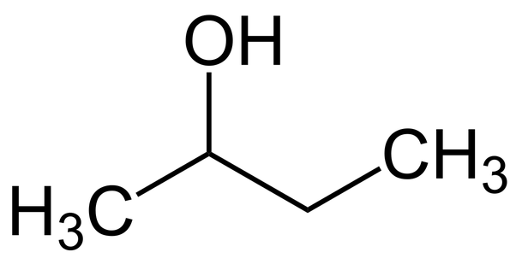
Nuclear Magnetic Resonance Spectroscopy
¹³C NMR: Proton coupled mode N+1 (splitting)
All the spectra that we have considered were based on (broadband decoupled mode), where all the signals appeared as singlets.
Another mode we have to be familiar with is (proton coupled mode (N+1)), which shows splitting not from adjacent hydrogens BUT from the hydrogens that directly attached to the carbon atom that will split (+1).
Example: What type of splitting in the following compound?
Carbon a attached to 3H (n=3), so (n+1) = 4 (quartet)
Carbon b attached to 1H (n=1), so (n+1) = 2 (doublet)
Carbon c attached to 2H (n=2), so (n+1) = 3 (triplet)
Carbon d attached to 3H (n=3), so (n+1) = 4 (quartet)
d
a
c
b

Slide 36
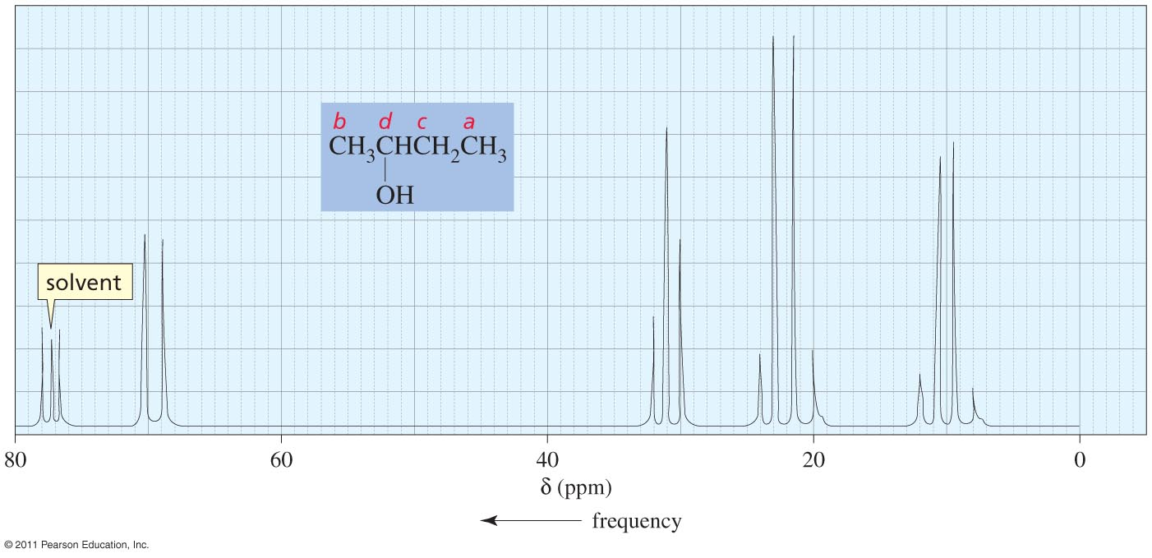
Nuclear Magnetic Resonance Spectroscopy
¹³C NMR: Proton coupled mode N+1 (splitting)
All the spectra that we have considered were based on (broadband decoupled mode), where all the signals appeared as singlets.
Another mode we have to be familiar with is (proton coupled mode (N+1)), which shows splitting not from adjacent hydrogens BUT from the hydrogens that directly attached to the carbon atom that will split (+1).
Example: What type of splitting in the following compound?
a
c
d
d
a
c
b
b

