Slide 1
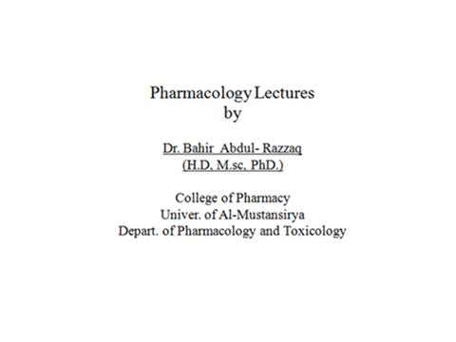

Slide 2
Definition of obesity

Slide 4
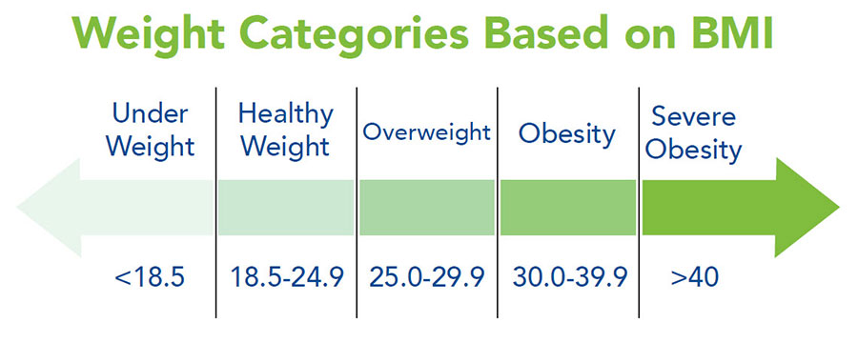

Slide 5
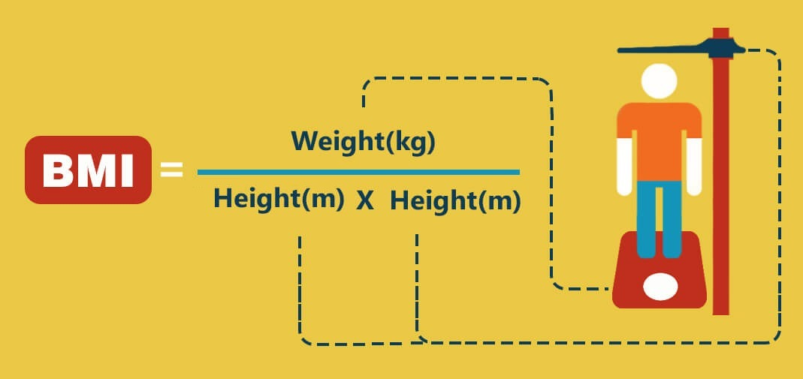

Slide 6
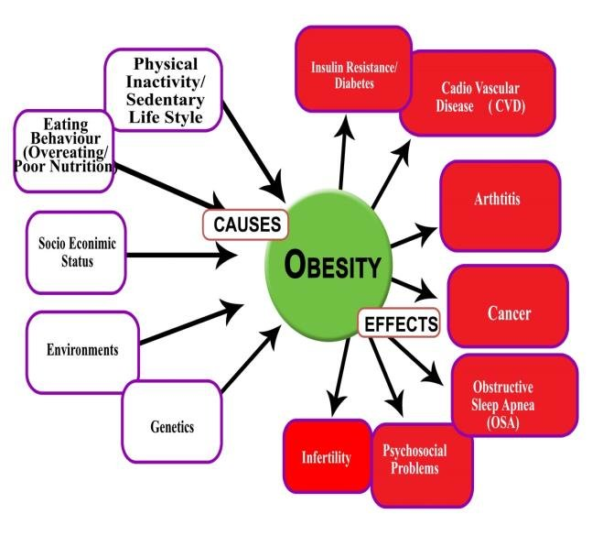
Causes & Effects

Slide 7
Pathogenesis of obesity

Slide 8
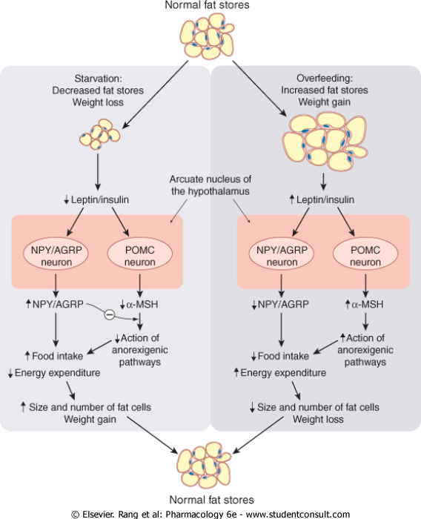

Slide 9
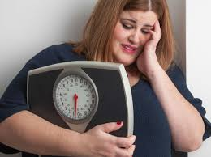
Complications of obesity

Slide 10
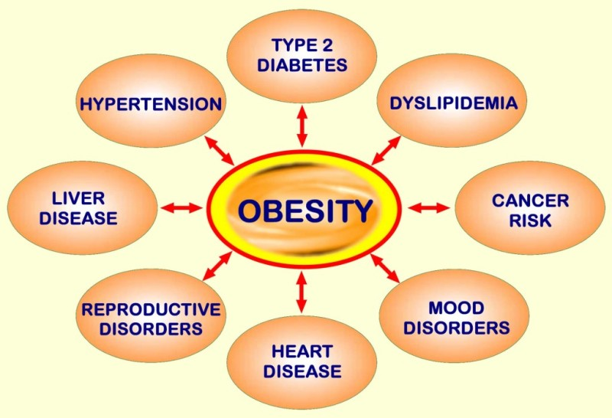

Slide 12
Criteria for anti-obesity drugs
Either:
1-if they demonstrate at least a 5% greater reduction in body weight as compared to placebo, after 12 wk.
Or: 2-shown in clinical trials to help patients lose approximately 5% - 10% of their body weight, after 12 wk.

Slide 13
1. Anorexiants
(appetite suppressants)

Slide 15
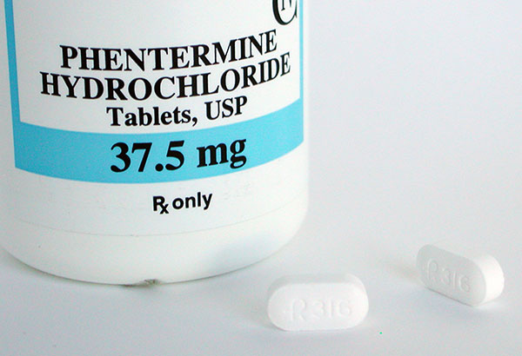

Slide 16
2.Lipase inhibitors
(orlistat)

Slide 18
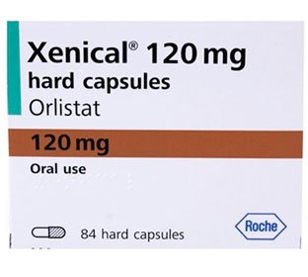

Slide 19
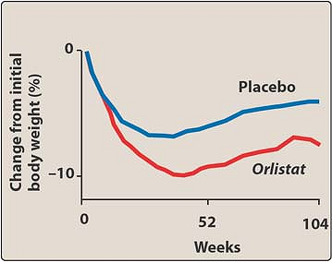

Slide 20
3.Serotonin agonist
(Lorcaserin: 5HT-2c agonist)

Slide 23
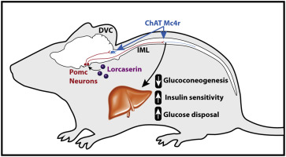

Slide 25
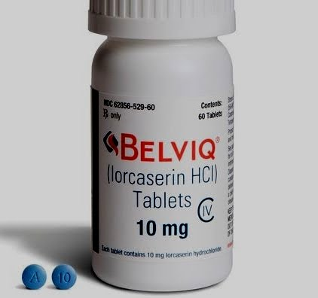

Slide 26
4.Combination drugs
(phentermine + topiramate)

Slide 28
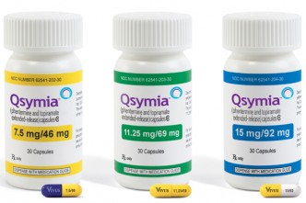
Dose escalation

Slide 30
