Slide 1
Introduction: Historic Background of Pharmacy Practice
Dr. Haider Raheem

Slide 2
Tracing the origins of pharmacy Sumerians
• The development of cuneiform writing on clay tablets during the third millennium BC included lists of drugs of animal, vegetable and mineral origin that were used in the management of diseases, and prescriptions with details of the ingredients used in their compounding.
• Many of the drugs listed were cited as having multiple uses since ailments were thought to be different manifestations of a condition.
• Use of medicines was carried out by priests (ashipu) and physicians (asu).

Slide 3
Egyptians
• The Ebers Papyrus (named after Georg Ebers, who purchased it in the nineteenth century) is a document dating back to 1550 BC, which describes prescriptions and modes of administration of drugs including gargles, inhalations, suppositories, ointments and lotions. Many of the drugs listed were included in the Sumerian documents.
• Use of medicines was carried out by priests. Imhotep who is regarded as the earliest physician, was the High Priest of Heliopolis.

Slide 4
Greeks and Romans
• Just as the Egyptians revered Imhotep as the god–physician, the Greeks worshipped Asklepios as their god of healing.
• Later on, the use of medicines was carried out by the rhizotomoi (experts in medicinal plants), such as Empedocles, and the pharmakopoloi (preparers and sellers of drugs).

Slide 5
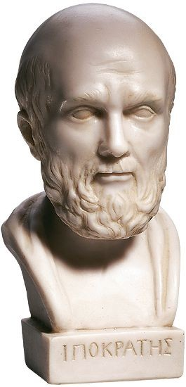
Hippocrates
• Considered to be the father of medicine.
• He is associated with a number of documents known collectively as the Hippocratic Corpus dating to 420–370 BC, which list 200–400 drugs of vegetable origin and describe the method of preparation of gargles, ointment and pessaries.
• His works placed emphasis on treating the patient with minimal reference to magical and religious powers.

Slide 6
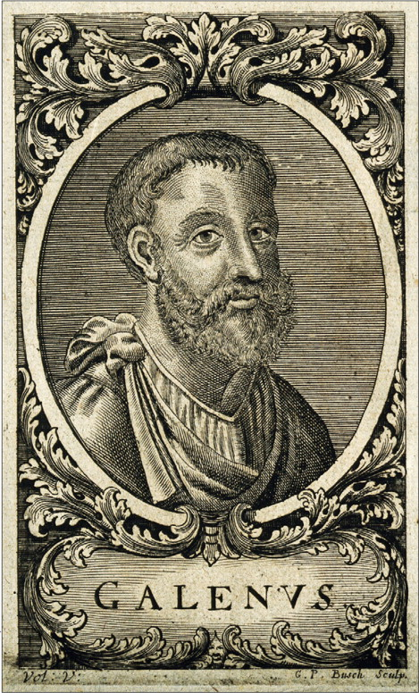
Galen
• A physician around AD 160.
• He compiled medical knowledge of the time drawing on the documents by Hippocrates and Dioscorides.
• He described the use of formulations made up of numerous plants which were referred to as ‘galenicals’.

Slide 7
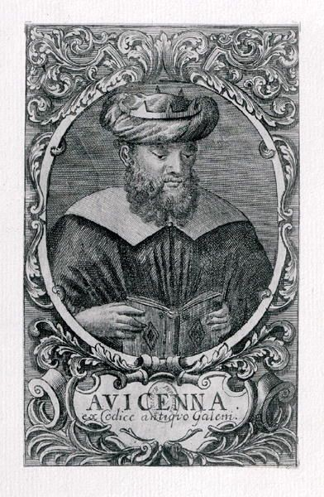
The Arabs
• In the Arab world, a large number of texts including documents related to medicine and works by Galen were translated into Arabic and that is how these documents have been transferred along history. Documents that were prepared included formularies, herbals and books on materia medica and toxicology.
• Avicenna, a Persian philosopher, compiled the book Canon of Medicine, in which he merged the Greek and Arab works. The book describes the use of around 760 drugs.

Slide 8
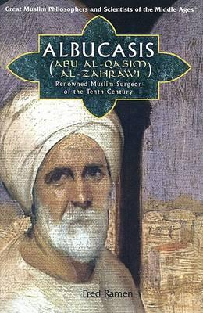
The Arabs
• The use of medications consisting of complex formulations (galenic medicine) was continued.
• This required skilled preparation which was entrusted to apothecaries who opened their shops in the ninth century in Baghdad. The practice of the apothecaries was inspected by the state.
• Albucasis, from the Arabic dominion in Spain, prepared documents which included a detailed description of the pharmaceutical process for the preparation of drugs in various dosage forms.

Slide 9
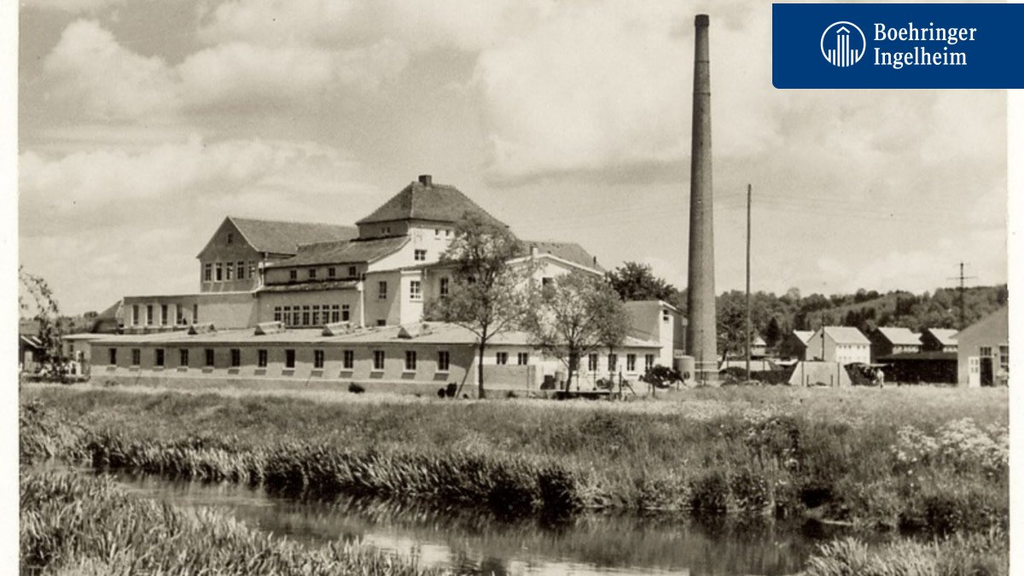
Early definition of the pharmacy profession
Early nineteenth century: retail pharmacies developed a separate manufacturing area, which included an area for extraction and purification, necessary for extraction of plant alkaloids such as quinine from cinchona bark used for malaria. Boehringer and Merck have their origins in community pharmacies in Stuttgart (1817) and Darmstadt (1827), Germany, respectively.
Late nineteenth century: separation of the manufacturing business from the retail community pharmacy.

Slide 10
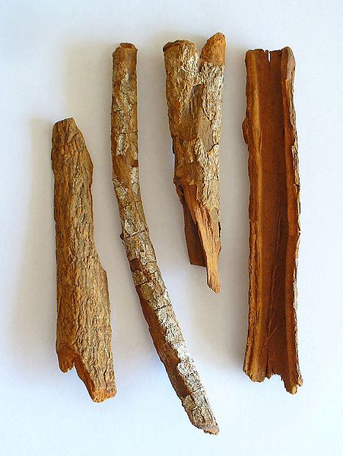
Development of medicines
Seventeenth century: cinchona bark extract used for fever, chills – the principal active ingredient being quinine.
Eighteenth century: foxglove plant used for the treatment of heart failure – digitalis.

Slide 11
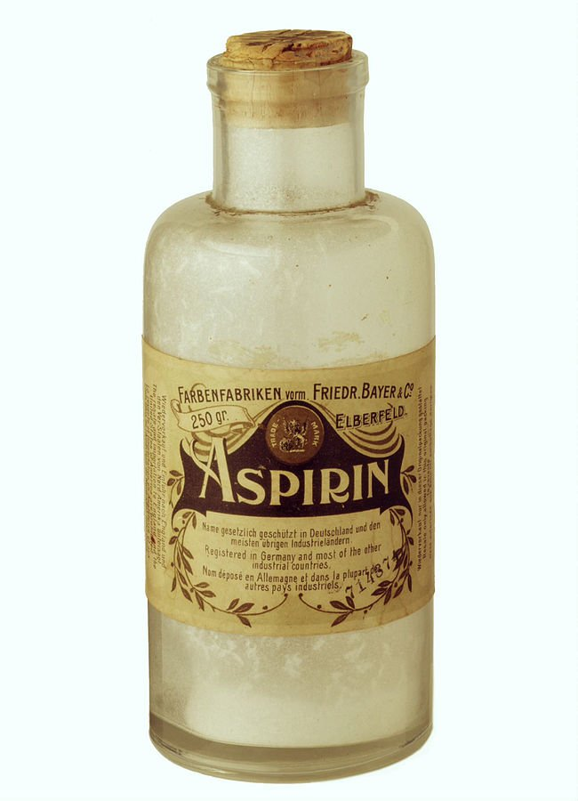
Analgesics and anaesthetics
1804 Serturner isolated morphine from opium
1832 Isolation of codeine
1842 Ether used as an anaesthetic and later chloroform
1876 Stricker showed that salicylic acid had analgesic effects
1899 Development of aspirin by Bayer
1961 Development of ibuprofen
1969 Ibuprofen marketed by Boots
1983 Ibuprofen registered as an over-the-counter drug in the United Kingdom.

Slide 12
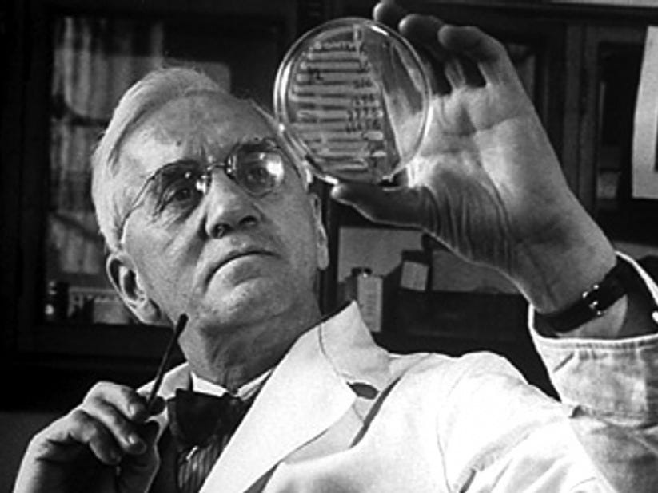
Antibacterial drugs
1891 Ehrlich coined the term ‘chemotherapy’; methylene blue used for malaria
1929 Antibiotic activity of penicillin described
1935 Sulphonamides developed by Domagk
1939–41 Florey and Chain synthesised penicillin
1944–5 Streptomycin and chlortetracycline isolated
1952 Isoniazid which was followed by other antituberculous drugs
1953 Phenoxymethylpenicillin
1956 Cephalosporin structure identified
1964 Cephaloridine marketed.

Slide 13
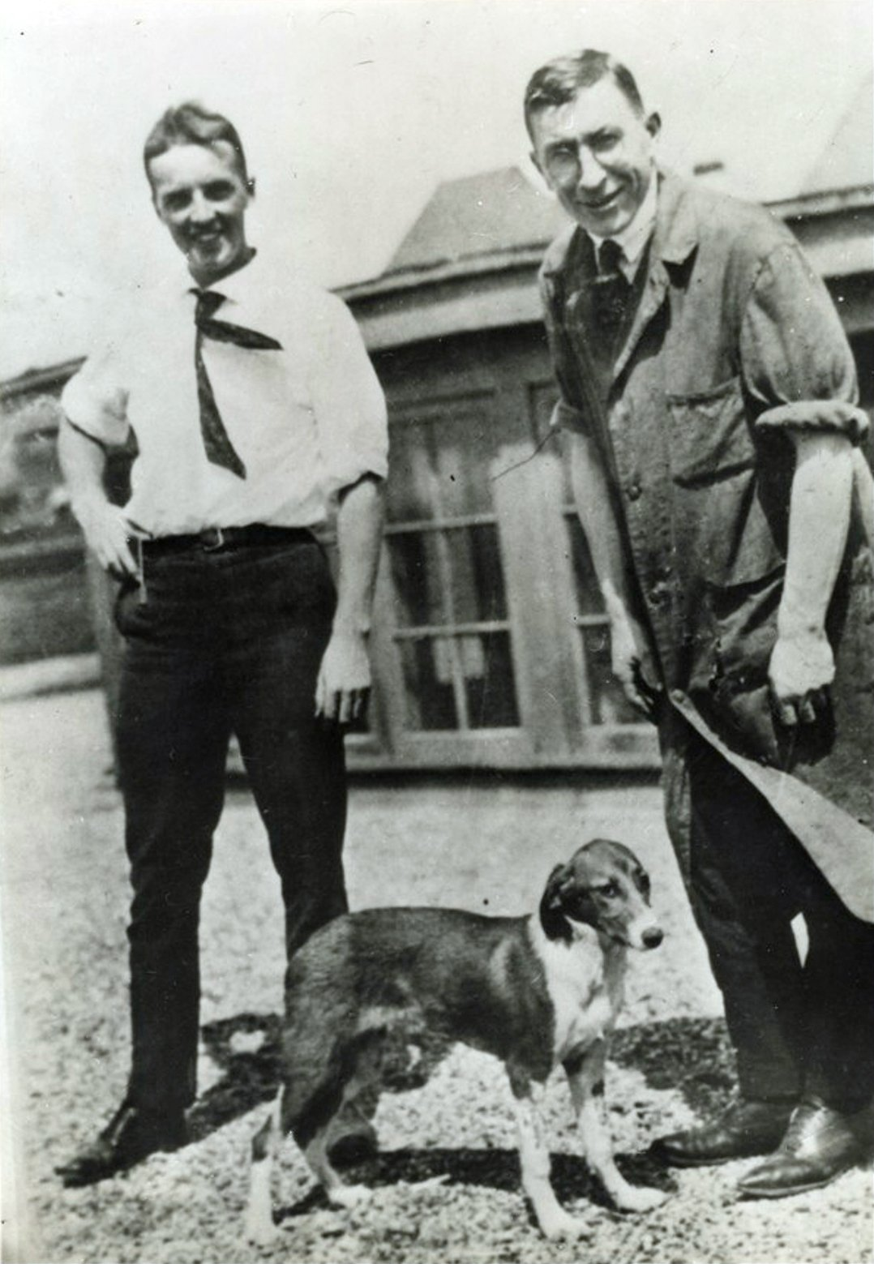
Endocrine system
1914 Crystals of thyroxine
1921–26 Isolation and crystallisation of insulin
1929 Isolation of oestrone
1934 Progesterone synthesised
1930–40 Isolation of different hormones from adrenal cortex
1959 First oral contraceptive
2006 Inhaled insulin marketed
2007 Pfizer announces that it will no longer market inhaled insulin due to marketing issues.

Slide 14
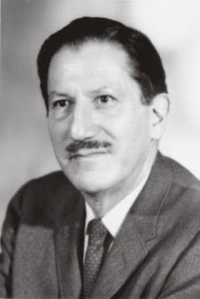
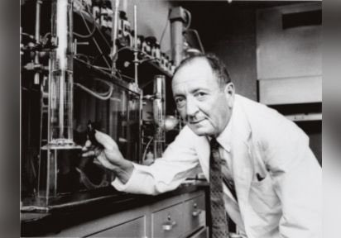
Anticancer agents and immunosuppressants
1946 Anticancer effect of nitrogen mustards described
1951 Mercaptopurine, an anticancer agent with an antimetabolite effect
1961 Azathioprine, an immunosuppressant
1970 Identification of paclitaxel
1992 Marketing authorisation for paclitaxel is granted
1990 Imatinib and trastuzumab developed
2000 Trastuzumab reaches registration
2002 Imatinib reaches registration
2006 Human papillomavirus vaccine hailed as the most important cervical cancer development since cervical screening.

Slide 15
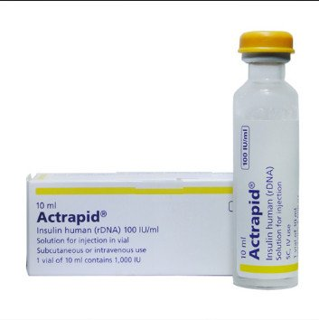
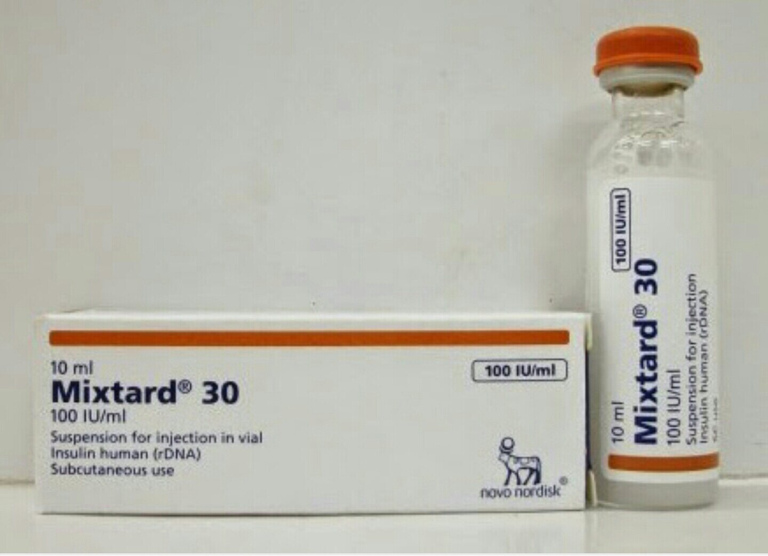
Therapeutic proteins produced by recombinant technology
1982 Human insulin
1986 Human interferon alpha used in hepatitis B and C
1987 Human tissue plasminogen activator used in heart attacks, human growth hormone
1989 Erythropoietin used in anaemia
1991 Granulocyte–macrophage colony–stimulating factor used in neutropenia
1992–97 Human factors VIII and IX used in haemophilia
1994 Abciximab used for prevention of blood clot
1997 Rituximab approved for non-Hodgkin’s lymphoma
1998 Infliximab approved for Crohn’s disease and arthritis.

Slide 16
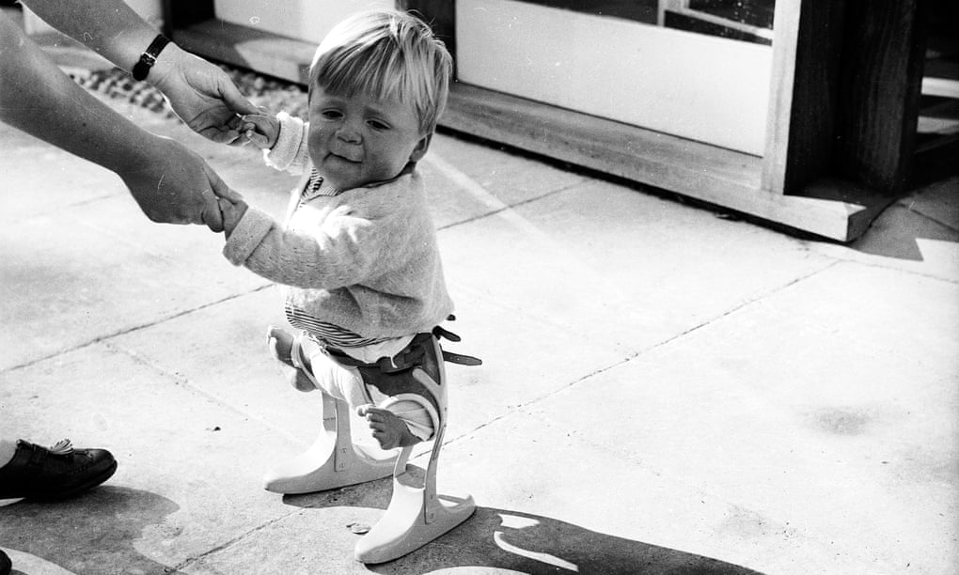
Adverse effects
1879–90 Sudden deaths during chloroform anaesthesia
1922 Jaundice associated with salvarsan
1937 People die after taking elixir of sulphanilamide which contained the solvent diethylene glycol
1955 Children in the USA infected with a polio vaccine due to a failure in the inactivation process
1961 Thalidomide – congenital malformations
1966 Chloramphenicol associated with blood dyscrasias
1997–99 Withdrawal of terfenadine and astemizole, the first antihistamines with a lower frequency of sedation that were marketed in the mid-1980s, due to increased risk of cardiotoxicity when taken with other drug therapy

Slide 17
Adverse effects
2000 Withdrawal of cisapride which was a unique product with parasympathomimetic acivity that had a stimulating effect on serotonin receptors as well and was used in gastric conditions, due to increased toxicity in concomitant drug administration
2004 Withdrawal of rofecoxib, a COX-2 inhibitor, due to increased cardiovascular events
2006 Withdrawal of ximelagatran, the first oral anticoagulant drug to be released since warfarin, due to liver toxicity
2006 Development by Pfizer of torcetrapib, which had the main intervention of increasing high-density lipoprotein, stopped due to increased mortality
2007 Telithromycin associated with exacerbation of myasthenia gravis, occurrence of hepatoxicity, visual disturbances and loss of consciousness; revision in guidelines for its use.

Slide 18
Development of pharmaceutical regulation United Kingdom
1963 As a result of the thalidomide tragedy, the Committee on Safety of Drugs was established
1968 Under the terms of the Medicines Act, the committee was renamed as Committee on Safety of Medicines (CSM). The Act stated that medicines required a licence to reach the UK market
1989 Medicines Control Agency (MCA) created
1994 Medical Devices Agency created
2003 Medicines and Healthcare Products Regulatory Agency (MHRA) established, bringing together MCA and Medical Devices Agency
2005 CSM became the Commission on Human Medicines (CHM), which provides advice to the MHRA.

Slide 19
European Union
1965 European directive for authorisation of medicinal products for human use presented
1975 Scientific Committee for Proprietary Medicinal Products for human use (CPMP) established
1993 Council regulation for the setting up of a European system for marketing authorisation of medicinal products and for the establishment of a European agency
1995 The European Medicines Agency (EMA) opens in London, UK.

Slide 20
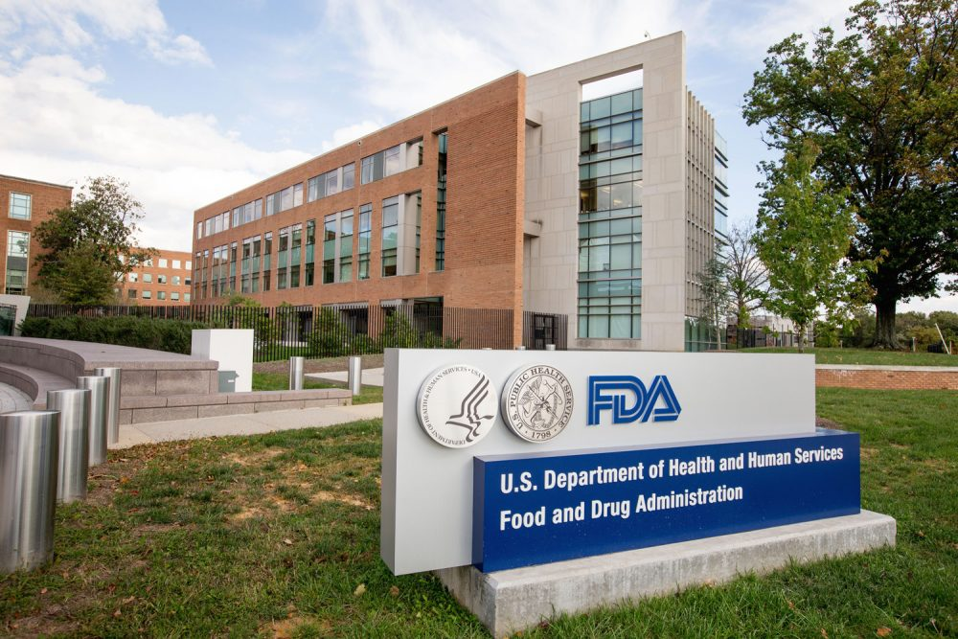
United States of America
1906 US Pure Food and Drugs Act which required information on contents and purity of medicines
1927 Food, Drug and Insecticide Administration takes up regulatory functions
1930 Food, Drug and Insecticide Administration renamed the Food and Drug Administration (FDA)
1938 As a result of the sulphanilamide elixir tragedy, the Food Drug and Cosmetics Act was passed which required approval by the FDA before a new drug product was marketed
1988 Food and Drug Administration Act which established the structure and responsibilities of the agency.

Slide 21
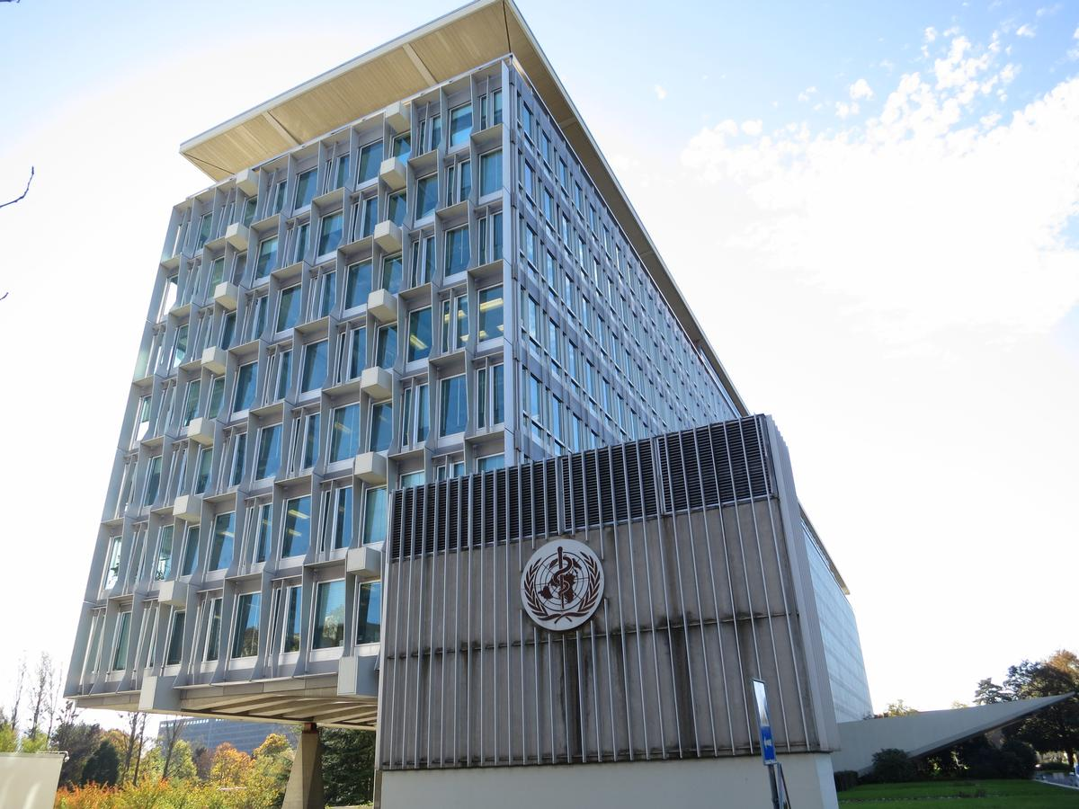
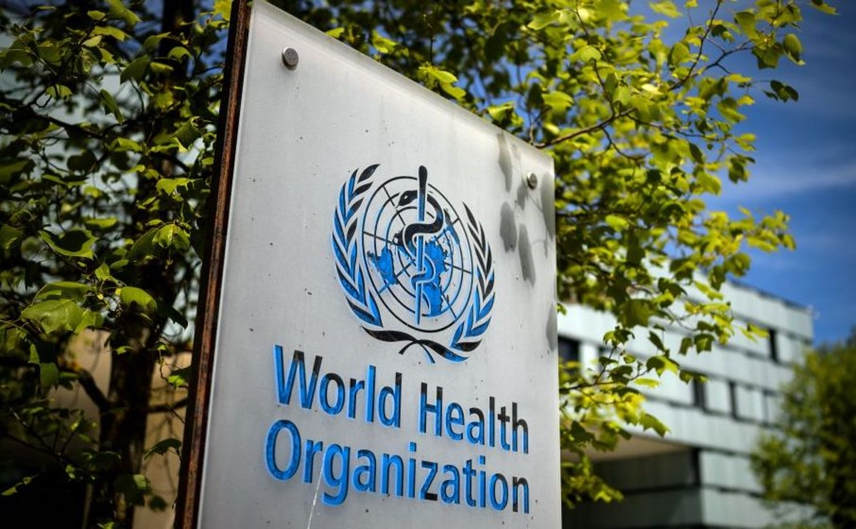
International
1989 At the WHO Conference of Drug Regulatory Authorities (ICDRA) plans for discussions between Europe, Japan and the USA on harmonisation started
1990 The International Conference on Harmonisation (ICH) was established. It is a forum of constructive dialogue among the three regions which aims at facilitating exchange, dissemination and communication of information.

