Slide 1
Unit 3 Reading and Writing
Hussein Alsheakh, PhD

Slide 2
Listening

Slide 3
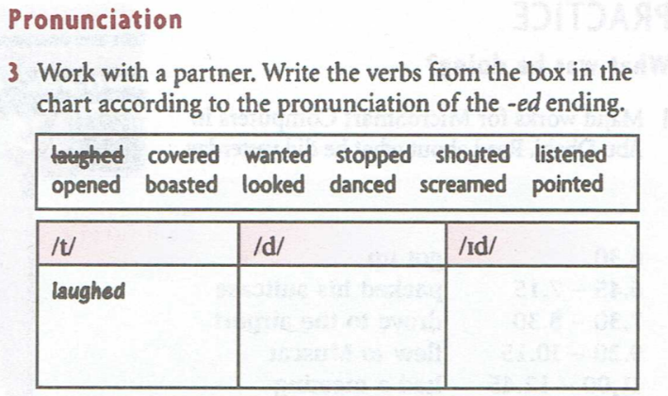
Listening

Slide 4
Test your Advanced English
Basic English
Advanced English
Basic English
Advanced English
Small
Cold
Hot
Tired / Very tired
Angry
Tasty
Tiny
Freezing / Chill
Boiling
Exhausted
Furious
Delicious
Good
Clean / Very clean
I’ll think about it
It’s very easy
Calm down
Busy/ Very busy
Splendid
Spotless
I’ll sleep on it
It’s a piece of cake
Pull yourself together
Swamped

Slide 5
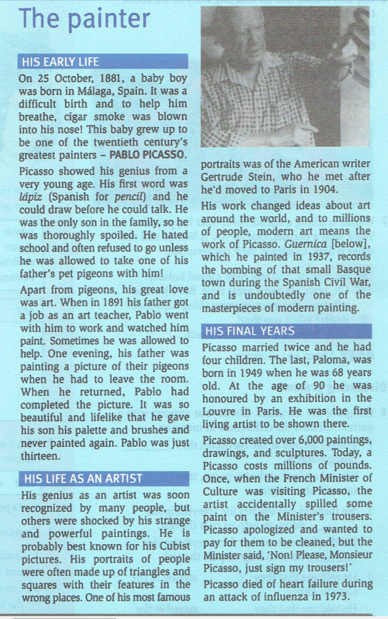
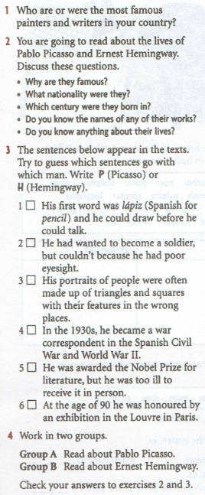
Reading

Slide 6
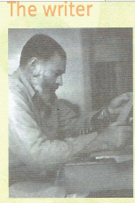
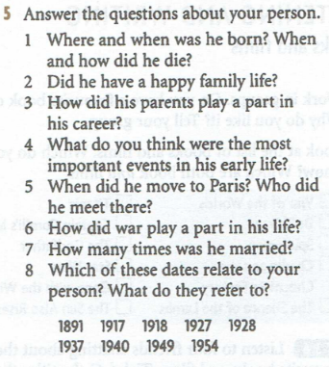
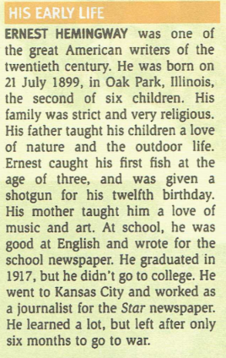
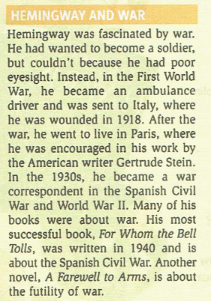
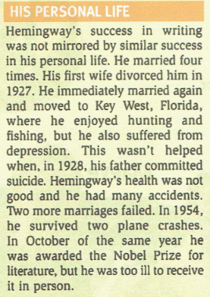
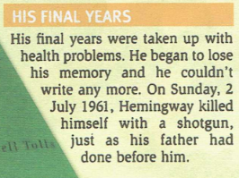
Reading

Slide 7
Writing

Slide 8
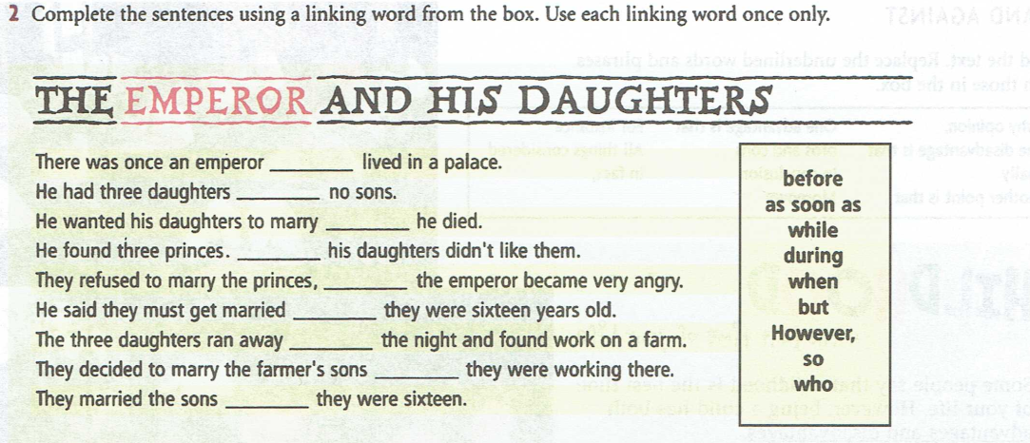
Writing

