Slide 1
Computer Laboratory Lecture 2 Basic Concepts of Information Technology (Hardware)

Slide 2
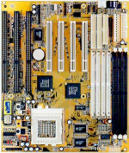
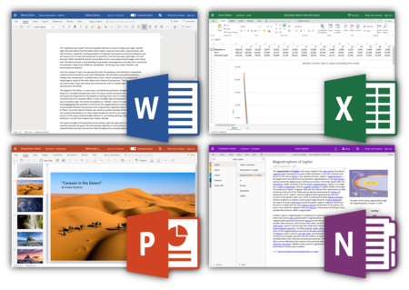
Lesson 4 – Hardware
Hardware
The term hardware refers to the physical components of the computer such as the system unit, mouse, keyboard, monitor etc.
Software
The software is the instructions (programs) that makes the computer work.
Software is held either on your computers hard disk, CD-ROM, DVD and is loaded from the disk into the computers RAM (Random Access Memory), as and when required.

Slide 3
Hardware
Central Processing Unit (CPU)

Slide 4
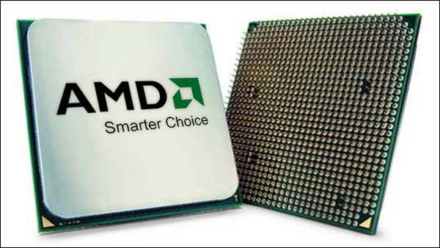
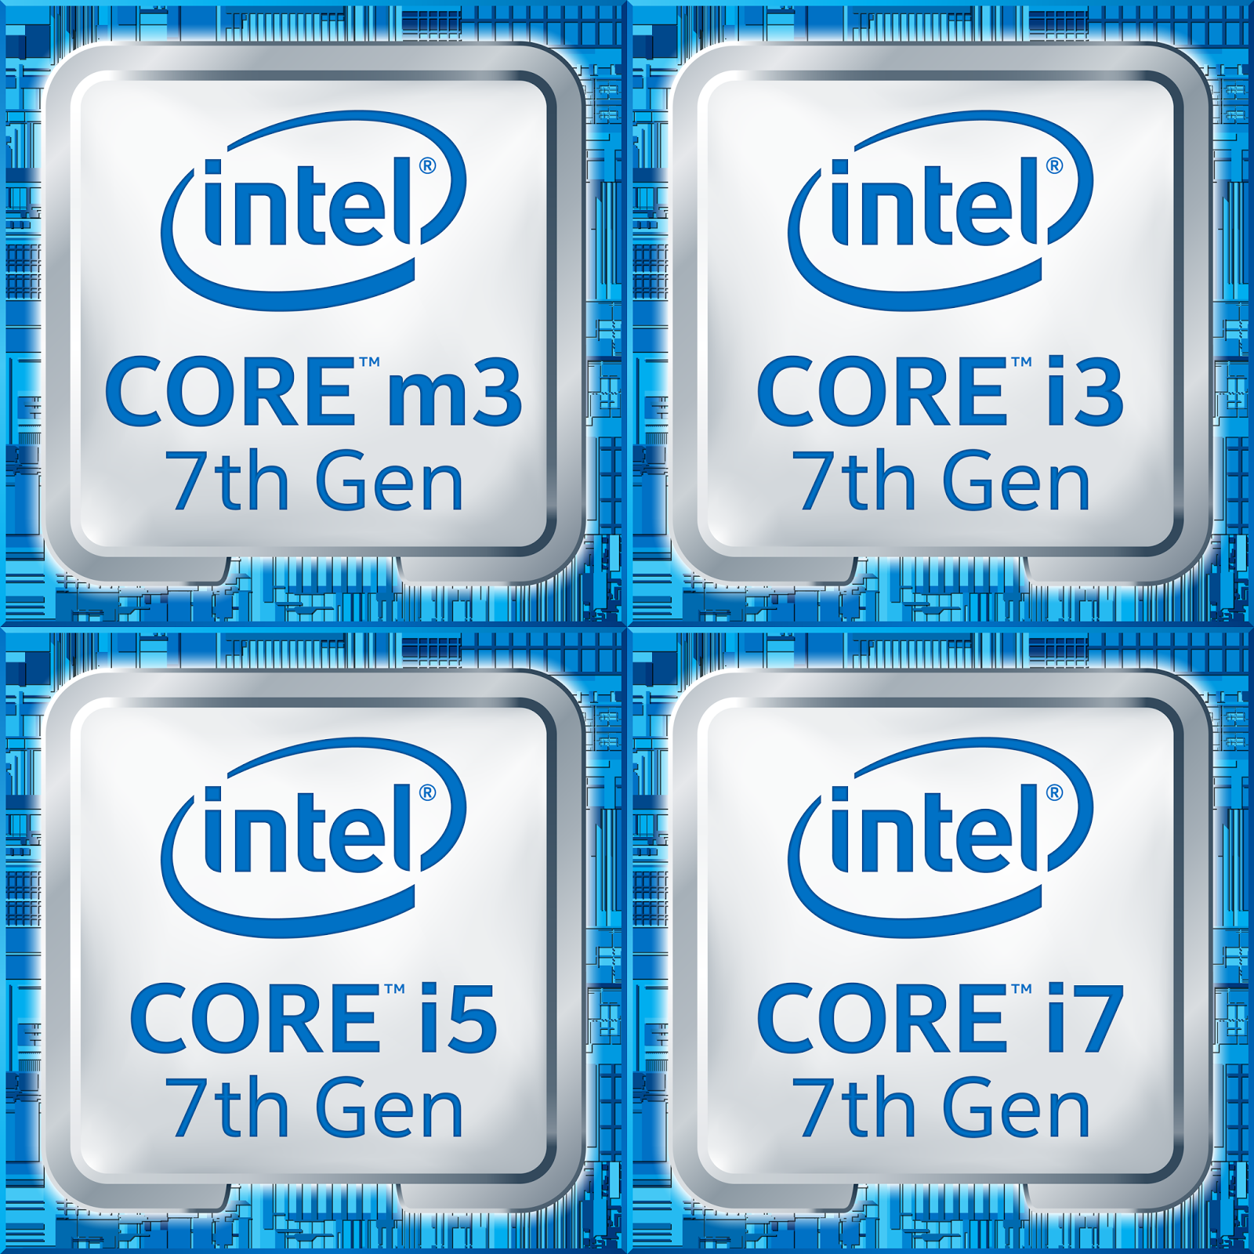
Lesson 6 – Central Processing Unit
Central Processing Unit (CPU)
CPU is the main part of the computer that performs all the work.
CPU is also called brain of the computer.
It performs processing, communication and all calculations of data.
CPU is normally an Intel or AMD.
It tells how fast your computer will run and its speed is measured in MHz or GHz.
A 3.6 GHz intel Core i5 is much faster than a 1.2 GHz intel Core i5 CPU.
CPU performs all the calculations within the computer.

Slide 5
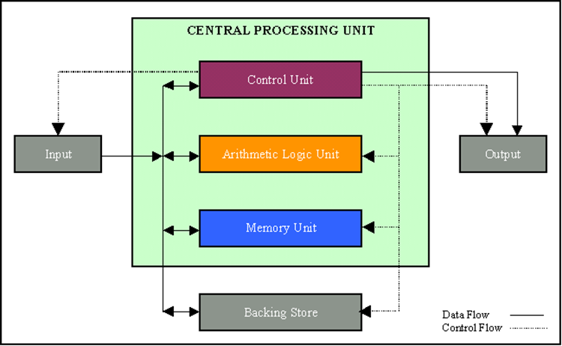
Parts of the CPU
Control unit: The control unit is responsible for loading and interpreting the individual instructions that include the computer program.
Arithmetic-logic unit: The ALU is responsible for carrying out arithmetic operations such as addition and subtraction as well as logical decisions such as whether one number is bigger than another.
On-board cache memory: Because the CPU can perform its operations much faster than data can be transferred from RAM, many CPUs have on-board cache memory.

Slide 6
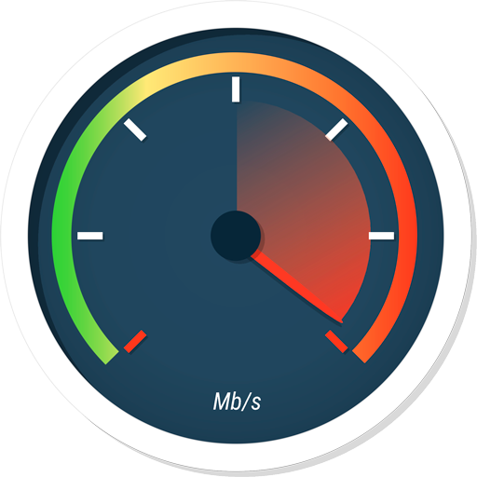
Parts of the CPU
Speed of the CPU: The CPU operates as a result of electronic pulses sent to it by another device on the motherboard called the clock.
The speed of a CPU is measured by the maximum number of pulses it can handle.
This is measured in MHz (megahertz) or millions of pulses per second or GHz (gigahertz) thousands of millions of pulses per second.
A good personal computer will use a CPU with a clock speed of over 2 GHz. This means it receives 2 000 000 000 million pulses every second from the CPU.

Slide 7
Hardware
Central Processing Unit (CPU)
Storge in computer / Memory

Slide 8
Lesson 11 – Storage Devices
Storage in Computer
In Computer, we can save Data/Information in many forms and devices.
All computers work on a binary numbering system, i.e. they process data
in one's or zero's.
This 1 or 0 level of storage is called a Bit.
The smallest unit of computer Storage is Bit. It can store either 1 or 0.
Measurements of computer storage/memory are:
8 Bits | 1 Byte
1024 Bytes | 1 Kilobyte (Kb)
1024 Kilobytes | 1 Megabyte (MB)
1024 Megabytes | 1 Gigabyte (GB)
1024 Gigabytes | 1 Terabyte (TB)

Slide 9
Lesson 11 – Storage Devices
Storage Devices
Some storage devices are as follows:
Hard disk
Floppy disk
Compact disk (CD)
Digital Versatile Disk (DVD)
Memory Stick/Flash Memory

Slide 10
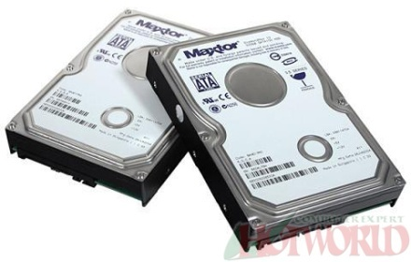
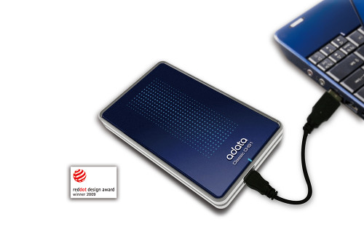
Lesson 11 – Storage Devices
Hard Disk
Generally, Data and computer programs are stored in the hard disk.
There are two types of hard disk.
Internal Hard Disk
External Hard Disk

Slide 11
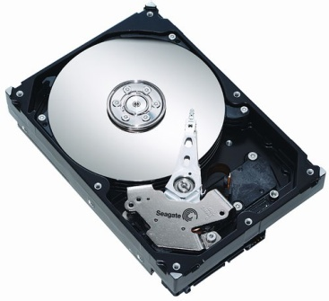
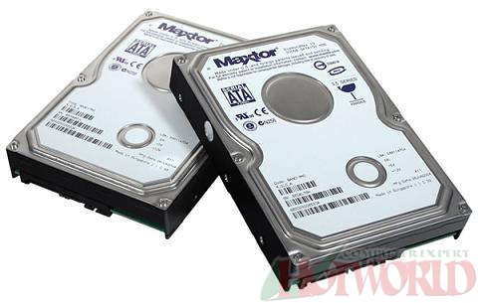
Lesson 11 – Storage Devices
Internal Hard Disks
These are inside the system unit/Box.
Their speed is very fast.
They can store huge amount of data often in Gigabytes. A Gigabyte is equivalent to 1024 Megabytes.
Their costs are falling rapidly and normally these are the cheapest way of storing data.

Slide 12
Lesson 11 – Storage Devices
External Hard Disks
These hard disks are outside the system box and we can connect them to computer using a USB port.
These hard disk normally slower that internal hard disks
These are more expensive than internal hard disks.
Their performance is approximately same as internal hard disks.
They can also store huge amount of data.

Slide 13
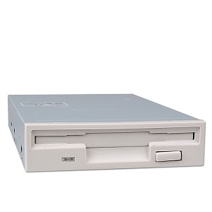
Lesson 11 – Storage Devices
Diskettes (Floppy Disks)
Speed of Floppy disk is very slow.
They can store small amount of data, normally 1.44 Mbytes.
They are very cheap.
They are not reliable.

Slide 14
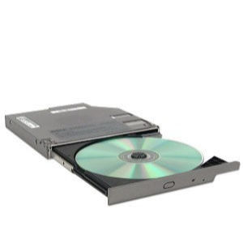
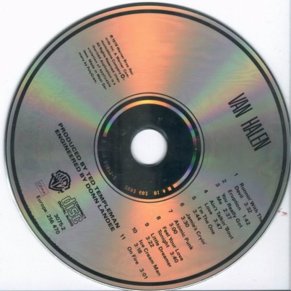
Lesson 11 – Storage Devices
CD-ROM Disks
CD-ROM is slower than hard disk but faster than floppy disk.
They can store data around 650 Mbytes.
CDs are also cheap as compared to hard disk.
DVD Drives
These are faster than CDs but slower than Hard disk.
They can store data up to 17 Gbytes.
They are a little bit expensive than CDs.

Slide 15
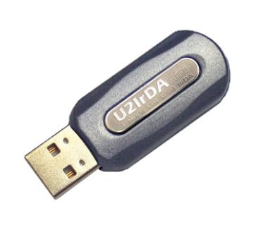
Lesson 11 – Storage Devices
Memory Sticks/Flash Memory
We can plug them directly into the computer using a USB port and use them.
They are small in size.
They can store good amount of data.
Digital cameras and other new devices have memory cards to store images/data.

Slide 16
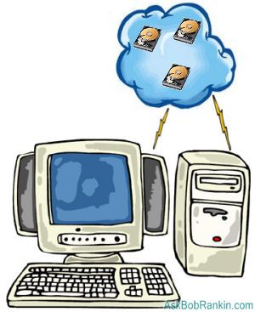
Lesson 11 – Storage Devices
Online file storage
Many websites provide the facility to save data on the internet.
We can store and access data using a PC and internet.
This facility is becoming popular now a days.

Slide 17
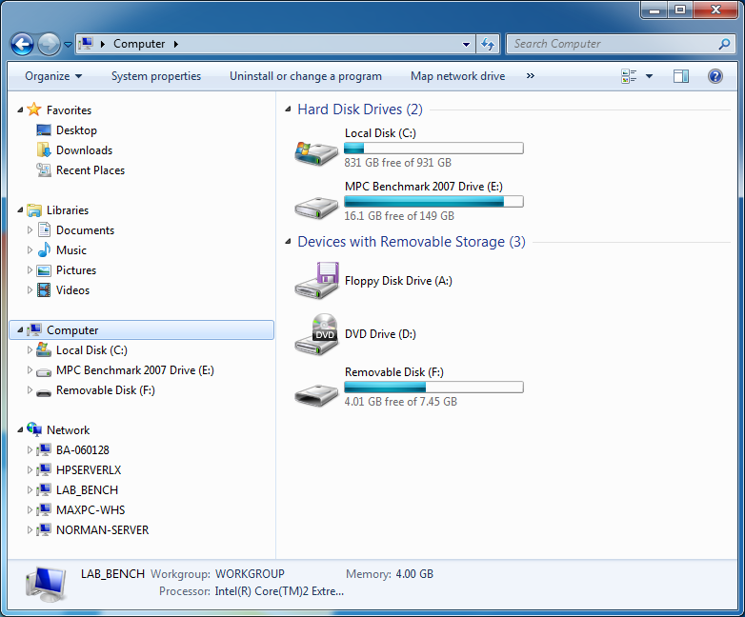
Lesson 12 – Storage Areas
Storage Areas
In Computer, storage areas are the places where we can store our data.
Computer hard disk can be divided into many parts/sections.
Each section is represented by an alphabet/character, e.g. (E:)
We can also use Network drive which is available to all PCs in a network.
This Photo by Unknown Author is licensed under CC BY-SA

Slide 18
Lesson 13 – Types of Memory
Memory
In computer, all data and information to do a job/task is stored in memory.
Types of Memory
There are two types of computer memory.
Random Access Memory (RAM)
Read Only Memory (ROM)

Slide 19
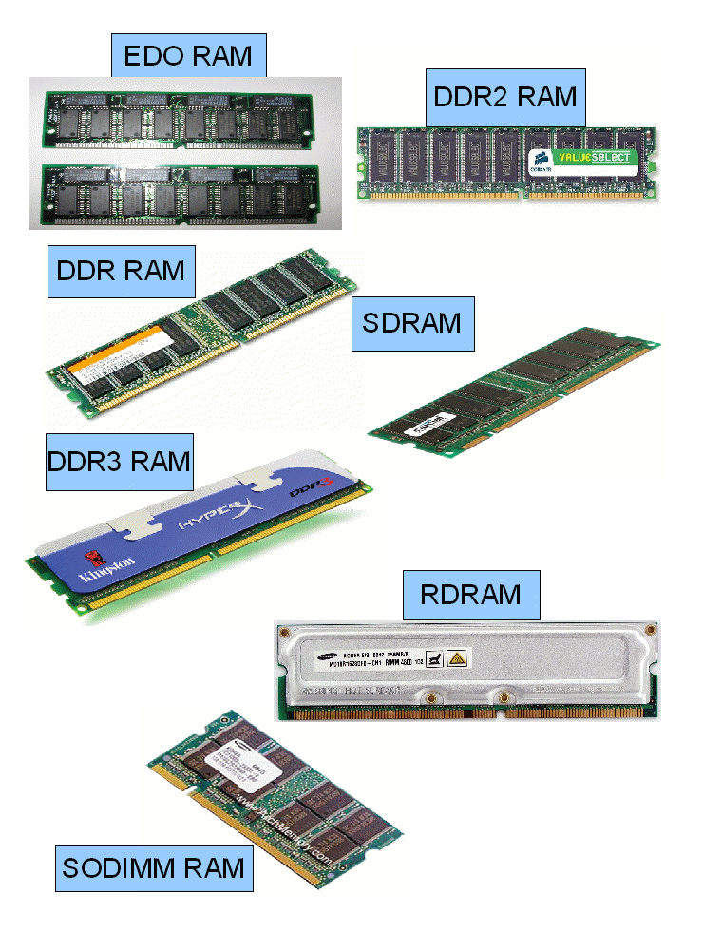
Lesson 13 – Types of Memory
Random Access Memory (RAM)
This is the main 'working' memory used by the computer.
This is used to store data or program on temporary basis.
When we use any data or program then its loaded into RAM.
When you first switch on the computer, the operating system is copied from disk into RAM.
This is also called Volatile Memory because when we switch off the computer, all data is lost.
Generally, a computer will operate faster if computer has more RAM.

Slide 20
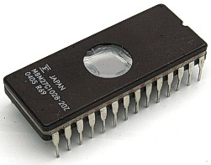
Lesson 13 – Types of Memory
ROM – Read Only Memory
It is a special type of memory chip that holds software or important information that a computer needs.
Information in ROM can only be read but not written to.
ROM retains information even after the powered is switched off. ROM is non-volatile.
An example is the ROM-BIOS chip, which contains read-only software.
Network cards and video cards also contain ROM chips.

Slide 21
Lesson 14 – Measuring Memory
Memory in Computer
The smallest unit of computer storage/memory is Bit.
Bit can store either 1 or 0.
Measurements of computer storage/memory are:
8 Bits | 1 Byte
1024 Bytes | 1 Kilobyte (Kb)
1024 Kilobyte | 1 Megabyte (MB)
1024 Megabyte | 1 Gigabyte (GB)
1024 Gigabyte | 1 Terabyte (TB)

Slide 22
Hardware
Central Processing Unit (CPU)
Storge in computer (Memory)
Input Devices

Slide 23
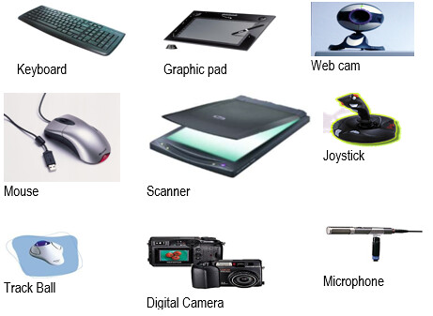
Lesson 7 – Input Devices
Input Devices
An Input Device is a device that is used to enter information into a PC
by typing, selecting, importing or downloading.
Some input devices are as follows:
Keyboard
Mouse
Touchpad
Trackballs
Scanner
Joysticks
Graphic Tablet
Digital cameras and Webcam
Microphone

Slide 24
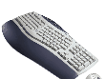
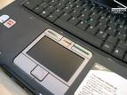
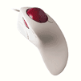
Lesson 7 – Input Devices
Keyboard
Mouse
Touchpad
It senses the movement of the fingertip and moves the mouse pointer (cursor) on the computer screen.
It is used in laptops.
Trackball
Its like mouse having a ball on the upper side.

Slide 25
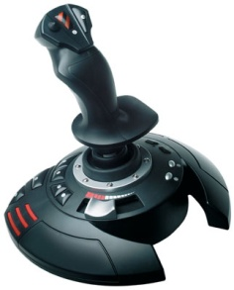
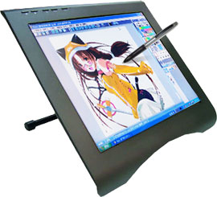
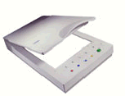
Lesson 7 – Input Devices
Joysticks
It is used to play games more quickly and efficiently.
Graphic Tablet
It is touch sensitive pad. A Stylus (digital pen) is used for drawing or writing.
Scanner
Scanner is used to convert any printed material to digital form and to import into the computer.
We can convert any printed text to a soft copy with a special computer software OCR.

Slide 26
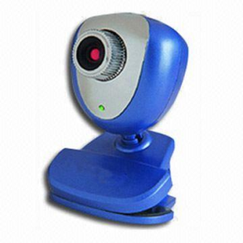
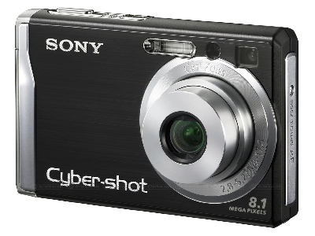
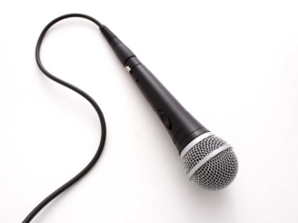
Lesson 7 – Input Devices
Webcam
It is a small camera which is used to show live images over the internet.
Digital Cameras
These cameras can store images in digital form on a memory card and transfer to computer.
Microphone
Microphone is used to convert speech into text by using special software.

Slide 27
Lesson 8 – Output Devices
Output Devices
An output Device is any device that is used to show information or
results of a PC.
Some Output devices are as follows:
Monitors
Speakers
Speech Synthesiser
Printers
Touch screens

Slide 28
Hardware
Central Processing Unit (CPU)
Storge in computer (Memory)
Input Devices
Output Devices

Slide 29
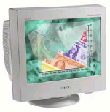
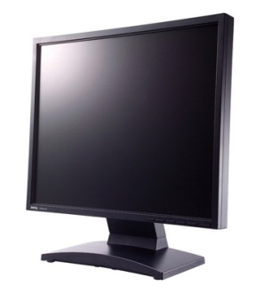
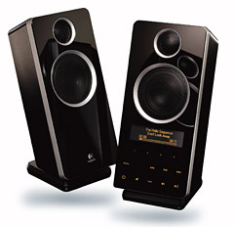
Lesson 8 – Output Devices
Output Devices
Monitors / Computer Screen/ VDU
This is the most common output device.
Picture quality of monitor is called Resolution.
Speakers
Speakers are used to take any audio output or result from the computer.
Speech Synthesiser
These are special software used to translate any written text into an audio speech.

Slide 30
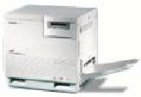
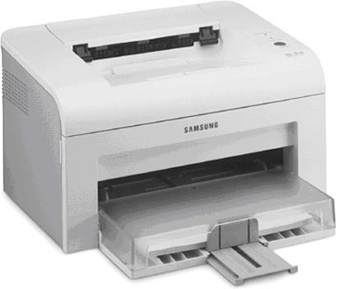
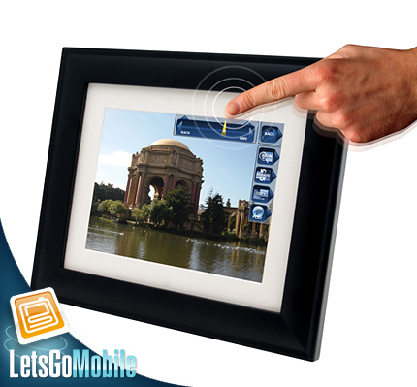
Lesson 8 – Output Devices
Printers
Printers are used to print paper copies of the text, pictures or any other data.
We have Colour printers and Black & White Printers
Dot matrix printers, Inkjet printers, Laser printers.
Touch screens
These are special monitors which are used not only to display information but also to take any input. These are used in smart phones and tablets.

Slide 31
Hardware
Central Processing Unit (CPU)
Storge in computer (Memory)
Input Devices
Output Devices
Input and Output Ports

Slide 32
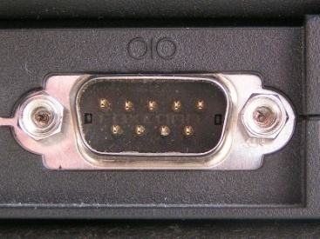
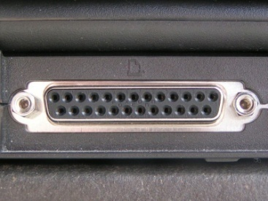
Lesson 8 – Output Devices
Input and Output Ports
A port is a place where we can connect any external device to computer.
Some types are as follows:
Serial Port
This port connects devices like mice and keyboard and transfers data in a single stream.
Parallel Port
This port connects devices like printers and transfers data in multiple streams.

Slide 33
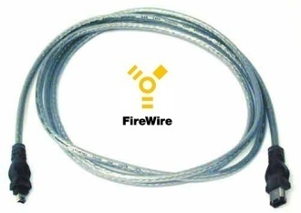
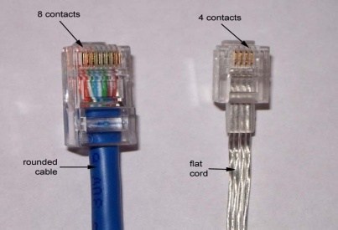
Lesson 8 – Output Devices
USB Port
This is most common port and widely used to connect many devices.
This is without pin.
FireWire Port
It is used to connect digital cameras because it transfers data at a high speed.
Network Port
This port is used to connect the PC to other PCs in a network.

Slide 34
Hardware
Central Processing Unit (CPU)
Storge in computer (Memory)
Input Devices
Output Devices
Input and Output Ports
Accessibility

Slide 35
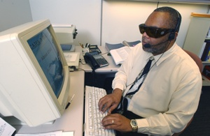
Lesson 9 – Accessibility
Accessibility
Accessibility refers to how much easy a system is by disable people.
There are many devices which are helpful for disable people.
Voice Recognition Software
These software can translate speech/voice into text.
Screen Reader
These software is helpful for blind people.
Screen Magnifier
For low vision people, this software is used.
On-screen keyboard
With this software, disable people can type data using a pointing device or joystick.

Slide 36
Hardware
Central Processing Unit (CPU)
Storge in computer (Memory)
Input Devices
Output Devices
Input and Output Ports
Accessibility
Factors that Impact on a Computer's Performance

Slide 37
Lesson 15 – Computer Performance
Factors that Impact on a Computer's Performance
We can know and judge the computer’s performance by following
factors:
CPU speed
RAM size
Hard disk speed and capacity
The number of applications running

