Slide 1
Designing Parallel Programs

Slide 2
Agenda
Automatic vs. Manual Parallelization
Understand the Problem and the Program
Partitioning
Communications
Synchronization
Data Dependencies
Load Balancing
Granularity
I/O
Limits and Costs of Parallel Programming
Performance Analysis and Tuning

Slide 3
Automatic vs. Manual Parallelization
Designing and developing parallel programs has characteristically been a very manual process. The programmer is typically responsible for both identifying and actually implementing parallelism.
Very often, manually developing parallel codes is a time consuming, complex, error-prone and iterative process.
For a number of years now, various tools have been available to assist the programmer with converting serial programs into parallel programs. The most common type of tool used to automatically parallelize a serial program is a parallelizing compiler or pre-processor.

Slide 4
A parallelizing compiler generally works in two different ways:
Fully Automatic
The compiler analyzes the source code and identifies opportunities for parallelism.
The analysis includes identifying inhibitors to parallelism and possibly a cost weighting on whether or not the parallelism would actually improve performance.
Loops (do, for) loops are the most frequent target for automatic parallelization.
Programmer Directed
Using "compiler directives" or possibly compiler flags, the programmer explicitly tells the compiler how to parallelize the code.
May be able to be used in conjunction with some degree of automatic parallelization also.

Slide 5
If you are beginning with an existing serial code and have time or budget constraints, then automatic parallelization may be the answer. However, there are several important caveats that apply to automatic parallelization:
Wrong results may be produced
Performance may actually degrade
Much less flexible than manual parallelization
Limited to a subset (mostly loops) of code
May actually not parallelize code if the analysis suggests there are inhibitors or the code is too complex
Most automatic parallelization tools are for Fortran
The remainder of this section applies to the manual method of developing parallel codes.

Slide 6
2) Understand the Problem and the Program
Undoubtedly, the first step in developing parallel software is to first understand the problem that you wish to solve in parallel. If you are starting with a serial program, this necessitates understanding the existing code also.
Before spending time in an attempt to develop a parallel solution for a problem, determine whether or not the problem is one that can actually be parallelized.

Slide 7
Example of Parallelizable Problem
Calculate the potential energy for each of several thousand independent conformations of a molecule. When done, find the minimum energy conformation.
This problem is able to be solved in parallel. Each of the molecular conformations is independently determinable. The calculation of the minimum energy conformation is also a parallelizable problem.

Slide 8
Example of a Non-parallelizable Problem
Calculation of the Fibonacci series (1,1,2,3,5,8,13,21,...) by use of the formula:
F(k + 2) = F(k + 1) + F(k)
This is a non-parallelizable problem because the calculation of the Fibonacci sequence as shown would entail dependent calculations rather than independent ones. The calculation of the k + 2 value uses those of both k + 1 and k. These three terms cannot be calculated independently and therefore, not in parallel.

Slide 9
Identify the program's hotspots
Know where most of the real work is being done. The majority of scientific and technical programs usually accomplish most of their work in a few places.
Profilers and performance analysis tools can help here
Focus on parallelizing the hotspots and ignore those sections of the program that account for little CPU usage.

Slide 10
Identify bottlenecks in the program
Are there areas that are disproportionately slow, or cause parallelizable work to halt or be deferred? For example, I/O is usually something that slows a program down.
May be possible to restructure the program or use a different algorithm to reduce or eliminate unnecessary slow areas

Slide 11
Other considerations
Identify inhibitors to parallelism. One common class of inhibitor is data dependence, as demonstrated by the Fibonacci sequence above.
Investigate other algorithms if possible. This may be the single most important consideration when designing a parallel application.

Slide 12
3) Partitioning
One of the first steps in designing a parallel program is to break the problem into discrete "chunks" of work that can be distributed to multiple tasks. This is known as decomposition or partitioning.
There are two basic ways to partition computational work among parallel tasks:
domain decomposition and
functional decomposition

Slide 13
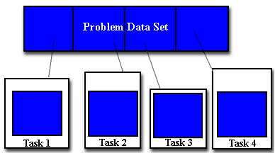
Domain Decomposition
In this type of partitioning, the data associated with a problem is decomposed. Each parallel task then works on a portion of of the data.

Slide 14
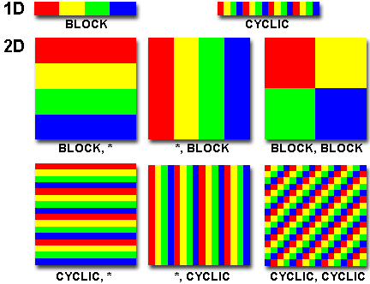
Partitioning Data
There are different ways to partition data

Slide 15
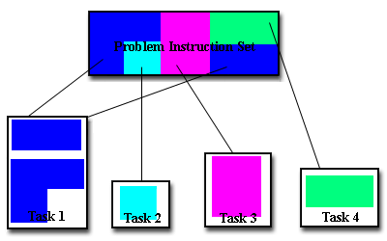
Functional Decomposition
In this approach, the focus is on the computation that is to be performed rather than on the data manipulated by the computation. The problem is decomposed according to the work that must be done. Each task then performs a portion of the overall work.
Functional decomposition lends itself well to problems that can be split into different tasks. For example
Eco system Modeling
Signal Processing
C limate Modeling

Slide 16
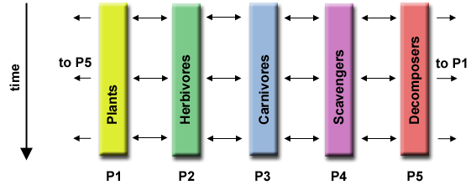
Ecosystem Modeling
Each program calculates the population of a given group, where each group's growth depends on that of its neighbors. As time progresses, each process calculates its current state, then exchanges information with the neighbor populations. All tasks then progress to calculate the state at the next time step.

Slide 17
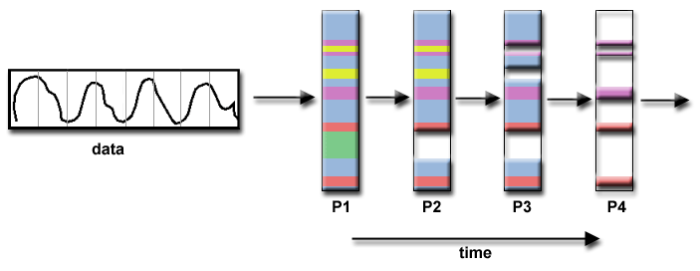
Signal Processing
An audio signal data set is passed through four distinct computational filters. Each filter is a separate process. The first segment of data must pass through the first filter before progressing to the second. When it does, the second segment of data passes through the first filter. By the time the fourth segment of data is in the first filter, all four tasks are busy.

Slide 18
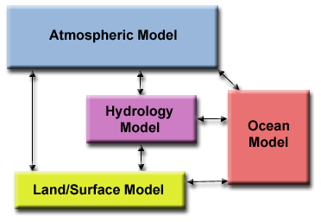
Climate Modeling
Each model component can be thought of as a separate task. Arrows represent exchanges of data between components during computation: the atmosphere model generates wind velocity data that are used by the ocean model, the ocean model generates sea surface temperature data that are used by the atmosphere model, and so on.
Combining these two types of problem decomposition is common and natural.

Slide 19
4) Communications
communications between tasks depends upon problem
You DON'T need communications
Some types of problems can be decomposed and executed in parallel with virtually no need for tasks to share data. For example, imagine an image processing operation where every pixel in a black and white image needs to have its color reversed. The image data can easily be distributed to multiple tasks that then act independently of each other to do their portion of the work.
These types of problems are often called embarrassingly parallel because they are so straight-forward. Very little inter-task communication is required.
You DO need communications
Most parallel applications are not quite so simple, and do require tasks to share data with each other. For example, a 3-D heat diffusion problem requires a task to know the temperatures calculated by the tasks that have neighboring data. Changes to neighboring data has a direct effect on that task's data.

Slide 20
Factors to Consider
There are a number of important factors to consider when designing your program's inter-task communications
(A) Cost of communications
Inter-task communication virtually always implies overhead.
Machine cycles and resources that could be used for computation are instead used to package and transmit data.
Communications frequently require some type of synchronization between tasks, which can result in tasks spending time "waiting" instead of doing work.
Competing communication traffic can saturate the available network bandwidth, further aggravating performance problems.

Slide 21
(B) Latency vs. Bandwidth
latency is the time it takes to send a minimal (0 byte) message from point A to point B. Commonly expressed as microseconds.
bandwidth is the amount of data that can be communicated per unit of time. Commonly expressed as megabytes/sec.
Sending many small messages can cause latency to dominate communication overheads. Often it is more efficient to package small messages into a larger message, thus increasing the effective communications bandwidth.

Slide 22
(C) Visibility of communications
With the Message Passing Model, communications are explicit and generally quite visible and under the control of the programmer.
With the Data Parallel Model, communications often occur transparently to the programmer, particularly on distributed memory architectures. The programmer may not even be able to know exactly how inter-task communications are being accomplished.

Slide 23
D) Synchronous vs asynchronous communications
Synchronous communications require some type of "handshaking" between tasks that are sharing data. This can be explicitly structured in code by the programmer, or it may happen at a lower level unknown to the programmer.
Synchronous communications are often referred to as blocking communications since other work must wait until the communications have completed.
Asynchronous communications allow tasks to transfer data independently from one another. For example, task 1 can prepare and send a message to task 2, and then immediately begin doing other work. When task 2 actually receives the data doesn't matter.
Asynchronous communications are often referred to as non-blocking communications since other work can be done while the communications are taking place.
Interleaving computation with communication is the single greatest benefit for using asynchronous communications.

Slide 24
(E) Scope of communications
Knowing which tasks must communicate with each other is critical during the design stage of a parallel code. Both of the two scopings described below can be implemented synchronously or asynchronously.
Point-to-point - involves two tasks with one task acting as the sender/producer of data, and the other acting as the receiver/consumer.
Collective - involves data sharing between more than two tasks, which are often specified as being members in a common group, or collective.

Slide 25
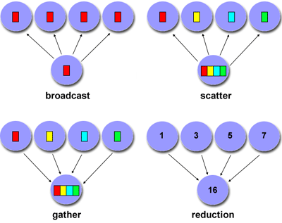
Collective Communications Example :

Slide 26
(F) Efficiency of communications
Very often, the programmer will have a choice with regard to factors that can affect communications performance. Only a few are mentioned here.
Which implementation for a given model should be used? Using the Message Passing Model as an example, one MPI implementation may be faster on a given hardware platform than another.
What type of communication operations should be used? As mentioned previously, asynchronous communication operations can improve overall program performance.
Network media - some platforms may offer more than one network for communications. Which one is best?

Slide 27
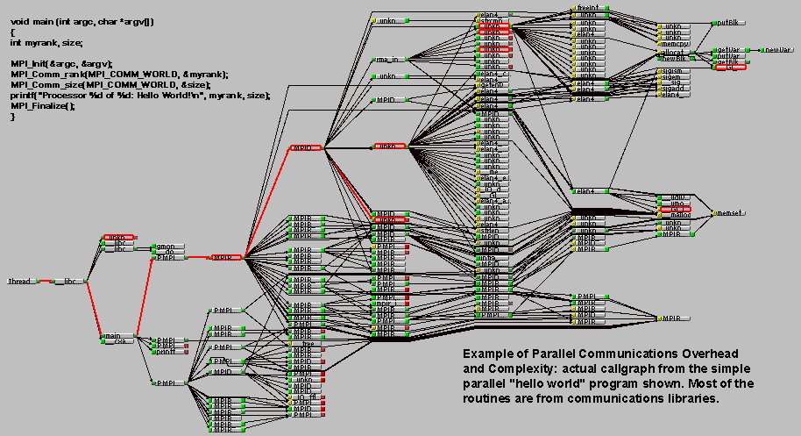
(G) Overhead and Complexity
Finally, realize that this is only a partial list of things to consider!!!

Slide 28
Types of Synchronization
5) Synchronization
Barrier
Usually implies that all tasks are involved
Each task performs its work until it reaches the barrier. It then stops, or "blocks".
When the last task reaches the barrier, all tasks are synchronized.
What happens from here varies. Often, a serial section of work must be done. In other cases, the tasks are automatically released to continue their work.
Lock / semaphore
Can involve any number of tasks
Typically used to serialize (protect) access to global data or a section of code. Only one task at a time may use (own) the lock / semaphore / flag.

Slide 29
The first task to acquire the lock "sets" it. This task can then safely (serially) access the protected data or code.
Other tasks can attempt to acquire the lock but must wait until the task that owns the lock releases it.
Can be blocking or non-blocking
Synchronous communication operations
Involves only those tasks executing a communication operation
When a task performs a communication operation, some form of coordination is required with the other task(s) participating in the communication. For example, before a task can perform a send operation, it must first receive an acknowledgment from the receiving task that it is OK to send.
Discussed previously in the Communications section.

Slide 30
6) Data Dependencies
A dependence exists between program statements when the order of statement execution affects the results of the program.
A data dependence results from multiple use of the same location(s) in storage by different tasks.
Dependencies are important to parallel programming because they are one of the primary inhibitors to parallelism.

Slide 31
Examples (1): Loop carried data dependence
DO 500 J = MYSTART,MYEND
A(J) = A(J-1) * 2.0500
CONTINUE
The value of A(J-1) must be computed before the value of A(J), therefore A(J) exhibits a data dependency on A(J-1). Parallelism is inhibited.
If Task 2 has A(J) and task 1 has A(J-1), computing the correct value of A(J) necessitates:
Distributed memory architecture - task 2 must obtain the value of A(J-1) from task 1 after task 1 finishes its computation
Shared memory architecture - task 2 must read A(J-1) after task 1 updates it

Slide 32
Examples(2): Loop independent data dependence
task 1 task 2
------ ------
X = 2 X = 4
. .
. .
Y = X**2 Y = X**3
As with the previous example, parallelism is inhibited. The value of Y is dependent on:
Distributed memory architecture - if or when the value of X is communicated between the tasks.
Shared memory architecture - which task last stores the value of X.
Although all data dependencies are important to identify when designing parallel programs, loop carried dependencies are particularly important since loops are possibly the most common target of parallelization efforts.

Slide 33
How to Handle Data Dependencies?
Distributed memory architectures - communicate required data at synchronization points.
Shared memory architectures -synchronize read/write operations between tasks.

Slide 34
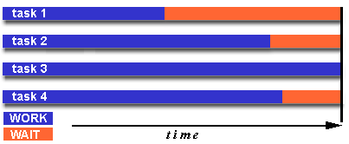
7) Load Balancing
Load balancing refers to the practice of distributing work among tasks so that all tasks are kept busy all of the time. It can be considered a minimization of task idle time.
Load balancing is important to parallel programs for performance reasons. For example, if all tasks are subject to a barrier synchronization point, the slowest task will determine the overall performance.

Slide 35
How to Achieve Load Balance? (1) Equally partition the work each task receives
For array/matrix operations where each task performs similar work, evenly distribute the data set among the tasks.
For loop iterations where the work done in each iteration is similar, evenly distribute the iterations across the tasks.
If a heterogeneous mix of machines with varying performance characteristics are being used, be sure to use some type of performance analysis tool to detect any load imbalances. Adjust work accordingly.

Slide 36
How to Achieve Load Balance? (2) Use dynamic work assignment
Certain classes of problems result in load imbalances even if data is evenly distributed among tasks:
Sparse arrays - some tasks will have actual data to work on while others have mostly "zeros".
Adaptive grid methods - some tasks may need to refine their mesh while others don't.
N-body simulations - where some particles may migrate to/from their original task domain to another task's; where the particles owned by some tasks require more work than those owned by other tasks.
When the amount of work each task will perform is intentionally variable, or is unable to be predicted, it may be helpful to use a scheduler - task pool approach. As each task finishes its work, it queues to get a new piece of work.
It may become necessary to design an algorithm which detects and handles load imbalances as they occur dynamically within the code.

