Slide 1
Fluid Mechanics Lectures 2nd year/1st semister/2018-2019/Al-Mustansiriyah unv./College of engineering/Highway &Transportation Dep.Lec.2

Slide 2
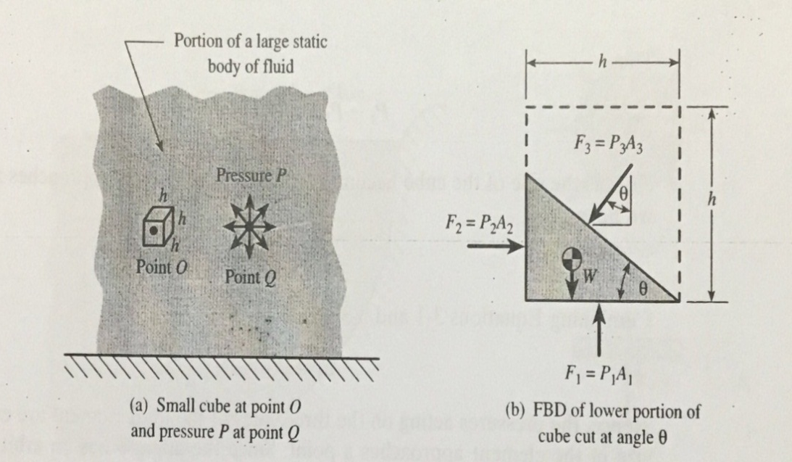
.
Fluid at rest pressure considerations
Pressure at point: Pascals law
Pressure acts equally in all directions at any point in static body of fluid. By referring to fig.below, which shows a small cube of fluid of dimension h located at arbitrary point O within a large static body of fluid (fig.1).

Slide 3
.F₁ is the pressure force due to P₁ upward direction.
.F₂ is the pressure force due to P₂ to the right.
.F₃ is the pressure force due to P₃ normal to the inclined surface (down and left).
.W is the weight of the fluid element.
F2-F1 sin ϴ =0
P2A2-P3A3 sin ϴ=0
P2(h tan ϴ*h)-P3(h/cosϴ*h)sinϴ=0
P2=P1
Vertical direction:
F1-F3cosϴ-W=0
P1A1-P3A3cos ϴ-γV=0
P1h²-P3(h/ cosϴ*h) cosϴ-γ(0.5h*h tanϴ)h=0
P1-P3-0.5γ(h tan ϴ)=0
P1=P3
Thus P1=P2=P3
.

Slide 4
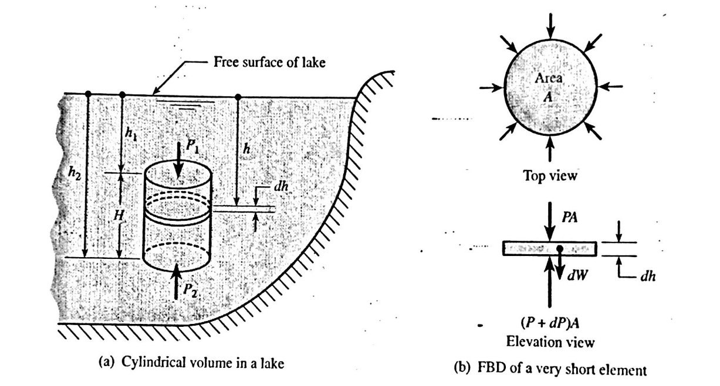
Derivation of the pressure-depth relationship for liquid
(P+dP)A-PA-dW=0
PA+dp(A)-PA-γ(dV)=0
A(dP)-γ(A*dh)=0
dP=γ(dh)
after integration
P2-P1=γ(h2-h1)=γH
Thus P=γh

Slide 5
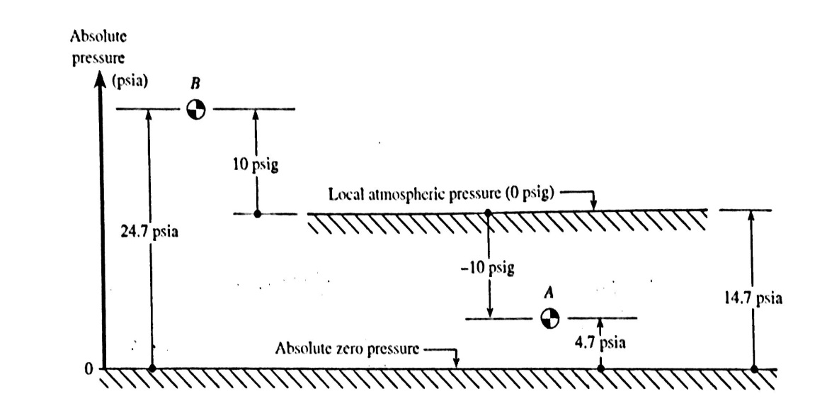
Absolute and gage pressure: the barometer
Gage pressure is measured relative to the atmosphere, whereas absolute pressure is measured relative to a perfect vacuum such as that which exists in outer space.
Fig. below shows graphically depicts the difference between gage and absolute pressure
Pa=4.7 psia thus Pa is less than atmosphere pressure.
Pb=24.7 psia thus Pb is grater than atmosphere pressure.
Pa=-10 psig =10 psi suction =10 psi vacuum=-10 psi
Pb =10 psig
Then Pabs =Pgage + Patm.

Slide 6
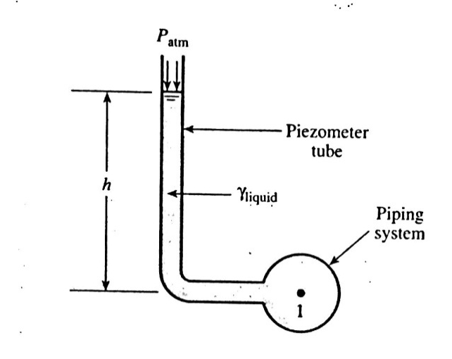
Manometers
1-Pisometer tube: it is a simple type of manometer, it is a simple tube is open to the atmosphere , at the top and attached at the bottom to a pipe or other container whose liquid pressure is to be measured.
-

Slide 7
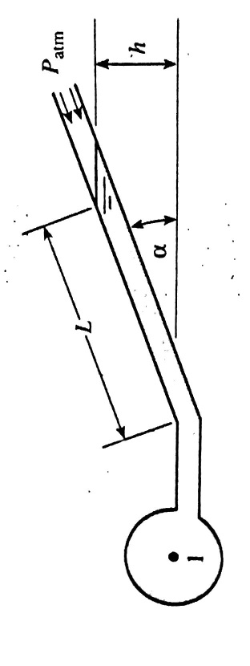
2-Inclined piezometer: it is for grater accuracy , P1=γh

Slide 8
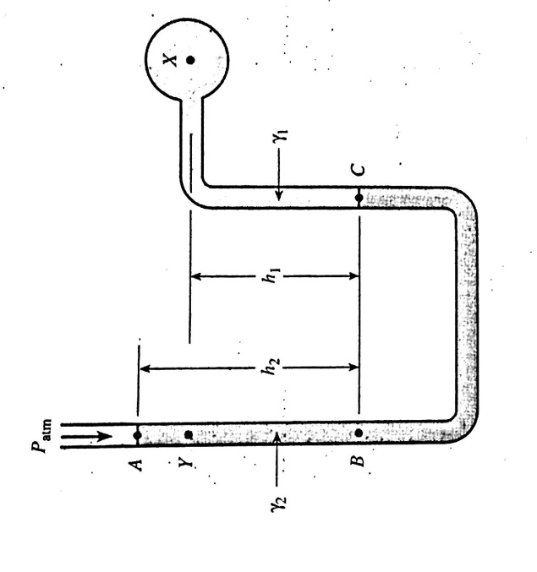
3-U-tube manometer: in this design two different fluids are used, and it can measure suction pressure and larger pressure than a piezometer . We start from one end and move toward the other, we use the relationship that starts that the change in pressure equals the specific weight times the change in elevation, we also note that a drop in elevation increases pressure and vice versa:Pb=Pa+γ2 h2=Pc
Px=Pc-γ1h1
If we use gage pressure Pa=Patm =0 gage
Thus Px= γ2 h2= γ1h1

Slide 9
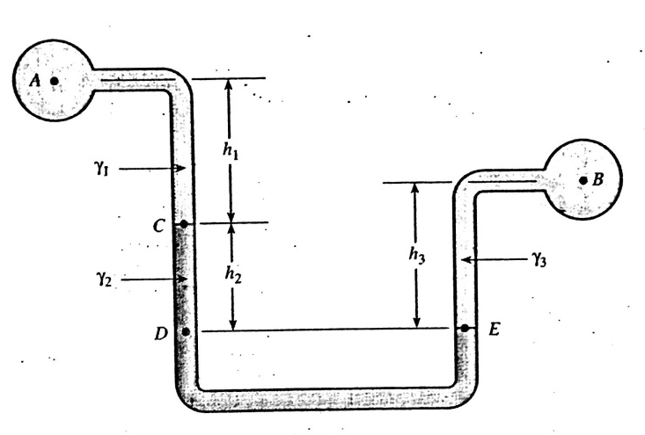
.
4-Diffrential manometer: it is used to measure the difference in pressure between two points in a fluid system .
.
Pb=Pa+ γ1h1+γ2h2+γ3h3

Slide 10
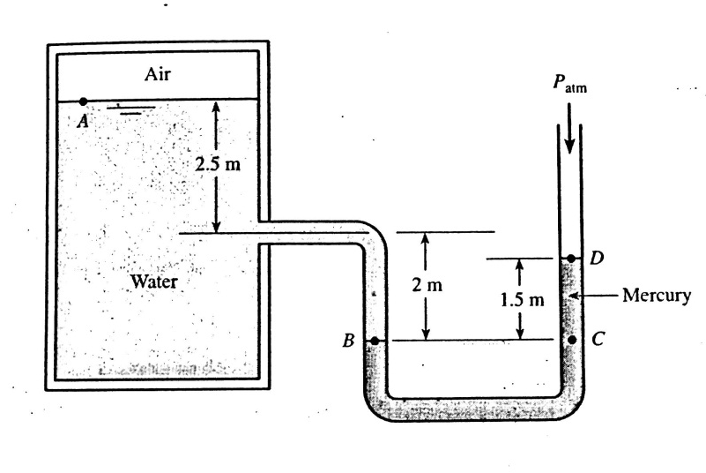
.
Examples
Ex.1:find the pressure of the air above the water in the tank
Pair =Pa=Pb-9810 *4.5 =Pb-44100 pa
Pc=Pb
Pd=Patm=0 gage=Pc-133*1.5
Pc=199500 pa.
Patm=Pc-44.1=199500
Pair=Pc-44100=199500-44100=155400 pa gage.

Slide 11
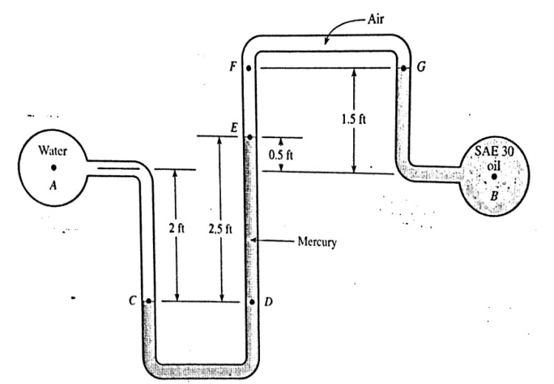
Ex.2:Water and oil flow in two pipeline using the double U-tube manometer as connected ,find the pressure difference Pa-Pb?
Pa=Pc-62.4*2=Pc-124.8
Pc=Pd=Pe+847*2.5=Pe+2118
Pe=Pf=Pg=Pb-57*1.5=Pb-85.5
Combining equations:
Pa=Pe+2118=Pb-85.5+2118-124.8
Pa-Pb=1908 =13.2 psi.
.

Slide 12
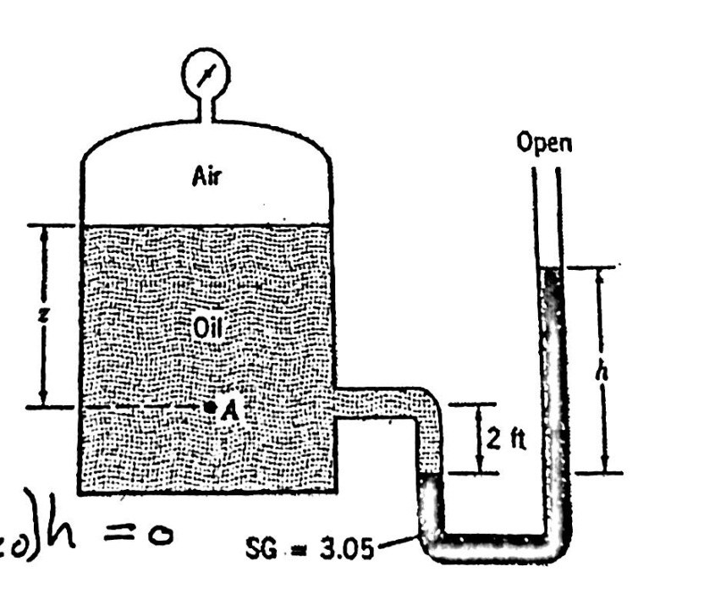
Ex.3:A U-tube manometer is connected to a closed tank (fig.),the air pressure in the tank is 0.5 psi and the liquid is oil (γ=54 lb/ft³),the pressure at point A is 2 psi. Find the depth of oil z and the differential reading h?
Pa=γoil *z+Pair
Z=Pa-Pair/γoil
=(2-0.5)/54
=4ft.
Pa+γoil(2)-S.G.(γw)h=0
h=(Pa+γoil)/(S.G.*γw)
=$\frac{2∗144+54∗2}{3.05∗62.4}$=2.08 ft.

Slide 13
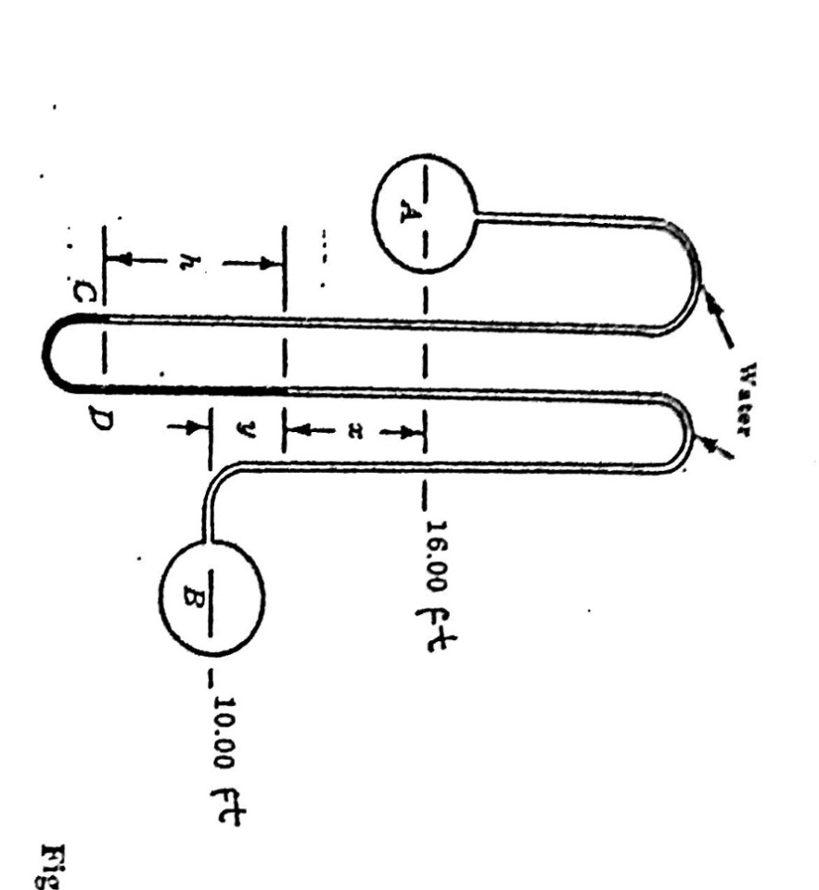
Ex.4:Vassels A and B(fig.)contain water under pressure 40 psi and 20 psi, what is the deflection of the mercury in the differential gage ?
40*144+62.4(x+h)-((13.6)(62.4))h + 62.4 y=(20)(144)
X+y=6 ft
Thus h= 4.14ft.

Slide 14
Thanks

