Slide 1
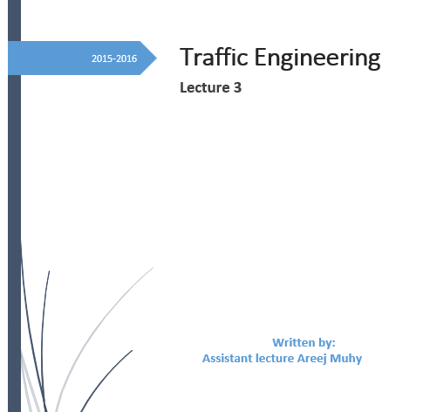

Slide 2
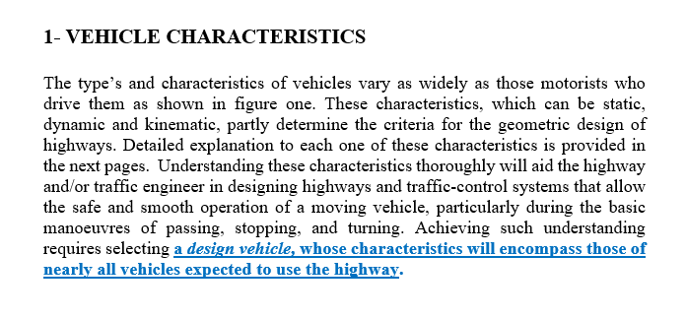
Lecture 3 Traffic Engineering Assistant Lecturer: Areej Muhy

Slide 3
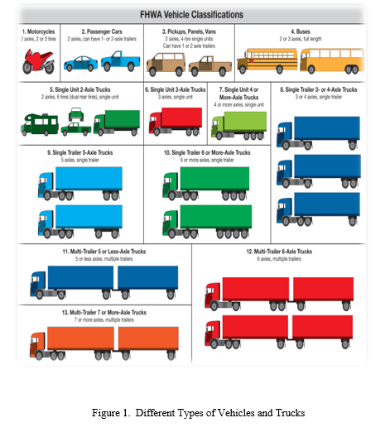
Lecture 3 Traffic Engineering Assistant Lecturer: Areej Muhy

Slide 4
Lecture 3 Traffic Engineering Assistant Lecturer: Areej Muhy

Slide 5
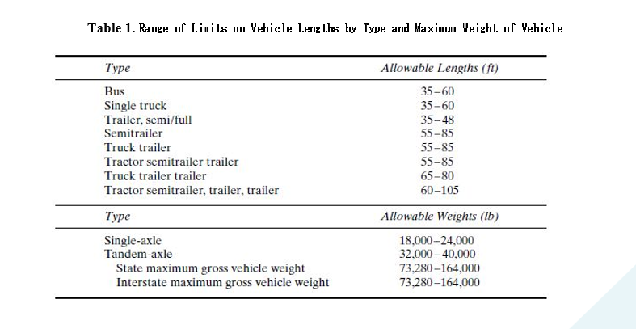
Lecture 3 Traffic Engineering Assistant Lecturer: Areej Muhy

Slide 6
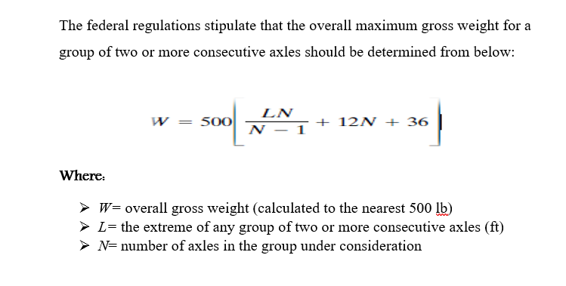
Lecture 3 Traffic Engineering Assistant Lecturer: Areej Muhy

Slide 7
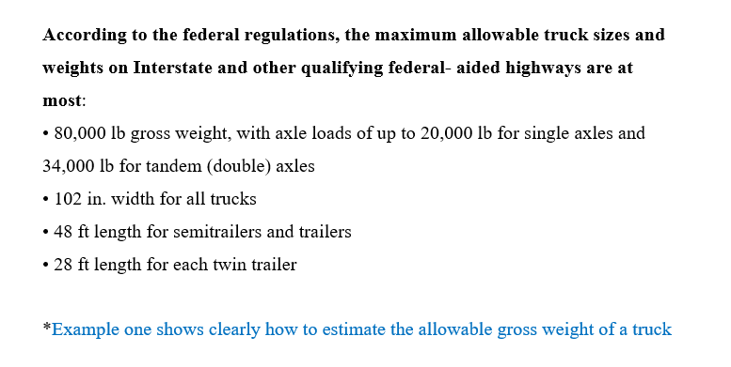
Lecture 3 Traffic Engineering Assistant Lecturer: Areej Muhy

Slide 8
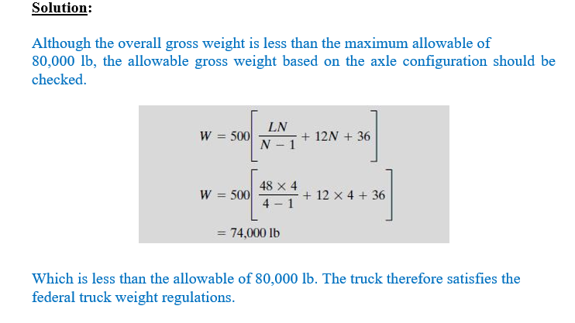
Lecture 3 Traffic Engineering Assistant Lecturer: Areej Muhy

Slide 9
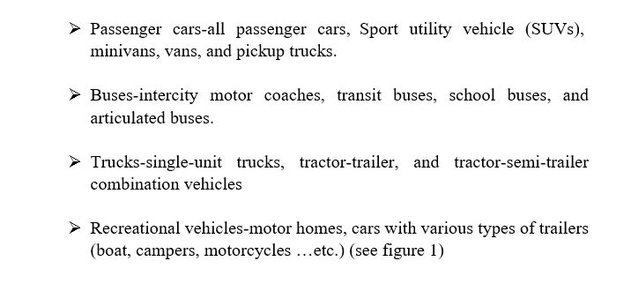
Lecture 3 Traffic Engineering Assistant Lecturer: Areej Muhy

Slide 10
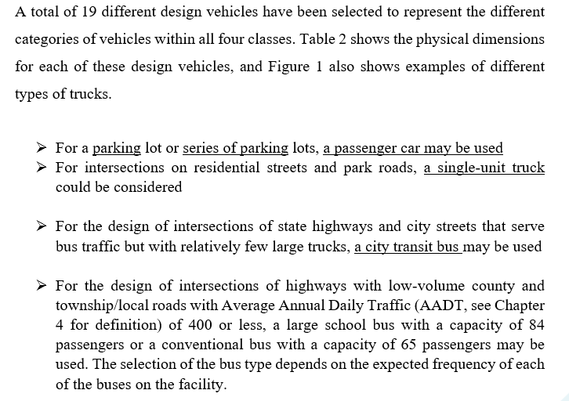
Lecture 3 Traffic Engineering Assistant Lecturer: Areej Muhy

Slide 11
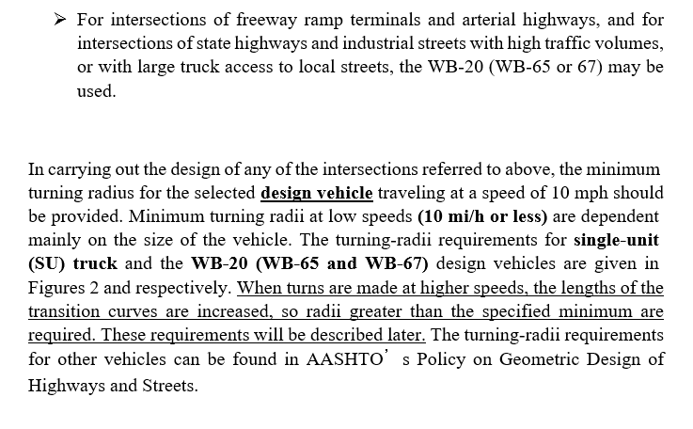
Lecture 3 Traffic Engineering Assistant Lecturer: Areej Muhy

Slide 12
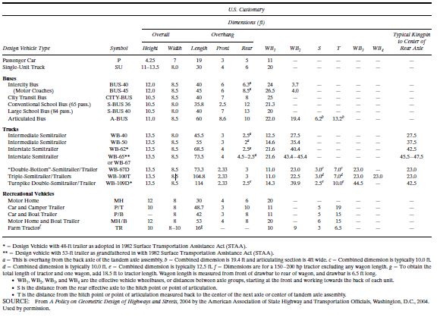
Lecture 3 Traffic Engineering Assistant Lecturer: Areej Muhy

Slide 13
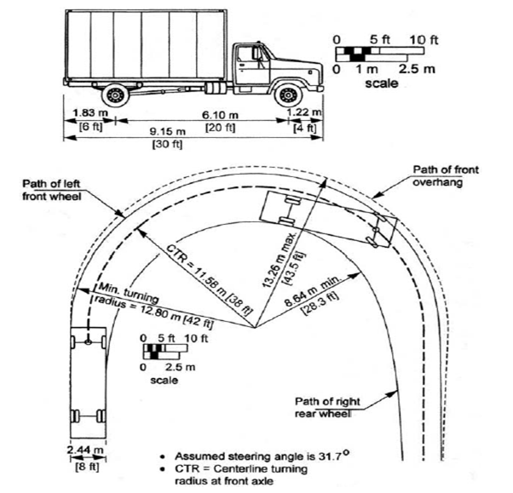
Lecture 3 Traffic Engineering Assistant Lecturer: Areej Muhy

Slide 14
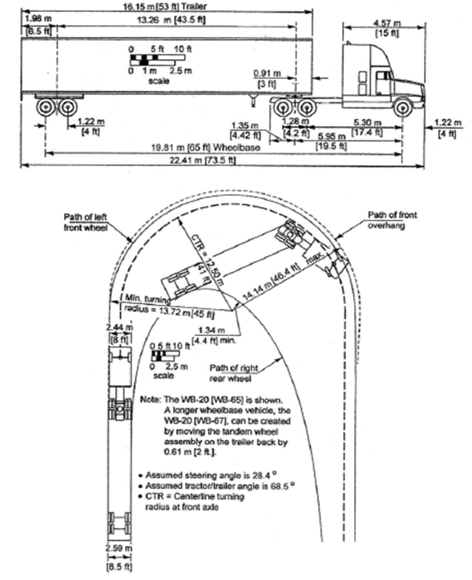
Lecture 3 Traffic Engineering Assistant Lecturer: Areej Muhy

Slide 15
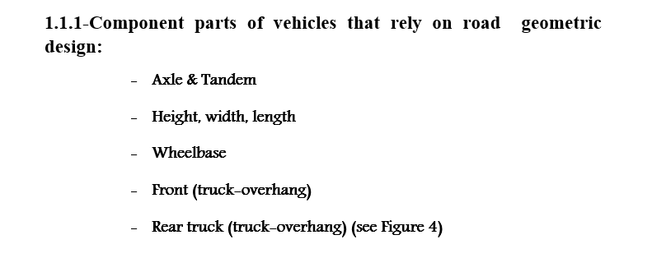
Lecture 3 Traffic Engineering Assistant Lecturer: Areej Muhy

Slide 16
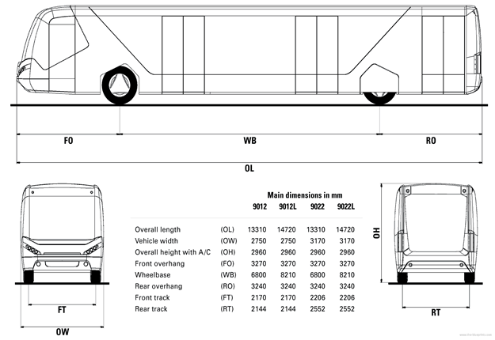
Lecture 3 Traffic Engineering Assistant Lecturer: Areej Muhy

Slide 17
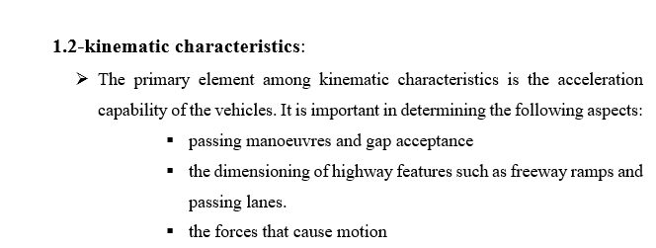
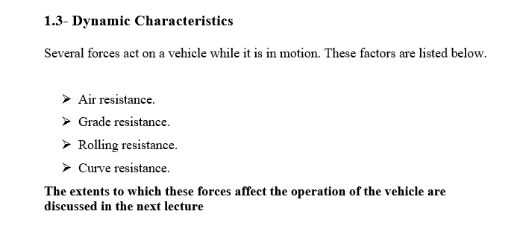
Lecture 3 Traffic Engineering Assistant Lecturer: Areej Muhy

Slide 18
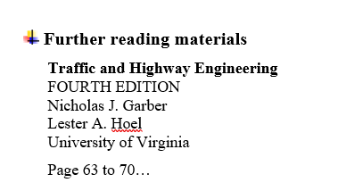
Lecture 3 Traffic Engineering Assistant Lecturer: Areej Muhy

