Slide 1
Asphalt Chemistry
First Stage
Lecture 8
Lecture. Rana Amir Yousif
Lecture. Sady Abd Tayeh
Highway and Transportation Engineering
Al-Mustansiriyah University
2018-2019

Slide 2
References:
Edwin J. Barth. ”Asphalt Science and Technology”, 1st Ed. ,1962.
James Speight” Asphalt Materials Science and Technology”, 1st Edition 2015.

Slide 3
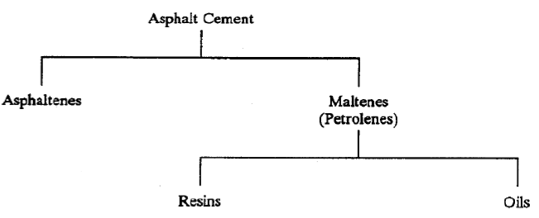
Fractions of Asphalt
Conceptual Compositional Model
Asphalt cements are considered to be made up of asphaltenes, resins, and oils as shown in the following chart:

Slide 4
Asphaltenes. Asphaltenes are generally dark brown, friable solids. The type of nonpolar solvent used to precipitate the asphaltenes affects the determination of its total amount in the asphalt cement. Higher amounts are precipitated by n-pentane than by n-heptane because the number of carbon atoms in n-pentane is less than that in n-heptane.
Asphaltenes are the most complex components with the highest polarity. Therefore, they have a very high tendency to interact and associate.
They are mixtures of many compounds that have a strong tendency to associate in conglomerates .تكتلات
Asphaltenes play a major role as the viscosity-building ("bodying") component of asphalt cements.
The amounts and characteristics of asphaltenes vary considerably from asphalt to asphalt. Low asphaltene content (less than about 10 percent) or weakly associating asphaltenes have been linked with tenderness in HMA.

Slide 5
Resins. Resins are generally dark and semi-solid or solid in character.
They are fluid when heated and become brittle when cold.
They work as agents that disperse (or "peptize" يستوعب او يحل ) the asphaltenes . throughout the oils to provide a homogeneous liquid.
They are soluble in n-pentane, but adsorb on fuller's earth or alumina.
On oxidation resins yield asphaltene type molecules.
Oils. Oils are usually colorless or white liquids.
They are soluble in most solvents.
They have paraffinic and naphthenic structures with no oxygen and nitrogen usually present.
On oxidation they yield asphaltene and resin molecules.

Slide 6
Asphalt as a Colloidal System نظام غروي
Asphalt cement is not a true solution, but is considered a colloidal system. The colloidal nature of asphalt cement has a dispersion of micelles المذيلات in an oily medium. The relative amounts and characteristics of asphaltenes, resins, and oils present in an asphalt cement influence its physical properties and performance in a HMA mixture.
These influences make the asphalt act as a "sol," "sol-gel," or "gel."
"Sol:" "Sol" asphalt cements typify a system in which the resins keep the asphaltenes highly "peptized" (or dispersed) in the oily phase.
"Sol" asphalt cements largely exhibit Newtonian flow characteristics.
Nitrogen bases are primarily responsible for "sol" characteristics.
"Sol-Gel:" It is intermediate between "sol" and "gel."
"Gel:" "Gel" asphalt cements typify a system in which resins are not very effective in
"peptizing'? asphaltenes, Excessive presence of paraffins in relation to nitrogen bases also tends to reduce solubility, leading to increased "gel" characteristics, and suggesting increased separation of the dispersed and dispersing phases.
"Gel" asphalt cements exhibit largely non-Newtonian behavior.

Slide 7
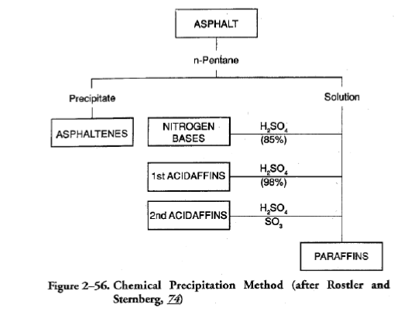
Analytical Procedures
The two most frequently used fractionation methods are:
(1) Rostler and Sternberg's chemical precipitation method:
It is only an analytical method;
it does not physically separate the components in asphalt cement.
Rostler and Sternberg attempted to identify and quantify five components in asphalt cement.

Slide 8
The following five components are quantified in this method:
Asphaltenes (A)
Asphaltenes are precipitated by n-pentane. They are considered as "bodying" agents in asphalt cement.
Nitrogen Bases (N)
85 percent sulferic acid is used to remove or precipitate polar compounds (quite aromatic in nature) from the maltene solution.
This fraction is called "nitrogen bases" and is considered to be the peptizer for the strongly associated asphaltenes in the solvating phase.
makes fraction (A) soluble and produce a homogenous mixture of other fractional components.
First Acidaffins (A1)
98 percent sulfuric acid is then used to precipitate another aromatic component low in nitrogen.
They are considered solvents for the peptized asphaltenes.
Fraction (A1); is a solvent for fraction (A) with (N),
(A1) is highly reactive and subject to oxidation (high unsaturation).

Slide 9
Second Acidaffins (A2)
Fuming sulfuric acid containing 30 percent SO, is then used to precipitate a less reactive and less aromatic component of the maltenes called "second acidaffins".
This component is also believed to be the solvent for peptized asphaltenes.
Fraction A2; is a solvent for fraction A but has a low unsaturation and less susceptible to oxidation.
Paraffins (P)
This is the final and oily constituent of the maltenes which is nonreactive to the fuming acid.
Paraffins are believed to act as "gelling agents."
Fraction P; having no chemical unsaturation, is least responsive to oxidation and thus contributes greatly to durability.
The ratio (N/P) responsible for the rheological properties (Gel/Sol)

Slide 10
For the quality and durability of asphalt cement:
A compatibility ratio of more than 0.5 is considered good.

Slide 11
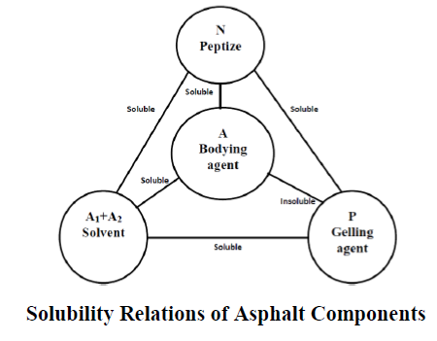
A durability parameter of less than 0.40 is considered poor, and more than 1.00 is considered good.

