Slide 1
Pavement Structural Analysis
3rd Stage
Lecture 5
Lecture. Rana Amir Yousif
Highway and Transportation Engineering
Al-Mustansiriyah University
2018-2019

Slide 2
References:
Nicholas J. Garber and Lester A. Hoel.”Traffic and Highway Engineering”, Fourth Edition.
Yoder; E. J. and M. W. Witczak, “Principles of Pavement Design”, A Wiley- Interscience Publication, John Wiley & Sons Inc., U.S.A., 1975.
Yaug H. Huang, “Pavement Analysis and Design”, Prentic Hall Inc., U.S.A., 1993.
“AASHTO Guide for Design of Pavement Structures 1993”, AASHTO, American Association of State Highway and Transportation Officials, U.S.A., 1993.
Oglesby Clarkson H., “Highway Engineering”, John Wiley & Sons Inc., U.S.A., 1975.

Slide 3
Stresses in Pavements
2.1. Stresses in Flexible Pavements
2.1.1. Stresses in Homogeneous Mass
Boussinesq formulated models for the stresses inside an elastic half-space due to a concentrated load applied on the surface. A half-space has an infinitely large area and an infinite depth with a top plane on which the loads are applied. The simplest way to characterize the behaviour of a flexible pavement under wheel loads is to consider the subgrade, the subbase, base, and the surfacing layers to form a homogeneous half-space. If the modulus ratio between the pavement and the subgrade is close to unity, as exemplified by a thin asphalt surface and a thin granular base, the Boussinesq theory can be applied to determine the stresses, strains, and deflections in the subgrade Figure 2-1 shows a homogeneous half-space subjected to a circular load with a radius a and a uniform pressure q. The halfspace has an elastic modulus E and a Poisson ratio, v. A small cylindrical element with centre at a distance z below the surface and r from the axis of symmetry is shown. Due to axisymmetry, there are only three normal stresses, σz, σr, and σt, and one shear stress, τrz, which is equal to τrz. These stresses are functions of q, r/ a, and z/ a.

Slide 4
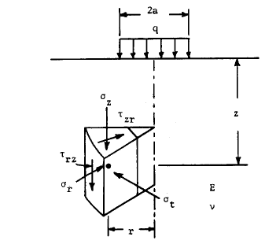
Figure 2-1: Stresses under axisymmetric circular loading

Slide 5
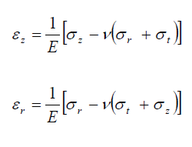
Foster and Ahlvin have developed charts as provided here from Figure 2-2 to
Figure 2-6 for determining vertical stress σz, radial stress σr, tangential stress σt, shear stress τrz, and vertical deflection w, assuming the half-space is incompressible with a Poisson ratio of 0.5.
After the stresses are obtained from the charts, the strains can be computed from

Slide 6
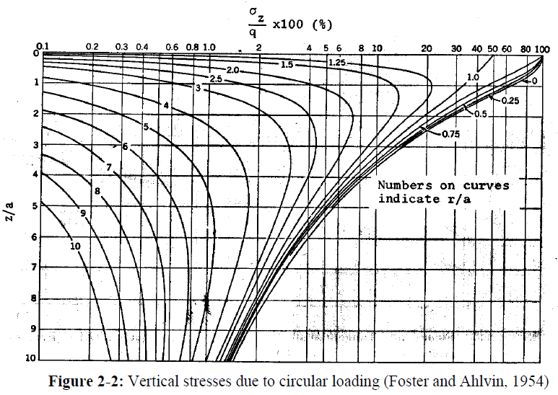
If the contact area consists of two circles, the stresses and strains can be computed by superposition.

Slide 7
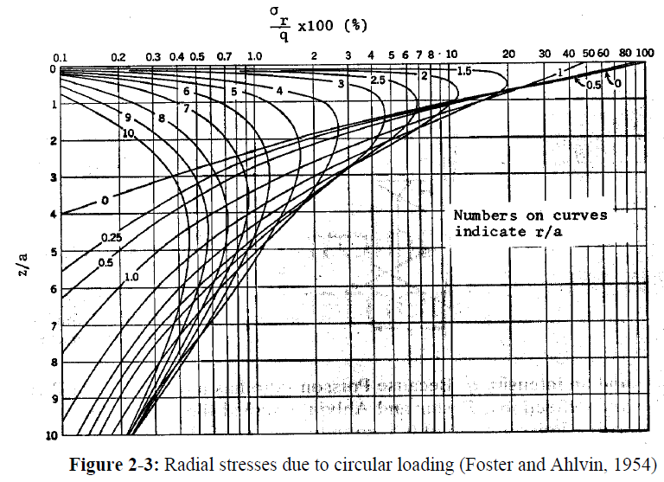

Slide 8
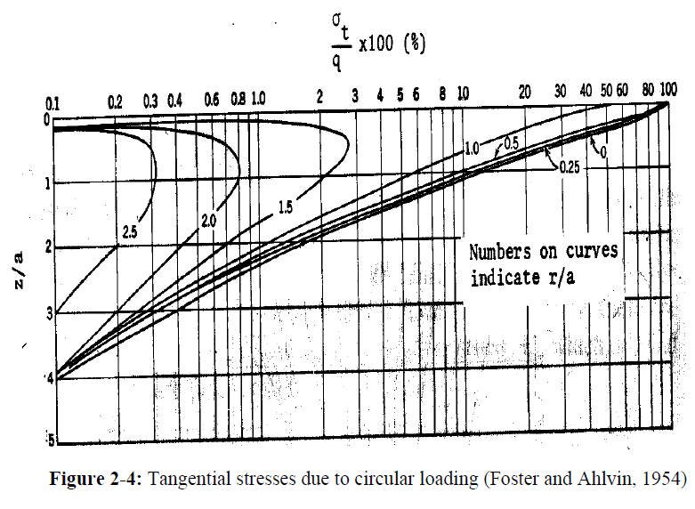

Slide 9
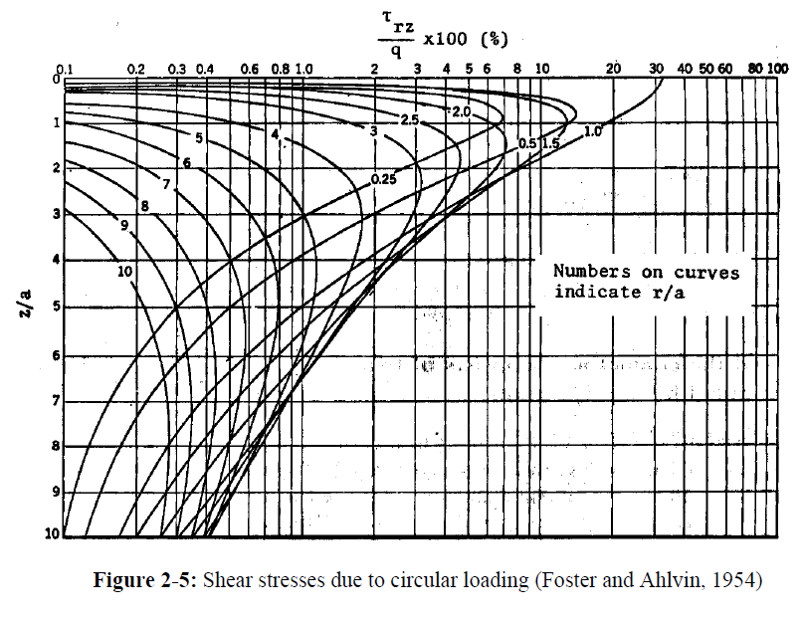

Slide 10
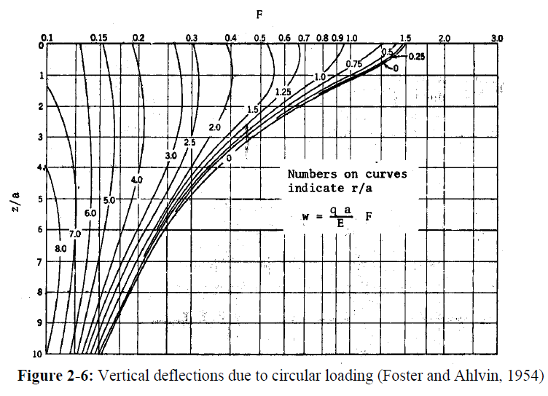

Slide 11
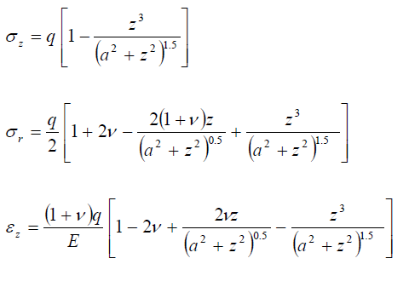
When a wheel load is applied over a single contact area, the most critical stress, strain, and deflection occur under the centre of the circular area on the axis of symmetry, where τrz = 0 and σr = σt, so σz and σr are the principal stresses.
The stresses, strain, and deflection on the axis of symmetry of a wheel load applied to a pavement, which is similar to a load applied to a flexible plate with radius a and a uniform pressure q, can be computed by:

Slide 12
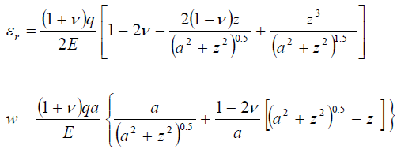
When ν = 0.5, the equation is simplified to
On the surface of the loaded half-space, z = 0, the deflection is

Slide 13
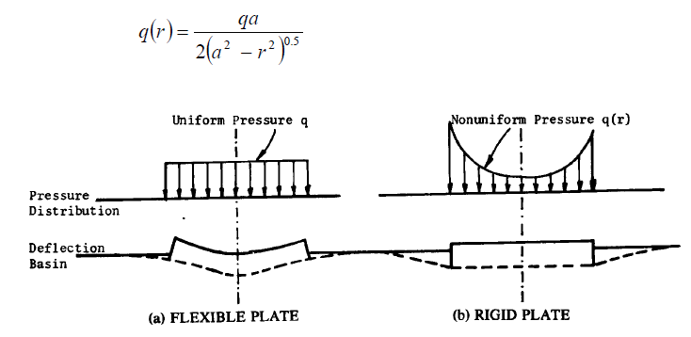
If the load is applied on a rigid plate such as that used in a plate loading test, the deflection is the same at all points on the plate, but the pressure distribution under the plate is not uniform and is expressed as:
Figure 2-7: Differences between flexible and rigid plates

Slide 14
The smallest pressure is at the centre and equal to one-half of the average pressure. The pressure at the edge is infinity. The deflection of the rigid plate is given by
All the above analyses are based on the assumption that the flexible pavement is homogenous, isotropic and semi-infinite, and that elastic properties are identical in every direction throughout the material.
With these assumptions, Bousinesq theory has the following drawbacks:
(1) Flexible pavements are multilayered structures each layer with its own modulus of
elasticity.
(2) The pavement layers and the subgrade soil are not perfectly elastic.
(3) The assumption that the load is uniformly distributed may not be true.

